Slide 1
CSE 421
Divide and Conquer
Yin Tat Lee

Slide 2
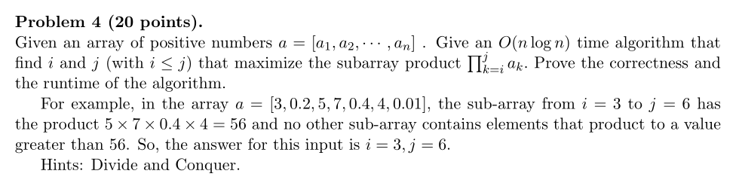
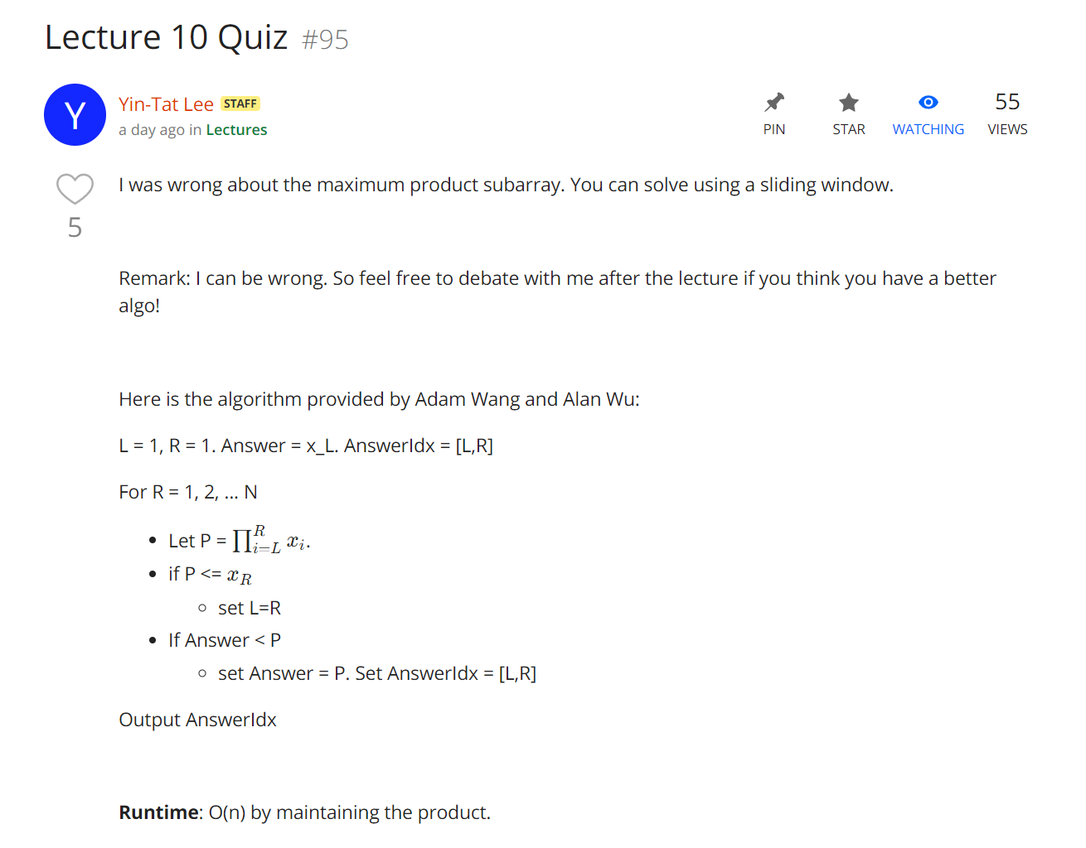
Quiz

Slide 3
Master Theorem

Slide 4

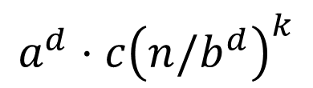










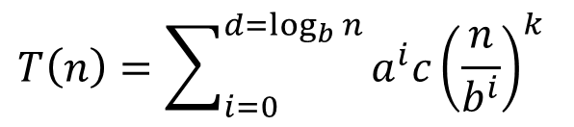



Proving Master Theorem
Problem size
$$T\left(n\right)=aT(n/b)+cn^{k}$$
# probs
cost
$$n$$
$$a$$
$$1$$
$$cn^{k}$$
$$n/b$$
$$a$$
$$a⋅c{\left(n/b\right)}^{k}$$
$$d=\log_{b}n$$
$$n/b^{2}$$
$$a2$$
$$a^{2}⋅c{\left(n/b^{2}\right)}^{k}$$
$$a^{d}⋅c{\left(n/b^{d}\right)}^{k}$$
$$1$$
$$ad$$
$$T\left(n\right)=\sum_{i=0}^{d=\log_{b}{n}}{a^{i}c{\left(\frac{n}{b^{i}}\right)}^{k}}$$

Slide 5

Master Theorem
  Suppose $T\left(n\right)=a T\left(\frac{n}{b}\right)+cn^{k}$ for all $n>b.$ Then,
  If $a<b^{k}$ then $T\left(n\right)=Θ\left(n^{k}\right)$
  If $a=b^{k}$ then $T\left(n\right)=Θ\left(n^{k}log n\right)$
  If $a>b^{k}$ then $T\left(n\right)=Θ\left(n^{\log_{b}a}\right)$
# of problems increases slower
than the decreases of cost.
First term dominates.
# of problems increases faster
than the decreases of cost
Last term dominates.

Slide 6
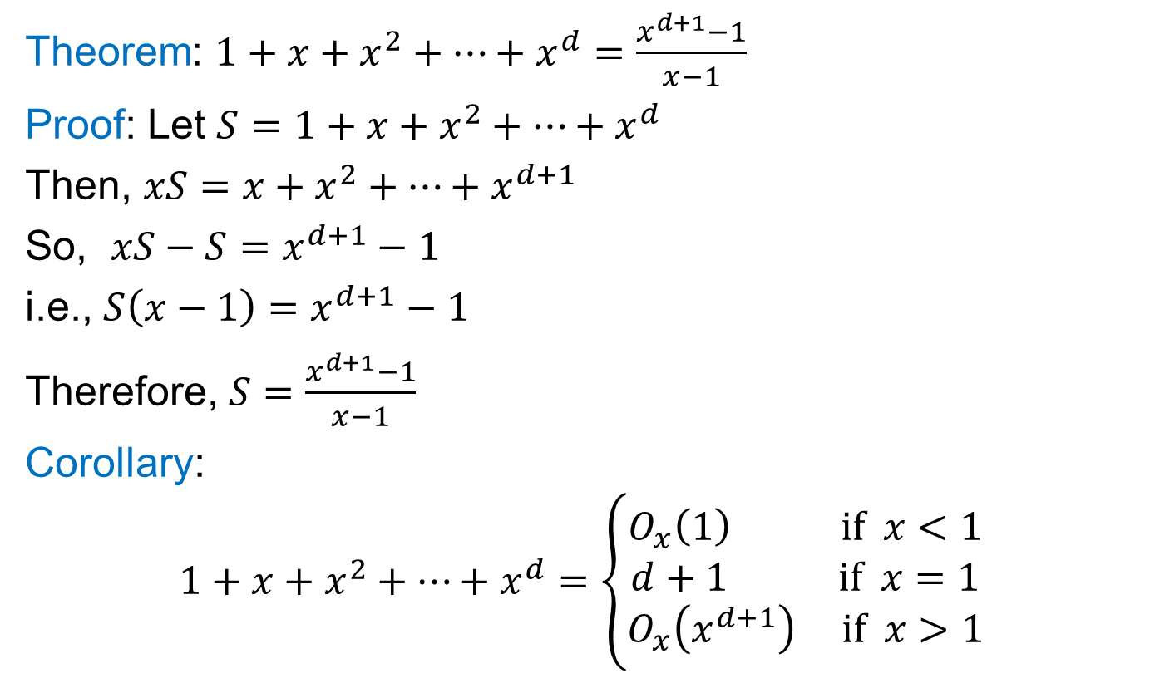
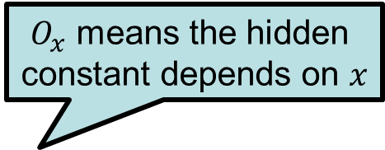
A Useful Identity
Theorem: $1+x+x^{2}+…+x^{d}=\frac{x^{d+1}−1}{x−1}$
Proof: Let $S=1+x+x^{2}+…+x^{d}$
Then, $xS=x+x^{2}+…+x^{d+1}$
So, $xS−S=x^{d+1}−1$
i.e., $S\left(x−1\right)=x^{d+1}−1$
Therefore, $S=\frac{x^{d+1}−1}{x−1}$
Corollary:
$$1+x+x^{2}+…+x^{d}=\left\{\begin{aligned}O_{x}\left(1\right) if x<1 \\ d+1 if x=1 \\ O_{x}\left(x^{d+1}\right) if x>1\end{aligned}\right.$$
$O_{x}$ means the hidden
constant depends on $x$

Slide 7

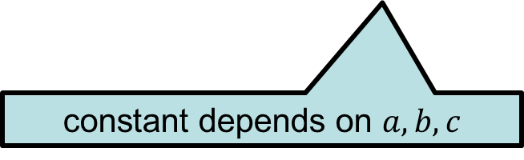
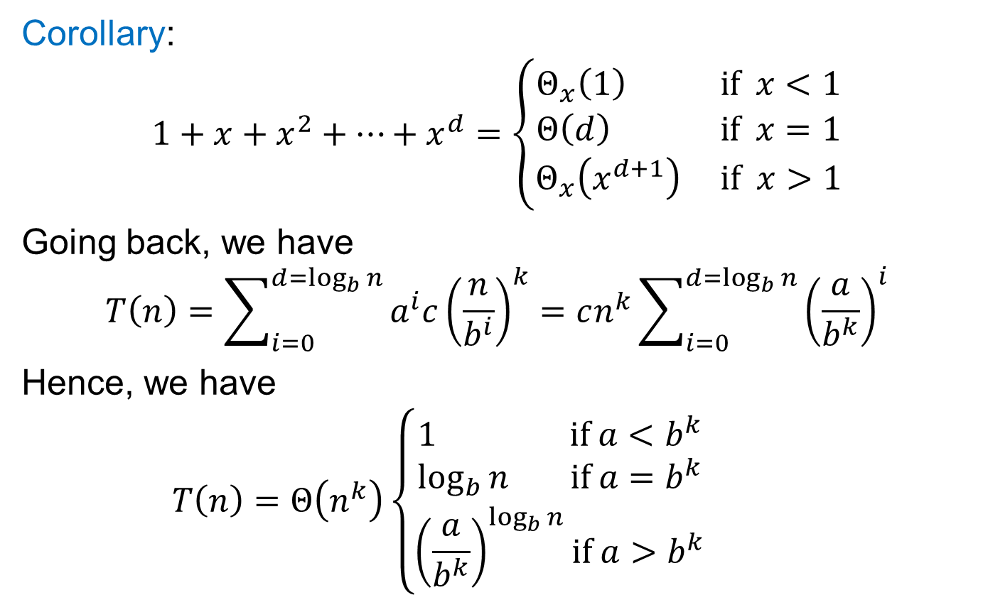
Solve: $T\left(n\right)=aT\left(\frac{n}{b}\right)+cn^{k}$
Corollary:
$$1+x+x^{2}+…+x^{d}=\left\{\begin{aligned}Θ_{x}\left(1\right) if x<1 \\ Θ\left(d\right) if x=1 \\ Θ_{x}\left(x^{d+1}\right) if x>1\end{aligned}\right.$$
Going back, we have
$$T\left(n\right)=\sum_{i=0}^{d=\log_{b}{n}}{a^{i}c{\left(\frac{n}{b^{i}}\right)}^{k}}=cn^{k}\sum_{i=0}^{d=\log_{b}{n}}{{\left(\frac{a}{b^{k}}\right)}^{i}}$$
Hence, we have
$$T\left(n\right)=Θ\left(n^{k}\right)\left\{\begin{aligned}1 if a<b^{k} \\ \log_{b}{n} if a=b^{k} \\ {\left(\frac{a}{b^{k}}\right)}^{\log_{b}{n}}if a>b^{k}\end{aligned}\right.$$
constant depends on $a,b,c$

Slide 8


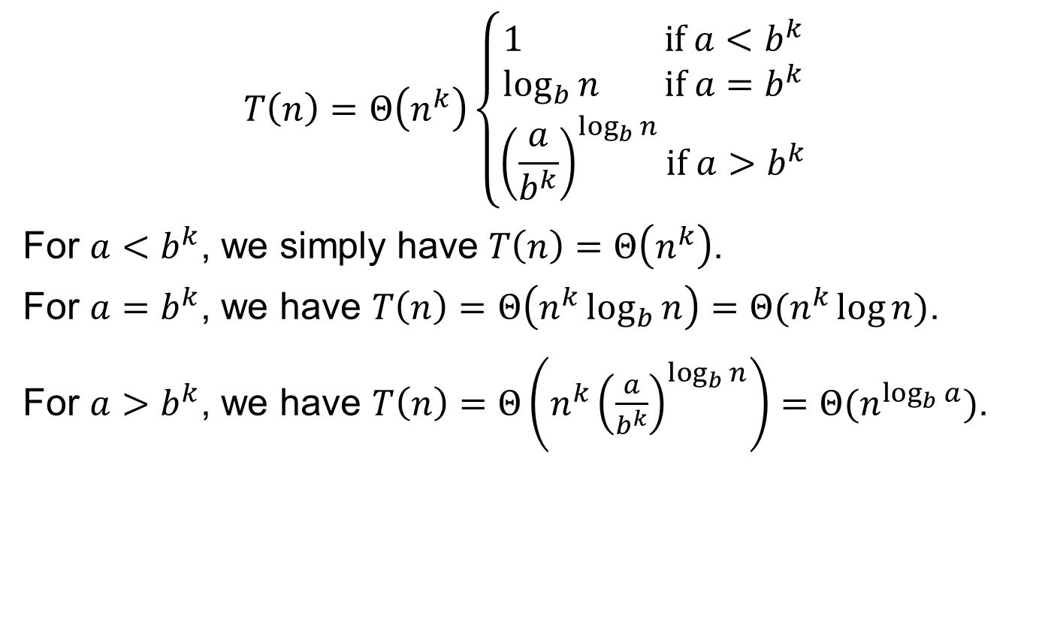
Solve: $T\left(n\right)=aT\left(\frac{n}{b}\right)+cn^{k}$
$$T\left(n\right)=Θ\left(n^{k}\right)\left\{\begin{aligned}1 if a<b^{k} \\ \log_{b}{n} if a=b^{k} \\ {\left(\frac{a}{b^{k}}\right)}^{\log_{b}{n}}if a>b^{k}\end{aligned}\right.$$
For $a<b^{k}$, we simply have $T\left(n\right)=Θ\left(n^{k}\right)$.
For $a=b^{k}$, we have $T\left(n\right)=Θ\left(n^{k}\log_{b}{n}\right)=Θ(n^{k}\log{n})$.
For $a>b^{k}$, we have $T\left(n\right)=Θ\left(n^{k}{\left(\frac{a}{b^{k}}\right)}^{\log_{b}{n}}\right)=Θ(n^{\log_{b}{a}})$.
$b^{k\log_{b}{n}}$
$={\left(b^{\log_{b}{n}}\right)}^{k}$
$=n^{k}$
$$a^{\log_{b}{n}}$$
$$={{(b}^{\log_{b}{a}})}^{\log_{b}{n}}$$
$$={{(b}^{\log_{b}{n}})}^{\log_{b}{a}}$$
$=n^{\log_{b}{a}}$

Slide 9
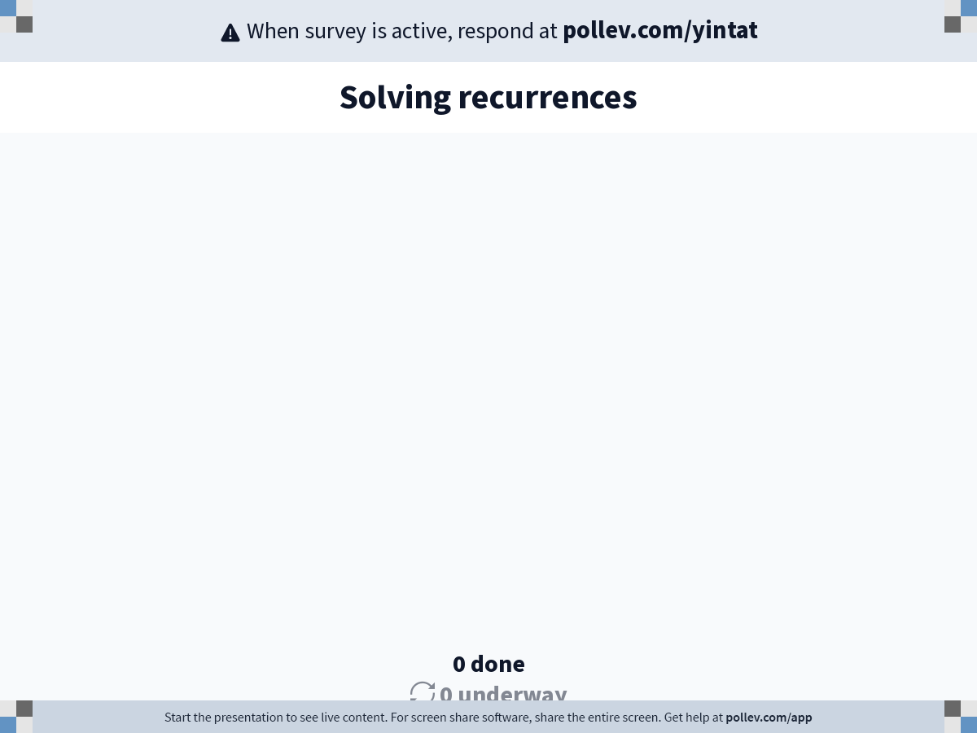
Notes:
Poll Title: Do not modify the notes in this section to avoid tampering with the Poll Everywhere activity.
More info at polleverywhere.com/support
Solving recurrences
https://www.polleverywhere.com/surveys/5xCVO0YPLb5tgeVvaeGdn?display_state=chart&activity_state=opened&state=opened&flow=Engagement&onscreen=persist

Slide 10
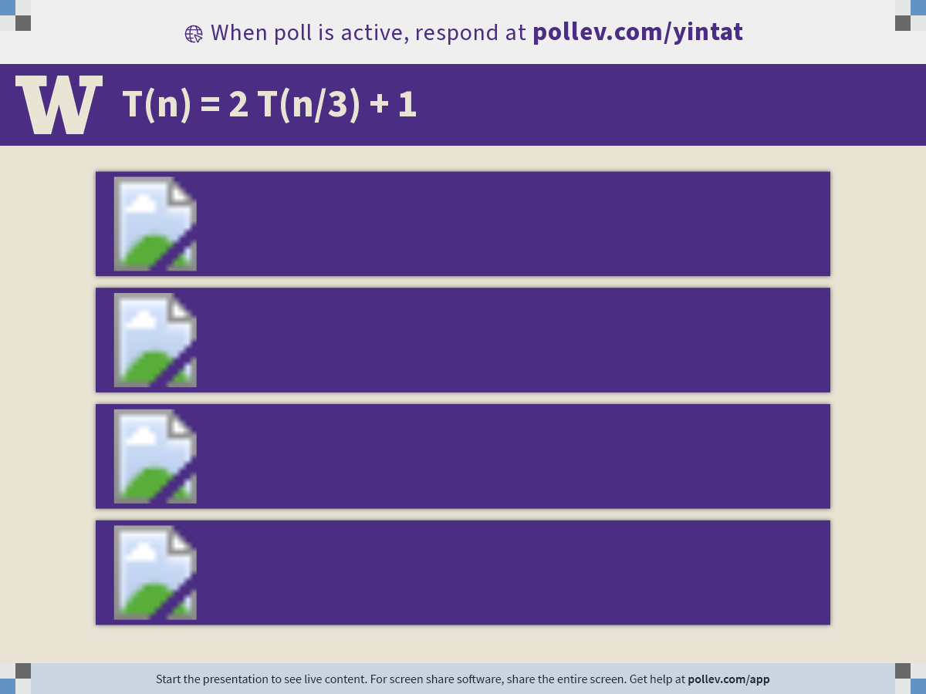
Notes:
Poll Title: Do not modify the notes in this section to avoid tampering with the Poll Everywhere activity.
More info at polleverywhere.com/support
T(n) = 2 T(n/3) + 1
https://www.polleverywhere.com/multiple_choice_polls/Ul7K8vy70MZYxczA38GKl?display_state=chart&activity_state=opened&state=opened&flow=Engagement&onscreen=persist&hide=instructions

Slide 11
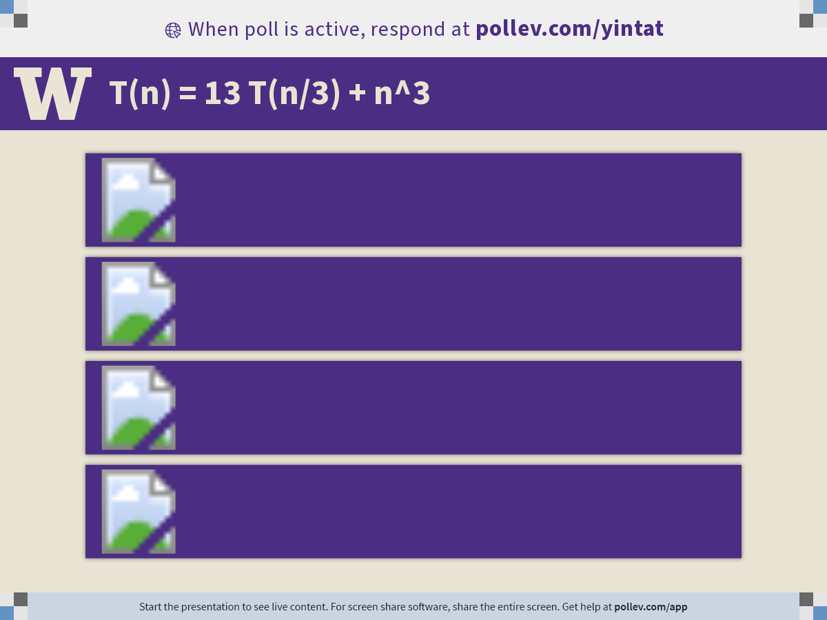
Notes:
Poll Title: Do not modify the notes in this section to avoid tampering with the Poll Everywhere activity.
More info at polleverywhere.com/support
T(n) = 13 T(n/3) + n^3
https://www.polleverywhere.com/multiple_choice_polls/lPHCYmLPXKuPCnrWeoggm?display_state=chart&activity_state=opened&state=opened&flow=Engagement&onscreen=persist&hide=instructions

Slide 12

Notes:
Poll Title: Do not modify the notes in this section to avoid tampering with the Poll Everywhere activity.
More info at polleverywhere.com/support
T(n) = 2 T(n/2) + n log n
https://www.polleverywhere.com/multiple_choice_polls/t8HRPtigGpxn0IaAnAyNA?display_state=chart&activity_state=opened&state=opened&flow=Engagement&onscreen=persist&hide=instructions

Slide 13
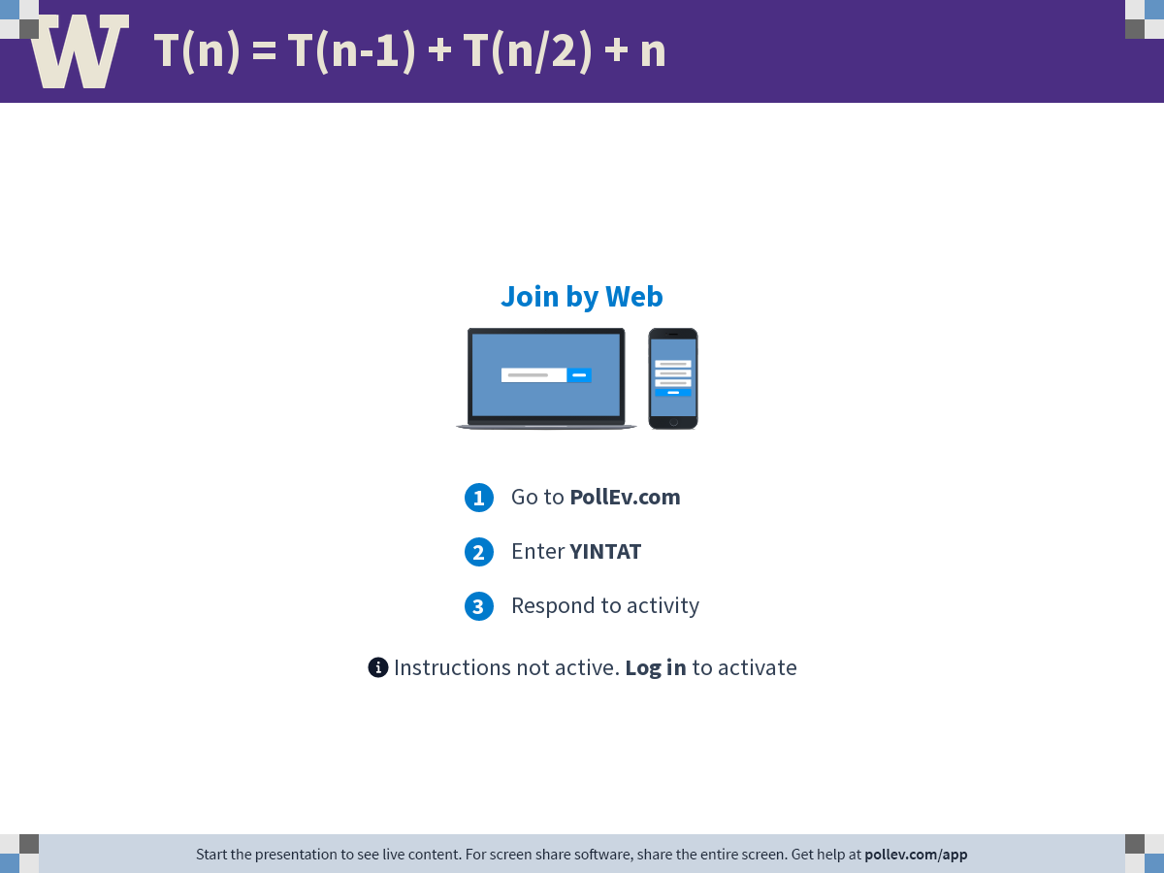
Notes:
Poll Title: Do not modify the notes in this section to avoid tampering with the Poll Everywhere activity.
More info at polleverywhere.com/support
T(n) = T(n-1) + T(n/2) + n
https://www.polleverywhere.com/free_text_polls/ST54BFvbcoKwcPSGgGnTS?display_state=chart&activity_state=opened&state=opened&flow=Engagement&onscreen=persist&hide=instructions

Slide 14
Finding the Closest Pair of Points

Slide 15
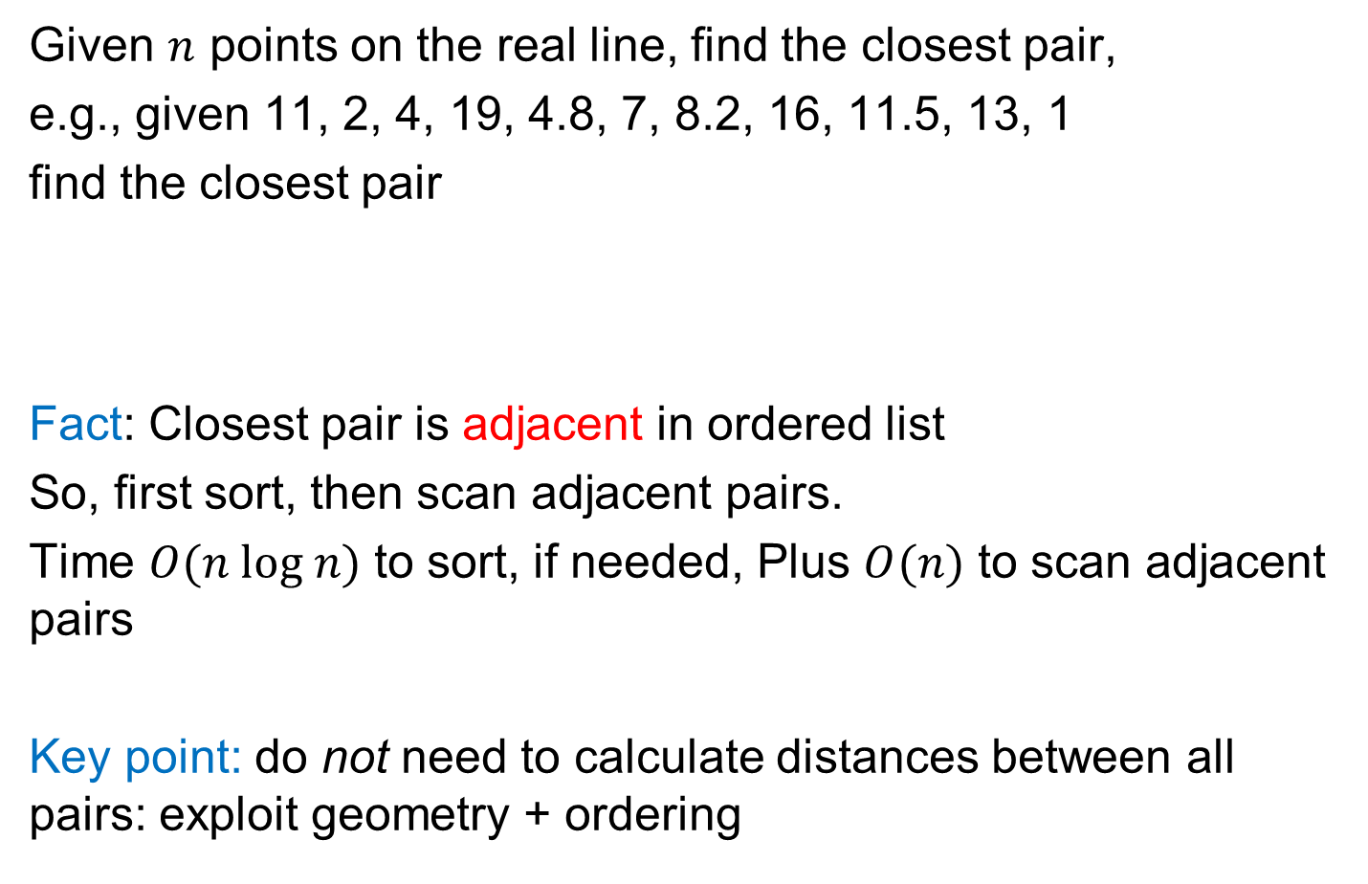
Closest Pair of Points (1-dimension)
Given $n$ points on the real line, find the closest pair,
e.g., given 11, 2, 4, 19, 4.8, 7, 8.2, 16, 11.5, 13, 1
find the closest pair
Fact: Closest pair is adjacent in ordered list
So, first sort, then scan adjacent pairs.
Time $O(n log n)$ to sort, if needed, Plus $O(n)$ to scan adjacent pairs
Key point: do not need to calculate distances between all pairs: exploit geometry + ordering
1
2
4
4.8
7
8.2
11
11.5
13
16
19

Slide 16
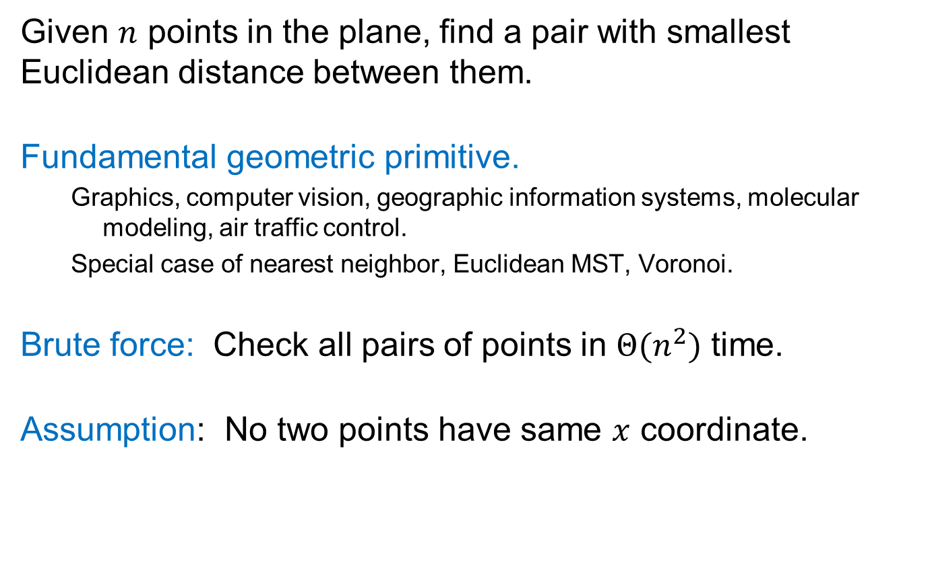
Closest Pair of Points (2-dimensions)
Given $n$ points in the plane, find a pair with smallest Euclidean distance between them.
Fundamental geometric primitive.
  Graphics, computer vision, geographic information systems, molecular modeling, air traffic control.
  Special case of nearest neighbor, Euclidean MST, Voronoi.
Brute force: Check all pairs of points in $Θ(n^{2})$ time.
Assumption: No two points have same $x$ coordinate.

Slide 17
Closest Pair of Points (2-dimensions)
No single direction along which one
can sort points to guarantee success!

Slide 18

Divide & Conquer
  Divide: draw vertical line $L$ with ≈ $n/2$ points on each side.
  Conquer: find closest pair on each side, recursively.
  Combine to find closest pair overall
  Return best solutions
How ?
L
8
21
12

Slide 19

Key Observation
Why the strip problem is easier?
  Suppose $δ$ is the minimum distance of all pairs in left/right of $L$.
  $$δ=\min\left(12,21\right)=12.$$
  Key Observation: suffices to consider points within $δ$ of line $L$.
  Almost the one-D problem again: Sort points in $2δ$-strip by their $y$ coordinate.
L
7
6
5
21
4
12
3
2
1
δ=12

Slide 20


Almost 1D Problem
Partition each side of $L$ into $\frac{δ}{2}×\frac{δ}{2}$ squares
Claim: No two points lie in the same $\frac{δ}{2}×\frac{δ}{2}$ box.
Proof: Such points would be within
$\sqrt{{\left(\frac{δ}{2}\right)}^{2}+{\left(\frac{δ}{2}\right)}^{2}}=δ\sqrt{\frac{1}{2}}≈0.7δ<δ$
Let $s_{i}$ have the $i^{th}$ smallest $y$-coordinate
among points in the $2δ$-width-strip.
Claim: If $\left|i−j\right|>11$, then the distance
between $s_{i}$ and $s_{j}$ is $>δ$.
Proof: only $11$ boxes within $δ$ of $y(s_{i})$.
49
j
$$>δ$$
31
30
½δ
29
29
½δ
i
27
28
26
25
δ
δ

Slide 21

Closest Pair (2 dimension)
Where is the bottleneck?
Closest-Pair($p_{1},p_{2},⋯,p_{n}$) {
if($n≤2$) return $|p_{1}−p_{2}|$
Compute separation line $L$ such that half the points
are on one side and half on the other side.
$δ_{1}$ = Closest-Pair(left half)
$δ_{2}$ = Closest-Pair(right half)
$δ$ = min($δ_{1},δ_{2}$)
Delete all points further than δ from separation line L
Sort remaining points p[1]…p[m] by y-coordinate.
for $i=1,2,⋯,m$
for k = $1,2,⋯,11$
if $i+k≤m$
δ = min(δ, distance(p[i], p[i+k]));
return δ.
}

Slide 22
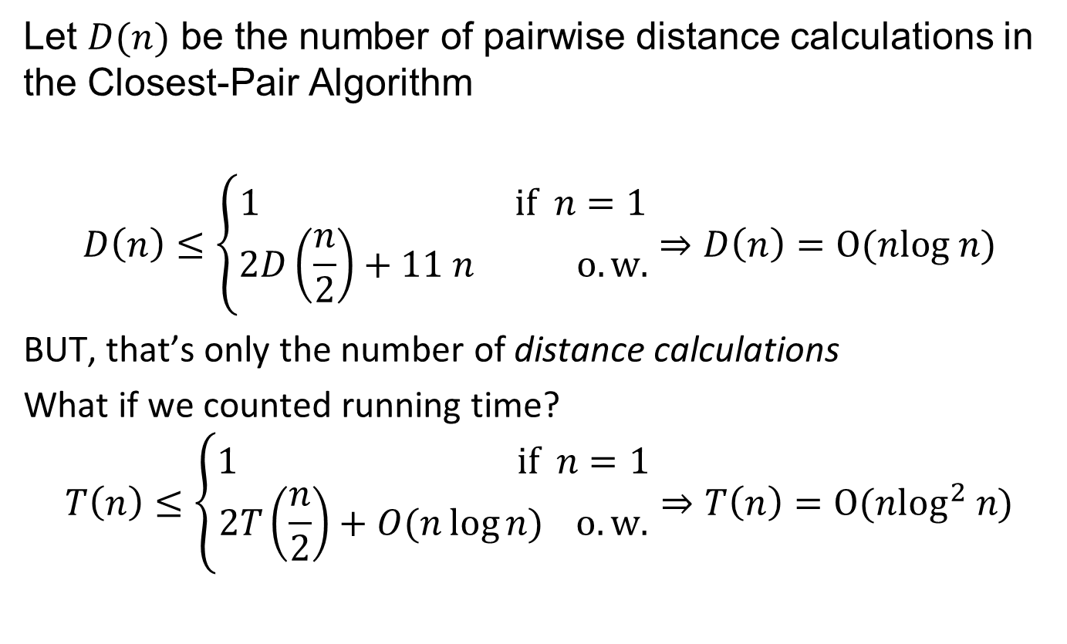
Closest Pair Analysis
  Let $D(n)$ be the number of pairwise distance calculations in the Closest-Pair Algorithm
$$D\left(n\right)≤\left\{\begin{aligned}1 if n=1 \\ 2D\left(\frac{n}{2}\right)+11 n o.w.\end{aligned}\right.⇒D\left(n\right)=O(nlog n)$$
BUT, that’s only the number of distance calculations
What if we counted running time?
$$T\left(n\right)≤\left\{\begin{aligned}1 if n=1 \\ 2T\left(\frac{n}{2}\right)+O(n\log{n)} o.w.\end{aligned}\right.⇒T\left(n\right)=O(n\log^{2} n)$$

Slide 23

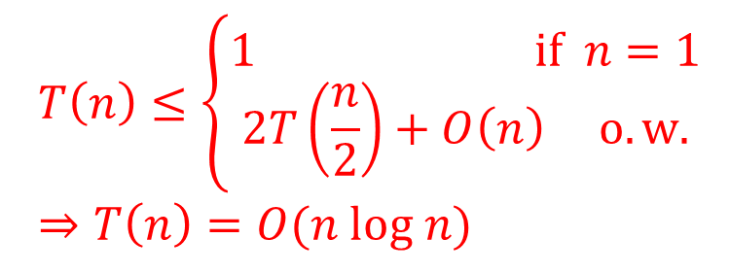
Closest Pair (2 dimension) Improved
Closest-Pair($p_{1},p_{2},⋯,p_{n}$) {
if($n≤2$) return $|p_{1}−p_{2}|$
Compute separation line $L$ such that half the points
are on one side and half on the other side.
($δ_{1},p_{1}$) = Closest-Pair(left half)
($δ_{2},p_{2}$) = Closest-Pair(right half)
$δ$ = min($δ_{1},δ_{2}$)
$p_{sorted}$ = merge($p_{1},p_{2}$) (merge sort it by y-coordinate)
Let $q$ be points (ordered as $p_{sorted}$) that is $δ$ from line L.
for $i=1,2,⋯,m$
for k = $1,2,⋯,11$
if $i+k≤m$
δ = min(δ, distance(q[i], q[i+k]));
return δ and $p_{sorted}$.
}
  $$T\left(n\right)≤\left\{\begin{aligned}1 if n=1 \\ 2T\left(\frac{n}{2}\right)+O\left(n\right) o.w.\end{aligned}\right.⇒T\left(n\right)=O(n log n)$$

Slide 24
Quiz
How to solve closest pair in 3 dimension?

Slide 25

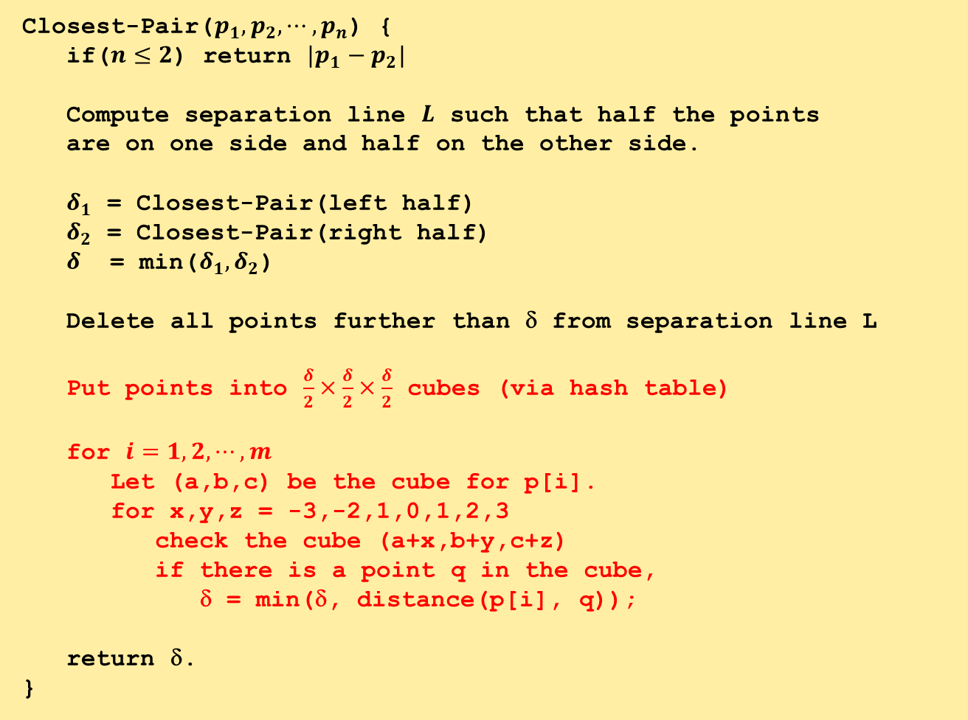
Closest-Pair($p_{1},p_{2},⋯,p_{n}$) {
if($n≤2$) return $|p_{1}−p_{2}|$
Compute separation line $L$ such that half the points
are on one side and half on the other side.
$δ_{1}$ = Closest-Pair(left half)
$δ_{2}$ = Closest-Pair(right half)
$δ$ = min($δ_{1},δ_{2}$)
Delete all points further than δ from separation line L
Put points into $\frac{δ}{2}×\frac{δ}{2}×\frac{δ}{2}$ cubes (via hash table)
for $i=1,2,⋯,m$
Let (a,b,c) be the cube for p[i].
for x,y,z = -3,-2,1,0,1,2,3
check the cube (a+x,b+y,c+z)
if there is a point q in the cube,
δ = min(δ, distance(p[i], q));
return δ.
}
  In $d$ dimension, the runtime is
  $$T\left(n\right)=2^{O(d)}n log n$$

Slide 26
Median

Slide 27
Selecting k-th smallest
    Problem: Given numbers $x_{1},…,x_{n}$ and an integer $1≤k≤n$ output the $k$-th smallest number
    $$Sel(\left\{x_{1},…,x_{n}\right\},k)$$
    A simple algorithm: Sort the numbers in time $O(n log⁡n)$then return the $k$-th smallest in the array.
    Can we do better?
    Yes, in time $O(n)$ if $k=1$ or $k=2.$
    Can we do $O\left(n\right)$ for all possible values of k?

Slide 28
An Idea
    Choose a number $w$ from $x_{1},…,x_{n}$
    Define
    $S_{<}\left(w\right)=\left\{x_{i}:x_{i}<w\right\}$
    $S_{=}\left(w\right)=\left\{x_{i}:x_{i}=w\right\}$
    $S_{>}\left(w\right)=\left\{x_{i}:x_{i}>w\right\}$
    Solve the problem recursively as follows:
    If $k≤{|S}_{<}(w)|$, output $Sel(S_{<}\left(w\right),k)$
    Else if $k≤\left|S_{<}\left(w\right)\right|+\left|S_{=}\left(w\right)\right|$, output w
    Else output $Sel(S_{>}\left(w\right),k−|S_{<}\left(w\right)|−|S_{=}\left(w\right)|)$
    Ideally want $\left|S_{<}\left(w\right)\right|,{|S}_{>}(w)|≤n/2$. In this case ALG runs in $O\left(n\right)+O\left(\frac{n}{2}\right)+O\left(\frac{n}{4}\right)+…+O\left(1\right)=O\left(n\right).$
Can be computed in
linear time

Slide 29
How to choose w?
    Suppose we choose w uniformly at random
    similar to the pivot in quicksort.
    Then, $𝔼\left[\left|S_{<}\left(w\right)\right|\right]=𝔼\left[\left|S_{>}\left(w\right)\right|\right]=n/2.$ Algorithm runs in $O(n)$ in expectation.
    Can we get $O(n)$ running time deterministically?
    Partition numbers into sets of size 3.
    Sort each set (takes O(n))
    $w=Sel(midpoints,n/6$)
$$≤$$
$$≤$$
$$≤$$
$$≤$$
$$≤$$
$$≤$$
$$≤$$
$$≤$$
$$≤$$
$$≤$$
$$≤$$
$$≤$$
$$≤$$
$$≤$$
$$w$$
$$≤$$
$$≤$$
$$≤$$
$$≤$$
$$≤$$
$$≤$$
$$≤$$
$$≤$$
$$≤$$
$$≤$$
$$≤$$
$$≤$$
$$≤$$
$$≤$$

Slide 30
How to lower bound $\left|S_{<}\left(w\right)\right|,|S_{>}\left(w\right)|$?
Assume all numbers are distinct for simplicity.
$$>w$$
    $\left|S_{<}\left(w\right)\right|≥2\left(\frac{n}{6}\right)=\frac{n}{3}$
    $\left|S_{>}\left(w\right)\right|≥2\left(\frac{n}{6}\right)=\frac{n}{3}.$
    So, what is the running time?
$$<$$
$$<$$
$$<$$
$$<$$
$$<$$
$$<$$
$$<$$
$$<$$
$$<$$
$$<$$
$$<$$
w
$$<$$
$$<$$
$$<$$
$$<$$
$$<$$
$$<$$
$$<$$
$$<$$
$$<$$
$$<$$
$$<$$
$$<$$
$$<$$
$$<$$
$$<$$
$$<$$
$$<$$
$$<$$
$$<$$
$$<$$
$$<$$
$$<w$$
$$\frac{n}{3}≤{|S}_{<}\left(w\right)|,\left|S_{>}\left(w\right)\right|≤\frac{2n}{3}$$

Slide 31
Asymptotic Running Time?
Assume all numbers are distinct for simplicity.
    If $k≤{|S}_{<}(w)|$, output $Sel(S_{<}\left(w\right),k)$
    Else if $k≤\left|S_{<}\left(w\right)\right|+\left|S_{=}\left(w\right)\right|$, output w
    Else output $Sel(S_{>}\left(w\right),k−|S_{<}\left(w\right)|−|S_{=}\left(w\right)|)$
    Where $\frac{n}{3}≤\left|S_{<}\left(w\right)\right|,\left|S_{>}\left(w\right)\right|≤\frac{2n}{3}$
    $$T\left(n\right)=T\left(\frac{n}{3}\right)+T\left(\frac{2n}{3}\right)+O\left(n\right)⇒T\left(n\right)=O(n log n)$$
$$<$$
$$<$$
$$<$$
$$<$$
$$<$$
$$<$$
$$<$$
$$<$$
$$<$$
$$<$$
$$<$$
$$w$$
$$<$$
$$<$$
$$<$$
$$<$$
$$<$$
$$<$$
$$<$$
$$<$$
$$<$$
$$<$$
$$<$$
$$<$$
$$<$$
$$<$$
$$<$$
$$<$$
$$<$$
$$<$$
$$<$$
$$<$$
$$<$$
$O(n log⁡n)$ again?
So, what is the point?

Slide 32
An Improved Idea
$$>w$$
    Partition into n/5 sets. Sort each set and set $w=Sel(midpoints,n/10$)
    $\left|S_{<}\left(w\right)\right|≥3\left(\frac{n}{10}\right)=\frac{3n}{10}$
    $\left|S_{>}\left(w\right)\right|≥3\left(\frac{n}{10}\right)=\frac{3n}{10}$
    $$T\left(n\right)=T\left(\frac{n}{5}\right)+T\left(\frac{7n}{10}\right)+O\left(n\right)⇒T\left(n\right)=O(n)$$
$$<$$
$$<$$
$$<$$
$$<$$
$$<$$
$$<$$
$$<$$
$$<$$
$$<$$
$$<$$
$$<$$
$$<$$
$$<$$
$$<$$
$$<$$
$$<$$
$$<$$
$$<$$
$$<$$
$$<$$
$$<$$
$$<$$
$$<$$
$$<$$
$$<$$
$$<$$
$$<$$
$$<$$
$$<$$
$$<$$
$$<$$
$$<$$
$$<$$
$$<$$
$$<$$
$$<$$
$$<$$
$$<$$
$$<$$
$$<$$
$$<$$
$$<$$
$$<$$
$$<$$
$$<$$
$$<$$
$$<$$
$$<$$
$$<$$
$$<$$
$$<$$
$$<$$
$$<$$
$$<$$
$$<w$$
$$\frac{3n}{10}≤{|S}_{<}\left(w\right)|,\left|S_{>}\left(w\right)\right|≤\frac{7n}{10}$$

Slide 33
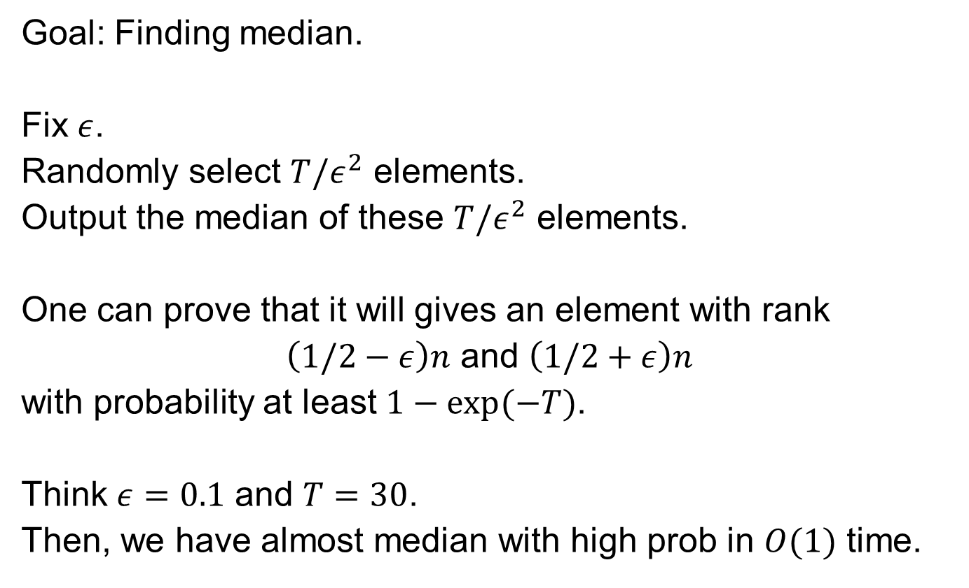
Can we do it even better?
    Goal: Finding median.
    Fix $ε$.
    Randomly select $T/ε^{2}$ elements.
    Output the median of these $T/ε^{2}$ elements.
    One can prove that it will gives an element with rank
    $\left(1/2−ε\right)n$ and $\left(1/2+ε\right)n$
    with probability at least $1−exp⁡(−T)$.
    Think $ε=0.1$ and $T=30$.
    Then, we have almost median with high prob in $O(1)$ time.

Slide 34
Integer Multiplication

Slide 35



Integer Arithmetic
1
1
1
1
1
1
0
1
Add: Given two $n$-bit integers
$a$ and $b$, compute $a+b$.
Multiply: Given two $n$-bit
integers $a$ and $b$, compute $a×b$.
The “grade school” method:
1
1
0
1
0
1
0
1
Add
+
0
1
1
1
1
1
0
1
1
0
1
0
1
0
0
1
0
$O(n)$ bit operations.
1
1
0
1
0
1
0
1
*
0
1
1
1
1
1
0
1
1
1
0
1
0
1
0
1
Multiply
0
0
0
0
0
0
0
0
1
1
0
1
0
1
0
1
1
1
0
1
0
1
0
1
1
1
0
1
0
1
0
1
$O(n^{2})$ bit operations.
1
1
0
1
0
1
0
1
1
1
0
1
0
1
0
1
0
0
0
0
0
0
0
0
0
1
1
0
1
0
0
0
0
0
0
0
0
0
0
1
35

Slide 36

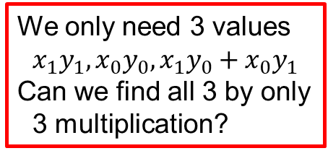
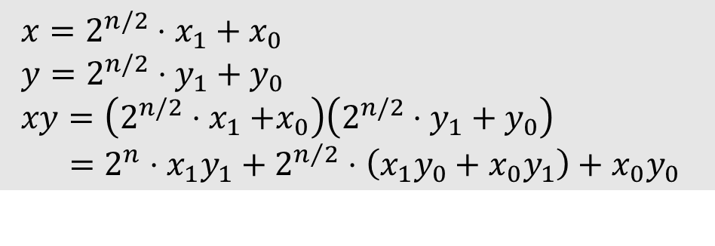
Divide and Conquer
Let $x,y$ be two $n$-bit integers
Write $x=2^{n/2}x_{1}+x_{0}$ and $y=2^{n/2}y_{1}+y_{0}$
where $x_{0},x_{1},y_{0},y_{1}$ are all $n/2$-bit integers.
Therefore,
$$T\left(n\right)=4T\left(\frac{n}{2}\right)+Θ(n)$$
So,
$$T\left(n\right)=Θ\left(n^{2}\right).$$
$x=2^{n/2}⋅x_{1}+x_{0}$
$y=2^{n/2}⋅y_{1}+y_{0}$
$xy=\left(2^{n/2}{⋅x}_{1}+x_{0}\right)\left(2^{n/2}⋅y_{1}+y_{0}\right)$
$=2^{n}⋅x_{1}y_{1}+2^{n/2}⋅\left(x_{1}y_{0}+x_{0}y_{1}\right)+x_{0}y_{0}$
We only need 3 values
$$x_{1}y_{1},x_{0}y_{0},x_{1}y_{0}+x_{0}y_{1}$$
Can we find all 3 by only
3 multiplication?

Slide 37


Key Trick: 4 multiplies at the price of 3
$x=2^{n/2}⋅x_{1}+x_{0}$
$y=2^{n/2}⋅y_{1}+y_{0}$
$xy=\left(2^{n/2}{⋅x}_{1}+x_{0}\right)\left(2^{n/2}⋅y_{1}+y_{0}\right)$
$=2^{n}⋅x_{1}y_{1}+2^{n/2}⋅\left(x_{1}y_{0}+x_{0}y_{1}\right)+x_{0}y_{0}$
$α=x_{1}+x_{0}$
$β=y_{1}+y_{0}$
$αβ=\left(x_{1}+x_{0}\right)\left(y_{1}+y_{0}\right)$
$=x_{1}y_{1}+\left(x_{1}y_{0}+x_{0}y_{1}\right)+x_{0}y_{0}$
$\left(x_{1}y_{0}+x_{0}y_{1}\right)=αβ−x_{1}y_{1}−x_{0}y_{0}$

Slide 38
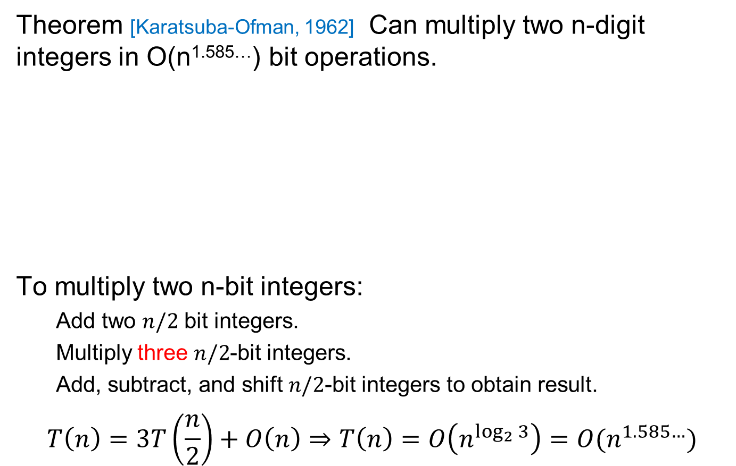

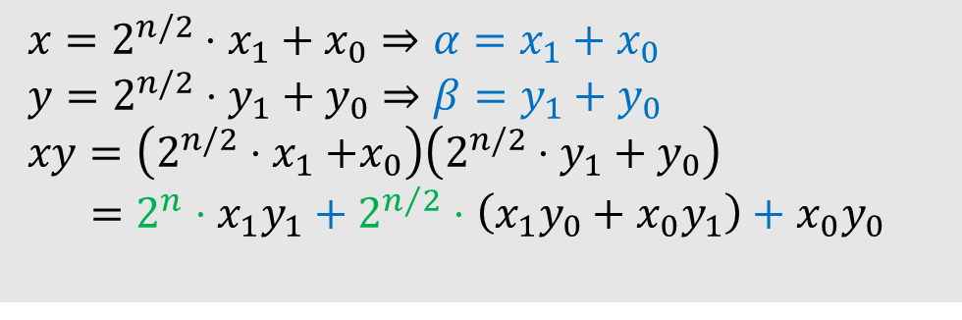
Key Trick: 4 multiplies at the price of 3
Theorem [Karatsuba-Ofman, 1962] Can multiply two n-digit integers in O(n^{1.585…}) bit operations.
To multiply two n-bit integers:
  Add two $n/2$ bit integers.
  Multiply three $n/2$-bit integers.
  Add, subtract, and shift $n/2$-bit integers to obtain result.
$$T\left(n\right)=3T\left(\frac{n}{2}\right)+O\left(n\right)⇒T\left(n\right)=O\left(n^{\log_{2}{3}}\right)=O(n^{1.585…})$$
$x=2^{n/2}⋅x_{1}+x_{0}⇒α=x_{1}+x_{0}$
$y=2^{n/2}⋅y_{1}+y_{0}⇒β=y_{1}+y_{0}$
$xy=\left(2^{n/2}{⋅x}_{1}+x_{0}\right)\left(2^{n/2}⋅y_{1}+y_{0}\right)$
$=2^{n}⋅x_{1}y_{1}+2^{n/2}⋅\left(x_{1}y_{0}+x_{0}y_{1}\right)+x_{0}y_{0}$
A
$$αβ−A−B$$
B

Slide 39
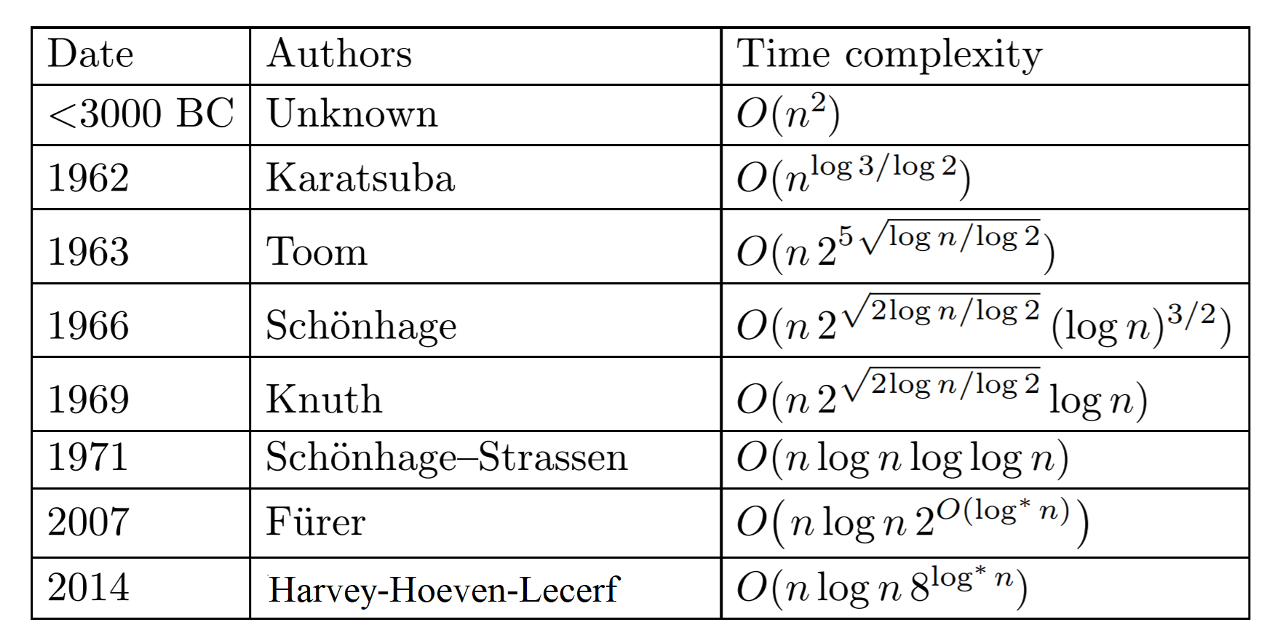

Integer Multiplication (Summary)
Exercise: generalize Karatsuba to do 5 size
$n/3$ subproblems
  This gives $Θ\left(n^{1.46…}\right)$ time algorithm
2019 Harvey-Hoeven $O(n\log{n})$

Slide 40
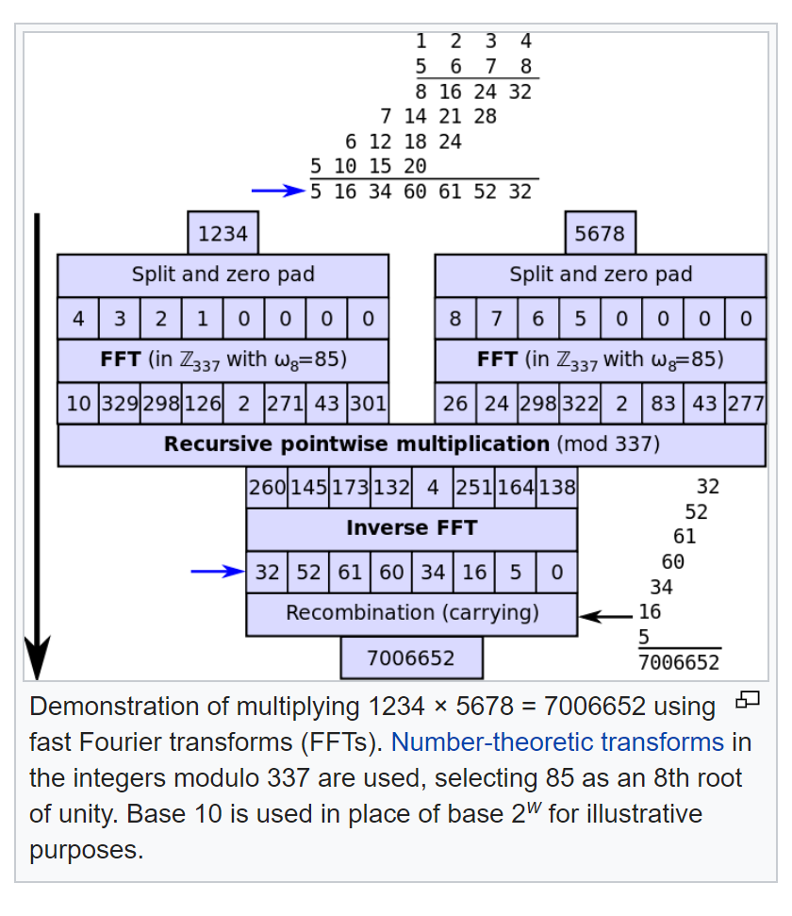
Integer Multiplication (Summary)

Slide 41
Matrix Multiplication

Slide 42
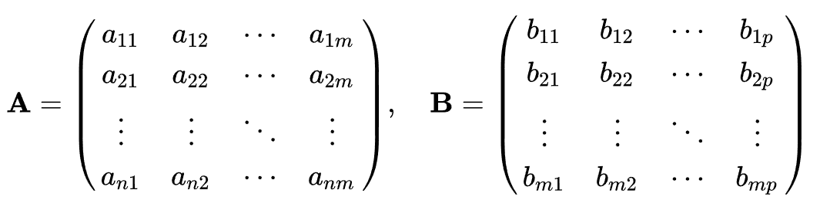
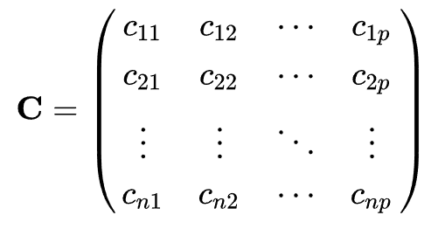
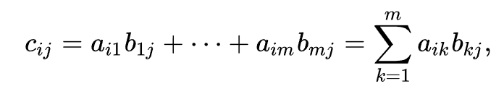
Multiplying Matrices
Let $A$ be an $n×m$ matrix, $B$ be an $m×p$ matrix.
Then, $C=AB$ is an $n×p$ matrix
such that
Question: Why matrix multiplication is defined in such way?

Slide 43
Multiplying Matrices

Slide 44
Multiplying Matrices

Slide 45
Multiplying Matrices
A₁₁
A₁₂
B₁₁
B₁₂
A₂₁
A₂₂
B₂₁
B₂₂
A₁₁B₁₁+A₁₂B₂₁
A₁₁B₁₂+A₁₂B₂₂
A₂₁B₁₁+A₂₂B₂₁
A₂₁B₁₂+A₂₂B₂₂

Slide 46
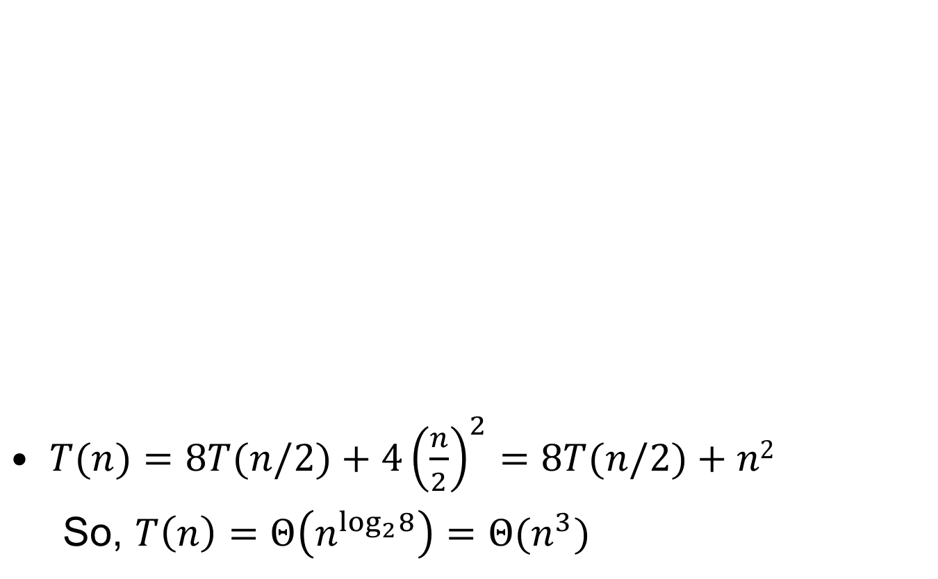
Simple Divide and Conquer
$T(n)=8T(n/2)+4{\left(\frac{n}{2}\right)}^{2}=8T(n/2)+n2$
  So, $T\left(n\right)=Θ\left(n^{\log_{2}8}\right)=Θ(n^{3})$
A₁₁
A₁₂
B₁₁
B₁₂
A₂₁
A₂₂
B₂₁
B₂₂
A₁₁B₁₁+A₁₂B₂₁
A₁₁B₁₂+A₁₂B₂₂
=
A₂₁B₁₁+A₂₂B₂₁
A₂₁B₁₂+A₂₂B₂₂

Slide 47
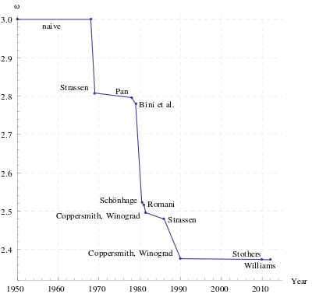
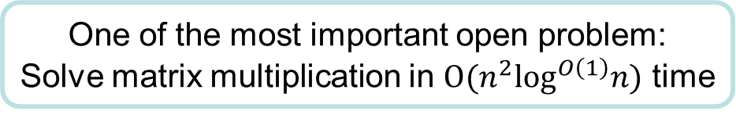
Strassen’s Divide and Conquer Algorithm
Strassen’s algorithm
  Multiply $2×2$ matrices using $7$ instead of $8$ multiplications (and $18$ additions)
  $$T\left(n\right)=7T\left(\frac{n}{2}\right)+18n$$
  Hence, we have $T\left(n\right)=O\left(n^{\log_{2}{7}}\right).$
Useful when $n\sim 500$.
One of the most important open problem:
Solve matrix multiplication in $O(n^{2}\log^{O\left(1\right)}n)$ time

Slide 48
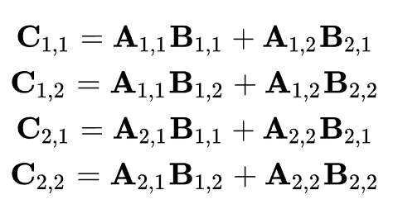
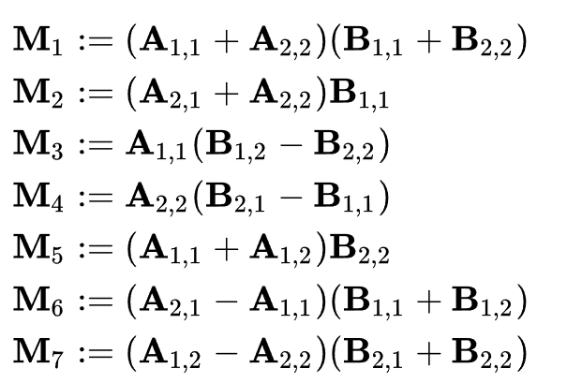
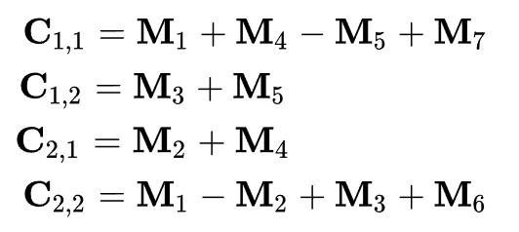
Strassen’s Divide and Conquer Algorithm
Naive
Strassen
How did Strassen come up with his matrix multiplication method?
Stackexchange: I've been told no-one really knows, anything would be mainly speculation.

