Slide 1
CSE 421: Introduction to Algorithms
Yin-Tat Lee

Slide 2
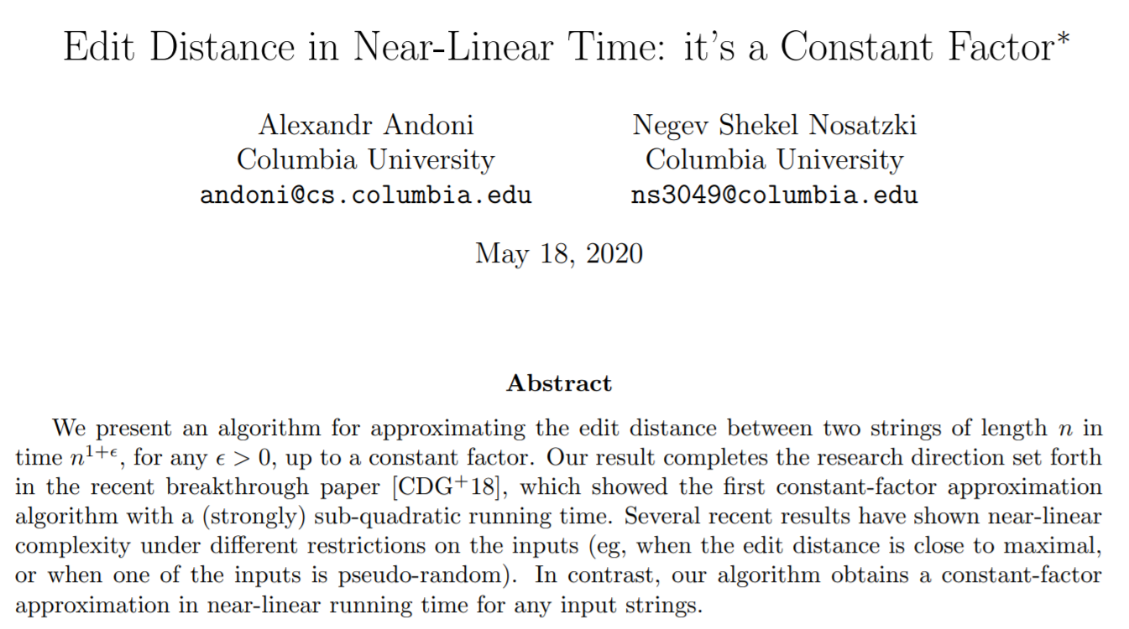
Quiz
Blue strip means not on HWs/exams
Input: two $n$-size strings $s_{1}$ and $s_{2}$.
$s_{1}=AGGCTACC$
$s_{2}=CAGGCTAC$
Output: minimum number of insertions/deletions to transform $s_{1}$ into $s_{2}$.
Algorithm: ????
Naively, $O{\left(1\right)}^{n}$ by enumerating all changes.
After this quarter, you should be able to
solve it in $O(n^{2})$ time
explain why your algorithm is correct.
Question: Is $O(n^{1.999})$ possible?
See arXiv: 2005.07678
If you forget about Big-Oh notation, don’t worry.
Next lecture.

Slide 3
This Course
Solve computational problems using less steps.
Goal:
Learn some techniques to design algorithms
Understand some problems are difficult
Prove some correctness
Grading Scheme
Homework 50% Weekly homework due on Wed before the class
Midterm 20%
Final 30%
You will get at least 3.4 if
Your score is >= 65%
Do not come to the class/exam if you feel sick! (There are videos)

Slide 4
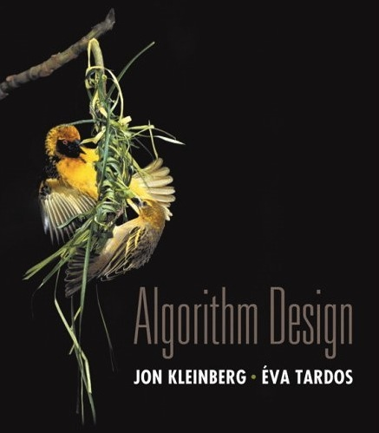
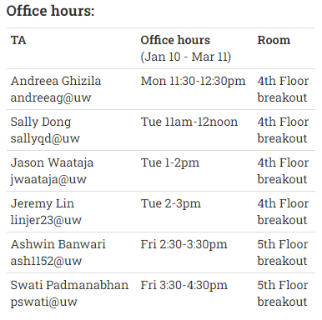
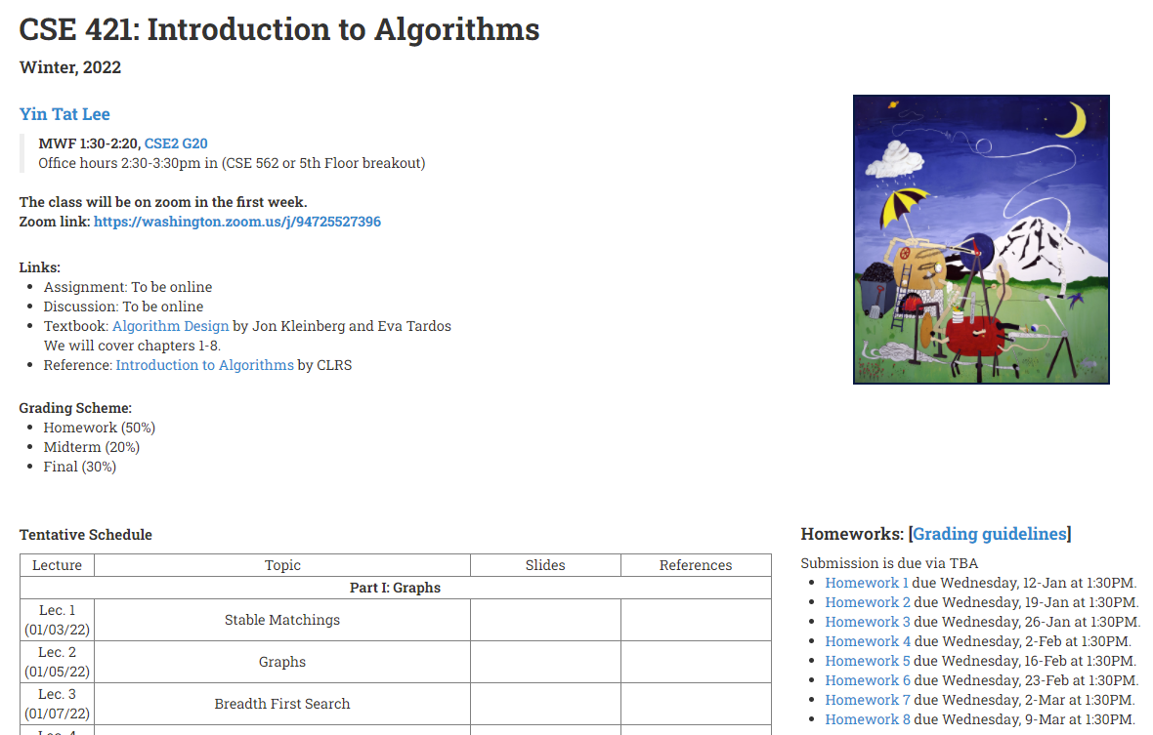
Where to get help?
Ask questions in the class!
Read the textbook!
Edstem: Online discussion forum (To be online).
Office hours:
Myself: M 2:30-3:30 in CSE 562
Course textbook
(optional)
Starting next week
Website: cs.washington.edu/421

Slide 5
Introducing myself
Blue strip means not on HWs/exams
Study theoretical computer science.
Among others, I gave the (theoretically) fastest algorithms for
Linear Programs
Network flow
Two topics that we will discuss in this course.

Slide 6
Notes:
Poll Title: Do not modify the notes in this section to avoid tampering with the Poll Everywhere activity. More info at polleverywhere.com/support Why do you take this class? (Beside YinTat is cool) https://www.polleverywhere.com/free_text_polls/rFd1IFKR6uthPIO7XJ5ah

Slide 7
Stable Matching Problem
Given $n$ men and $n$ women, find a “stable matching”.
We know the preference of all people.
favorite
least favorite
favorite
least favorite
1st
2nd
3rd
1st
2nd
3rd
Xavier
Amy
Brenda
Claire
Amy
Yuri
Xavier
Zoran
Yuri
Brenda
Amy
Claire
Brenda
Xavier
Yuri
Zoran
Zoran
Amy
Brenda
Claire
Claire
Xavier
Yuri
Zoran
Men’s Preference Profile
Women’s Preference Profile

Slide 8
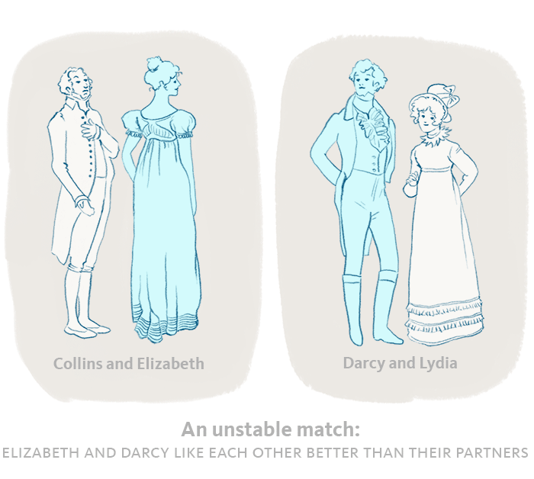
Stable Matching
Perfect matching:
Each man gets exactly one woman.
Each woman gets exactly one man.
Stability: no incentive to exchange
an unmatched pair m-w is unstable
if m and w prefer each other to their current partners.

Slide 9
Stable Matching
Perfect matching:
Each man gets exactly one woman.
Each woman gets exactly one man.
Stability: no incentive to exchange
an unmatched pair m-w is unstable
if m and w prefer each other to their current partners.
Stable matching: perfect matching with no unstable pairs.
Stable matching problem: Given the preference lists of $n$ men and $n$ women, find a stable matching if one exists.
m
w

Slide 10
Example
Question. Is assignment X-C, Y-B, Z-A stable?
favorite
least favorite
favorite
least favorite
1st
2nd
3rd
1st
2nd
3rd
Xavier
Amy
Brenda
Claire
Amy
Yuri
Xavier
Zoran
Yuri
Brenda
Amy
Claire
Brenda
Xavier
Yuri
Zoran
Zoran
Amy
Brenda
Claire
Claire
Xavier
Yuri
Zoran
Men’s Preference Profile
Women’s Preference Profile

Slide 11
Example
Question. Is assignment X-C, Y-B, Z-A stable?
Answer. No. Look at Brenda and Xavier.
favorite
least favorite
favorite
least favorite
1st
2nd
3rd
1st
2nd
3rd
Xavier
Amy
Brenda
Claire
Amy
Yuri
Xavier
Zoran
Yuri
Brenda
Amy
Claire
Brenda
Xavier
Yuri
Zoran
Zoran
Amy
Brenda
Claire
Claire
Xavier
Yuri
Zoran
Men’s Preference Profile
Women’s Preference Profile

Slide 12
Example (cont’d)
Question: Is assignment X-A, Y-B, Z-C stable?
Answer: Yes. (X, Y are happy. No one want Z.)
favorite
least favorite
favorite
least favorite
1st
2nd
3rd
1st
2nd
3rd
Xavier
Amy
Brenda
Claire
Amy
Yuri
Xavier
Zoran
Yuri
Brenda
Amy
Claire
Brenda
Xavier
Yuri
Zoran
Zoran
Amy
Brenda
Claire
Claire
Xavier
Yuri
Zoran
Men’s Preference Profile
Women’s Preference Profile

Slide 13
Existence of Stable Matchings
Question. Do stable matchings always exist?
Answer. Seems unclear in real-world. Yet, it always exists!
Question. How to find stable matchings?

Slide 14
Propose-And-Reject Algorithm [Gale-Shapley’62]
Initialize each person to be free.
while (some man is free) {
Choose such a man m
w = 1st woman on m's list to whom m has not yet proposed
if (w is free)
assign m and w to be engaged
else if (w prefers m to her fiancé m')
assign m and w to be engaged, and m' to be free
else
w rejects m
}
Switch the pdf for an example.

Slide 15
Notes:
Poll Title: Do not modify the notes in this section to avoid tampering with the Poll Everywhere activity. More info at polleverywhere.com/support Fairness https://www.polleverywhere.com/surveys/RoVrgiscCMOpA1EmOkQDM?display_state=chart&activity_state=opened&state=opened&flow=Engagement&onscreen=persist

Slide 16
Notes:
Poll Title: Do not modify the notes in this section to avoid tampering with the Poll Everywhere activity. More info at polleverywhere.com/support For the stable matching problem, can there be more than 1 solution? https://www.polleverywhere.com/multiple_choice_polls/8A4tdsdquBIFbM6BfN67f?display_state=chart&activity_state=opened&state=opened&flow=Engagement&onscreen=persist&hide=instructions

Slide 17
Notes:
Poll Title: Do not modify the notes in this section to avoid tampering with the Poll Everywhere activity. More info at polleverywhere.com/support Does every run of propose-and-reject algorithm give the same output? https://www.polleverywhere.com/multiple_choice_polls/gD9dKwDGIfQ4fJN2JZX50?display_state=chart&activity_state=opened&state=opened&flow=Engagement&onscreen=persist&hide=instructions

Slide 18
Notes:
Poll Title: Do not modify the notes in this section to avoid tampering with the Poll Everywhere activity. More info at polleverywhere.com/support What is the output for this preference list? https://www.polleverywhere.com/multiple_choice_polls/aeB9VGEA30NkuUs3bcjQt?display_state=chart&activity_state=opened&state=opened&flow=Engagement&onscreen=persist&hide=instructions

Slide 19
Notes:
Poll Title: Do not modify the notes in this section to avoid tampering with the Poll Everywhere activity. More info at polleverywhere.com/support Is the result fair to women? https://www.polleverywhere.com/multiple_choice_polls/ZjiXFBB3s1wMLo8M4Uknp?display_state=chart&activity_state=opened&state=opened&flow=Engagement&onscreen=persist&hide=instructions

Slide 20
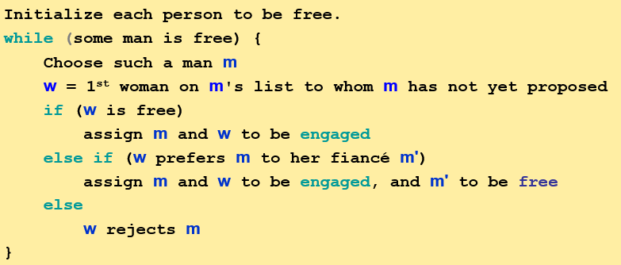
Basic Properties
The algorithm ends.
Is every step valid? How many iterations it takes?
The output is correct.
It finds a perfect matching that is stable.
How to prove them?
When stuck, try to list out properties of the algorithms.
Observation 1: Men propose to women in decreasing order of preference.
Observation 2: Woman's partner get better and better. Never unmatched once matched.
Notes:
Ob1: If men get rejected. They will propose to the next one (less favorable one) in the list.
Ob2: In the algorithm, woman only switches partner when she get a better proposal.

Slide 21
Summary
Stable matching problem: Given n men and n women, and their preferences, find a stable matching.
Propose-And-Reject algorithm: Guarantees to find a stable matching for any problem instance in $O(n^{2})$ steps.
Steps on solving problems:
Formulate the problem
Define the algorithm
Prove the algorithm ends
Prove the output is correct

Slide 22
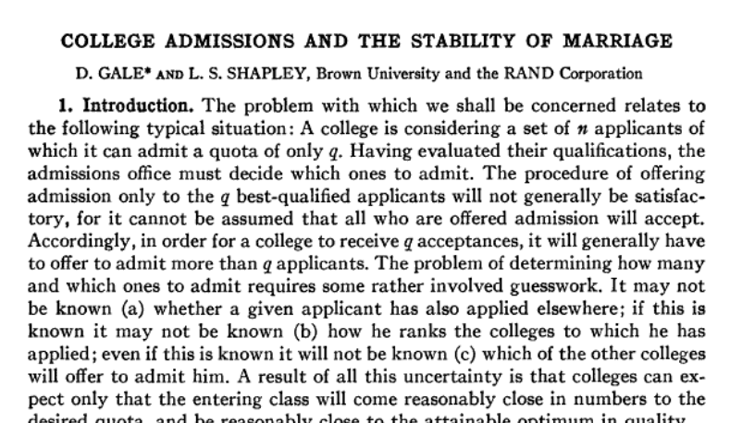
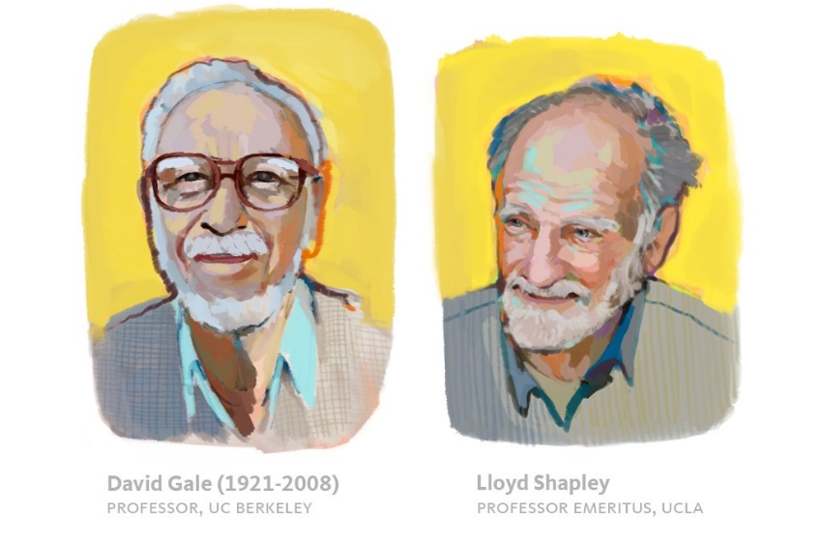
Why this problem is important?
In 1962, Gale and Shapley published the paper
“College Admissions and the Stability of Marriage”
To
“The American Mathematical Monthly”

Slide 23
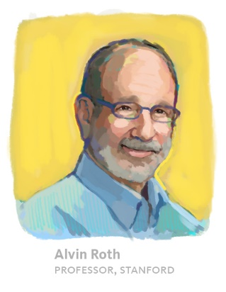
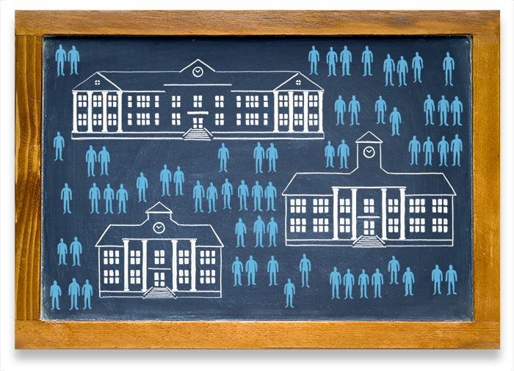
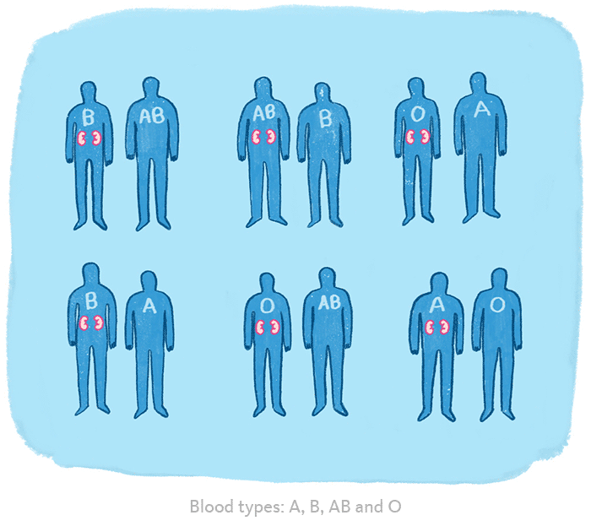
Why this problem is important?
Alvin Roth modified the Gale-Shapley algorithm and apply it to
National Residency Match Program (NRMP), a system that assigns new doctors to hospitals around the country. (90s)
Public high school assignment process (00s)
Helping transplant patients find a match (2004)
(Saved >1,000 people every year!)
Reference: https://medium.com/@UofCalifornia/how-a-matchmaking-algorithm-saved-lives-2a65ac448698
Notes:
https://forward.com/news/breaking-news/164327/alvin-roth-transformed-kidney-donation-system/

Slide 24
Why this problem is important?
Some of the problems in this course may seem obscure.
But their abstraction allows for variety of applications.
Shapley and Roth got the Nobel Prize (Economic) in 2012.
(David Gale passed away in 2008.)

