Slide 1
CSE 421 Algorithms
Lecture 22
Network Flow, Part 2

Slide 2
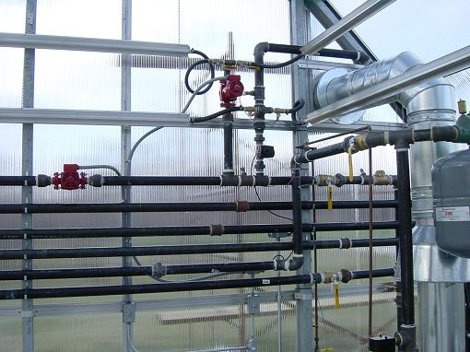
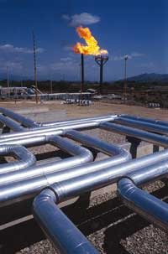
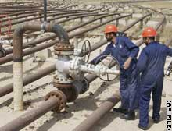
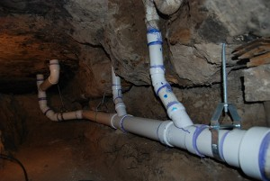
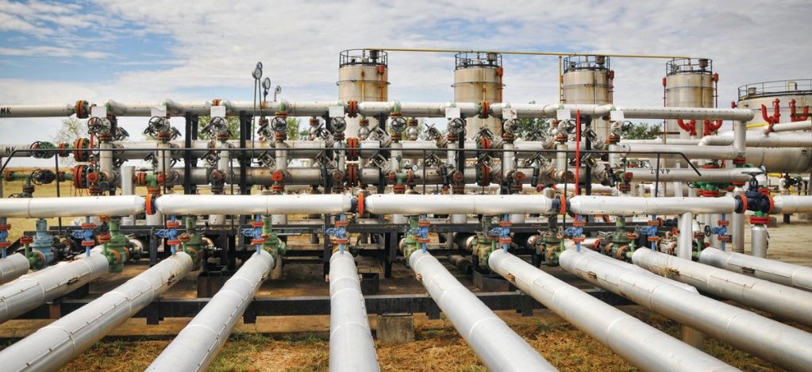
Network Flow

Slide 3
Outline
Network flow definitions
Flow examples
Augmenting Paths
Residual Graph
Ford Fulkerson Algorithm
Cuts
Maxflow-MinCut Theorem
Simple applications of Max Flow

Slide 4
Ford-Fulkerson Algorithm (1956)
while not done
Construct residual graph G_{R}
Find an s-t path P in G_{R} with capacity b > 0
Add b units along in G
If the sum of the capacities of edges leaving s is at most C, then the algorithm takes at most C iterations

Slide 5
Cuts in a graph
Cut: Partition of V into disjoint sets S, T with s in S and t in T.
Cap(S,T): sum of the capacities of edges from S to T
Flow(S,T): net flow out of S
Sum of flows out of S minus sum of flows into S
Flow(S,T) <= Cap(S,T)

Slide 6
What is Cap(S,T) and Flow(S,T)
S={s, a, b, e, h}, T = {c, f, i, d, g, t}
20/20
20/20
a
d
g
0/5
0/5
20/20
20/20
5/5
0/5
0/5
5/5
0/20
s
25/30
b
20/20
e
h
30/30
t
20/20
0/5
5/5
20/20
0/5
0/10
15/20
15/25
c
f
i
20/20
10/10
Cap(S,T) = 95, Flow(S,T) = 80 – 15 = 65

Slide 7
Minimum value cut
u
40
10
s
10
t
10
40
v

Slide 8
Find a minimum value cut
6
6
5
8
10
3
6
s
7
2
t
4
5
3
8
5
4

Slide 9
Find a minimum value cut
6
6
5
8
10
3
6
s
7
2
t
4
5
3
8
5
4

Slide 10
Find a minimum value cut
6:5
6:5
5:5
8:0
10:3
3:3
6:5
s
7:6
2:2
t
4:4
5:4
3:3
8:3
5:0
4:3

Slide 11
MaxFlow – MinCut Theorem
There exists a flow which has the same value of the minimum cut
Proof: Consider a flow where the residual graph has no s-t path with positive capacity
Let S be the set of vertices in G_{R} reachable from s with paths of positive capacity
s
t

Slide 12
Let S be the set of vertices in G_{R} reachable from s with paths of positive capacity
u
v
s
t
y
x
S
T
What can we say about the flows and capacity
between u and v? x and y?

Slide 13
Max Flow - Min Cut Theorem
Ford-Fulkerson algorithm finds a flow where the residual graph is disconnected, hence FF finds a maximum flow.
If we want to find a minimum cut, we begin by looking for a maximum flow.

Slide 14
Performance
The worst case performance of the Ford-Fulkerson algorithm is horrible
u
1000
1000
s
1
t
1000
1000
v

Slide 15
Better methods of finding augmenting paths
Find the maximum capacity augmenting path
O(m²log(C)) time algorithm for network flow
Find the shortest augmenting path
O(m²n) time algorithm for network flow
Find a blocking flow in the residual graph
O(mnlog n) time algorithm for network flow

Slide 16
Problem Reduction
Reduce Problem A to Problem B
Convert an instance of Problem A to an instance of Problem B
Use a solution of Problem B to get a solution to Problem A
Practical
Use a program for Problem B to solve Problem A
Theoretical
Show that Problem B is at least as hard as Problem A

Slide 17
Problem Reduction Examples
Reduce the problem of finding the Maximum of a set of integers to finding the Minimum of a set of integers
Find the maximum of: 8, -3, 2, 12, 1, -6
Construct an equivalent minimization problem

Slide 18
Undirected Network Flow
Undirected graph with edge capacities
Flow may go either direction along the edges (subject to the capacity constraints)
u
10
20
s
5
t
20
10
v
Construct an equivalent flow problem

Slide 19
Bipartite Matching
A graph G=(V,E) is bipartite if the vertices can be partitioned into disjoints sets X,Y
A matching M is a subset of the edges that does not share any vertices
Find a matching as large as possible

Slide 20
Application
A collection of teachers
A collection of courses
And a graph showing which teachers can teach which courses
RA
311
PB
331
ME
332
DG
401
AK
421

Slide 21
Converting Matching to Network Flow
s
t

Slide 22
Finding edge disjoint paths
t
s
Construct a maximum cardinality set of
edge disjoint paths

