Slide 1
CSE 421 Algorithms
Richard Anderson
Lecture 19
Memory Efficient Dynamic Programming

Slide 2
Announcements
Office Hours, 2:30 pm, MW, CSE2 344

Slide 3
Longest Common Subsequence
C=c₁…c_{g} is a subsequence of A=a₁…a_{m} if C can be obtained by removing elements from A (but retaining order)
LCS(A, B): A maximum length sequence that is a subsequence of both A and B
LCS(BARTHOLEMEWSIMPSON, KRUSTYTHECLOWN)
= RTHOWN

Slide 4
LCS Optimization
A = a₁a₂…a_{m}
B = b₁b₂…b_{n}
Opt[ j, k] is the length of LCS(a₁a₂…a_{j}, b₁b₂…b_{k})

Slide 5
Optimization recurrence
If a_{j} = b_{k}, Opt[ j,k ] = 1 + Opt[ j-1, k-1 ]
If a_{j} != b_{k}, Opt[ j,k] = max(Opt[ j-1,k], Opt[ j,k-1])

Slide 6
Dynamic Programming Computation

Slide 7
Code to compute Opt[ n, m]
for (int i = 0; i < n; i++)
for (int j = 0; j < m; j++)
if (A[ i ] == B[ j ] )
Opt[ i,j ] = Opt[ i-1, j-1 ] + 1;
else if (Opt[ i-1, j ] >= Opt[ i, j-1 ])
Opt[ i, j ] = Opt[ i-1, j ];
else
Opt[ i, j ] = Opt[ i, j-1];

Slide 8
Storing the path information
A[1..m], B[1..n]
for i = 1 to m Opt[i, 0] = 0;
for j = 1 to n Opt[0,j] = 0;
Opt[0,0] := 0;
for i = 1 to m
for j = 1 to n
if A[i] = B[j] { Opt[i,j] = 1 + Opt[i-1,j-1]; Best[i,j] = Diag; }
else if Opt[i-1, j] >= Opt[i, j-1]
{ Opt[i, j] = Opt[i-1, j]; Best[i,j] = Left; }
else { Opt[i, j] = Opt[i, j-1]; Best[i,j] = Down; }
b₁…b_{n}
a₁…a_{m}

Slide 9
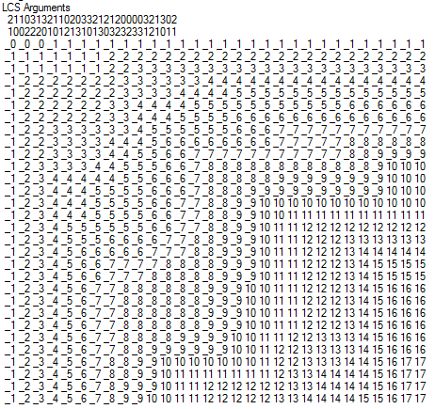
Reconstructing Path from Distances

Slide 10
How good is this algorithm?
Is it feasible to compute the LCS of two strings of length 300,000 on a standard desktop PC? Why or why not.

Slide 11
Implementation 1
public int ComputeLCS() {
int n = str1.Length;
int m = str2.Length;
int[,] opt = new int[n + 1, m + 1];
for (int i = 0; i <= n; i++)
opt[i, 0] = 0;
for (int j = 0; j <= m; j++)
opt[0, j] = 0;
for (int i = 1; i <= n; i++)
for (int j = 1; j <= m; j++)
if (str1[i-1] == str2[j-1])
opt[i, j] = opt[i - 1, j - 1] + 1;
else if (opt[i - 1, j] >= opt[i, j - 1])
opt[i, j] = opt[i - 1, j];
else
opt[i, j] = opt[i, j - 1];
return opt[n,m];
}

Slide 12
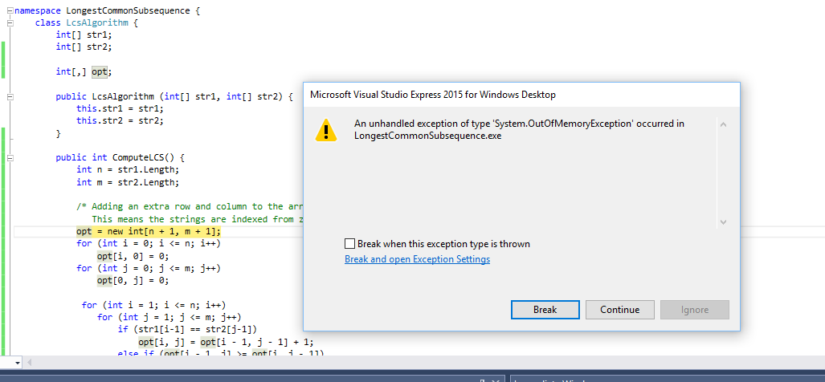
N = 17000
Runtime should be about 5 seconds*
* Personal PC, 6 years old

Slide 13
Implementation 2
public int SpaceEfficientLCS() {
int n = str1.Length;
int m = str2.Length;
int[] prevRow = new int[m + 1];
int[] currRow = new int[m + 1];
for (int j = 0; j <= m; j++)
prevRow[j] = 0;
for (int i = 1; i <= n; i++) {
currRow[0] = 0;
for (int j = 1; j <= m; j++) {
if (str1[i - 1] == str2[j - 1])
currRow[j] = prevRow[j - 1] + 1;
else if (prevRow[j] >= currRow[j - 1])
currRow[j] = prevRow[j];
else
currRow[j] = currRow[j - 1];
}
for (int j = 1; j <= m; j++)
prevRow[j] = currRow[j];
}
return currRow[m];
}

Slide 14
N = 300000
N: 10000 Base 2 Length: 8096 Gamma: 0.8096 Runtime:00:00:01.86
N: 20000 Base 2 Length: 16231 Gamma: 0.81155 Runtime:00:00:07.45
N: 30000 Base 2 Length: 24317 Gamma: 0.8105667 Runtime:00:00:16.82
N: 40000 Base 2 Length: 32510 Gamma: 0.81275 Runtime:00:00:29.84
N: 50000 Base 2 Length: 40563 Gamma: 0.81126 Runtime:00:00:46.78
N: 60000 Base 2 Length: 48700 Gamma: 0.8116667 Runtime:00:01:08.06
N: 70000 Base 2 Length: 56824 Gamma: 0.8117715 Runtime:00:01:33.36
N: 300000 Base 2 Length: 243605 Gamma: 0.8120167 Runtime:00:28:07.32

Slide 15
Observations about the Algorithm
The computation can be done in O(m+n) space if we only need one column of the Opt values or Best Values
The algorithm can be run from either end of the strings

Slide 16
Computing LCS in O(nm) time and O(n+m) space
Divide and conquer algorithm
Recomputing values used to save space

Slide 17
Divide and Conquer Algorithm
Where does the best path cross the middle column?
For a fixed i, and for each j, compute the LCS that has a_{i} matched with b_{j}

Slide 18
Constrained LCS
LCS_{i,j}(A,B): The LCS such that
a₁,…,a_{i} paired with elements of b₁,…,b_{j}
a_{i+1},…a_{m} paired with elements of b_{j+1},…,b_{n}
LCS_{4,3}(abbacbb, cbbaa)

Slide 19
A = RRSSRTTRTS B=RTSRRSTST
Compute LCS_{5,0}(A,B), LCS_{5,1}(A,B),…,LCS_{5,9}(A,B)

Slide 20
A = RRSSRTTRTS B=RTSRRSTST
Compute LCS_{5,0}(A,B), LCS_{5,1}(A,B),…,LCS_{5,9}(A,B)
j | left | right
0 | 0 | 4
1 | 1 | 4
2 | 1 | 3
3 | 2 | 3
4 | 3 | 3
5 | 3 | 2
6 | 3 | 2
7 | 3 | 1
8 | 4 | 1
9 | 4 | 0

Slide 21
Computing the middle column
From the left, compute LCS(a₁…a_{m/2},b₁…b_{j})
From the right, compute LCS(a_{m/2+1}…a_{m},b_{j+1}…b_{n})
Add values for corresponding j’s
Note – this is space efficient

Slide 22
Divide and Conquer
A = a₁,…,a_{m} B = b₁,…,b_{n}
Find j such that
LCS(a₁…a_{m/2}, b₁…b_{j}) and
LCS(a_{m/2+1}…a_{m},b_{j+1}…b_{n}) yield optimal solution
Recurse

Slide 23
Algorithm Analysis
T(m,n) = T(m/2, j) + T(m/2, n-j) + cnm

Slide 24
Prove by induction that T(m,n) <= 2cmn
T(m,n) = T(m/2, j) + T(m/2, n-j) + cnm

Slide 25
Memory Efficient LCS Summary
We can afford O(nm) time, but we can’t afford O(nm) space
If we only want to compute the length of the LCS, we can easily reduce space to O(n+m)
Avoid storing the value by recomputing values
Divide and conquer used to reduce problem sizes

