Slide 1
CSE 421 Algorithms
Richard Anderson
Lecture 18
Dynamic Programming

Slide 2
Announcements

Slide 3
One dimensional dynamic programming: Interval scheduling
Opt[ j ] = max (Opt[ j – 1], w_{j} + Opt[ p[ j ] ])

Slide 4
Two dimensional dynamic programming
K-segment linear approximation
Opt_{k}[ j ] = min _{i} { Opt_{k-1}[ i ] + E_{i,j} } for 0 < i < j
4
3
2
1
 | 0 | 0 | 0 | 0 | 0 | 0 | 0 | 0 | 0 | 0 | 0 | 0 | 0 | 0 | 0 | 0 | 0

Slide 5
Two dimensional dynamic programming
Subset sum and knapsack
Opt[ j, K] = max(Opt[ j – 1, K], Opt[ j – 1, K – w_{j}] + w_{j})
Opt[ j, K] = max(Opt[ j – 1, K], Opt[ j – 1, K – w_{j}] + v_{j})
4
3
2
1
 | 0 | 0 | 0 | 0 | 0 | 0 | 0 | 0 | 0 | 0 | 0 | 0 | 0 | 0 | 0 | 0 | 0

Slide 6
Alternate approach for Strict Subset Sum
Alternate solution of Strict Subset Sum with a dynamic programming algorithm:
Sum[i, K] = true if there is a subset of {w₁,…w_{i}} that sums to exactly K, false otherwise
Sum [i, K] = Sum [i -1, K] OR Sum[i - 1, K - w_{i}]
Sum [0, 0] = true; Sum[0, K] = false for K != 0
Saving space: Can you replace the two dimensional array with a one dimensional array?

Slide 7
Run time for Subset Sum
With n items and target sum K, the run time is O(nK)
If K is 1,000,000,000,000,000,000,000,000 this is very slow
Alternate brute force algorithm: examine all subsets: O(n2^{n})

Slide 8
Dynamic Programming Examples
Examples
Optimal Billboard Placement
Text, Solved Exercise, Pg 307
Linebreaking with hyphenation
Compare with HW problem 6, Pg 317
String approximation
Text, Solved Exercise, Page 309
Longest Common Subsequence
Text, Section 6.6

Slide 9
Billboard Placement
Maximize income in placing billboards
b_{i} = (p_{i}, v_{i}), v_{i}: value of placing billboard at position p_{i}
Constraint:
At most one billboard every five miles
Example
{(6,5), (8,6), (12, 5), (14, 1)}

Slide 10
Design a Dynamic Programming Algorithm for Billboard Placement
Compute Opt[1], Opt[2], . . ., Opt[n]
What is Opt[k]?
Input b₁, …, b_{n}, where b_{i} = (p_{i}, v_{i}), position and value of billboard i

Slide 11
Solution
j = 0; // j is five miles behind the current position
// the last valid location for a billboard, if one placed at P[k]
for k := 1 to n
while (P[ j ] < P[ k ] – 5)
j := j + 1;
j := j – 1;
Opt[ k] = Max(Opt[ k-1] , V[ k ] + Opt[ j ]);

Slide 12
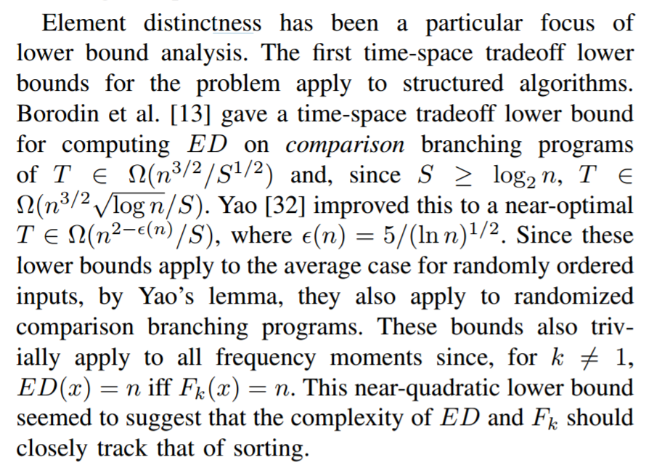
Optimal line breaking

Slide 13
Optimal Paragraphing
Optimal line breaking:
Assign words to paragraphs to minimize the sum of line penalties (square of excess white space)
Words w₁, w₂, . . . w_{n}
Pen(i, j): penalty of filling a line with w_{i},…,w_{j}
Opt[j, k]: minimum penalty of ending line k with w_{j}

Slide 14
String approximation
Given a string S, and a library of strings B = {b₁, …b_{m}}, construct an approximation of the string S by using copies of strings in B.
B = {abab, bbbaaa, ccbb, ccaacc}
S = abaccbbbaabbccbbccaabab

Slide 15
Formal Model
Strings from B assigned to non-overlapping positions of S
Strings from B may be used multiple times
Cost of δ for unmatched character in S
Cost of γ for mismatched character in S
MisMatch(i, j) – number of mismatched characters of b_{j}, when aligned starting with position i in s.

Slide 16
Design a Dynamic Programming Algorithm for String Approximation
Compute Opt[1], Opt[2], . . ., Opt[n]
What is Opt[k]?
Target string S = s₁s₂…s_{n}
Library of strings B = {b_{1,}…,b_{m}}
MisMatch(i,j) = number of mismatched characters with b_{j} when aligned
starting at position i of S.

Slide 17
Opt[k] = fun(Opt[0],…,Opt[k-1])
How is the solution determined from sub problems?
Target string S = s₁s₂…s_{n}
Library of strings B = {b_{1,}…,b_{m}}
MisMatch(i,j) = number of mismatched characters with b_{j} when aligned
starting at position i of S.

Slide 18
Solution
for i := 1 to n
Opt[k] = Opt[k-1] + δ;
for j := 1 to |B|
p = i – len(b_{j});
Opt[k] = min(Opt[k], Opt[p-1] + γ MisMatch(p, j));

Slide 19
Longest Common Subsequence
C=c₁…c_{g} is a subsequence of A=a₁…a_{m} if C can be obtained by removing elements from A (but retaining order)
LCS(A, B): A maximum length sequence that is a subsequence of both A and B
ocurranec
occurrence
attacggct
tacgacca

Slide 20
Determine the LCS of the following strings
BARTHOLEMEWSIMPSON
KRUSTYTHECLOWN

Slide 21
String Alignment Problem
Align sequences with gaps
Charge δ_{x} if character x is unmatched
Charge γ_{xy} if character x is matched to character y
CAT TGA AT
CAGAT AGGA
Note: the problem is often expressed as a minimization problem,
with γ_{xx} = 0 and δ_{x} > 0

Slide 22
LCS Optimization
A = a₁a₂…a_{m}
B = b₁b₂…b_{n}
Opt[ j, k] is the length of LCS(a₁a₂…a_{j}, b₁b₂…b_{k})

Slide 23
Optimization recurrence
If a_{j} = b_{k}, Opt[ j,k ] = 1 + Opt[ j-1, k-1 ]
If a_{j} != b_{k}, Opt[ j,k] = max(Opt[ j-1,k], Opt[ j,k-1])

Slide 24
Give the Optimization Recurrence for the String Alignment Problem
Charge δ_{x} if character x is unmatched
Charge γ_{xy} if character x is matched to character y
Opt[ j, k] =
Let a_{j} = x and b_{k} = y
Express as minimization
Opt[j,k] = max(γ_{xy} + Opt[j-1,k-1], δ_{x} + Opt[j-1, k], δ_{y} + Opt[j, k-1])

Slide 25
Dynamic Programming Computation

Slide 26
Code to compute Opt[j,k]

Slide 27
Storing the path information
A[1..m], B[1..n]
for i := 1 to m Opt[i, 0] := 0;
for j := 1 to n Opt[0,j] := 0;
Opt[0,0] := 0;
for i := 1 to m
for j := 1 to n
if A[i] = B[j] { Opt[i,j] := 1 + Opt[i-1,j-1]; Best[i,j] := Diag; }
else if Opt[i-1, j] >= Opt[i, j-1]
{ Opt[i, j] := Opt[i-1, j], Best[i,j] := Left; }
else { Opt[i, j] := Opt[i, j-1], Best[i,j] := Down; }
b₁…b_{n}
a₁…a_{m}

Slide 28
How good is this algorithm?
Is it feasible to compute the LCS of two strings of length 300,000 on a standard desktop PC? Why or why not.

