Slide 1
CSE 421 Algorithms
Richard Anderson
Lecture 13, Winter 2019
Recurrences, Part 2

Slide 2
Announcements
Homework HW5 deadline Feb 20
Exams will be returned Feb 20
Adjusted lecture schedule

Slide 3
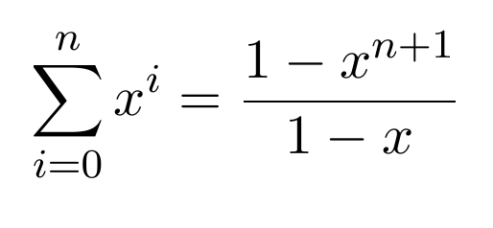
Recurrence Examples
T(n) = 2 T(n/2) + cn
O(n log n)
T(n) = T(n/2) + cn
O(n)
More useful facts:
log_{k}n = log₂n / log₂k
k ^{log n} = n ^{log k}

Slide 4
Unrolling the recurrence

Slide 5
Recursive Matrix Multiplication
Multiply 2 x 2 Matrices:
| r s | | a b| |e g|
| t u | | c d| | f h|
r = ae + bf
s = ag + bh
t = ce + df
u = cg + dh
A N x N matrix can be viewed as a 2 x 2 matrix with entries that are (N/2) x (N/2) matrices.
The recursive matrix multiplication algorithm recursively multiplies the (N/2) x (N/2) matrices and combines them using the equations for multiplying 2 x 2 matrices
=

Slide 6
Recursive Matrix Multiplication
How many recursive calls are made at each level?
How much work in combining the results?
What is the recurrence?

Slide 7
What is the run time for the recursive Matrix Multiplication Algorithm?
Recurrence:

Slide 8
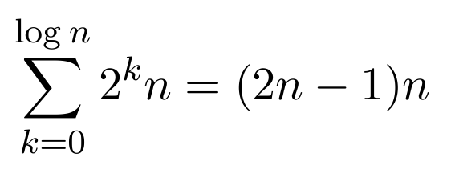
T(n) = 4T(n/2) + n
Total Work
n
n/2
n/2
n/2
n/2
n/4
n/4
n/4
n/4
n/4
n/4
n/4
n/4
n/4
n/4
n/4
n/4
n/4
n/4
n/4
n/4

Slide 9
T(n) = 2T(n/2) + n²

Slide 10
T(n) = 2T(n/2) + n^{1/2}

Slide 11
Recurrences
Three basic behaviors
Dominated by initial case
Dominated by base case
All cases equal – we care about the depth

Slide 12
What you really need to know about recurrences
Work per level changes geometrically with the level
Geometrically increasing (x > 1)
The bottom level wins
Geometrically decreasing (x < 1)
The top level wins
Balanced (x = 1)
Equal contribution

Slide 13
Classify the following recurrences (Increasing, Decreasing, Balanced)
T(n) = n + 5T(n/8)
T(n) = n + 9T(n/8)
T(n) = n² + 4T(n/2)
T(n) = n³ + 7T(n/2)
T(n) = n^{1/2} + 3T(n/4)

Slide 14
Strassen’s Algorithm
Where:
p₁ = (b – d)(f + h)
p₂= (a + d)(e + h)
p₃= (a – c)(e + g)
p₄= (a + b)h
p₅= a(g – h)
p₆= d(f – e)
p₇= (c + d)e
Multiply 2 x 2 Matrices:
| r s | | a b| |e g|
| t u| | c d| | f h|
=
r = p₁ + p₂ – p₄ + p₆
s = p₄ + p₅
t = p₆ + p₇
u = p₂ - p₃ + p₅ - p₇
From AHU 1974

Slide 15
Recurrence for Strassen’s Algorithms
T(n) = 7 T(n/2) + cn²
What is the runtime?
log₂ 7 = 2.8073549221

Slide 16
BFPRT Recurrence
T(n) <= T(3n/4) + T(n/5) + 20 n
What bound do you expect?

