Slide 1
CSE 421 Algorithms
Richard Anderson
Winter 2019
Lecture 7

Slide 2
Announcements
Reading
For today, sections 4.1, 4.2,
For Friday, sections 4.4, 4.5, 4.7, 4.8
Homework 3 is available
Random Interval Graphs

Slide 3
Highlight from last lecture: Topological Sort Algorithm
While there exists a vertex v with in-degree 0
Output vertex v
Delete the vertex v and all out going edges
3
H
1
4
2
E
I
A
6
5
D
G
12
7
J
C
9
F
10
8
K
B
L
11

Slide 4
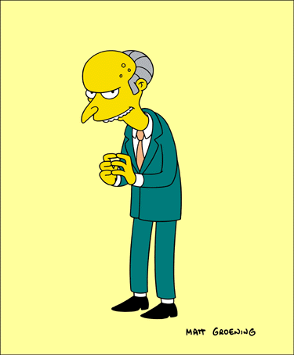
Greedy Algorithms

Slide 5
Greedy Algorithms
Solve problems with the simplest possible algorithm
The hard part: showing that something simple actually works
Pseudo-definition
An algorithm is Greedy if it builds its solution by adding elements one at a time using a simple rule

Slide 6
Scheduling Theory
Tasks
Processing requirements, release times, deadlines
Processors
Precedence constraints
Objective function
Jobs scheduled, lateness, total execution time

Slide 7
Interval Scheduling
Tasks occur at fixed times
Single processor
Maximize number of tasks completed
Tasks {1, 2, . . . N}
Start and finish times, s(i), f(i)

Slide 8
What is the largest solution?

Slide 9
Greedy Algorithm for Scheduling
Let T be the set of tasks, construct a set of independent tasks I, A is the rule determining the greedy algorithm
I = { }
While (T is not empty)
Select a task t from T by a rule A
Add t to I
Remove t and all tasks incompatible with t from T

Slide 10
Simulate the greedy algorithm for each of these heuristics
Schedule earliest starting task
Schedule shortest available task
Schedule task with fewest conflicting tasks

Slide 11
Greedy solution based on earliest finishing time
Example 1
Example 2
Example 3

Slide 12
Theorem: Earliest Finish Algorithm is Optimal
Key idea: Earliest Finish Algorithm stays ahead
Let A = {i₁, . . ., i_{k}} be the set of tasks found by EFA in increasing order of finish times
Let B = {j₁, . . ., j_{m}} be the set of tasks found by a different algorithm in increasing order of finish times
Show that for r<= min(k, m), f(i_{r}) <= f(j_{r})

Slide 13
Stay ahead lemma
A always stays ahead of B, f(i_{r}) <= f(j_{r})
Induction argument
f(i₁) <= f(j₁)
If f(i_{r-1}) <= f(j_{r-1}) then f(i_{r}) <= f(j_{r})
Since f(i_{r-1}) <= f(j_{r-1}), both i_{r} and j_{r} are available for the Earliest Finish Algorithm

Slide 14
Completing the proof
Let A = {i₁, . . ., i_{k}} be the set of tasks found by EFA in increasing order of finish times
Let O = {j₁, . . ., j_{m}} be the set of tasks found by an optimal algorithm in increasing order of finish times
If k < m, then the Earliest Finish Algorithm stopped before it ran out of tasks

Slide 15
Scheduling all intervals
Minimize number of processors to schedule all intervals

Slide 16
How many processors are needed for this example?

Slide 17
Prove that you cannot schedule this set of intervals with two processors

Slide 18
Depth: maximum number of intervals active

Slide 19
Algorithm
Sort by start times
Suppose maximum depth is d, create d slots
Schedule items in increasing order, assign each item to an open slot
Correctness proof: When we reach an item, we always have an open slot

Slide 20
What happens on “Random” sets of intervals
Given n random intervals
What is the expected number independent intervals
What is the expected depth

Slide 21
What is a random set of intervals
Method 1:
Each interval assigned random start position in [0.0, 1.0]
Each interval assigned a random length in [0.0, 1.0]
Method 2:
Start with the array [1, 1, 2, 2, 3, 3, 4, 4, 5, 5]
Randomly permute it [2, 1, 4, 2, 3, 4, 5, 1, 3, 5]
Index of the first j is the start of interval j, and the index of the second j is the end of interval j

Slide 22
Scheduling tasks
Each task has a length t_{i} and a deadline d_{i}
All tasks are available at the start
One task may be worked on at a time
All tasks must be completed
Goal minimize maximum lateness
Lateness = f_{i} – d_{i} if f_{i} >= d_{i}

Slide 23
Example
Time
Deadline
2
2
3
4
2
3
Lateness 1
3
2
Lateness 3

Slide 24
Determine the minimum lateness
Show the schedule 2, 3, 4, 5 first and compute lateness
Time
Deadline
2
6
3
4
4
5
5
12

