Slide 1
CSE 421 Algorithms
Autumn 2019
Lecture 11
Minimum Spanning Trees (Part II)

Slide 2
Interval Scheduling
What is the expected size of the maximum independent set for random intervals
What is the expected size of the maximum intersection for random intervals
Method 1: Each interval assigned a random start position and random length from [0,1]
Method 2: Random permutation of interval endpoints

Slide 3
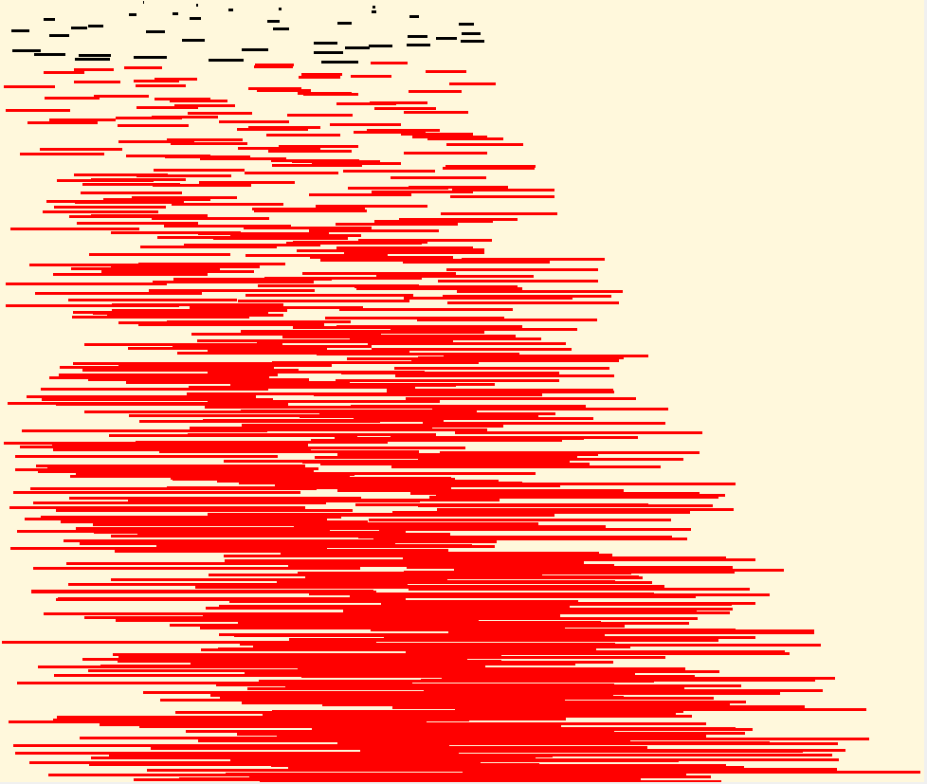
Independent Set
Maximum independent set only contains small intervals

Slide 4
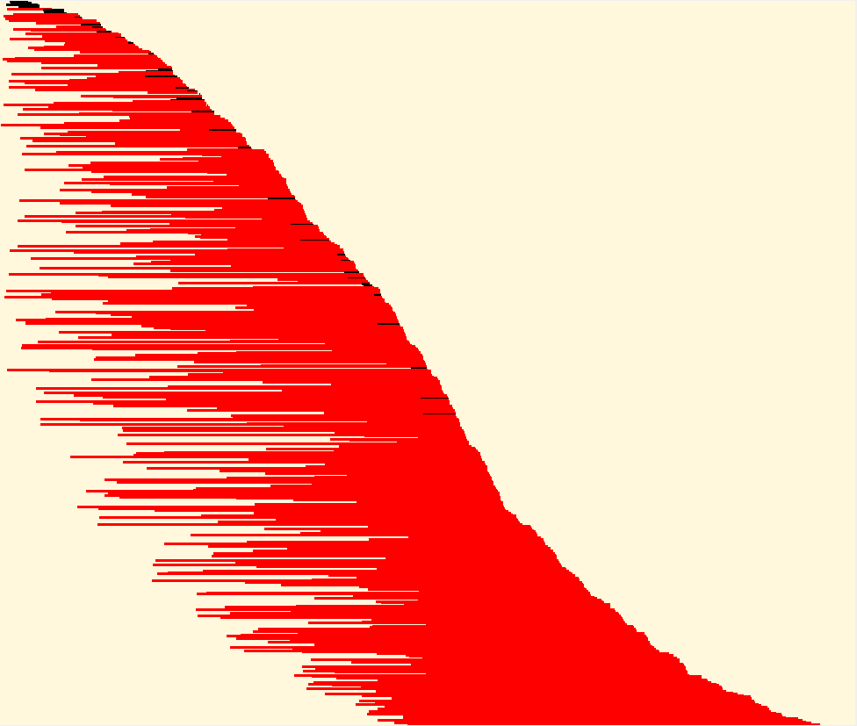
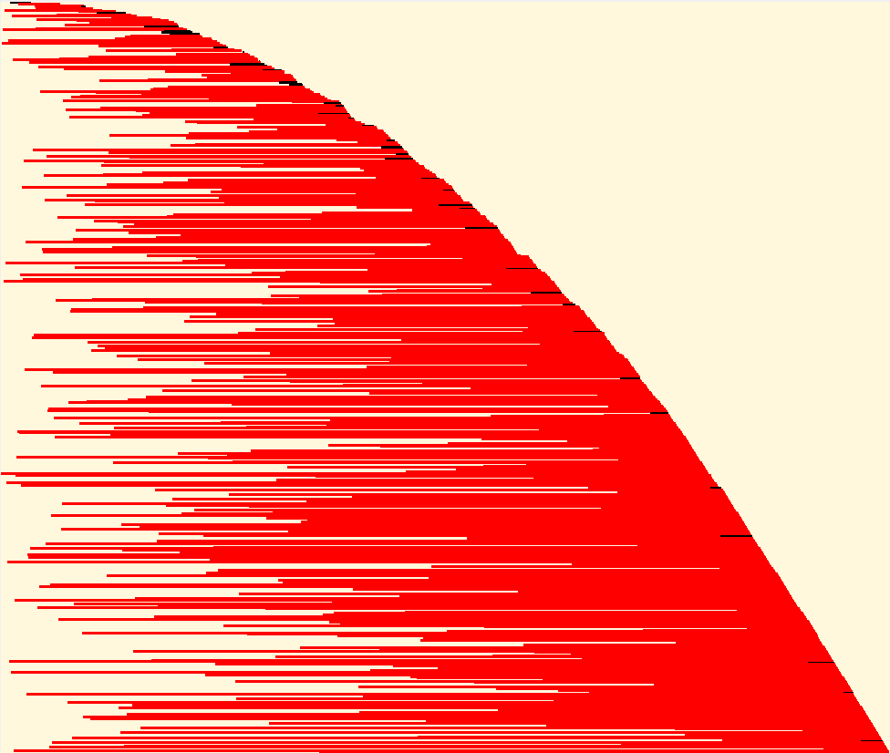
Maximum Intersection
Maximum intersection is at the middle

Slide 5
Minimum Spanning Tree
Undirected Graph G=(V,E) with edge weights
15
t
a
6
9
14
3
4
e
10
13
c
s
11
20
5
17
2
7
g
b
8
u
f
22
1
12
16
v
For simplicity, assume all edge costs are distinct

Slide 6
Greedy Algorithms for Minimum Spanning Tree
[Prim] Extend a tree by including the cheapest out going edge
[Kruskal] Add the cheapest edge that joins disjoint components
[ReverseDelete] Delete the most expensive edge that does not disconnect the graph
4
b
c
11
5
8
20
a
d
7
22
e

Slide 7
Edge inclusion lemma
Let S be a subset of V, and suppose e = (u, v) is the minimum cost edge of E, with u in S and v in V-S
e is in every minimum spanning tree of G
Or equivalently, if e is not in T, then T is not a minimum spanning tree
e
S
V - S

Slide 8
Proof
e is the minimum cost edge between S and V-S
Suppose T is a spanning tree that does not contain e
Add e to T, this creates a cycle
The cycle must have some edge e₁ = (u₁, v₁) with u₁ in S and v₁ in V-S
T₁ = T – {e₁} + {e} is a spanning tree with lower cost
Hence, T is not a minimum spanning tree
e₁
S
V - S
e

Slide 9
Optimality Proofs
Prim’s Algorithm computes a MST
Kruskal’s Algorithm computes a MST
Show that when an edge is added to the MST by Prim or Kruskal, the edge is the minimum cost edge between S and V-S for some set S.

Slide 10
Prim’s Algorithm
S = { }; T = { };
while S != V
choose the minimum cost edge e = (u,v), with u in S, and v in V-S
add e to T
add v to S

Slide 11
Prove Prim’s algorithm computes an MST
Show an edge e is in the MST when it is added to T

Slide 12
Kruskal’s Algorithm
Let C = {{v₁}, {v₂}, . . ., {v_{n}}}; T = { }
while |C| > 1
Let e = (u, v) with u in C_{i} and v in C_{j} be the minimum cost edge joining distinct sets in C
Replace C_{i} and C_{j} by C_{i} U C_{j}
Add e to T

Slide 13
Prove Kruskal’s algorithm computes an MST
Show an edge e is in the MST when it is added to T

Slide 14
Reverse-Delete Algorithm
Lemma: The most expensive edge on a cycle is never in a minimum spanning tree
e

Slide 15
Reverse-Delete Algorithm
Let e be the max cost edge whose removal does not disconnect the graph
Let T be a spanning tree of G=(V, E – {e})

Slide 16
Dealing with the assumption of no equal weight edges
Force the edge weights to be distinct
Add small quantities to the weights
Give a tie breaking rule for equal weight edges

Slide 17
Application: Clustering
Given a collection of points in an r- dimensional space and an integer K, divide the points into K sets that are closest together

Slide 18
Distance clustering
Divide the data set into K subsets to maximize the distance between any pair of sets
dist (S₁, S₂) = min {dist(x, y) | x in S₁, y in S₂}

Slide 19
Divide into 2 clusters

Slide 20
Divide into 3 clusters

Slide 21
Divide into 4 clusters

Slide 22
Distance Clustering Algorithm
Let C = {{v₁}, {v₂},. . ., {v_{n}}}; T = { }
while |C| > K
Let e = (u, v) with u in C_{i} and v in C_{j} be the minimum cost edge joining distinct sets in C
Replace C_{i} and C_{j} by C_{i} U C_{j}

Slide 23
K-clustering

Slide 24
Shortest paths in directed graphs vs undirected graphs
2
d
2
d
a
1
a
1
4
5
4
5
4
4
4
e
4
e
1
c
1
c
s
2
s
2
3
3
3
3
2
2
6
g
6
g
b
b
7
3
7
3
f
f

Slide 25
What about the minimum spanning tree of a directed graph?
Must specify the root r
Branching: Out tree with root r
2
d
2
d
1
a
1
a
5
4
5
4
4
4
4
4
e
e
1
1
c
c
r
2
r
2
3
3
3
3
2
2
6
g
6
g
b
b
3
7
3
7
f
f
Assume all vertices reachable from r
Also called an arborescence

Slide 26
Finding a minimum branching
r
r
10
2
10
2
1
4
4
2
2
2
2
8
4
4

Slide 27
Finding a minimum branching
Remove all edges going into r
Normalize the edge weights, so the minimum weight edge coming into each vertex has weight zero
7
5
2
4
0
2
This does not change the edges of the minimum branching

Slide 28
Finding a minimum branching
Consider the graph that consists of the minimum cost edge coming in to each vertex
If this graph is a branching, then it is the minimum cost branching
Otherwise, the graph contains one or more cycles
Collapse the cycles in the original graph to super vertices
Reweight the graph and repeat the process

Slide 29
Finding a minimum branching
r
r
r
r
10
2
10
8
1
6
1
2
1
4
0
0
4
2
2
0
0
2
2
8
4
4
0
0
4

Slide 30
Correctness Proof
Lemma 4.38 Let C be a cycle in G consisting of edges of cost 0 with r not in C. There is an optimal branching rooted at r that has exactly one edge entering C.
The lemma justifies using the edges of the cycle in the branching
An induction argument is used to cover the multiple levels of compressing cycles
r
0
1
0
0
0
0
0
4
0

