Slide 1
CSE 421 Algorithms
Richard Anderson
Autumn 2019
Lecture 4

Slide 2
Announcements
Guest lecturers Friday and Monday
Reading
Chapter 2.1, 2.2
Chapter 3 (Mostly review)
Start on Chapter 4
Homework Guidelines
Submit homework with Canvas
Submit problems separately
Deadline is 1:29 PM on Wednesday
Describing an algorithm
Clarity is most important
Pseudocode generally preferable to just English
But sometimes both methods combined work best
Prove that your algorithm works
A proof is a “convincing argument”
Give the run time for your algorithm
Justify that the algorithm satisfies the runtime bound
You may lose points for style
Homework assignments will (probably) be worth the same amount

Slide 3
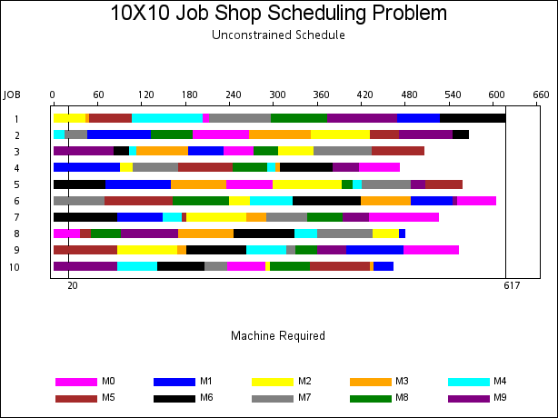
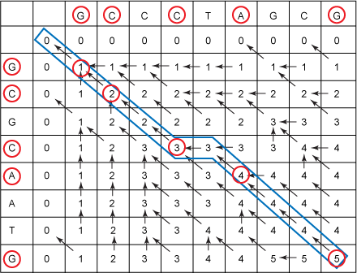
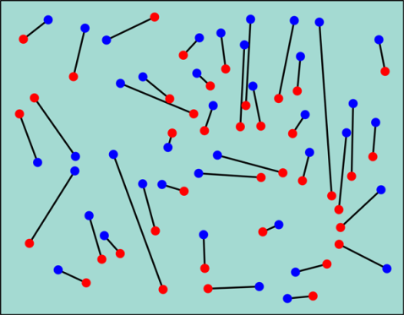
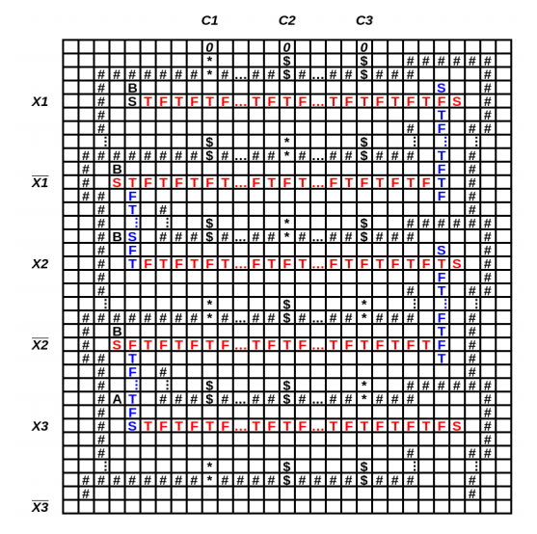
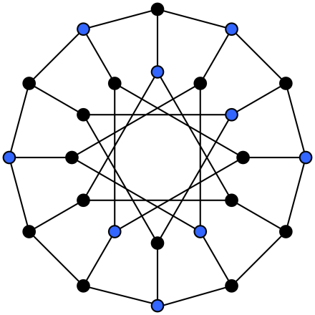
Five Problems
Scheduling
Weighted Scheduling
Bipartite Matching
Maximum Independent Set
Competitive Facility Location

Slide 4
NP-Completeness
Hard to find a solution
Easy to verify a solution once you have one
Hamiltonian circuit
Clique
Subset sum
Graph coloring

Slide 5
Are there even harder problems?
Simple game:
Players alternating selecting nodes in a graph
Score points associated with node
Remove nodes neighbors
When neither can move, player with most points wins
4
3
2
6
5
2
3
4
1
6

Slide 6
Competitive Facility Location
Choose location for a facility
Value associated with placement
Restriction on placing facilities too close together
Competitive placement of facilities
E.g., KFC and McDonald’s
P-Space complete instead of NP-Complete
Appear to be much harder
No obvious certificate
G has a Maximum Independent Set of size 10
Player 1 wins by at least 10 points

Slide 7
What does it mean for an algorithm to be efficient?

Slide 8
Definitions of efficiency
Fast in practice
Qualitatively better worst case performance than a brute force algorithm

Slide 9
Polynomial time efficiency
An algorithm is efficient if it has a polynomial run time
Run time as a function of problem size
Run time: count number of instructions executed on an underlying model of computation
T(n): maximum run time for all problems of size at most n

Slide 10
Polynomial Time
Algorithms with polynomial run time have the property that increasing the problem size by a constant factor increases the run time by at most a constant factor (depending on the algorithm)

Slide 11
Why Polynomial Time?
Generally, polynomial time seems to capture the algorithms which are efficient in practice
The class of polynomial time algorithms has many good, mathematical properties

Slide 12
Polynomial vs. Exponential Complexity
Suppose you have an algorithm which takes n! steps on a problem of size n
If the algorithm takes one second for a problem of size 10, estimate the run time for the following problems sizes:
12 14 16 18 20
10: 1 second
12: 2 minutes
14: 6 hours
16: 2 months
18: 50 years
20: 20K years

Slide 13
Ignoring constant factors
Express run time as O(f(n))
Emphasize algorithms with slower growth rates
Fundamental idea in the study of algorithms
Basis of Tarjan/Hopcroft Turing Award

Slide 14
Why ignore constant factors?
Constant factors are arbitrary
Depend on the implementation
Depend on the details of the model
Determining the constant factors is tedious and provides little insight

Slide 15
Why emphasize growth rates?
The algorithm with the lower growth rate will be faster for all but a finite number of cases
Performance is most important for larger problem size
As memory prices continue to fall, bigger problem sizes become feasible
Improving growth rate often requires new techniques

Slide 16
Formalizing growth rates
T(n) is O(f(n)) [T : Z⁺ → R⁺]
If n is sufficiently large, T(n) is bounded by a constant multiple of f(n)
Exist c, n₀, such that for n > n₀, T(n) < c f(n)
T(n) is O(f(n)) will be written as: T(n) = O(f(n))
Be careful with this notation

Slide 17
Prove 3n² + 5n + 20 is O(n²)
Let c =
Let n₀ =
Choose c = 6, n₀ = 5
T(n) is O(f(n)) if there exist c, n₀, such that for n > n₀, T(n) < c f(n)

Slide 18
Order the following functions in increasing order by their growth rate
n log⁴n
2n² + 10n
2^{n/100}
1000n + log⁸ n
n¹⁰⁰
3^{n}
1000 log¹⁰n
n^{1/2}

Slide 19
Lower bounds
T(n) is Ω(f(n))
T(n) is at least a constant multiple of f(n)
There exists an n₀, and ε > 0 such that T(n) > εf(n) for all n > n₀
Warning: definitions of Ω vary
T(n) is Θ(f(n)) if T(n) is O(f(n)) and T(n) is Ω(f(n))

Slide 20
Useful Theorems
If lim (f(n) / g(n)) = c for c > 0 then f(n) = Θ(g(n))
If f(n) is O(g(n)) and g(n) is O(h(n)) then f(n) is O(h(n))
If f(n) is O(h(n)) and g(n) is O(h(n)) then f(n) + g(n) is O(h(n))

Slide 21
Ordering growth rates
For b > 1 and x > 0
log^{b}n is O(n^{x})
For r > 1 and d > 0
n^{d} is O(r^{n})

