Slide 1
CSE 421
Greedy Algorithms / Dijkstra’s Algorithm
Yin Tat Lee

Slide 2
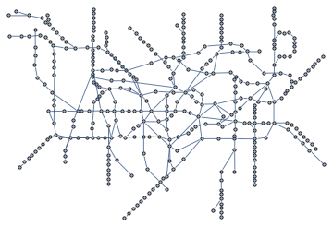
Single Source Shortest Path
Given an (un)directed graph $G=(V,E)$ with non-negative
edge weights $c_{e}≥0$ and a start vertex $s$.
Find length of shortest paths from $s$ to each vertex in $G$
$$s$$

Slide 3
Dijkstra($G,c,s$) {
Initialize set of explored nodes $S←\{s\}$
// Maintain distance from $s$ to each vertices in $S$
$d\left[s\right]←0$
while ($S≠V$)
{
Pick an edge $(u,v)$ such that $u∈S$ and $v∉S$ and
$d[u]+c_{(u,v)}$ is as small as possible.
Add $v$ to $S$ and define $d[v]=d[u]+c_{(u,v)}$.
$Parent\left(v\right)←u$.
}

Slide 4
Dijkstra’s Algorithm: Example
s
0
2
4
∞
5
∞
7
∞
3
1
4
∞
6
3
5
∞
∞
∞
8
1
9
8
∞
∞
∞
4
∞
5
2
10
∞

Slide 5
Dijkstra’s Algorithm: Example
s
0
2
4
2
5
4
7
∞
3
1
4
∞
6
3
5
∞
∞
∞
8
1
9
8
∞
∞
∞
4
∞
5
2
10
∞

Slide 6
Dijkstra’s Algorithm: Example
s
0
2
4
2
5
4
7
∞
3
1
4
∞
6
3
5
∞
∞
∞
8
1
9
8
∞
∞
∞
4
∞
5
2
10
∞

Slide 7
Dijkstra’s Algorithm: Example
s
0
2
4
2
5
4
7
9
3
1
4
∞
6
3
5
∞
∞
∞
8
1
9
8
∞
∞
∞
4
∞
5
2
10
∞

Slide 8
Dijkstra’s Algorithm: Example
s
0
2
4
2
5
4
7
9
3
1
4
∞
6
3
5
∞
∞
∞
8
1
9
8
∞
∞
∞
4
∞
5
2
10
∞

Slide 9
Dijkstra’s Algorithm: Example
s
0
2
4
2
5
4
7
9
3
1
4
7
6
3
5
5
∞
8
8
1
9
8
∞
∞
∞
4
∞
5
2
10
∞

Slide 10
Dijkstra’s Algorithm: Example
s
0
2
4
2
5
4
7
9
3
1
4
7
6
3
5
5
∞
8
8
1
9
8
∞
∞
∞
4
∞
5
2
10
∞

Slide 11
Dijkstra’s Algorithm: Example
s
0
2
4
2
5
4
7
9
3
1
4
7
6
3
5
5
∞
8
8
1
9
8
13
∞
∞
4
∞
5
2
10
∞

Slide 12
Dijkstra’s Algorithm: Example
s
0
2
4
2
5
4
7
9
3
1
4
7
6
3
5
5
∞
8
8
1
9
8
13
∞
∞
4
∞
5
2
10
∞

Slide 13
Dijkstra’s Algorithm: Example
s
0
2
4
2
5
4
7
9
3
1
4
7
6
3
5
5
∞
8
8
1
9
8
13
∞
∞
4
∞
5
2
10
∞

Slide 14
Dijkstra’s Algorithm: Example
s
0
2
4
2
5
4
7
9
3
1
4
7
6
3
5
5
∞
8
8
1
9
8
13
∞
16
4
∞
5
2
10
∞

Slide 15
Dijkstra’s Algorithm: Example
s
0
2
4
2
5
4
7
9
3
1
4
7
6
3
5
5
∞
8
8
1
9
8
13
∞
16
4
∞
5
2
10
∞

Slide 16
Dijkstra’s Algorithm: Example
s
0
2
4
2
5
4
7
9
3
1
4
7
6
3
5
5
15
8
8
1
9
8
13
∞
16
4
10
5
2
10
∞

Slide 17
Dijkstra’s Algorithm: Example
s
0
2
4
2
5
4
7
9
3
1
4
7
6
3
5
5
15
8
8
1
9
8
13
∞
16
4
10
5
2
10
∞

Slide 18
Dijkstra’s Algorithm: Example
s
0
2
4
2
5
4
7
9
3
1
4
7
6
3
5
5
15
8
8
1
9
8
13
14
16
4
10
5
2
10
20

Slide 19
Dijkstra’s Algorithm: Example
s
0
2
4
2
5
4
7
9
3
1
4
7
6
3
5
5
15
8
8
1
9
8
13
14
16
4
10
5
2
10
20

Slide 20
Dijkstra’s Algorithm: Example
s
0
2
4
2
5
4
7
9
3
1
4
7
6
3
5
5
15
8
8
1
9
8
13
14
16
4
10
5
2
10
19

Slide 21
Dijkstra’s Algorithm: Example
s
0
2
4
2
5
4
7
9
3
1
4
7
6
3
5
5
15
8
8
1
9
8
13
14
16
4
10
5
2
10
19

Slide 22
Dijkstra’s Algorithm: Example
s
0
2
4
2
5
4
7
9
3
1
4
7
6
3
5
5
15
8
8
1
9
8
13
14
16
4
10
5
2
10
18

Slide 23
Dijkstra’s Algorithm: Example
s
0
2
4
2
5
4
7
9
3
1
4
7
6
3
5
5
15
8
8
1
9
8
13
14
16
4
10
5
2
10
Dijkstra’s Algorithm outputs a tree.
18

Slide 24
Disjkstra’s Algorithm: Correctness
Theorem: For any $u∈S$, the path $P_{u}$ on the tree in the shortest path from $s$ to $u$ on $G$. (For all $u∈S,d\left(u\right)=dist(s,u)$.)
Proof: Induction on $\left|S\right|=k$.
Base Case: This is always true when $S=\left\{s\right\}.$
Inductive Step: Say $v$ is the ${\left(k+1\right)}^{st}$ vertex that we add to S.
Let $(u,v)$ be last edge on $P_{v}.$
If $P_{v}$ is not the shortest path, there is a shorter path $P$ to $S$.
Consider the first time that $P$ leaves $S$ with edge $(x,y)$.
So, $c\left(P\right)≥d\left(x\right)+c_{x,y}≥d\left(u\right)+c_{u,v}=d\left(v\right)=c\left(P_{v}\right).$
A contradiction.
S
y
$P$ is the shorter path.
Due to the choice of $v$
s
$$P$$
x
u
v
$$P_{v}$$

Slide 25
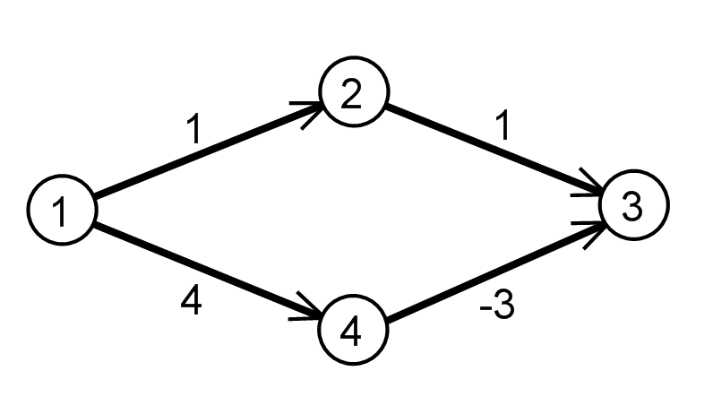
Remarks on Dijkstra’s Algorithm
Algorithm works on directed graph (with nonnegative weights)
Algorithm produces a tree of shortest paths to $s$ following Parent links (for undirected graph)
The algorithm fails with negative edge weights.
e.g., some airline tickets
Why does it fail?
Dijkstra’s algorithm is similar to BFS:
Substitute every edge with $c_{e}=k$ with a path of length k, then run BFS.

Slide 26
Implementing Dijkstra’s Algorithm
Priority Queue: Elements each with an associated key Operations
Insert
Find-min
Return the element with the smallest key
Delete-min
Return the element with the smallest key and delete it from the data structure
Decrease-key
Decrease the key value of some element
Implementations
Arrays:
$O(n)$ time find/delete-min,
$O(1)$ time insert/decrease key
Binary Heaps:
$O(log⁡n)$ time insert/decrease-key/delete-min,
$O(1)$ time find-min
Fibonacci heap:
$O(1)$ time insert/decrease-key
$O(log⁡n)$ delete-min
O(1) time find-min
Read wiki!

Slide 27
Dijkstra($G,c,s$) {
Initialize set of explored nodes $S←\{s\}$
// Maintain distance from $s$ to each vertices in $S$
$d\left[s\right]←0$
Insert all neighbors $v$ of s into a priority queue with value $c_{(s,v)}$.
while ($S≠V$)
{
// Pick an edge $(u,v)$ such that $u∈S$ and $v∉S$ and
// $d[u]+c_{(u,v)}$ is as small as possible.
u ← delete min element from $Q$
Add $v$ to $S$ and define $d[v]=d[u]+c_{(u,v)}$.
$Parent\left(v\right)←u$.
foreach (edge $e=(v,w)$ incident to $v$)
if ($w∉ S$)
if ($w$ is not in the $Q$)
Insert $w$ into $Q$ with value $d\left[v\right]+c_{(v,w)}$
else (the key of $w$ > $d\left[v\right]+c_{(v,w)}$)
Decrease key of $v$ to $d[v]+c_{(v,w)}$.
}
$O(n)$ of insert,
each in $O(1)$
$O(n)$ of delete min,
each in $O(log⁡n)$
$O(m)$ of decrease/insert key,
each runs in $O(1)$

Slide 28
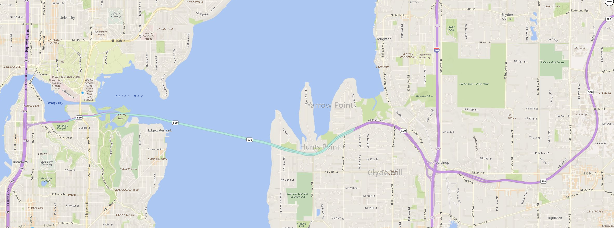
How does Bing Maps work?
Continent-sized road networks have 10s of millions intersections.
Dijkstra’s algorithm: few seconds.
How do you go from UW to Microsoft?
For a region, there is a small set of nodes such that all sufficiently long shortest paths out of the region pass a node in the set
UW
Microsoft
This slide modified slides from A.V. Goldberg (a former MSR researcher)

Slide 29
Transit Node (TN) Algorithm
Basic concepts
divide a map into regions (a few thousand)
for each region, optimal paths to far away places pass
through one of a small number of access nodes (≈ 10 on the average)
the union of access nodes is the set of transit nodes (≈ 10 000)
Empirical observation: small number of access/transit nodes
Preprocessing algorithm
find access nodes for every region
connect each vertex to its access nodes
compute all pairs of shortest paths between transit nodes

Slide 30
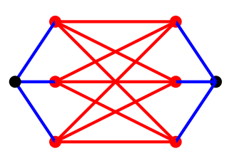
Transit Node (TN) Algorithm
The algorithm:
If the query $(s,t)$ is far away, the shortest path is of the form
$$s−access\left(s\right)−access\left(t\right)−t$$
We can create a table look-up for $(access\left(s\right),access\left(t\right))$ pairs.
If the query $(s,t)$ is close, you can do say use Dijkstra.
The precise algorithm is much more complicated.
It can find $s−t$ shortest path in $<300$ ns instead of $>1$ sec!

