Slide 1
CSE 421: Introduction to Algorithms
Complexity
Yin-Tat Lee

Slide 2
Defining Efficiency
“Runs fast on typical real problem instances”
Pros:
Sensible,
Bottom-line oriented
Cons:
Moving target (diff computers, programming languages)
Highly subjective (how fast is “fast”? What is “typical”?)

Slide 3
Measuring Efficiency
Time ≈ # of instructions executed in a simple programming language
only simple operations (+,*,-,=,if,call,…)
each operation takes one time step
each memory access takes one time step
no fancy stuff (add these two matrices, copy this long string,…) built in

Slide 4
Time Complexity
Problem: An algorithm can have different running time on different inputs
Solution: The complexity of an algorithm associates a number T(N), the “time” the algorithm takes on problem size N.
Mathematically,
T is a function that maps positive integers giving problem size to positive integers giving number of steps
On which inputs of size N?

Slide 5
Time Complexity (N)
Worst Case Complexity: max # steps algorithm takes on any input of size N
Average Case Complexity: avg # steps algorithm takes on inputs of size N
Best Case Complexity: min # steps algorithm takes on any input of size N
This Couse

Slide 6
Time Complexity on Worst Case Inputs
T(N)
$$2N log2N$$
Time
$$N \log_{2}N$$
Problem size N

Slide 7
O-Notation
Given two positive functions f and g
f(N) is O(g(N)) iff there is a constant c>0 s.t., f(N) is eventually always ≤ c g(N)
f(N) is Ω(g(N)) iff there is a constant ε>0 s.t.,
f(N) is ≥ ε g(N) for infinitely
f(N) is Θ(g(N)) iff there are constants c₁, c₂>0 so that eventually always c₁g(N) ≤ f(N) ≤ c₂g(N)

Slide 8
Asymptotic Bounds for common fns
Polynomials:
$a_{0}+a_{1}n+…+a_{d}n^{d}$ is $O\left(n^{d}\right)$
Logarithms:
$\log_{a}{n}=O(\log_{b}{n)}$ for all constants $a,b>0$
Logarithms: log grows slower than every polynomial
For all $x>0$, $\log{n=O(n^{k})}$
$n\log{n}=O\left(n^{1.01}\right)$

Slide 9
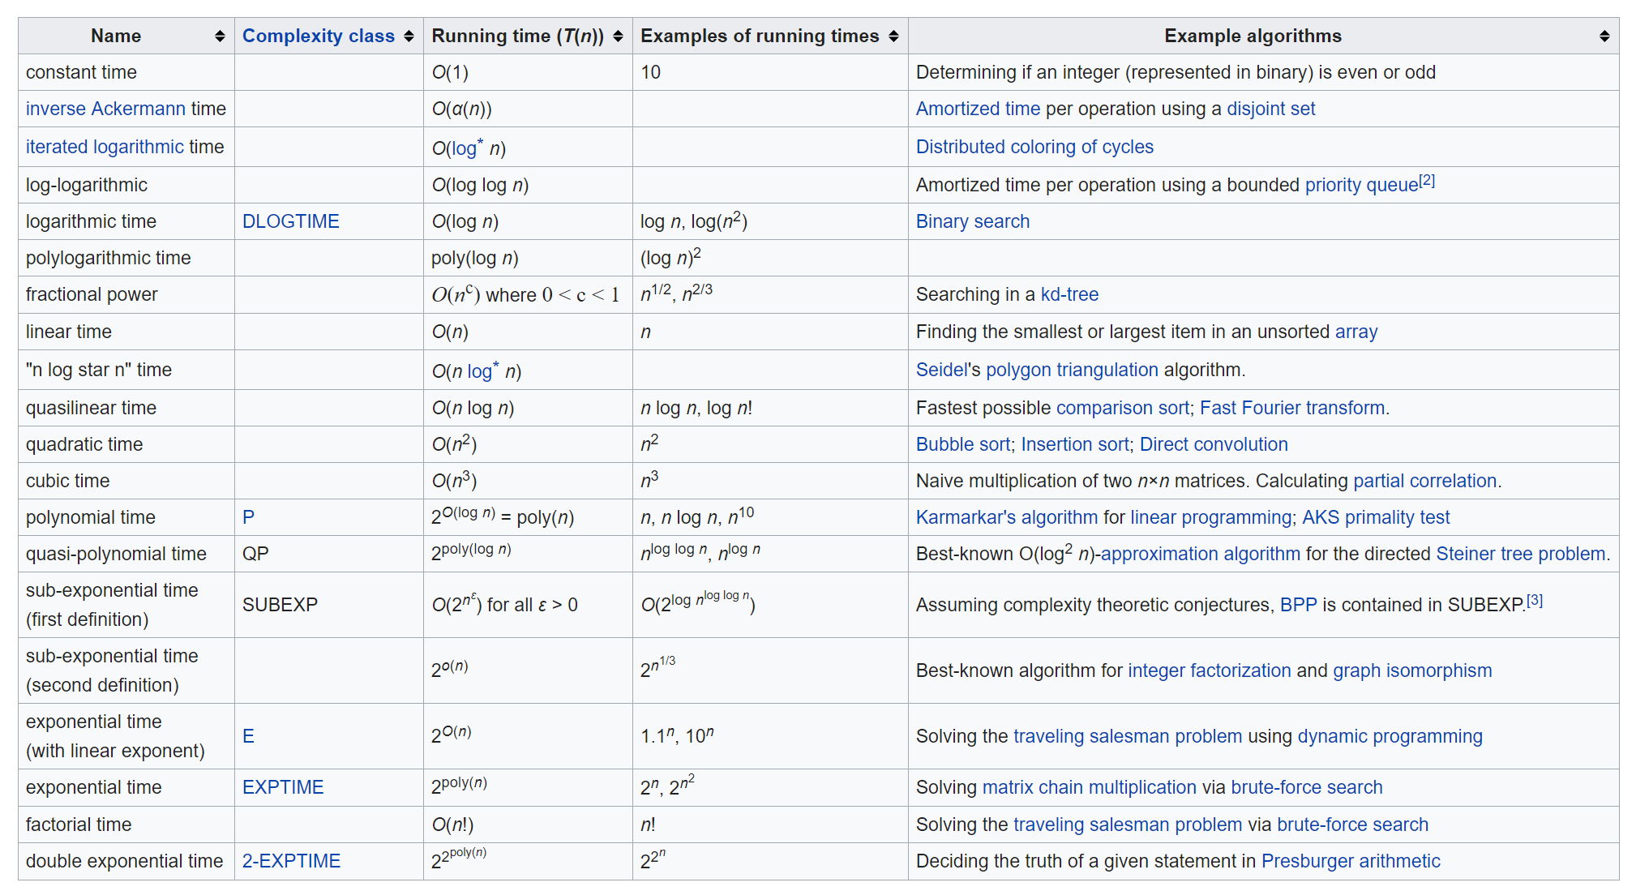
Running Time
An algorithm runs in polynomial time if $T\left(n\right)=n^{O(1)}$.
Equivalently, $T\left(n\right)=n^{d}$ for some constant d.
Stable matching!

Slide 10
Why it matters?
Suppose we can do 1 million operations per second.
not only get very big, but do so abruptly, which likely yields erratic performance on small instances
Outdated: Nvidia announced a “computer” this Tue that do 2 quadrillion ($2×{10}^{15}$) operations/sec.
It brings down the 31,710 years to 500 sec.
However, $2^{100}$ operations still takes millions of years.
Notes:
Unfortunately, it cost 400,000 dollar (2018).

Slide 11
Why “Polynomial”?
Point is not that n²⁰⁰⁰ is a practical bound, or that the differences among n and 2n and n² are negligible.
Rather, simple theoretical tools may not easily capture such differences, whereas exponentials are qualitatively different from polynomials, so more amenable to theoretical analysis.
“My problem is in P” is a starting point for a more detailed analysis
“My problem is not in P” may suggest that you need to shift to a more tractable variant

Slide 12
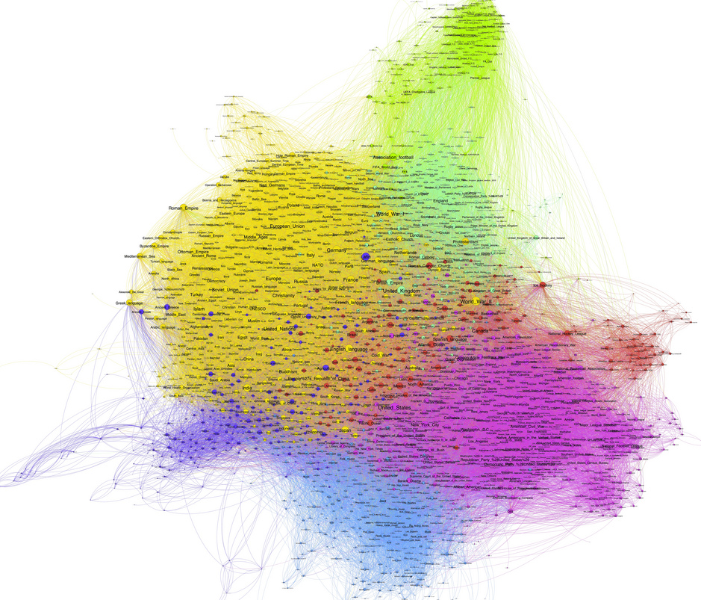
Graphs

Slide 13
Undirected Graphs G=(V,E)
A
2
10
3
Disconnected graph
11
12
4
8
Multi edges
13
B
9
Isolated vertices
6
Self loop
7

Slide 14
Graphs don’t Live in Flat Land
Geometrical drawing is mentally convenient, but mathematically irrelevant:
4 drawings of a single graph:
A
7
4
3
A
A
4
7
7
4
7
4
3
A
3
3

Slide 15
Directed Graphs
1
2
10
3
self loop
11
12
4
8
13
5
9
Multi edge
6
7

Slide 16
Terminology
Degree of a vertex: # edges that touch that vertex
deg(6)=3
Connected: Graph is connected if there is a path between every two vertices
Connected component: Maximal set of connected vertices
3
5
4
1
6
2
7
10

Slide 17
Terminology (cont’d)
Path: A sequence of distinct vertices
s.t. each vertex is connected
to the next vertex with an edge
Cycle: Path of length > 2 that has
the same start and end
Tree: A connected graph with no cycles
3
5
6
4
1
2
10
1
2
5
4
3
6

Slide 18
Degree Sum
Claim: In any undirected graph, the number of edges is equal to $\left(1/2\right)\sum_{vertex v}{deg⁡(v)}$
Pf: $\sum_{vertex v}{deg⁡(v)}$ counts every edge of the graph exactly twice; once from each end of the edge.
3
5
4
1
6
2
|E|=8
$$\sum_{vertex v}{\deg\left(v\right)=2+2+1+1+3+2+3+2=16}$$
7
10

Slide 19
Odd Degree Vertices
Claim: In any undirected graph, the number of odd degree vertices is even
Pf: In previous claim we showed sum of all vertex degrees is even. So there must be even number of odd degree vertices, because sum of odd number of odd numbers is odd.
3
5
4
1
6
2
4 odd degree vertices
3, 4, 5, 6
7
10

Slide 20
#edges
Let $G=(V,E)$ be a graph with $n=|V|$ vertices and $m=\left|E\right|$ edges.
Claim: $0≤m≤\left({n \atop 2}\right)=\frac{n\left(n−1\right)}{2}=O(n^{2})$
Pf: Since every edge connects two distinct vertices (i.e., G has no loops)
and no two edges connect the same pair of vertices (i.e., G has no multi-edges)
It has at most $\left({n \atop 2}\right)$ edges.

