Slide 1
CSE 421
NP-Completeness / Linear Programs
Yin Tat Lee

Slide 2
Fixing some mistake.
Thm. Max cardinality matching in G = value of max flow in H.
Proof. (matching val $≥$ maxflow val) Let $f$ be a max flow in $H$ of value $k$.
Integrality theorem ⇒ $k$ is integral and we can assume $f$ is 0-1.
Consider $M$ = set of edges from $X$ to $Y$ with $f\left(e\right)=1$.
each node in $X$ and $Y$ participates in at most one edge in $M$.
$|M|=k$ because the flow from $s∪X$ to $Y∪t$ equals to the flow value $k$.
G
1
$$∞$$
1'
1
1'
H
1
2
2'
1
2
2'
s
3
3'
t
3
3'
4
4'
4
4'
5
5'
5
5'

Slide 3
Decision Problems
A decision problem is a computational problem where the answer is just yes/no.
We can define a problem by a set $X$.
The answer for the input $s$ is YES iff $s∈X$.
Certifier: Algorithm C(x, t) is a certifier for problem A if
$s∈X$ if and only if (There is a $t$ such that $C\left(x,t\right)=YES$))
NP: Set of all decision problems for which there exists a poly-time certifier.
Co-NP: $X∈NP$ if and only if $\overline{X}∈co−NP$.

Slide 4
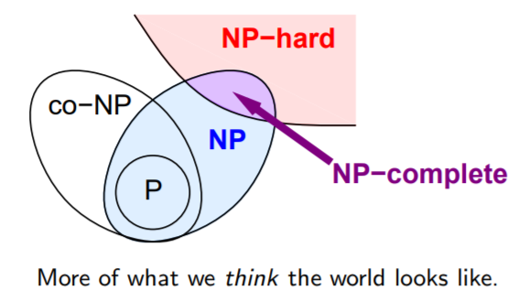
NP Completeness
Complexity Theorists Approach: We don’t know how to prove any problem in NP is hard. So, let’s find hardest problems in NP.
NP-hard: A problem B is NP-hard iff for any problem $A∈NP$, we have $A≤_{p}B$
NP-Completeness: A problem B is NP-complete iff B is NP-hard and $B∈NP$.
Motivations:
If $P≠NP,$ then every NP-Complete problems is not in P. So, we shouldn’t try to design Polytime algorithms
To show $P=NP$, it is enough to design a polynomial time algorithm for just one NP-complete problem.

Slide 5
Cook-Levin Theorem
Theorem (Cook 71, Levin 73): 3-SAT is NP-complete, i.e., for all problems $A∈NP,$ $A≤_{p}$ 3-SAT.
(See CSE 431 for the proof)
So, 3-SAT is the hardest problem in NP.
What does this say about other problems of interest? Like Independent set, Vertex Cover, …
Fact: If $A≤_{p}B$ and $B≤_{p}C$ then, $A≤_{p}C$
Pf idea: Just compose the reductions from A to B and B to C
So, if we prove 3-SAT $≤_{p}$ Independent set, then Independent Set, Clique, Vertex cover, Set cover are all NP-complete
3-SAT $≤_{p}$ Independent Set $≤_{p}$ Vertex Cover $≤_{p}$ Set Cover

Slide 6
3-SAT $≤_{p}$ Independent Set
Map a 3-CNF to (G,k). Say k is number of clauses
Create a vertex for each literal
Joint two literals if
They belong to the same clause (blue edges)
The literals are negations, e.g., $x_{i}, \overline{x_{i}}$ (red edges)
Set k be the # of clauses.
$$\left(x_{1}∨\overline{x_{3}}∨x4\right)∧\left( x_{2}∨\overline{x_{4}}∨x3\right)∧\left( x_{2}∨ \overline{x_{1}}∨x3\right)$$
$$x_{1}$$
$$x_{2}$$
$$x_{2}$$
Polynomial-Time Reduction
$$\overline{x_{3}}$$
$$\overline{x_{4}}$$
$$\overline{x_{1}}$$
$$x_{4}$$
$$x_{3}$$
$$x_{3}$$

Slide 7
Correctness of 3-SAT $≤_{p}$ Indep Set
F satisfiable => An independent of size k
Given a satisfying assignment, Choose one node from each clause where the literal is satisfied
$$\left(x_{1}∨\overline{x_{3}}∨x_{4}\right)∧\left(x_{2}∨\overline{x_{4}}∨x_{3}\right)∧\left(x_{2}∨\overline{x_{1}}∨x_{3}\right)$$
Satisfying assignment: $x_{1}=T,x_{2}=F,x_{3}=T,x_{4}=F$
S has exactly one node per clause => No blue edges between S
S follows a truth-assignment => No red edges between S
S has one node per clause => |S|=k
$$x_{1}$$
$$x_{2}$$
$$x_{2}$$
$$\overline{x_{3}}$$
$$\overline{x_{4}}$$
$$\overline{x_{1}}$$
$$x_{4}$$
$$x_{3}$$
$$x_{3}$$

Slide 8
Correctness of 3-SAT $≤_{p}$ Indep Set
An independent set of size k => A satisfying assignment
Given an independent set S of size k.
S has exactly one vertex per clause (because of blue edges)
S does not have $x_{i},\overline{x_{i}}$ (because of red edges)
So, S gives a satisfying assignment
Satisfying assignment: $x_{1}=F,x_{2}=?,x_{3}=T,x_{4}=T$
$$\left(x_{1}∨\overline{x_{3}}∨x_{4}\right)∧\left(x_{2}∨\overline{x_{4}}∨x_{3}\right)∧\left(x_{2}∨\overline{x_{1}}∨x_{3}\right)$$
$$x_{1}$$
$$x_{2}$$
$$x_{2}$$
$$\overline{x_{3}}$$
$$\overline{x_{4}}$$
$$\overline{x_{1}}$$
$$x_{4}$$
$$x_{3}$$
$$x_{3}$$

Slide 9
Summary
If a problem is NP-hard it does not mean that all instances are hared, e.g., Vertex-cover has a polynomial-time algorithm in trees
We learned the crucial idea of polynomial-time reduction. This can be even used in algorithm design, e.g., we know how to solve max-flow so we reduce image segmentation to max-flow
NP-Complete problems are the hardest problem in NP
NP-hard problems may not necessarily belong to NP.
Polynomial-time reductions are transitive relations

Slide 10
Linear Programming

Slide 11
Linear System of Equations
In high school we learn Gaussian elimination algorithm to solve a system of linear equations
$$x_{1}+x_{3}=7 \\ 2x_{2}+x_{1}=5 \\ 3x_{1}+7x_{2}−x_{3}=1$$
We set $x_{3}=7−x_{1}$ and we substitute in the following equations.
Then we substitute $x_{2}=\frac{{5−x}_{1}}{2}$ in to the third equations.
The third equational uniquely defines $x_{1}$

Slide 12
Linear Programming
Optimize a linear function subject to linear inequalities
$$\max{ 3x_{1}+4x_{3}} \\ s.t., { x}_{1}+x_{2}≤5 \\ { x}_{3}−x_{1}=4 \\ x_{3}−x_{2}≥−5 \\ x_{1},x_{2},x_{3}≥0$$
We can have inequalities,
We can have a linear objective functions

Slide 13
Applications of Linear Programming
Generalizes: Ax=b, 2-person zero-sum games, shortest path, max-flow, matching, multicommodity flow, MST, min weighted arborescence, …
Why significant?
We can solve linear programming in polynomial time.
We can model many practical problems with a linear model and solve it with linear programming
Linear Programming in Practice:
There are very fast implementations: CPLEX, Gorubi, ….
CPLEX can solve LPs with millions of variables/constraints in seconds

Slide 14
Example 1: Diet Problem
Suppose you want to schedule a diet for yourself. There are four category of food: veggies, meat, fruits, and dairy. Each category has its own (p)rice, (c)alories and (h)appiness per pound:
Linear Modeling: Consider a linear model: If we eat 0.5lb of meat an 0.2lb of fruits we will be $0.5{ h}_{m}+0.2 h_{f}$ happy
You should eat 1500 calories to be healthy
You can spend 20 dollars a day on food.
Goal: Maximize happiness?
 | veggies | meat | fruits | dairy
price | $$p_{v}$$ | $$p_{m}$$ | $$p_{f}$$ | $$p_{d}$$
calorie | $$c_{v}$$ | $$c_{m}$$ | $$c_{f}$$ | $$c_{d}$$
happiness | $$h_{v}$$ | $$h_{m}$$ | $$h_{f}$$ | $$h_{d}$$

Slide 15
Diet Problem by LP
You should eat 1500 calaroies to be healthy
You can spend 20 dollars a day on food.
Goal: Maximize happiness?
 | veggies | meat | fruits | dairy
price | $$p_{v}$$ | $$p_{m}$$ | $$p_{f}$$ | $$p_{d}$$
calorie | $$c_{v}$$ | $$c_{m}$$ | $$c_{f}$$ | $$c_{d}$$
happiness | $$h_{v}$$ | $$h_{m}$$ | $$h_{f}$$ | $$h_{d}$$
$$\max{ x_{v}h_{v}+x_{m}h_{m}+x_{f}h_{f}+x_{d}h_{d}} \\ s.t. x_{v}p_{v}+x_{m}p_{m}+x_{f}p_{f}+x_{d}p_{d}≤20 \\ x_{v}c_{v}+x_{m}c_{m}+x_{f}c_{f}+x_{d}c_{d}≤1500 \\ x_{v},x_{m},x_{f},x_{d}≥0$$
#pounds of veggies, meat, fruits, dairy to eat per day

Slide 16
How to Design an LP?
Define the set of variables
Put constraints on your variables,
should they be nonnegative?
Write down the constraints
If a constraint is not linear try to approximate it with a linear constraint
Write down the objective function
If it is not linear approximation with a linear function
Decide if it is a minimize/maximization problem

Slide 17
Example 2: Max Flow
Define the set of variables
For every edge $e$ let $x_{e}$ be the flow on the edge $e$
Put constraints on your variables
$x_{e}≥0$ for all edge e (The flow is nonnegative)
Write down the constraints
$x_{e}≤c(e)$ for every edge e, (Capacity constraints)
$\sum_{e out of v}{x_{e}}=\sum_{e in to v}{x_{e}}$ $∀v≠s,t$ (Conservation constraints)
Write down the objective function
$\sum_{e out of s}{x_{e}}$
Decide if it is a minimize/maximization problem
max

Slide 18
Example 2: Max Flow
$$\max{ \sum_{e out of s}{x_{e}}} \\ s.t. \sum_{e out of v}{x_{e}=\sum_{e in to v}{x_{e}}} ∀v≠s,t$$
$$x_{e}≤c\left(e\right) ∀e$$
$$x_{e}≥0 ∀e$$

Slide 19
Example 3: Min Cost Max Flow
Suppose we can route 100 gallons of water from $s$ to $t.$
But for every pipe edge $e$ we have to pay $p\left(e\right)$
for each gallon of water that we send through $e.$
Goal: Send 100 gallons of water from $s$ to $t$ with minimum possible cost
$$\min{ \sum_{e∈E}{{p\left(e\right)⋅x}_{e}}} \\ s.t. \sum_{e out of v}{x_{e}=\sum_{e in to v}{x_{e}}} ∀v≠s,t \\ \sum_{e out of s}{x_{e}=100}$$
$$x_{e}≤c\left(e\right) ∀e$$
$$x_{e}≥0 ∀e$$

Slide 20
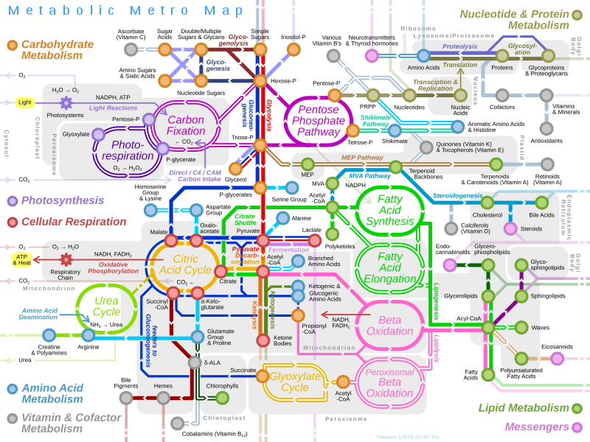
Example 4: Metabolic Network
Let $v_{i}$ are the rate of different chemical reaction in your body.
It satisfies mass conversation (translate to linear inequality).
It satisfies some upper and lower bound.
Optimizing certain function in your body is corresponding to solving a linear program!
How you find that LP? DNA!
https://vmh.uni.lu/#reconmap
Disclaimer: I suspect your biology is better than mine.

Slide 21
Summary (Linear Programming)
Linear programming is one of the biggest advances in 20th century
It is being used in many areas of science: Mechanics, Physics, Operations Research, and in CS: AI, Machine Learning, Theory, …
Almost all problems that we talked can be solved with LPs, Why not use LPs?
In some sense, current fastest algorithm for maxflow is based on LP!
Maybe one day, I need to rewrite CSE 421.
But still need to wait for a test of time.
There is rich theory of LP-duality which generalizes max-flow min-cut theorem
Up to now, the current asymptotically fastest algorithm is by me. Feel free to beat it.

Slide 22
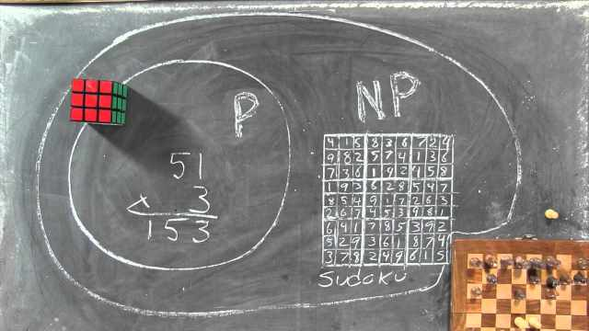
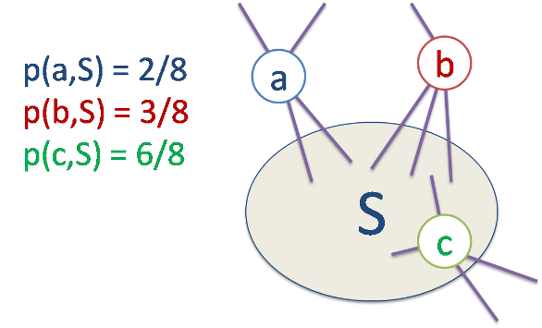
What is next?
CSE 431 (Complexity Course)
How to prove lower bounds on algorithms?
CSE 521 (Graduate Algorithms Course)
How to design streaming algorithms?
How to design algorithms for high dimensional data?
How to use matrices/eigenvalues/eigenvectors to design algorithms
How to use LPs to design algorithms?
CSE 525 (Graduate Randomized Algorithms Course)
How to use randomization to design algorithms?
How to use Markov Chains to design algorithms?
CSE ??? (Graduate Convex Optimization)
A new course by me next winter ☺

