Slide 1
CSE 421
Edmonds-Karp Algorithm, More Applications
Yin Tat Lee

Slide 2
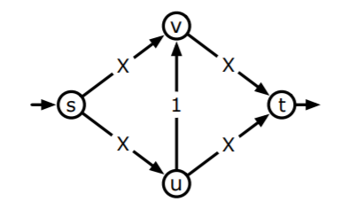
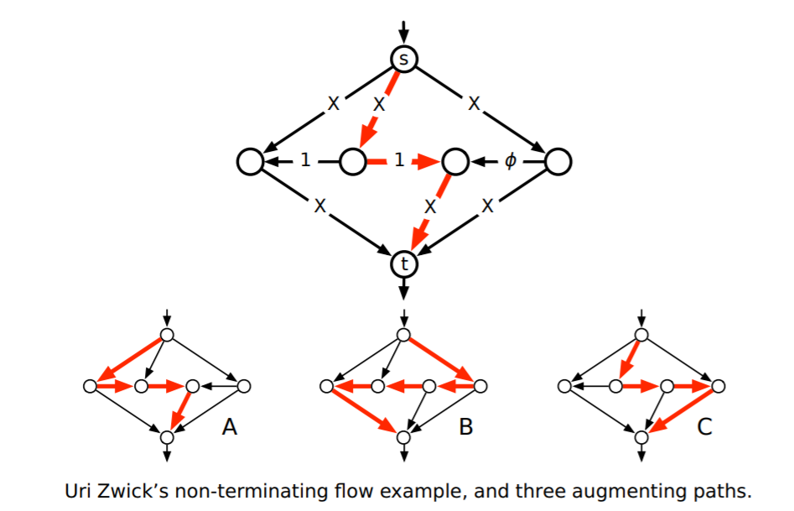
FF may converge to wrong answer
FF is not polynomial time.
It can take $X$ steps for this graph.
FF may not even converge to a correct flow for irrational capacity.
$φ=\frac{\sqrt{5}−1}{2}$, $X=3$.
Augmenting paths along
the large figure.
Then,
B,C,B,A,B,C,B,A,B,C,B,A,…
In limit, it will send $4+\sqrt{5}$ unit.
But, maxflow = 7.

Slide 3
Edmonds-Karp Algorithm
Use a shortest augmenting path (via Breadth First Search in residual graph)
Time: $O(m^{2}n)$.
G
G_{f}
G_{f’}
s
s
s
5/9
x
x
x
3/10
0/5
u
u
u
3/3
v
v
v
2/5
t
t
t

Slide 4
Distance to $s$ is non-decreasing.
Let $f$ be a flow, $G_{f}$ the residual graph, and $P$ a shortest augmenting path. Then no vertex is closer to $s$ after augmentation along $P$.
Proof: Augmentation along $P$ only
deletes forward edges
no new (hence no shorter) path created
adds back edges that go to previous vertices along $P$
BFS is unchanged, since $v$ visited before $(u,v)$ examined
s
v
a back edge
u

Slide 5
Distance for bottleneck edges
Let $d_{f}(s,v)$ be the distance from $s$ to $v$ on $G_{f}$.
Shortest s-t path P in G_{f}
>c_{P}
>c_{P}
c_{P}
c_{P}
s
u
v
x
w
t
bottleneck edge
After augmenting along $P$
$d_{f}\left(s,v\right)=d_{f}\left(s,u\right)+1$ since this is a shortest path
>0
>0
s
u
v
x
w
t
For $(u,v)$ to be bottleneck again for some flow $f′$
s
u
v
x
w
t
$$d_{f^{′}}\left(s,u\right)=d_{f^{′}}\left(s,v\right)+1≥d_{f}\left(s,v\right)+1=d_{f}\left(s,u\right)+2$$

Slide 6
Theorem
Edmonds-Karp performs $O(mn)$ flow augmentations
Proof:
Each step, some edge disappear from $G_{f}$.
(Note however that some edge may reappear.)
Any edge $(u,v)$ disappears from $G_{f}$ at most $n/2$ times.
(because the distance increased by $2$ every disappearance.)
There are at most $mn/2$ disappearances.
Total time is $O(m^{2}n)$.

Slide 7
Maximum flow
$O\left({mn}^{2}U\right) \text{[}\text{Dantzig}\text{ ′51]}$
$O\left(mn U\right) \text{[}\text{Ford} \text{Fulkerson}\text{ ′56]}$
$O\left(m^{2}n\right) \text{[}\text{Dinitz}\text{ ′70, }\text{Edmonds} \text{Karp}\text{ ′72]}$
$O\left({mn}^{2}\right) \text{[}\text{Dinitz}\text{ ′70]}$
$O\left(m^{2}\log{U}\right) \text{[}\text{Edmonds} \text{Karp}\text{ ′72, }\text{Dinitz}\text{ ′73] }$
$O\left(mn\log{U}\right) \text{[}\text{Dinitz}\text{ ′73, }\text{Gabow}\text{ ′85] }$
$O\left(n^{3}\right) \text{[}\text{Karzanov}\text{ ′74]}$
$O\left(n^{2}\sqrt{m}\right) \text{[}\text{Cherkassky}\text{ ′77] }$
$O\left(mn\log^{2}{n}\right) \text{[}\text{Galil} \text{Naamad}\text{ ′80]}$
$O\left(mn\log{n}\right) \text{[}\text{Sleator} \text{Tarjan}\text{ ′83]}$
$O\left(mn\log\left(\frac{n^{2}}{m}\right)\right) \text{[}\text{Goldberg} \text{Tarjan}\text{ ′88]}$
$O\left(mn +n^{2}\log{U}\right)\text{[}\text{Ahuja} \text{Orlin}\text{ ′89]}$
$O\left(mn\log\left(\frac{n \sqrt{\log{U}}}{m + 2}\right)\right) \text{[}\text{Ahuja} \text{Orlin} \text{Tarjan}\text{ ′89]}$
$O\left(mn +n^{\frac{8}{3}}\log{n}\right)\text{[}\text{Alon}\text{ ′90]}$
$O\left(mn + n^{2}\log^{2}{n}\right) \text{[}\text{Cheriyan} \text{Hagerup}\text{ ′95]}$
$O\left(\frac{n^{3}}{\log{n}}\right) \text{[}\text{Cheriyan} \text{Hagerup} \text{Mehlhorn}\text{ ′96]}$
$O\left(mn + n^{2+ε}\right) \text{[}\text{King} \text{Rao} \text{Tarjan}\text{ ′92]}$
$O\left(mn\log_{\frac{m}{n}}{\log^{2+ε}{n}}\right) \text{[}\text{Phillips} \text{Westbrook}\text{ ′93]}$
$O\left(mn\left(\log_{\frac{m}{n\log{n}}}n \right)\right) [King Rao Tarjan ′94]$
$O\left(m⋅\min\left(n^{\frac{2}{3}},m^{\frac{1}{2}}\right)\log\left(\frac{n^{2}}{m}\right)\log{U}\right)$ $[Goldberg Rao ′98]$
Current Best ($U$ = maximum capacity):
$O((m+nF)\log^{O(1)}{(nU))}$ [Karger-Levine 02]
$O(mn)$ [Orlin 13]
$O(m\sqrt{n}\log^{O(1)}{(nU))}$ [Lee-Sidford 13]
$O(m^{\frac{10}{7}}U^{\frac{1}{7}}\log^{O(1)}{(nU))}$ [Madry 13]
$O((m+m^{\frac{3}{4}}n^{\frac{1}{4}} \sqrt{F})\log^{O(1)}{(nU))}$ [Sidford-Tian 17]

Slide 8
Image Segmentation

Slide 9
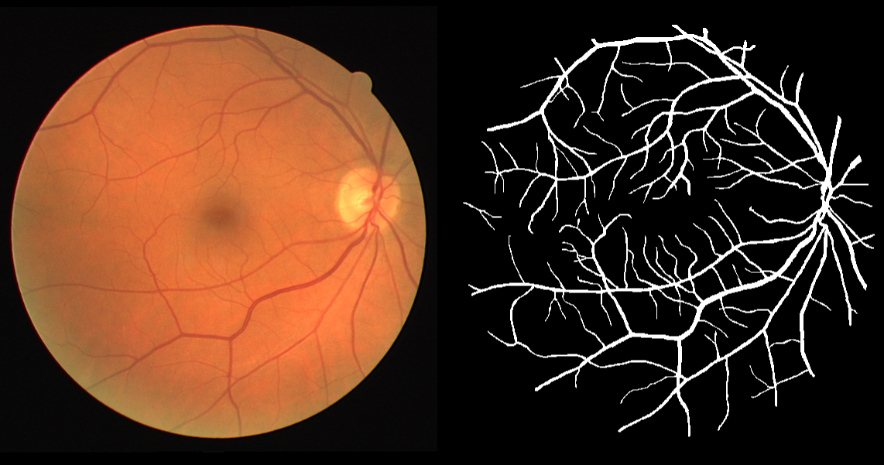
Image Segmentation
Given an image we want to separate
foreground from background
Important problem in image processing.
Divide image into coherent regions.

Slide 10
Foreground / background segmentation
Label each pixel as foreground/background.
$V$ = set of pixels, $E$ = pairs of neighboring pixels.
$a_{i}$ is the original image.
$a_{i}≫0$ means we prefer to label $i$ in foreground.
$p_{i,j}≥0$ is separation penalty for labeling one of $i$ and j as foreground, and the other as background.
Goals:
Find partition $(S, \overline{S})$ that minimizes:
$$−\sum_{i∈S}{a_{i}}+\sum_{\begin{aligned}\left(i,j\right)∈E \\ i∈S,j∈\overline{S}\end{aligned}}{p_{i,j}}$$
where $S$ is the foreground.

Slide 11
Min cut Formulation
$G′ = (V′, E′).$
Add s to correspond to foreground;
Add t to correspond to background;
Use two anti-parallel edges instead of undirected edge.
p_{ij}
p_{ij}
p_{ij}
p_{ij}
$a_{j}$ if $a_{j}>0$
s
i
j
t
$−a_{j}$ if $a_{j}<0$
$$G′$$

Slide 12
Min cut Formulation (cont’d)
Consider min cut $(S, \overline{S})$ in G’. ($S$ = foreground.)
$$cap\left(S, \overline{S}\right)=\sum_{i∈S}{−a_{i}}1_{a_{i}<0}+\sum_{i∈\overline{S}}{a_{i}}1_{a_{i}>0}+\sum_{\begin{aligned}\left(i,j\right)∈E \\ i∈S,j∈\overline{S}\end{aligned}}{p_{i,j}}$$
$=−\sum_{i∈S}{a_{i}}+\sum_{i∈S}{a_{i}}1_{a_{i}>0}+\sum_{i∈\overline{S}}{a_{i}}1_{a_{i}>0}+\sum_{⋯}{p_{i,j}}$
$=−\sum_{i∈S}{a_{i}}+\sum_{i}{a_{i}}+\sum_{⋯}{p_{i,j}}$
$=−\sum_{i∈S}{a_{i}}+\sum_{⋯}{p_{i,j}}+constant$
Precisely, what we want to minimize.
p_{ij}
$a_{j}$ if $a_{j}>0$
s
i
j
t
$$S$$
$−a_{j}$ if $a_{j}<0$
$$G′$$

Slide 13
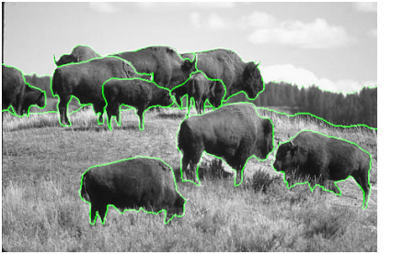
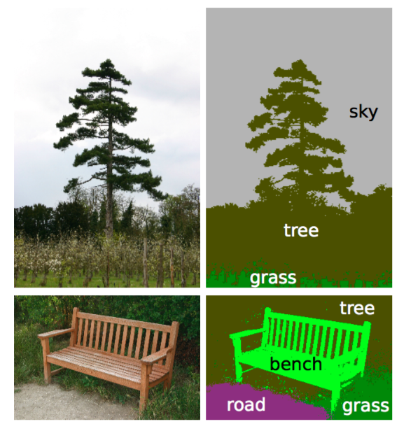
Reality
The main difficulty is to come up with a good model.
May want to have human interaction.
Segmentation may be real-valued instead of {0,1}.
There are many more than 1 objects.
May need labeling.
Augmenting path is not great for GPU.

Slide 14
Project Selection
Given a DAG G=(V,E) representing
precedence constraints on tasks
(a task points to its predecessors)
a profit value p(v) for each task v∈V
(may be positive or negative)
Find a set A⊆V of tasks that is closed under predecessors,
(i.e. if (u,v)∈E and u∈A then v∈A)
that maximizes Profit(A)=Σ_{v∈A} p(v)
-1
2
4
3
8
-5
-6
-3
10
4
11
12
-13
Each task points to its predecessor tasks
14

Slide 15
Extended Graph
s
-1
2
4
3
8
-5
-6
-3
10
4
11
12
-13
14
t

Slide 16
Extended Graph G’
s
For each vertex v
If p(v)≥0 add (s,v) edge
with capacity p(v)
If p(v)<0 add (v,t) edge
with capacity –p(v)
10
-1
2
4
3
8
-5
-6
-3
10
4
11
12
5
-13
14
t

Slide 17
Extended Graph G’
Want: Set capacities on edges of G so that for minimum s-t-cut $(S,\overline{S})$ in G’, the set A=S-{s}
satisfies precedence constraints
has maximum possible profit in G
Cut capacity with S={s} is just C=Σ_{v: p(v)≥0} p(v)
Profit(A) ≤ C for any set A
To satisfy constraints, don’t want any original edges of G going forward across the minimum cut
That would correspond to a task in A=S-{s} that had a predecessor not in A=S-{s}
Set capacity of each of the edges of G to $+∞$.

Slide 18
Extended Graph G’
Capacity C=Σ_{v: p(v)≥0} p(v)
s
10
-1
2
4
3
8
-5
-6
-3
10
4
11
12
5
-13
14
t

Slide 19
Extended Graph G’
s
10
Cut value
=13+3+2+3+4
=13+3
+C-4-8-10-11-12-14
-1
2
4
3
8
-5
-6
-3
10
4
11
12
5
-13
14
t

Slide 20
Project Selection
Claim Any s-t-cut $(S,\overline{S})$ in G’ such that A=S-{s} satisfies
precedence constraints and
has capacity c(S,T)=C - Σ_{v∈A} p(v) = C - Profit(A)
Corollary A minimum cut $(S,\overline{S})$ in G’ yields an optimal solution A=S-{s} to the project selection problem
Algorithm Compute maximum flow f in G’, find the set S of nodes reachable from s in G’_{f} and return S-{s}

Slide 21
Proof of Claim
A=S-{s} satisfies precedence constraints
No edge of G crosses forward out of A since those edges have capacity $+∞$
Only forward edges cut are of the form
(v,t) for v∈A or (s,v) for v∉A
The (v,t) edges for v∈A contribute Σ_{v∈A:p(v)<0} -p(v) = - Σ_{v∈A:p(v)<0} p(v)
The (s,v) edges for v∉A contribute Σ_{v∉A: p(v)≥0} p(v)=C-Σ_{v∈A: p(v)≥0} p(v)
Therefore the total capacity of the cut is c(S,T) = C - Σ_{v∈A} p(v) =C-Profit(A)

