Slide 1
CSE 421
Greedy: Huffman Codes
Yin Tat Lee

Slide 2
Compression Example
100k file, 6 letter alphabet:
File Size:
ASCII, 8 bits/char: 800kbits
$2^{3}>6$; 3 bits/char: 300kbits
Why?
Storage, transmission
a 45%
b 13%
c 12%
d 16%
e 9%
f 5%
2
Notes:
417, 421, 521

Slide 3
Compression Example
a 45%
b 13%
c 12%
d 16%
e 9%
f 5%
100k file, 6 letter alphabet:
File Size:
ASCII, 8 bits/char: 800kbits
2³ > 6; 3 bits/char: 300kbits
better:
2.52 bits/char 74%*2 +26%*4: 252kbits
Optimal?
E.g.:
a 00
b 01
d 10
c 1100
e 1101
f 1110
Why not:
00
01
10
110
1101
1110
1101110 = cf or ec?
Notes:
417, 421, 521

Slide 4
Data Compression
Binary character code (“code”)
each k-bit source string maps to unique code word (e.g. k=8)
“compression” alg: concatenate code words for successive k-bit “characters” of source
Fixed/variable length codes
all code words equal length?
Prefix codes
no code word is prefix of another (unique decoding)
4
Notes:
417, 421, 521

Slide 5
Prefix Codes = Trees
a 45%
b 13%
c 12%
d 16%
e 9%
f 5%
100
100
0
1
0
1
86
14
a:45
55
0
1
0
0
1
58
28
14
25
30
0
1
0
1
0
1
0
1
0
1
a:45
b:13
c:12
d:16
e:9
f:5
c:12
b:13
14
d:16
0
1
f:5
e:9
1 0 1 0 0 0 0 0 1
1 1 0 0 0 1 0 1
f a b
f a b
Notes:
417, 421, 521

Slide 6
Greedy Idea #1
a 45%
b 13%
c 12%
d 16%
e 9%
f 5%
Put most frequent under root, then recurse …
100
a:45
.
. .
. .
Notes:
417, 421, 521

Slide 7
Greedy Idea #1
a 45%
b 13%
c 12%
d 16%
e 9%
f 5%
Top down: Put most frequent under root, then recurse
Too greedy: unbalanced tree .45*1 + .16*2 + .13*3 … = 2.34 not too bad, but imagine if all freqs were ~1/6: (1+2+3+4+5+5)/6=3.33
100
a:45
55
d:16
29
.
.
.
b:13
Notes:
417, 421, 521
.45 = .45*1
.32 = .16*2
.39 = .13*3
.48 = .12*4
.70 = (.05+.09)*5
2.34

Slide 8
Greedy Idea #2
a 45%
b 13%
c 12%
d 16%
e 9%
f 5%
Top down: Divide letters into 2 groups, with ~50% weight in each; recurse (Shannon-Fano code)
Again, not terrible 2*.5+3*.5 = 2.5
But this tree can easily be improved! (How?)
100
50
50
a:45
f:5
25
25
b:13
c:12
d:16
e:9
Notes:
417, 421, 521 15wi lec 10 ended here.
Improved: f-d is inversion
In class suggestion: do shannon-fano, then flip all inversion. Improves this tree, but doesn’t give opt
(.45+.16)*2+.39*3 = 2.39

Slide 9
Greedy idea #3
a 45%
b 13%
c 12%
d 16%
e 9%
f 5%
Bottom up: Group least frequent letters near bottom
100
.
.
.
.
.
.
25
14
c:12
b:13
f:5
e:9
Notes:
417, 421, 521

Slide 10
(a)
(b)
f:5
e:9
c:12
b:13
d:16
a:45
c:12
b:13
14
d:16
a:45
0
1
f:5
e:9
(c)
(d)
14
d:16
25
a:45
25
30
a:45
0
1
0
1
0
1
0
1
f:5
e:9
c:12
b:13
c:12
b:13
14
d:16
0
1
f:5
e:9
(e)
(f)
a:45
55
100
0
1
0
1
25
30
a:45
55
0
1
0
1
0
1
c:12
b:13
14
d:16
25
30
0
1
0
1
0
1
f:5
e:9
c:12
b:13
14
d:16
0
1
f:5
e:9
.45*1 + .41*3 + .14*4 = 2.24 bits per char
Notes:
417, 421, 521
.45 = .45*1
1.23 = .41*3
.56 = .14*4
-----------------
2.24

Slide 11
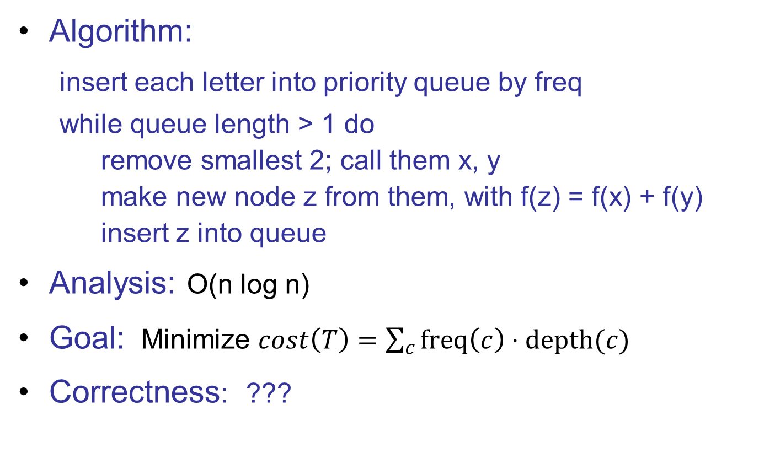
Huffman’s Algorithm (1952)
Algorithm:
insert each letter into priority queue by freq
while queue length > 1 do
remove smallest 2; call them x, y
make new node z from them, with f(z) = f(x) + f(y)
insert z into queue
Analysis: O(n log n)
Goal: Minimize $cost\left(T\right)=\sum_{c}{freq\left(c\right)⋅depth(c)}$
Correctness: ???
T = Tree
C = alphabet (leaves)
Notes:
417, 421, 521

Slide 12
Correctness Strategy
100
50
50
a:45
f:5
25
25
b:13
c:12
d:16
e:9
Optimal solution may not be unique, so cannot prove that greedy gives the only possible answer.
Instead, show greedy’s solution is as good as any.
How: an exchange argument
Identify inversions: node-pairs whose swap improves tree
13
Notes:
417, 421, 521
more detailed setup for new proof

Slide 13
Defn: A pair of leaves x,y is an inversion if
depth(x) ≥ depth(y)
and
freq(x) ≥ freq(y)
y
Claim: If we flip an inversion, cost never increases.
Why? All other things being equal, better to give more frequent letter the shorter code.
before after
I.e., non-negative cost savings.
x
$$\left(d\left(x\right)f\left(x\right)+d\left(y\right)f\left(y\right)\right)−\left(d\left(x\right)f\left(y\right)+d\left(y\right)f\left(x\right)\right)$$
$$=\left(d\left(x\right)−d\left(y\right)\right)\left(f\left(x\right)−f\left(y\right)\right)≥0$$
Notes:
417, 421, 521
this proof generalizes to internal nodes, too, basically just as easy; that doesn’t seem to simplify CLR lemmas below, but important to my proof

Slide 14
General Inversions
100
50
50
a:45
f:5
25
25
b:13
c:12
d:16
e:9
Define the frequency of an internal node to be the
sum of the frequencies of the leaves in that subtree.
We can generalize
the defn of inversion for any pair of nodes.
the associated claim still holds:
exchanging an inverted pair of nodes (& associated subtrees) cannot raise the cost of a tree.
Proof: Same.
Notes:
417, 421, 521

Slide 15

Correctness Strategy
100
50
50
a:45
f:5
25
25
b:13
c:12
d:16
e:9
Lemma:
Any prefix code tree $T$ can be converted to
a huffman tree $H$ via inversion-exchanges
Corollary:
Huffman tree is optimal.
Proof:
Apply the above lemma to any optimal tree $T=T_{1}$.
The lemma only exchanges inversions, which never increase cost.
So, $cost\left(T_{1}\right)≥cost\left(T_{2}\right)≥cost\left(T_{4}\right)≥⋯≥cost(H)$.
13
Notes:
417, 421, 521
more detailed setup for new proof

Slide 16
H:
(a)
(b)
f:5
e:9
c:12
b:13
d:16
a:45
c:12
b:13
14
d:16
a:45
f:5
e:9
(c)
(d)
14
d:16
25
a:45
25
30
a:45
f:5
e:9
c:12
b:13
c:12
b:13
14
d:16
f:5
e:9
T:
100
T’:
100
55
a:45
55
a:45
14
41
25
30
f:5
e:9
d:16
25
c:12
b:13
d:16
14
c:12
b:13
f:5
e:9
Notes:
417, 421, 521
Slide gives concrete ex of general pf on next. Method: nodes in T painted yellow as added to heap, until discrepancy, which flags an inversion
Cost(T) = 100+55+14+41+25=235 Cost(T’) = same – 41+30 = 224

Slide 17
Lemma: prefix $T$ $→$ Huffman $H$ via inversion
Induction Hypothesis: At $k^{th}$ iteration of Huffman,
all nodes in the queue is a subtree of $T$ (after inversions).
Base case: all nodes are leaves of $T$.
Inductive step: Huffman extracts $A$, $B$ from the $Q$.
Case 1: $A,B$ is a siblings in $T$.
Their newly created parent node in $H$ corresponds to their parent in $T$.
(used induction hypothesis here.)
13
Notes:
417, 421, 521
more detailed setup for new proof

Slide 18

Lemma: prefix $T$ $→$ Huffman $H$ via inversion
Induction Hypothesis: At $k^{th}$ iteration of Huffman,
all nodes in the queue is a subtree of $T$ (after inversions).
Case 2: $A,B$ is not a siblings in $T$.
WLOG, in T, $depth(A)≥depth(B)$ & A is C’s sib.
Note B can’t overlap C because
If $B=C$, we have case 1.
If $B$ is a subtree of $C$, $depth\left(B\right)>depth(A)$.
If $C$ is a subtree of $B$, $A$ and $B$ overlaps.
Now, note that
$depth\left(A\right)=depth(C)≥depth(B)$
$freq\left(C\right)≥freq(B)$ because Huff picks the min 2.
So, $B−C$ is an inversion. Swapping gives $T′$ that satisfies the induction.
T
T’
B
C
13
A
C
A
B
Notes:
417, 421, 521
more detailed setup for new proof

Slide 19

Correctness Strategy
100
50
50
a:45
f:5
25
25
b:13
c:12
d:16
e:9
Lemma:
Any prefix code tree $T$ can be converted to
a huffman tree H via inversion-exchanges
Corollary:
Huffman tree is optimal.
Proof:
Apply the above lemma to any optimal tree $T=T_{1}$.
The lemma only exchanges inversions, which never increase cost.
So, $cost\left(T_{1}\right)≥cost\left(T_{2}\right)≥cost\left(T_{4}\right)≥⋯≥cost(H)$.
13
Notes:
417, 421, 521
more detailed setup for new proof

Slide 20
Data Compression
Huffman is optimal.
BUT still might do better!
Huffman encodes fixed length blocks. What if we vary them?
Huffman uses one encoding throughout a file. What if characteristics change?
What if data has structure? E.g. raster images, video,…
Huffman is lossless. Necessary?
LZ77, JPG, MPEG, …
Notes:
417, 421, 521

Slide 21
The rest are just for fun. (I learnt compression this morning.)

Slide 22
Adaptive Huffman coding
Often, data comes from a stream.
Difficult to know the frequencies in the beginning. There are multiple ways to update Huffman tree.
FGK (Faller-Gallager-Knuth)
There is a special external node, called 0-node, is used to identify a newly-coming character.
Maintain the tree is sorted.
When the freq is increased by 1, it can create inverted pairs. In that case, we swap nodes, subtrees, or both.
(Exercise to figure out how to do exactly!)
13
Notes:
417, 421, 521
more detailed setup for new proof

Slide 23
LZ77
Cursor
a
a
c
a
a
c
a
b
c
a
b
a
b
a
c
Dictionary (previously coded)
Lookahead
Buffer
Dictionary and buffer “windows” are fixed length and slide with the cursor
Repeat:
Output (p, l, c) where p = position of the longest match that starts in the dictionary (relative to the cursor) l = length of longest match c = next char in buffer beyond longest match
Advance window by l + 1
Theory: it is optimal if the windows size tends to $+∞$ and
string is generated by Markov chain. [WZ94]
Notes:
Why do we need the next char?

Slide 24
LZ77: Example
a
a
c
a
a
c
a
b
c
a
b
a
a
a
c
(_,0,a)
a
a
c
a
a
c
a
b
c
a
b
a
a
a
c
(1,1,c)
a
a
c
a
a
c
a
b
c
a
b
a
a
a
c
(3,4,b)
a
a
c
a
a
c
a
b
c
a
b
a
a
a
c
(3,3,a)
a
a
c
a
a
c
a
b
c
a
b
a
a
a
c
(1,2,c)
Dictionary (size = 6)
Longest match
Buffer (size = 4)
Next character

Slide 25
How to do it even better?
gzip
Based on LZ77.
Adaptive Huffman code the positions, lengths and chars
Non greedy: possibly use shorter match so that next match is better
….
In general, compression is like prediction.
The entropy of English letter is 4.219 bits per letter
3-letter model yields 2.77 bits per letter
Human experiments suggested 0.6 to 1.3 bits per letter.
For example, you can use deep net to predict and compression 1 GB of wiki to 160MB. (search deepzip)
(to compare, gzip 330MB, Huffman 500-600MB)
We are reaching the limit of human compression!
(8bit * 0.16 ~ 1.2 bit per symbol)
Notes:
Match must be at least length 3. Why?
How does storing in order of position help?

Slide 26
Ultimate Answer? See Kolmogorov complexity.
Disclaimer: I don’t recommend playing such competitions unless you REALLY know what you are doing.

