Slide 1
CSE 421: Introduction to Algorithms
Stable Matching
Yin-Tat Lee

Slide 2
Administrativia Stuffs
HW1 is out!
It is due Wednesday Apr 04 before class.
Please submit to Canvas
How to submit?
Submit a separate file for each problem
Double check your submission before the deadline!!
For hand written solutions, take a picture, turn it into pdf and submit
Guidelines:
Always prove your algorithm halts and outputs correct answer
You can collaborate, but you must write solutions on your own
Your proofs should be clear, well-organized, and concise. Spell out main idea.
Sanity Check: Make sure you use assumptions of the problem
You CANNOT search the solution online.

Slide 3
Last Lecture (summary)
Stable matching problem: Given n men and n women, and their preferences, find a stable matching.
Gale-Shapley algorithm: Guarantees always finds a stable matching by running at most $n^{2}$ proposals.
Main properties:
Men go down their lists
Women trade up!
For a perfect matching M, a pair m-w is unstable
if they prefer each other to their match in M.

Slide 4
Questions
Q: How to implement GS algorithm efficiently?
Q: If there are multiple stable matchings, which one does GS find?
Q: How many stable matchings are there?

Slide 5
Implementation of GS Algorithm
Problem size
N=2n² words
2n people each with a preference list of length n
2n²log n bits
specifying an ordering for each preference list takes nlog n bits
Q. Why do we care?
A. Usually, the running time is lower-bounded by input length.

Slide 6
Propose-And-Reject Algorithm [Gale-Shapley’62]
Initialize each person to be free.
while (some man is free and hasn't proposed to every woman) {
Choose such a man m
w = 1st woman on m's list to whom m has not yet proposed
if (w is free)
assign m and w to be engaged
else if (w prefers m to her fiancé m')
assign m and w to be engaged, and m' to be free
else
w rejects m
}

Slide 7
Efficient Implementation
We describe O(n²) time implementation.
Representing men and women:
Assume men are named 1, …, n.
Assume women are named n+1, …, 2n.
Engagements.
Maintain a list of free men, e.g., in a queue.
Maintain two arrays wife[m], and husband[w].
set entry to 0 if unmatched
if m matched to w then wife[m]=w and husband[w]=m
Men proposing:
For each man, maintain a list of women, ordered by preference.
Maintain an array count[m] that counts the number of proposals made by man m.

Slide 8
A Preprocessing Idea
Women rejecting/accepting.
Does woman w prefer man m to man m'?
For each woman, create inverse of preference list of men.
Constant time access for each query after O(n) preprocessing per woman. O(n²) total reprocessing cost.
Amy
1st
2nd
3rd
4th
5th
6th
7th
8th
Pref
8
3
7
1
4
5
6
2
Amy
1
2
3
4
5
6
7
8
Inverse
4th
8th
2nd
5th
6th
7th
3rd
1st
for i = 1 to n
inverse[pref[i]] = i
Amy prefers man 3 to 6 since $inverse[3]=2 < 7=inverse[6]$

Slide 9
Questions
How to implement GS algorithm efficiently?
We can implement GS algorithm in O(n²) time.
Q: If there are multiple stable matchings, which one does GS find?
Q: How many stable matchings are there?

Slide 10
Understanding the Solution
Q. For a given problem instance, there may be several stable matchings. Do all executions of Gale-Shapley yield the same stable matching? If so, which one?
An instance with two stable matchings:
A-X, B-Y.
A-Y, B-X.
1st
2nd
1st
2nd
Xavier
A
B
Amy
Y
X
Yuri
B
A
Brenda
X
Y

Slide 11
Man Optimal Assignments
Definition: Man m is a valid partner of woman w if there exists some stable matching in which they are matched.
Man-optimal matching: Each man receives the best valid partner (according to his preferences).
Simultaneously best for each and every man.
Claim: All executions of GS yield a man-optimal matching, which is a stable matching!
No reason a priori to believe that man-optimal matching is perfect, let alone stable.

Slide 12
Man Optimality
S
m-w
m’-w’
Claim: GS matching S* is man-optimal.
Proof: (by contradiction)
Suppose some man is paired with someone other than his best partner. Men propose in decreasing order of preference ⇒ some man is rejected by a valid partner.
Let m be the man who is the first such rejection, and let w be the women who is first valid partner that rejects him.
Let S be a stable matching where w and m are matched.
In building S*, when m is rejected, w forms (or reaffirms) engagement with a man, say m’, whom she prefers to m.
Let w’ be the partner of m’ in S.
In building S*, m’ is not rejected by any valid partner at the point when m is rejected by w. Thus, m’ prefers w to w’.
But w prefers m’ to m.
Thus w-m’ is unstable in S.
. . .
since this is the first rejection by a valid partner

Slide 13
Man Optimality Summary
Man-optimality: In version of GS where men propose, each man receives the best valid partner.
Q: Does man-optimality come at the expense of the women?
w is a valid partner of m if there exist some stable matching where m and w are paired

Slide 14
Woman Pessimality
Woman-pessimal assignment: Each woman receives the worst valid partner.
Claim. GS finds woman-pessimal stable matching S*.
Proof.
Suppose m-w matched in S*, but m is not worst valid partner for w.
There exists stable matching S in which w is paired with a man, say m’, whom she likes less than m.
Let w’ be the partner of m’ in S.
m prefers w to w’.
Thus, m-w is an unstable in S.
man-optimality of S*

Slide 15
Questions
Q: How to implement GS algorithm efficiently?
We can implement GS algorithm in O(n²) time.
Q: If there are multiple stable matchings, which one does GS find?
It finds the man-optimal woman-pessimal matching.
Q: How many stable matchings are there?

Slide 16
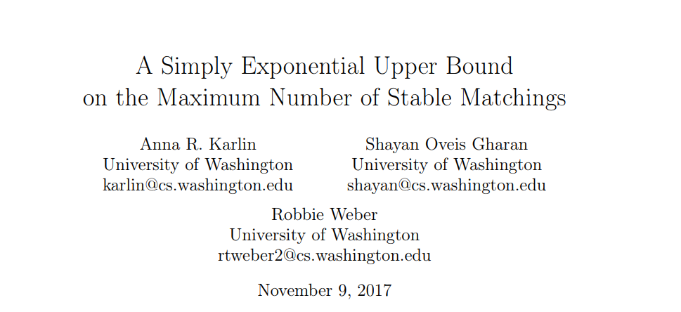
How many stable Matchings?
We already show every instance has at least 1 stable matchings.
There are instances with about ${2.28}^{n}$ stable matchings.
There are at most ${131072}^{n}$ stable matchings.
[Research-Question]:
Is there an “efficient” algorithm that chooses a uniformly random stable matching of a given instance.

Slide 17
More realistic
Let $F⊂M×W$ be the set of relationship (possible marriage).
Can we find a perfect stable matching in $F$?
No. Consider w prefers m’ to m, m’ prefers w to w’.
There is no perfect stable matching even there’s prefect matching in $F$.
What can we find?
Same algorithm gives a (non-perfect) matching that is stable.
m
w
m’
w’
Gale-Shapley algorithm is very robust to variations!
For a matching M, a pair m-w is unstable
if (m,w)$∈F$ and they prefer each other to their match in M.
(They prefer not to be alone.)

