Slide 1
CSE 421
Vertex Cover / Set Cover
Yin Tat Lee

Slide 2
Approximation Algorithms

Slide 3
How to deal with NP-complete Problem
Many of the important problems are NP-complete.
SAT, Set Cover, Graph Coloring, TSP, Max IND Set, Vertex Cover, …
So, we cannot find optimum solutions in polynomial time.
What to do instead?
Find optimum solution of special cases (e.g., random inputs)
Find near optimum solution in the worst case

Slide 4
Approximation Algorithm
We call an algorithm has approximation ratio $α(n)$ if
$$\frac{Cost of computed solution}{Cost of the optimum}≤α(n)$$
for any input of length $n$. (worst case)
Goal: For each NP-hard problem find an poly-time approximation algorithm with the best possible approximation ratio.

Slide 5
Vertex Cover
Given a graph $G=(V,E)$, Find smallest set of vertices touching every edge

Slide 6
Greedy Algorithm?
Greedy algorithms are typically used in practice to find a (good) solution to NP-hard problems
Strategy (1): Iteratively, include a vertex that covers most new edges
Q:Does this give an optimum solution?
A: No,

Slide 7
Greedy (1): Pick vertex that covers the most
$$B_{4}$$
$$B_{1}$$
$$B_{2}$$
$$B_{3}$$

Slide 8
Greedy (1): Pick vertex that covers the most
$$B_{4}$$
$$B_{1}$$
$$B_{2}$$
$$B_{3}$$

Slide 9
Greedy (1): Pick vertex that covers the most
$$B_{4}$$
$$B_{1}$$
$$B_{2}$$
$$B_{3}$$

Slide 10
Greedy (1): Pick vertex that covers the most
$$B_{4}$$
$$B_{1}$$
$$B_{2}$$
$$B_{3}$$

Slide 11
Greedy (1): Pick vertex that covers the most
$$B_{4}$$
$$B_{1}$$
$$B_{2}$$
$$B_{3}$$

Slide 12
Greedy (1): Pick vertex that covers the most
$$B_{4}$$
$$B_{1}$$
$$B_{2}$$
$$B_{3}$$

Slide 13
Greedy (1): Pick vertex that covers the most
$$B_{4}$$
$$B_{1}$$
$$B_{2}$$
$$B_{3}$$

Slide 14
Greedy (1): Pick vertex that covers the most
$$B_{4}$$
$$B_{1}$$
$$B_{2}$$
$$B_{3}$$

Slide 15
Greedy (1): Pick vertex that covers the most
$$B_{4}$$
$$B_{1}$$
$$B_{2}$$
$$B_{3}$$

Slide 16
Greedy (1): Pick vertex that covers the most
$$B_{4}$$
$$B_{1}$$
$$B_{2}$$
$$B_{3}$$
Greedy Vertex cover = 20
OPT Vertex cover = 8

Slide 17
Greedy (1): Pick vertex that covers the most
$$B_{4}$$
$$B_{1}$$
$$B_{2}$$
$$B_{3}$$
Greedy Vertex cover = 20
OPT Vertex cover = 8

Slide 18
Greedy (1): Pick vertex that covers the most
$n$ vertices. Each vertex has one edge into each $B_{i}$
$$B_{n}$$
$$B_{n−1}$$
$$B_{1}$$
$${|B}_{i}|=n/i$$
Greedy pick bottom vertices = $n+\frac{n}{2}+\frac{n}{3}+…+1≈n\ln{n}$
OPT pick top vertices = n

Slide 19
A Different Greedy Rule
Greedy 2: Iteratively, pick both endpoints of an uncovered edge.
Vertex cover = 6

Slide 20
Greedy 2: Pick Both endpoints of an uncovered edge
$$B_{4}$$
$$B_{1}$$
$$B_{2}$$
$$B_{3}$$
Greedy vertex cover = 16
OPT vertex cover = 8

Slide 21
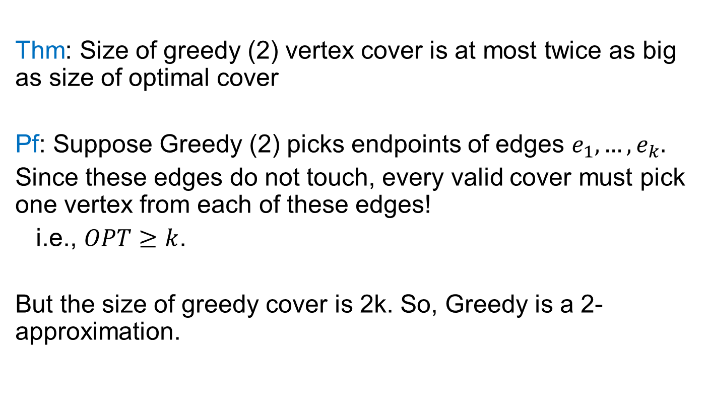
Greedy (2) gives 2-approximation
Thm: Size of greedy (2) vertex cover is at most twice as big as size of optimal cover
Pf: Suppose Greedy (2) picks endpoints of edges $e_{1},…,e_{k}.$
Since these edges do not touch, every valid cover must pick one vertex from each of these edges!
i.e., $OPT≥k$.
But the size of greedy cover is 2k. So, Greedy is a 2-approximation.

Slide 22
Set Cover
Given a number of sets on a ground set of elements,
Goal: choose minimum number of sets that cover all.
e.g., a company wants to hire employees with certain skills.

Slide 23
Set Cover
Given a number of sets on a ground set of elements,
Goal: choose minimum number of sets that cover all.
Set cover = 4

Slide 24
A Greedy Algorithm
Strategy: Pick the set that maximizes # new elements covered

Slide 25
A Greedy Algorithm
Strategy: Pick the set that maximizes # new elements covered

Slide 26
A Greedy Algorithm
Strategy: Pick the set that maximizes # new elements covered

Slide 27
A Greedy Algorithm
Strategy: Pick the set that maximizes # new elements covered

Slide 28
A Greedy Algorithm
Strategy: Pick the set that maximizes # new elements covered
Thm: Greedy has ln n approximation ratio

Slide 29
A Tight Example for Greedy

Slide 30
A Tight Example for Greedy

Slide 31
A Tight Example for Greedy

Slide 32
A Tight Example for Greedy

Slide 33
A Tight Example for Greedy

Slide 34
A Tight Example for Greedy
Greedy = 5
OPT = 2

Slide 35
Greedy Gives O(log(n)) approximation
Thm: If the best solution has k sets, greedy finds at most k ln(n) sets.
Pf: Suppose OPT=k
There is set that covers 1/k fraction of remaining elements, since there are k sets that cover all remaining elements.
So in each step, algorithm will cover 1/k fraction of remaining elements.
#elements uncovered after t steps
$$≤n{\left(1−\frac{1}{k}\right)}^{t}≤ne^{−\frac{t}{k}}$$
So after $t=k\ln{n}$ steps, # uncovered elements < 1.

Slide 36
Approximation Algorithm Summary
The best known approximation algorithm for set cover is the greedy.
It is NP-Complete to obtain better than ln(n) approximation ratio for set cover.
The best known approximation algorithm for vertex cover is the greedy.
It has been open for 40 years to obtain a polynomial time algorithm with approximation ratio better than 2
There is a long list of questions we do not know the best approximation algorithm.
https://www.youtube.com/watch?v=n7v9psW3Qwo
https://en.wikipedia.org/wiki/Unique_games_conjecture

