Slide 1
CSE 421
Divide and Conquer / Median
Yin Tat Lee

Slide 2
Exercise for Midterm
Given a weighted directed acyclic graph with $n$ vertices and $m$ edges. Give an $O(n+m)$ time algorithm to find the shortest path distance from vertex $s$ to all other vertices. (Hints: Topological sort.)

Slide 3
Exercise for Midterm
Given a connected graph with $n$ vertices and $m$ edges with $m≥n$. Give an $O(n)$ time algorithm to find a cycle.

Slide 4
Exercise for Midterm
Given an array of elements $a_{1},a_{2},⋯,a_{n}$. Suppose that there are more than half of the elements are same. We call that element as the majority. Given an $O\left(n logn\right)$ time algorithm to find the majority. (Hints: Divide and Conquer)

Slide 5
Median

Slide 6
Selecting k-th smallest
Problem: Given numbers $x_{1},…,x_{n}$ and an integer $1≤k≤n$ output the $k$-th smallest number
$$Sel(\left\{x_{1},…,x_{n}\right\},k)$$
A simple algorithm: Sort the numbers in time $O(n log⁡n)$then return the $k$-th smallest in the array.
Can we do better?
Yes, in time $O(n)$ if $k=1$ or $k=2.$
Can we do $O\left(n\right)$ for all possible values of k?

Slide 7
An Idea
Choose a number $w$ from $x_{1},…,x_{n}$
Define
$S_{<}\left(w\right)=\left\{x_{i}:x_{i}<w\right\}$
$S_{=}\left(w\right)=\left\{x_{i}:x_{i}=w\right\}$
$S_{>}\left(w\right)=\left\{x_{i}:x_{i}>w\right\}$
Solve the problem recursively as follows:
If $k≤{|S}_{<}(w)|$, output $Sel(S_{<}\left(w\right),k)$
Else if $k≤\left|S_{<}\left(w\right)\right|+\left|S_{=}\left(w\right)\right|$, output w
Else output $Sel(S_{>}\left(w\right),k−|S_{<}\left(w\right)|−|S_{=}\left(w\right)|)$
Ideally want $\left|S_{<}\left(w\right)\right|,{|S}_{>}(w)|≤n/2$. In this case ALG runs in $O\left(n\right)+O\left(\frac{n}{2}\right)+O\left(\frac{n}{4}\right)+…+O\left(1\right)=O\left(n\right).$
Can be computed in
linear time

Slide 8
How to choose w?
Suppose we choose w uniformly at random
similar to the pivot in quicksort.
Then, $𝔼\left[\left|S_{<}\left(w\right)\right|\right]=𝔼\left[\left|S_{>}\left(w\right)\right|\right]=n/2.$ Algorithm runs in $O(n)$ in expectation.
Can we get $O(n)$ running time deterministically?
Partition numbers into sets of size 3.
Sort each set (takes O(n))
$w=Sel(midpoints,n/6$)
$$≤$$
$$≤$$
$$≤$$
$$≤$$
$$≤$$
$$≤$$
$$≤$$
$$≤$$
$$≤$$
$$≤$$
$$≤$$
$$≤$$
$$≤$$
$$≤$$
$$w$$
$$≤$$
$$≤$$
$$≤$$
$$≤$$
$$≤$$
$$≤$$
$$≤$$
$$≤$$
$$≤$$
$$≤$$
$$≤$$
$$≤$$
$$≤$$
$$≤$$

Slide 9
How to lower bound $\left|S_{<}\left(w\right)\right|,|S_{>}\left(w\right)|$?
Assume all numbers are distinct for simplicity.
$$>w$$
$\left|S_{<}\left(w\right)\right|≥2\left(\frac{n}{6}\right)=\frac{n}{3}$
$\left|S_{>}\left(w\right)\right|≥2\left(\frac{n}{6}\right)=\frac{n}{3}.$
So, what is the running time?
$$<$$
$$<$$
$$<$$
$$<$$
$$<$$
$$<$$
$$<$$
$$<$$
$$<$$
$$<$$
$$<$$
w
$$<$$
$$<$$
$$<$$
$$<$$
$$<$$
$$<$$
$$<$$
$$<$$
$$<$$
$$<$$
$$<$$
$$<$$
$$<$$
$$<$$
$$<$$
$$<$$
$$<$$
$$<$$
$$<$$
$$<$$
$$<$$
$$<w$$
$$\frac{n}{3}≤{|S}_{<}\left(w\right)|,\left|S_{>}\left(w\right)\right|≤\frac{2n}{3}$$

Slide 10

Asymptotic Running Time?
Assume all numbers are distinct for simplicity.
If $k≤{|S}_{<}(w)|$, output $Sel(S_{<}\left(w\right),k)$
Else if $k≤\left|S_{<}\left(w\right)\right|+\left|S_{=}\left(w\right)\right|$, output w
Else output $Sel(S_{>}\left(w\right),k−|S_{<}\left(w\right)|−|S_{=}\left(w\right)|)$
Where $\frac{n}{3}≤\left|S_{<}\left(w\right)\right|,\left|S_{>}\left(w\right)\right|≤\frac{2n}{3}$
$$T\left(n\right)=T\left(\frac{n}{3}\right)+T\left(\frac{2n}{3}\right)+O\left(n\right)⇒T\left(n\right)=O(n log n)$$
$$<$$
$$<$$
$$<$$
$$<$$
$$<$$
$$<$$
$$<$$
$$<$$
$$<$$
$$<$$
$$<$$
$$w$$
$$<$$
$$<$$
$$<$$
$$<$$
$$<$$
$$<$$
$$<$$
$$<$$
$$<$$
$$<$$
$$<$$
$$<$$
$$<$$
$$<$$
$$<$$
$$<$$
$$<$$
$$<$$
$$<$$
$$<$$
$$<$$
$O(n log⁡n)$ again?
So, what is the point?

Slide 11
An Improved Idea
$$>w$$
Partition into n/5 sets. Sort each set and set $w=Sel(midpoints,n/10$)
$\left|S_{<}\left(w\right)\right|≥3\left(\frac{n}{10}\right)=\frac{3n}{10}$
$\left|S_{>}\left(w\right)\right|≥3\left(\frac{n}{10}\right)=\frac{3n}{10}$
$$T\left(n\right)=T\left(\frac{n}{5}\right)+T\left(\frac{7n}{10}\right)+O\left(n\right)⇒T\left(n\right)=O(n)$$
$$<$$
$$<$$
$$<$$
$$<$$
$$<$$
$$<$$
$$<$$
$$<$$
$$<$$
$$<$$
$$<$$
$$<$$
$$<$$
$$<$$
$$<$$
$$<$$
$$<$$
$$<$$
$$<$$
$$<$$
$$<$$
$$<$$
$$<$$
$$<$$
$$<$$
$$<$$
$$<$$
$$<$$
$$<$$
$$<$$
$$<$$
$$<$$
$$<$$
$$<$$
$$<$$
$$<$$
$$<$$
$$<$$
$$<$$
$$<$$
$$<$$
$$<$$
$$<$$
$$<$$
$$<$$
$$<$$
$$<$$
$$<$$
$$<$$
$$<$$
$$<$$
$$<$$
$$<$$
$$<$$
$$<w$$
$$\frac{3n}{10}≤{|S}_{<}\left(w\right)|,\left|S_{>}\left(w\right)\right|≤\frac{7n}{10}$$

Slide 12
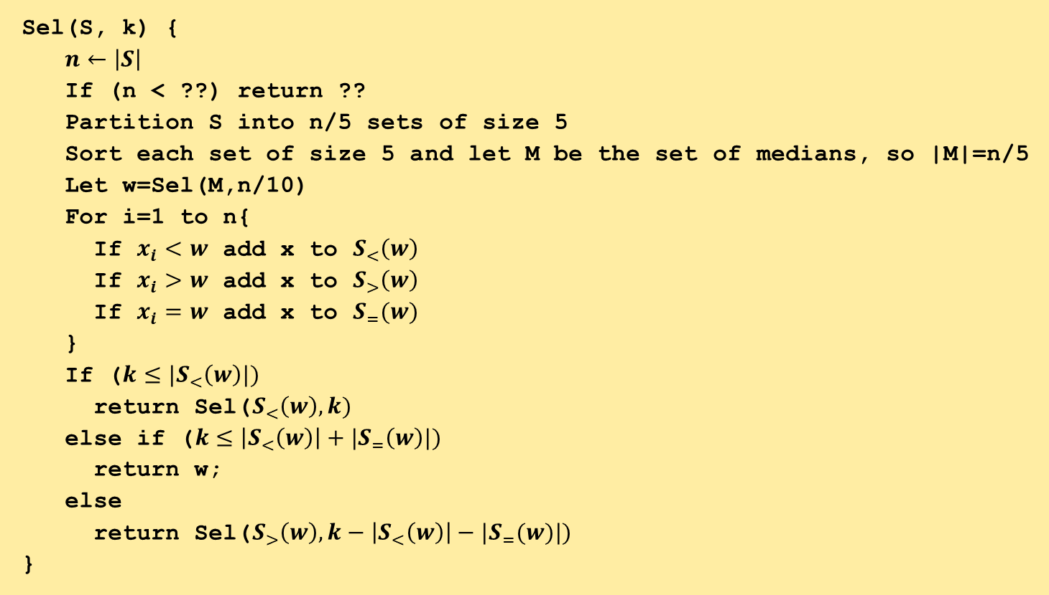
An Improved Idea
Sel(S, k) {
$n←\left|S\right|$
If (n < ??) return ??
Partition S into n/5 sets of size 5
Sort each set of size 5 and let M be the set of medians, so |M|=n/5
Let w=Sel(M,n/10)
For i=1 to n{
If $x_{i}<w$ add x to $S_{<}\left(w\right)$
If $x_{i}>w$ add x to $S_{>}\left(w\right)$
If $x_{i}=w$ add x to $S_{=}(w)$
}
If ($k≤|S_{<}\left(w\right)|)$
return Sel($S_{<}\left(w\right),k)$
else if ($k≤\left|S_{<}\left(w\right)\right|+|S_{=}\left(w\right)|)$
return w;
else
return Sel($S_{>}\left(w\right),k−\left|S_{<}\left(w\right)\right|−{|S}_{=}(w)|)$
}
We can maintain each
set in an array

