Slide 1
CSE 421
Divide and Conquer / Multiplication & Median
Yin Tat Lee

Slide 2
Integer Multiplication Matlab code is included in the pptx. For this class, you just need to remember FFT and convolution can be done in O(n log n) time

Slide 3
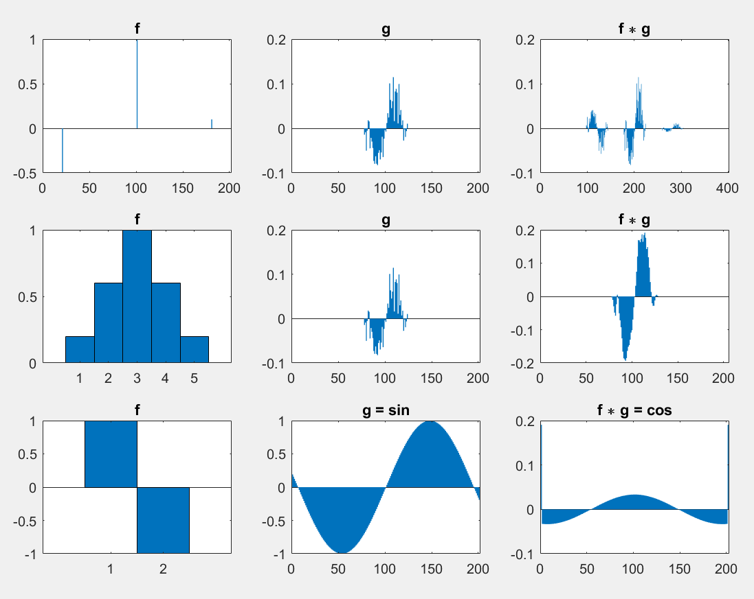
Convolution
Recall that
$${\left(f∗g\right)}_{t}=\sum_{k=−∞}^{∞}{f_{k}g_{t−k}}.$$
Question: Why we can solve integer multiplication using convolution?
Notes:
% slide 1
t = -100:100;
x = t / 30;
a = sin(x) .* abs(abs(x)-pi/4).^2;
a = a + 0.03 *randn(size(t));
a(abs(x)>pi/4) = 0;
b = zeros(size(t));
b(101) = 1;
b(101-80) = -0.5;
b(101+80) = 0.1;
subplot(3,3,1);
bar(b,1);
title('f');
subplot(3,3,2);
bar(a,1);
title('g');
subplot(3,3,3);
bar(conv(a,b),1);
title('f \ast g');
b = [0.2 0.6 1 0.6 0.2];
subplot(3,3,4);
bar(b,1);
title('f');
subplot(3,3,5);
bar(a,1);
title('g');
subplot(3,3,6);
bar(conv(a,b),1);
title('f \ast g');
a = sin(x);
b = [1 -1];
subplot(3,3,7);
bar(b,1);
title('f');
subplot(3,3,8);
bar(a,1);
title('g = sin');
subplot(3,3,9);
bar(conv(a,b),1);
title('f \ast g = cos');

Slide 4
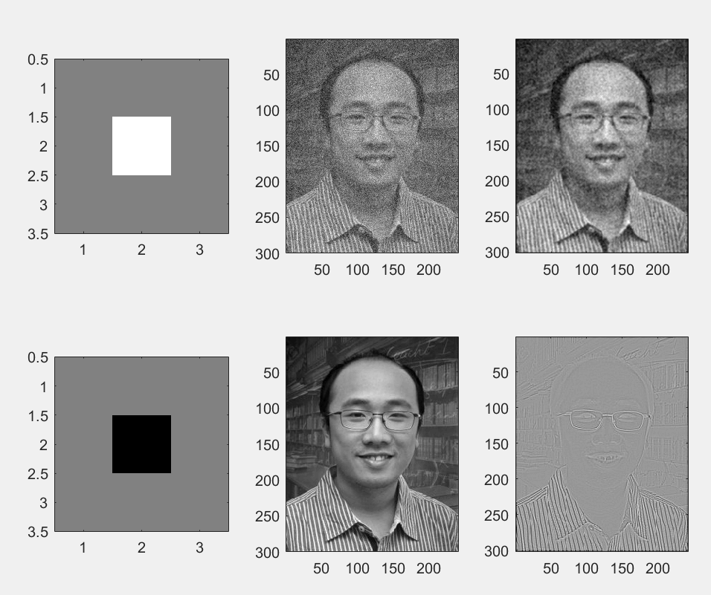
2-D Convolution (just for fun)
$${\left(f∗g\right)}_{t_{1},t_{2}}=\sum_{k_{1},k_{2}=−∞}^{∞}{f_{k_{1},k_{2}}g_{t_{1}−k_{1},t_{2}−k_{2}}}.$$
0.5
1
0.5
-4
Notes:
A = imread('http://yintat.com/wp-content/uploads/2017/12/2011_photo1-240x300.jpg');
A_ = double(A(:,:,1)) + double(A(:,:,2)) + double(A(:,:,3));
A = A_ + randn(size(A_)) * 100;
B = [0.5 0.5 0.5; 0.5 1 0.5; 0.5 0.5 0.5];
subplot(2,3,1);
imagesc(B)
colormap('gray')
caxis([0 1])
axis image
subplot(2,3,2);
imagesc(A)
colormap('gray')
axis image
subplot(2,3,3);
C = conv2(A,B);
imagesc(C)
colormap('gray')
axis image
B = [0.5 0.5 0.5; 0.5 -4 0.5; 0.5 0.5 0.5];
subplot(2,3,4);
imagesc(B)
colormap('gray')
caxis([0 1])
axis image
subplot(2,3,5);
imagesc(A_)
colormap('gray')
axis image
subplot(2,3,6);
imagesc(conv2(A_,B))
colormap('gray')
axis image

Slide 5
Convolution neural network (just for fun)
Convolution is a way to extract information from data.
But how can we design what kernel to use?
Optimization…

Slide 6
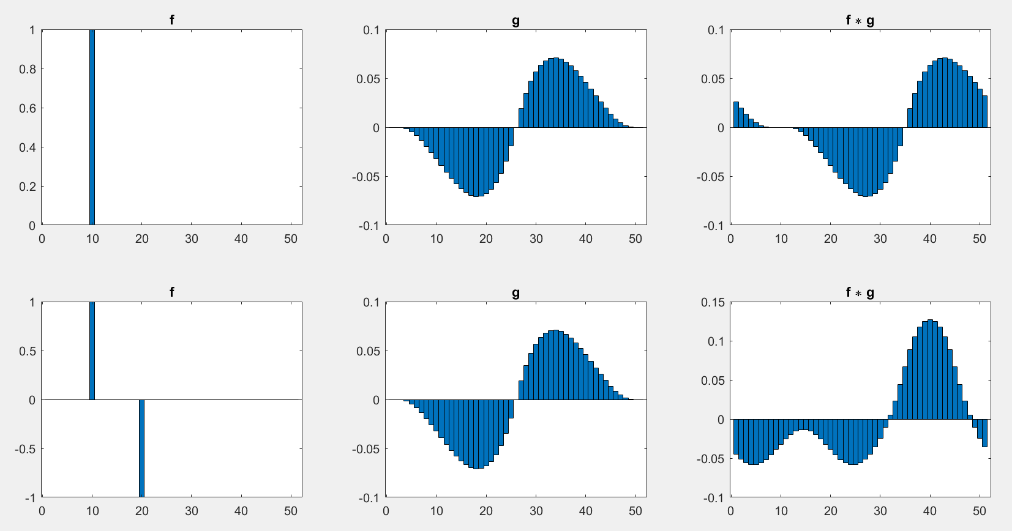
Circular Convolution
Given $f_{0},f_{1},⋯,f_{N−1}$; $g_{0},g_{1},⋯,g_{N−1}$
$${\left(f∗g\right)}_{t}=\sum_{k=0}^{N−1}{f_{k}g_{t−k mod N}}.$$
Question: If we can compute circular convolution in time $O(n log n)$,
then we can calculate convolution in time $O(n log n)$.
Notes:
%% slide 3
t = -25:25;
x = t / 30;
a = sin(x) .* abs(abs(x)-pi/4).^2;
a(abs(x)>pi/4) = 0;
b = zeros(1,51);
b(10) = 1;
subplot(2,3,1);
bar(b,1);
title('f');
subplot(2,3,2);
bar(a,1);
title('g');
subplot(2,3,3);
bar(cconv(a,b, 51),1);
title('f \ast g');
b = zeros(1,51);
b(10) = 1;
b(20) = -1;
subplot(2,3,4);
bar(b,1);
title('f');
subplot(2,3,5);
bar(a,1);
title('g');
subplot(2,3,6);
bar(cconv(a,b, 51),1);
title('f \ast g');

Slide 7
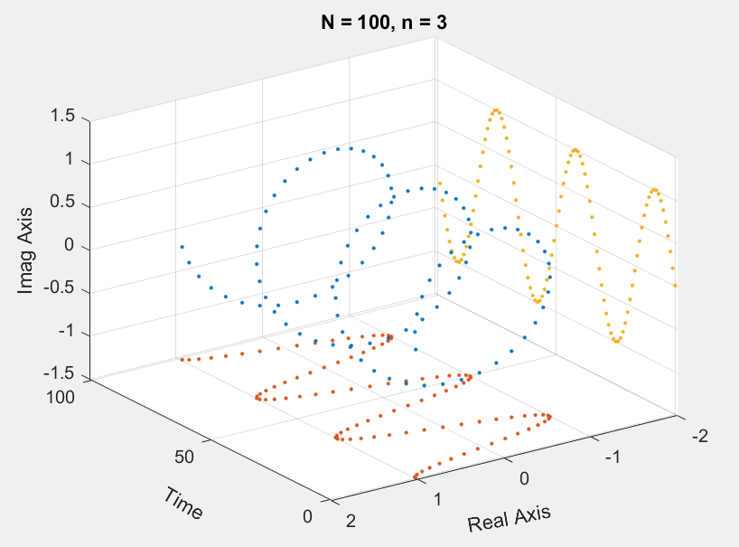
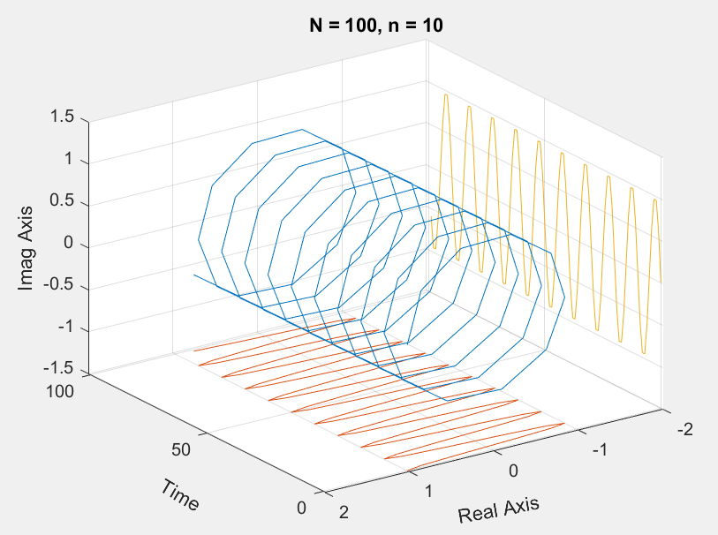
Discrete Fourier Transform
Given $x_{0},x_{1},⋯,x_{N−1}∈ℂ$;
$$ℱ{\left(x\right)}_{k}=\sum_{n=0}^{N−1}{x_{n}⋅e^{−\frac{2πi}{N}kn}}=\sum_{n=0}^{N−1}{x_{n}⋅\left[\cos{(\frac{2πkN}{n}})−i\sin{(\frac{2πkN}{n}})\right]}$$
What is $e^{−\frac{2πi}{N}kn}$ looks like for fixed $n$ and $N$?
Fourier Transform is just the sum of these spirals.
Notes:
%% slide 4
N = 100;
t = 0:(N-1);
n = 3;
f = exp(2*pi*n/N*1i*t);
figure(1)
plot3(t, real(f), imag(f), '.')
hold on
plot3(t, real(f), zeros(size(t))-1.5, '.')
plot3(t, zeros(size(t))-2, imag(f), '.')
hold off
grid on
axis([-1 N+1 -2 2 -1.5 1.5])
view([-125 30])
xlabel('Time', 'Rotation',-30)
ylabel('Real Axis', 'Rotation',10)
zlabel('Imag Axis')
title('N = 100, n = 3');
N = 100;
t = 0:(N-1);
n = 10;
f = exp(2*pi*n/N*1i*t);
figure(2)
plot3(t, real(f), imag(f))
hold on
plot3(t, real(f), zeros(size(t))-1.5)
plot3(t, zeros(size(t))-2, imag(f))
hold off
grid on
axis([-1 N+1 -2 2 -1.5 1.5])
view([-125 30])
xlabel('Time', 'Rotation',-30)
ylabel('Real Axis', 'Rotation',10)
zlabel('Imag Axis')
title('N = 100, n = 10');

Slide 8
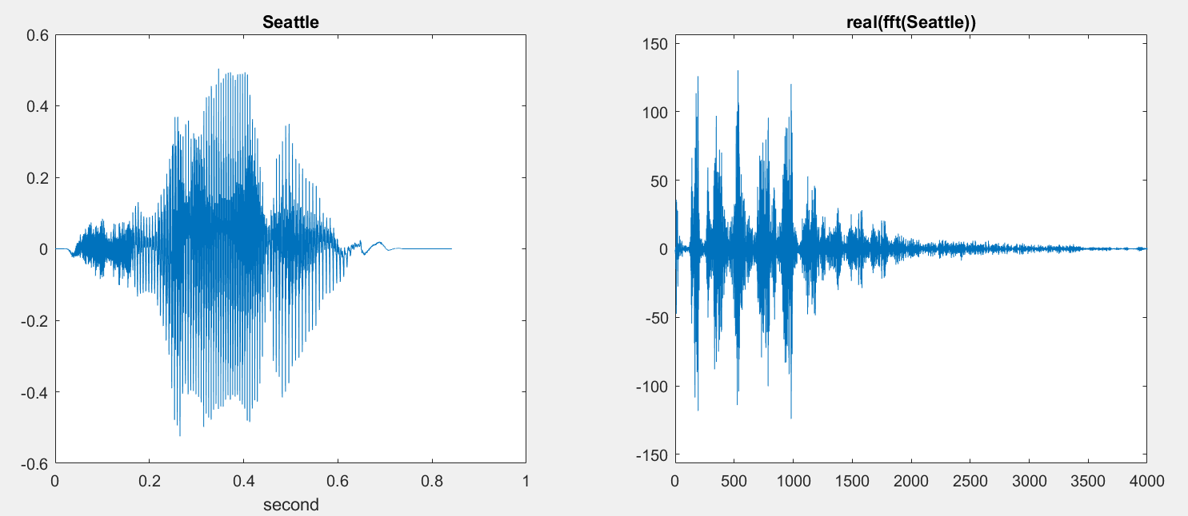
DFT is invertible!
Given $x_{0},x_{1},⋯,x_{N−1}∈ℂ$;
$$ℱ{\left(x\right)}_{k}=\sum_{n=0}^{N−1}{x_{n}⋅e^{−\frac{2πi}{N}kn}}.$$
This maps is invertible and hence
$$x_{k}=\frac{1}{N}\sum_{n=0}^{N−1}{ℱ{\left(x\right)}_{n}⋅e^{\frac{2πi}{N}kn}}.$$
This is saying all complex signals can be represented by spirals!
So, you can think $x$ is signal, $ℱ(x)$ is the frequency (or opposite).
Notes:
%% slide 4
N = 100;
t = 0:(N-1);
n = 3;
f = exp(2*pi*n/N*1i*t);
figure(1)
plot3(t, real(f), imag(f), '.')
hold on
plot3(t, real(f), zeros(size(t))-1.5, '.')
plot3(t, zeros(size(t))-2, imag(f), '.')
hold off
grid on
axis([-1 N+1 -2 2 -1.5 1.5])
view([-125 30])
xlabel('Time', 'Rotation',-30)
ylabel('Real Axis', 'Rotation',10)
zlabel('Imag Axis')
title('N = 100, n = 3');
N = 100;
t = 0:(N-1);
n = 10;
f = exp(2*pi*n/N*1i*t);
figure(2)
plot3(t, real(f), imag(f))
hold on
plot3(t, real(f), zeros(size(t))-1.5)
plot3(t, zeros(size(t))-2, imag(f))
hold off
grid on
axis([-1 N+1 -2 2 -1.5 1.5])
view([-125 30])
xlabel('Time', 'Rotation',-30)
ylabel('Real Axis', 'Rotation',10)
zlabel('Imag Axis')
title('N = 100, n = 10');

Slide 9
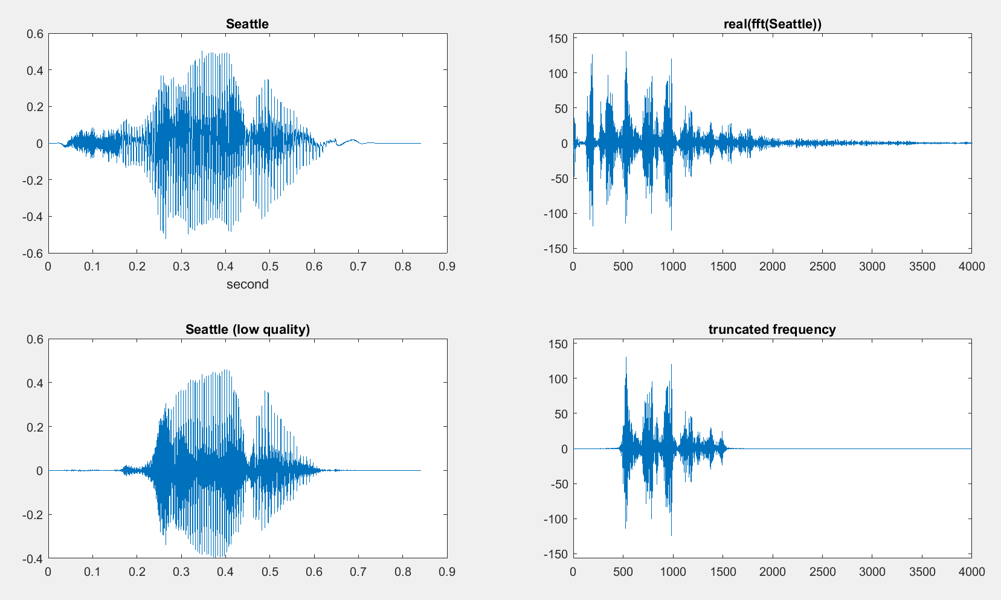
(just for fun)
Notes:
[y,FS] = audioread('Seattle.mp3');
subplot(2,2,1);
t = ((1:size(y))/FS);
plot(t,y)
xlabel('second')
title('Seattle');
% lol, you can play it like this soundsc(y,FS)
N = length(y);
hz = FS.*(fftshift(-(N/2-1):(N/2)))/N;
subplot(2,2,2);
fy = fft(y);
mfy = max(abs(fy));
plot(hz, real(fy))
axis([0 4000 -1.2*mfy 1.2*mfy])
title('real(fft(Seattle))');
low = 500;
hi = 1500;
f = exp(-max(abs(abs(hz) - (low+hi)/2) - (hi-low)/2,0)/20)';
subplot(2,2,4);
fy_ = fy.*f;
plot(hz, real(fy_))
axis([0 4000 -1.2*mfy 1.2*mfy])
title('truncated frequency');
subplot(2,2,3);
z = real(ifft(fy_));
plot(t, z)
title('Seattle (low quality)');
%soundsc(z,FS)
audiowrite('Seattle_bad.wav', z/max(abs(z)), FS);

Slide 10
Convolution Theorem
Given $x_{0},x_{1},⋯,x_{N−1}∈ℂ$;
$$ℱ{\left(x\right)}_{k}=\sum_{n=0}^{N−1}{x_{n}⋅e^{−\frac{2πi}{N}kn}}.$$
Theorem: $ℱ\left(x\right)⋅ℱ\left(y\right)=ℱ\left(x∗y\right)$.
Corollary: $x∗y=ℱ^{−1}(ℱ\left(x\right)⋅ℱ\left(y\right))$.
Proof:
Let $e_{i}$ be a vector that is $1$ at index $i$ and $0$ otherwises.
Note that $x=∑x_{i}e_{i}$ and $y=∑y_{j}e_{j}$, then
Then, we have
$$ℱ\left(x\right)⋅ℱ\left(y\right)=∑x_{i}ℱ\left(e_{i}\right)⋅∑y_{j}ℱ\left(e_{j}\right)=∑x_{i}y_{j}ℱ\left(e_{i}\right)⋅ℱ\left(e_{j}\right)$$
Exercise: $ℱ\left(e_{i}\right)⋅ℱ\left(e_{j}\right)=ℱ\left(e_{i}∗e_{j}\right)$ for all $i,j$,
Hence, $ℱ\left(x\right)⋅ℱ\left(y\right)=∑x_{i}y_{j}ℱ\left(e_{i}∗e_{j}\right)=ℱ\left(∑x_{i}y_{j}e_{i}∗e_{j}\right)=ℱ\left(x∗y\right)$.
To compute convolution,
It suffices to compute DFT

Slide 11
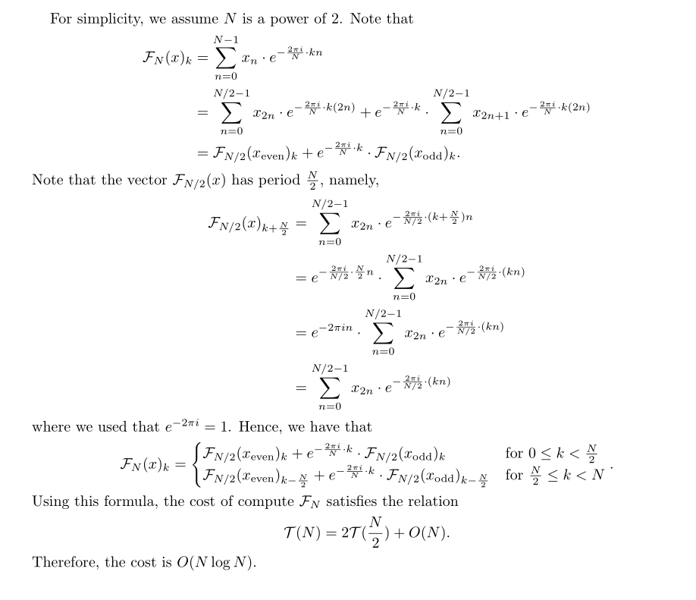
Fast Fourier Transform
Given $x_{0},x_{1},⋯,x_{N−1}∈ℂ$;
$$ℱ{\left(x\right)}_{k}=\sum_{n=0}^{N−1}{x_{n}⋅e^{−\frac{2πi}{N}kn}}.$$

Slide 12
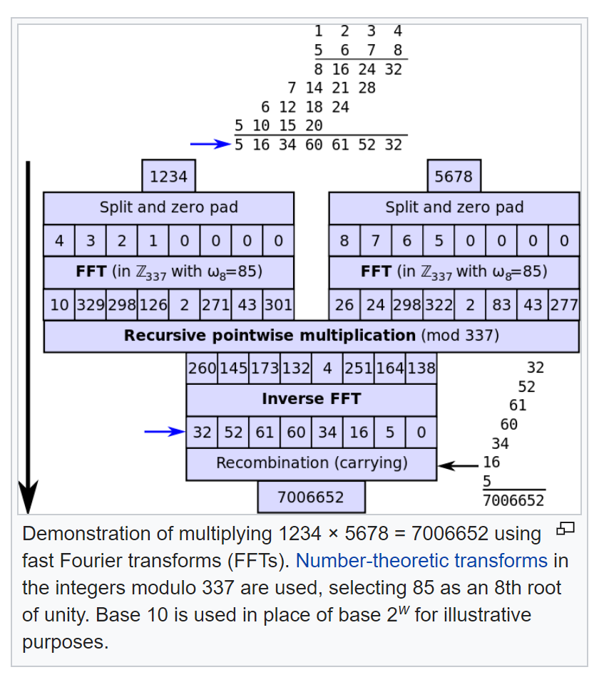
Integer Multiplication

Slide 13
Median

Slide 14
Selecting k-th smallest
Problem: Given numbers $x_{1},…,x_{n}$ and an integer $1≤k≤n$ output the $k$-th smallest number
$$Sel(\left\{x_{1},…,x_{n}\right\},k)$$
A simple algorithm: Sort the numbers in time $O(n log⁡n)$then return the $k$-th smallest in the array.
Can we do better?
Yes, in time $O(n)$ if $k=1$ or $k=2.$
Can we do $O\left(n\right)$ for all possible values of k?

Slide 15
An Idea
Choose a number $w$ from $x_{1},…,x_{n}$
Define
$S_{<}\left(w\right)=\left\{x_{i}:x_{i}<w\right\}$
$S_{=}\left(w\right)=\left\{x_{i}:x_{i}=w\right\}$
$S_{>}\left(w\right)=\left\{x_{i}:x_{i}>w\right\}$
Solve the problem recursively as follows:
If $k≤{|S}_{<}(w)|$, output $Sel(S_{<}\left(w\right),k)$
Else if $k≤\left|S_{<}\left(w\right)\right|+\left|S_{=}\left(w\right)\right|$, output w
Else output $Sel(S_{>}\left(w\right),k−|S_{<}\left(w\right)|−|S_{=}\left(w\right)|)$
Ideally want $\left|S_{<}\left(w\right)\right|,{|S}_{>}(w)|≤n/2$. In this case ALG runs in $O\left(n\right)+O\left(\frac{n}{2}\right)+O\left(\frac{n}{4}\right)+…+O\left(1\right)=O\left(n\right).$
Can be computed in
linear time

Slide 16
How to choose w?
Suppose we choose w uniformly at random
similar to the pivot in quicksort.
Then, $𝔼\left[\left|S_{<}\left(w\right)\right|\right]=𝔼\left[\left|S_{>}\left(w\right)\right|\right]=n/2.$ Algorithm runs in $O(n)$ in expectation.
Can we get $O(n)$ running time deterministically?
Partition numbers into sets of size 3.
Sort each set (takes O(n))
$w=Sel(midpoints,n/6$)
$$≤$$
$$≤$$
$$≤$$
$$≤$$
$$≤$$
$$≤$$
$$≤$$
$$≤$$
$$≤$$
$$≤$$
$$≤$$
$$≤$$
$$≤$$
$$≤$$
$$w$$
$$≤$$
$$≤$$
$$≤$$
$$≤$$
$$≤$$
$$≤$$
$$≤$$
$$≤$$
$$≤$$
$$≤$$
$$≤$$
$$≤$$
$$≤$$
$$≤$$

Slide 17
How to lower bound $\left|S_{<}\left(w\right)\right|,|S_{>}\left(w\right)|$?
Assume all numbers are distinct for simplicity.
$$>w$$
$\left|S_{<}\left(w\right)\right|≥2\left(\frac{n}{6}\right)=\frac{n}{3}$
$\left|S_{>}\left(w\right)\right|≥2\left(\frac{n}{6}\right)=\frac{n}{3}.$
So, what is the running time?
$$<$$
$$<$$
$$<$$
$$<$$
$$<$$
$$<$$
$$<$$
$$<$$
$$<$$
$$<$$
$$<$$
w
$$<$$
$$<$$
$$<$$
$$<$$
$$<$$
$$<$$
$$<$$
$$<$$
$$<$$
$$<$$
$$<$$
$$<$$
$$<$$
$$<$$
$$<$$
$$<$$
$$<$$
$$<$$
$$<$$
$$<$$
$$<$$
$$<w$$
$$\frac{n}{3}≤{|S}_{<}\left(w\right)|,\left|S_{>}\left(w\right)\right|≤\frac{2n}{3}$$

Slide 18
Asymptotic Running Time?
Assume all numbers are distinct for simplicity.
If $k≤{|S}_{<}(w)|$, output $Sel(S_{<}\left(w\right),k)$
Else if $k≤\left|S_{<}\left(w\right)\right|+\left|S_{=}\left(w\right)\right|$, output w
Else output $Sel(S_{>}\left(w\right),k−|S_{<}\left(w\right)|−|S_{=}\left(w\right)|)$
Where $\frac{n}{3}≤\left|S_{<}\left(w\right)\right|,\left|S_{>}\left(w\right)\right|≤\frac{2n}{3}$
$$T\left(n\right)=T\left(\frac{n}{3}\right)+T\left(\frac{2n}{3}\right)+O\left(n\right)⇒T\left(n\right)=O(n log n)$$
$$<$$
$$<$$
$$<$$
$$<$$
$$<$$
$$<$$
$$<$$
$$<$$
$$<$$
$$<$$
$$<$$
$$w$$
$$<$$
$$<$$
$$<$$
$$<$$
$$<$$
$$<$$
$$<$$
$$<$$
$$<$$
$$<$$
$$<$$
$$<$$
$$<$$
$$<$$
$$<$$
$$<$$
$$<$$
$$<$$
$$<$$
$$<$$
$$<$$
$O(n log⁡n)$ again?
So, what is the point?

Slide 19
An Improved Idea
$$>w$$
Partition into n/5 sets. Sort each set and set $w=Sel(midpoints,n/10$)
$\left|S_{<}\left(w\right)\right|≥3\left(\frac{n}{10}\right)=\frac{3n}{10}$
$\left|S_{>}\left(w\right)\right|≥3\left(\frac{n}{10}\right)=\frac{3n}{10}$
$$T\left(n\right)=T\left(\frac{n}{5}\right)+T\left(\frac{7n}{10}\right)+O\left(n\right)⇒T\left(n\right)=O(n)$$
$$<$$
$$<$$
$$<$$
$$<$$
$$<$$
$$<$$
$$<$$
$$<$$
$$<$$
$$<$$
$$<$$
$$<$$
$$<$$
$$<$$
$$<$$
$$<$$
$$<$$
$$<$$
$$<$$
$$<$$
$$<$$
$$<$$
$$<$$
$$<$$
$$<$$
$$<$$
$$<$$
$$<$$
$$<$$
$$<$$
$$<$$
$$<$$
$$<$$
$$<$$
$$<$$
$$<$$
$$<$$
$$<$$
$$<$$
$$<$$
$$<$$
$$<$$
$$<$$
$$<$$
$$<$$
$$<$$
$$<$$
$$<$$
$$<$$
$$<$$
$$<$$
$$<$$
$$<$$
$$<$$
$$<w$$
$$\frac{3n}{10}≤{|S}_{<}\left(w\right)|,\left|S_{>}\left(w\right)\right|≤\frac{7n}{10}$$

Slide 20
An Improved Idea
Sel(S, k) {
$n←\left|S\right|$
If (n < ??) return ??
Partition S into n/5 sets of size 5
Sort each set of size 5 and let M be the set of medians, so |M|=n/5
Let w=Sel(M,n/10)
For i=1 to n{
If $x_{i}<w$ add x to $S_{<}\left(w\right)$
If $x_{i}>w$ add x to $S_{>}\left(w\right)$
If $x_{i}=w$ add x to $S_{=}(w)$
}
If ($k≤|S_{<}\left(w\right)|)$
return Sel($S_{<}\left(w\right),k)$
else if ($k≤\left|S_{<}\left(w\right)\right|+|S_{=}\left(w\right)|)$
return w;
else
return Sel($S_{>}\left(w\right),k−\left|S_{<}\left(w\right)\right|−{|S}_{=}(w)|)$
}
We can maintain each
set in an array

