Slide 1
CSE 421
Master Theorem
Yin Tat Lee

Slide 2


Almost 1D Problem
Partition each side of $L$ into $\frac{δ}{2}×\frac{δ}{2}$ squares
Claim: No two points lie in the same $\frac{δ}{2}×\frac{δ}{2}$ box.
Say we want to check if there is a point < $δ$ close to point 31.
Only need to check points with indices roughly 31. (coz we sorted).
How many? Not too many coz every box only have 1 point.
49
$$>δ$$
31
30
29
27
28
26
25
δ
δ

Slide 3

Closest Pair (2 dimension)
Closest-Pair($p_{1},p_{2},⋯,p_{n}$) {
if($n≤2$) return $|p_{1}−p_{2}|$
Compute separation line $L$ such that half the points
are on one side and half on the other side.
$δ_{1}$ = Closest-Pair(left half)
$δ_{2}$ = Closest-Pair(right half)
$δ$ = min($δ_{1},δ_{2}$)
Delete all points further than δ from separation line L
Sort remaining points p[1]…p[m] by y-coordinate.
for $i=1,2,⋯,m$
for k = $1,2,⋯,11$
if $i+k≤m$
δ = min(δ, distance(p[i], p[i+k]));
return δ.
}

Slide 4
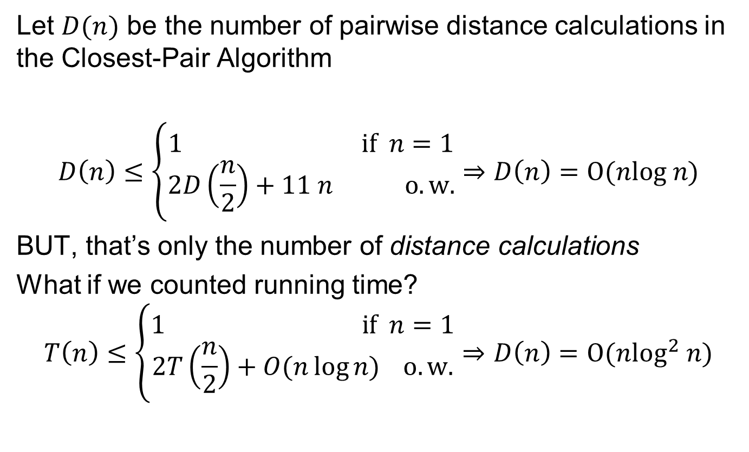
Closest Pair Analysis
  Let $D(n)$ be the number of pairwise distance calculations in the Closest-Pair Algorithm
$$D\left(n\right)≤\left\{\begin{aligned}1 if n=1 \\ 2D\left(\frac{n}{2}\right)+11 n o.w.\end{aligned}\right.⇒D\left(n\right)=O(nlog n)$$
BUT, that’s only the number of distance calculations
What if we counted running time?
$$T\left(n\right)≤\left\{\begin{aligned}1 if n=1 \\ 2T\left(\frac{n}{2}\right)+O(n\log{n)} o.w.\end{aligned}\right.⇒D\left(n\right)=O(n\log^{2} n)$$

Slide 5

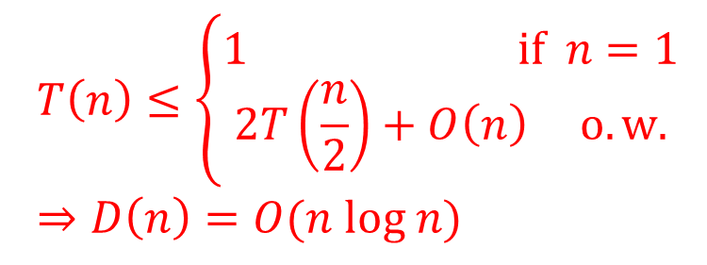
Closest Pair (2 dimension) Improved
Closest-Pair($p_{1},p_{2},⋯,p_{n}$) {
if($n≤2$) return $|p_{1}−p_{2}|$
Compute separation line $L$ such that half the points
are on one side and half on the other side.
($δ_{1},p_{1}$) = Closest-Pair(left half)
($δ_{2},p_{2}$) = Closest-Pair(right half)
$δ$ = min($δ_{1},δ_{2}$)
$p_{sorted}$ = merge($p_{1},p_{2}$) (merge sort it by y-coordinate)
Let $q$ be points (ordered as $p_{sorted}$) that is $δ$ from line L.
for $i=1,2,⋯,m$
for k = $1,2,⋯,11$
if $i+k≤m$
δ = min(δ, distance(q[i], q[i+k]));
return δ and $p_{sorted}$.
}
  $$T\left(n\right)≤\left\{\begin{aligned}1 if n=1 \\ 2T\left(\frac{n}{2}\right)+O\left(n\right) o.w.\end{aligned}\right.⇒D\left(n\right)=O(n log n)$$

Slide 6
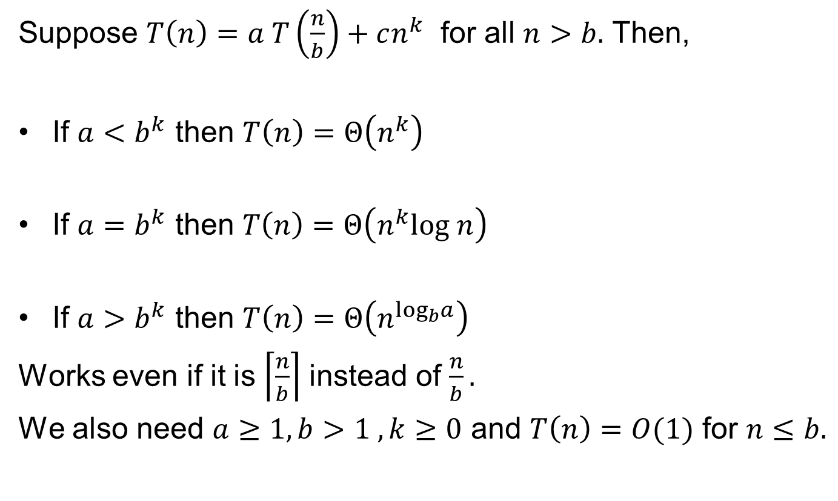
Master Theorem
  Suppose $T\left(n\right)=a T\left(\frac{n}{b}\right)+cn^{k}$ for all $n>b.$ Then,
  If $a<b^{k}$ then $T\left(n\right)=Θ\left(n^{k}\right)$
  If $a=b^{k}$ then $T\left(n\right)=Θ\left(n^{k}log n\right)$
  If $a>b^{k}$ then $T\left(n\right)=Θ\left(n^{\log_{b}a}\right)$
  Works even if it is $\left\lceil \frac{n}{b}\right\rceil$ instead of $\frac{n}{b}.$
  We also need $a≥1,b>1 , k≥0$ and $T\left(n\right)=O(1)$ for $n≤b.$

Slide 7
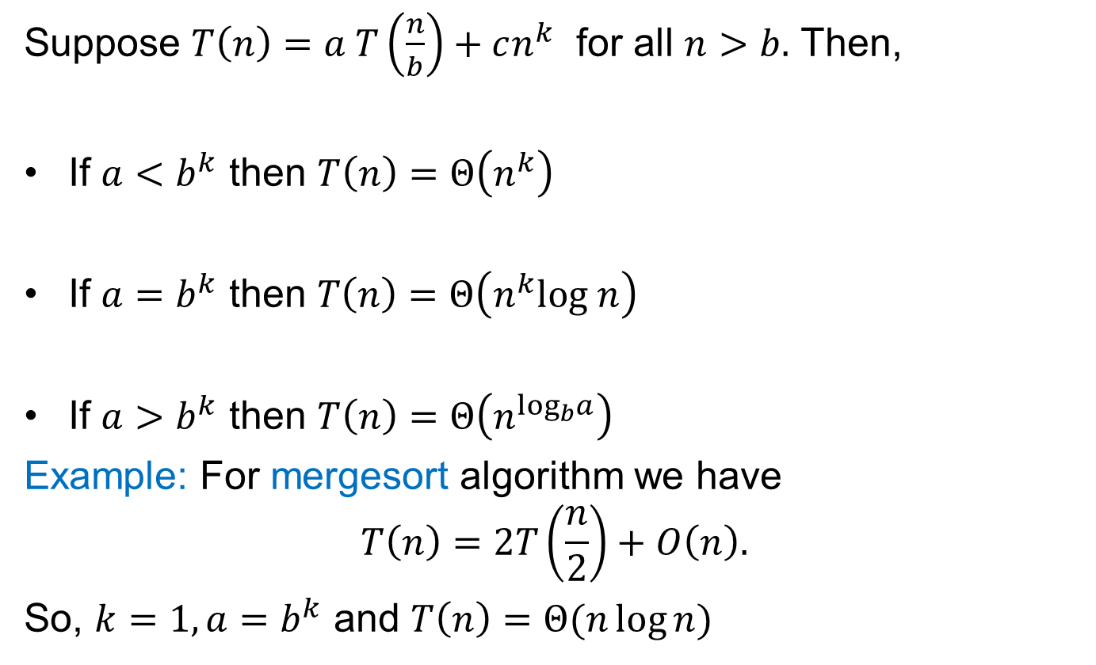
Master Theorem
  Suppose $T\left(n\right)=a T\left(\frac{n}{b}\right)+cn^{k}$ for all $n>b.$ Then,
  If $a<b^{k}$ then $T\left(n\right)=Θ\left(n^{k}\right)$
  If $a=b^{k}$ then $T\left(n\right)=Θ\left(n^{k}log n\right)$
  If $a>b^{k}$ then $T\left(n\right)=Θ\left(n^{\log_{b}a}\right)$
  Example: For mergesort algorithm we have
  $$T\left(n\right)=2T\left(\frac{n}{2}\right)+O\left(n\right).$$
  So, $k=1,a=b^{k}$ and $T\left(n\right)=Θ(n\log{n)}$

Slide 8


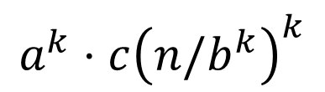










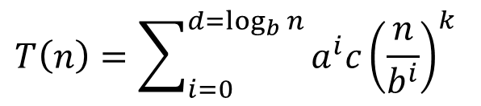



Proving Master Theorem
Problem size
$$T\left(n\right)=aT(n/a)+cn^{k}$$
# probs
cost
$$n$$
$$a$$
$$1$$
$$cn^{k}$$
$$n/b$$
$$a$$
$$a⋅c{\left(n/b\right)}^{k}$$
$$d=\log_{b}n$$
$$n/b^{2}$$
$$a2$$
$$a^{2}⋅c{\left(n/b^{2}\right)}^{k}$$
$$b$$
$$a^{k}⋅c{\left(n/b^{k}\right)}^{k}$$
$$1$$
$$ad$$
$$T\left(n\right)=\sum_{i=0}^{d=\log_{b}{n}}{a^{i}c{\left(\frac{n}{b^{i}}\right)}^{k}}$$

Slide 9

Master Theorem
  Suppose $T\left(n\right)=a T\left(\frac{n}{b}\right)+cn^{k}$ for all $n>b.$ Then,
  If $a<b^{k}$ then $T\left(n\right)=Θ\left(n^{k}\right)$
  If $a=b^{k}$ then $T\left(n\right)=Θ\left(n^{k}log n\right)$
  If $a>b^{k}$ then $T\left(n\right)=Θ\left(n^{\log_{b}a}\right)$
# of problems increases slower
than the decreases of cost.
First term dominates.
# of problems increases faster
than the decreases of cost
Last term dominates.

Slide 10
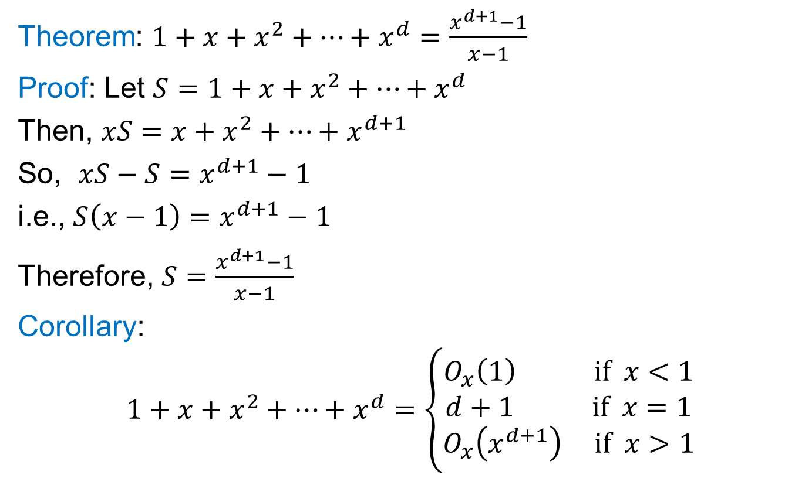
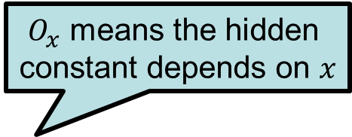
A Useful Identity
Theorem: $1+x+x^{2}+…+x^{d}=\frac{x^{d+1}−1}{x−1}$
Proof: Let $S=1+x+x^{2}+…+x^{d}$
Then, $xS=x+x^{2}+…+x^{d+1}$
So, $xS−S=x^{d+1}−1$
i.e., $S\left(x−1\right)=x^{d+1}−1$
Therefore, $S=\frac{x^{d+1}−1}{x−1}$
Corollary:
$$1+x+x^{2}+…+x^{d}=\left\{\begin{aligned}O_{x}\left(1\right) if x<1 \\ d+1 if x=1 \\ O_{x}\left(x^{d+1}\right) if x>1\end{aligned}\right.$$
$O_{x}$ means the hidden
constant depends on $x$

Slide 11

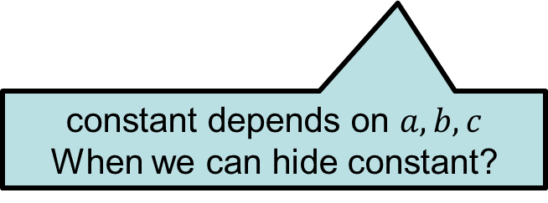
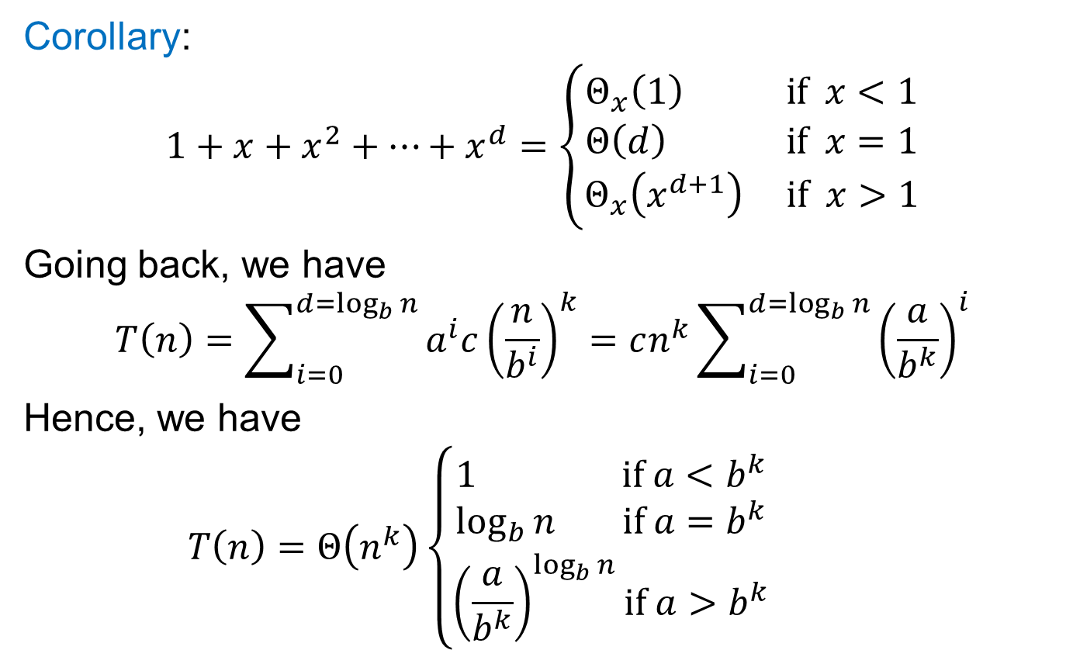
Solve: $T\left(n\right)=aT\left(\frac{n}{b}\right)+cn^{k}$
Corollary:
$$1+x+x^{2}+…+x^{d}=\left\{\begin{aligned}Θ_{x}\left(1\right) if x<1 \\ Θ\left(d\right) if x=1 \\ Θ_{x}\left(x^{d+1}\right) if x>1\end{aligned}\right.$$
Going back, we have
$$T\left(n\right)=\sum_{i=0}^{d=\log_{b}{n}}{a^{i}c{\left(\frac{n}{b^{i}}\right)}^{k}}=cn^{k}\sum_{i=0}^{d=\log_{b}{n}}{{\left(\frac{a}{b^{k}}\right)}^{i}}$$
Hence, we have
$$T\left(n\right)=Θ\left(n^{k}\right)\left\{\begin{aligned}1 if a<b^{k} \\ \log_{b}{n} if a=b^{k} \\ {\left(\frac{a}{b^{k}}\right)}^{\log_{b}{n}}if a>b^{k}\end{aligned}\right.$$
constant depends on $a,b,c$
When we can hide constant?

Slide 12


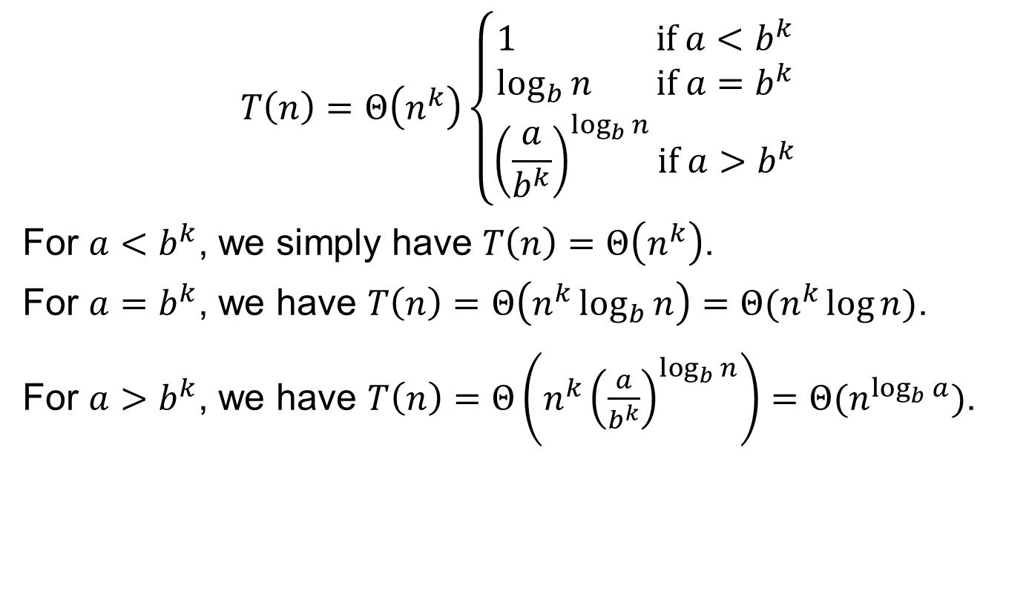
Solve: $T\left(n\right)=aT\left(\frac{n}{b}\right)+cn^{k}$
$$T\left(n\right)=Θ\left(n^{k}\right)\left\{\begin{aligned}1 if a<b^{k} \\ \log_{b}{n} if a=b^{k} \\ {\left(\frac{a}{b^{k}}\right)}^{\log_{b}{n}}if a>b^{k}\end{aligned}\right.$$
For $a<b^{k}$, we simply have $T\left(n\right)=Θ\left(n^{k}\right)$.
For $a=b^{k}$, we have $T\left(n\right)=Θ\left(n^{k}\log_{b}{n}\right)=Θ(n^{k}\log{n})$.
For $a>b^{k}$, we have $T\left(n\right)=Θ\left(n^{k}{\left(\frac{a}{b^{k}}\right)}^{\log_{b}{n}}\right)=Θ(n^{\log_{b}{a}})$.
$b^{k\log_{b}{n}}$
$={\left(b^{\log_{b}{n}}\right)}^{k}$
$=n^{k}$
$$a^{\log_{b}{n}}$$
$$={{(b}^{\log_{b}{a}})}^{\log_{b}{n}}$$
$$={{(b}^{\log_{b}{n}})}^{\log_{b}{a}}$$
$=n^{\log_{b}{a}}$

Slide 13
Example

