Slide 1
CSE 421
Greedy Algorithms / Interval Scheduling
Yin Tat Lee

Slide 2

Interval Scheduling
  Job $j$ starts at $s(j)$ and finishes at $f(j)$.
  Two jobs compatible if they don’t overlap.
  Goal: find maximum subset of mutually compatible jobs.
a
b
b
c
d
e
e
f
g
h
h
Time
0
1
2
3
4
5
6
7
8
9
10
11

Slide 3

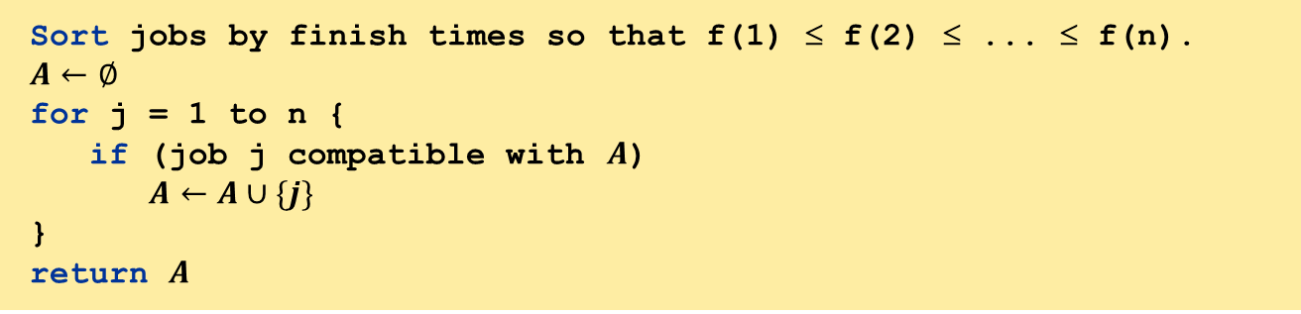
Greedy Alg: Earliest Finish Time
Consider jobs in increasing order of finish time. Take each job provided it’s compatible with the ones already taken.
Implementation. $O(nlog⁡n).$
  Remember job $j^{∗}$ that was added last to $A$.
  Job $j$ is compatible with $A$ if $s\left(j\right)≥f(j^{∗})$.
Sort jobs by finish times so that f(1) ≤ f(2) ≤ ... ≤ f(n).
$$A←∅$$
for j = 1 to n {
if (job j compatible with $A$)
$A←A∪\{j\}$
}
return $A$

Slide 4
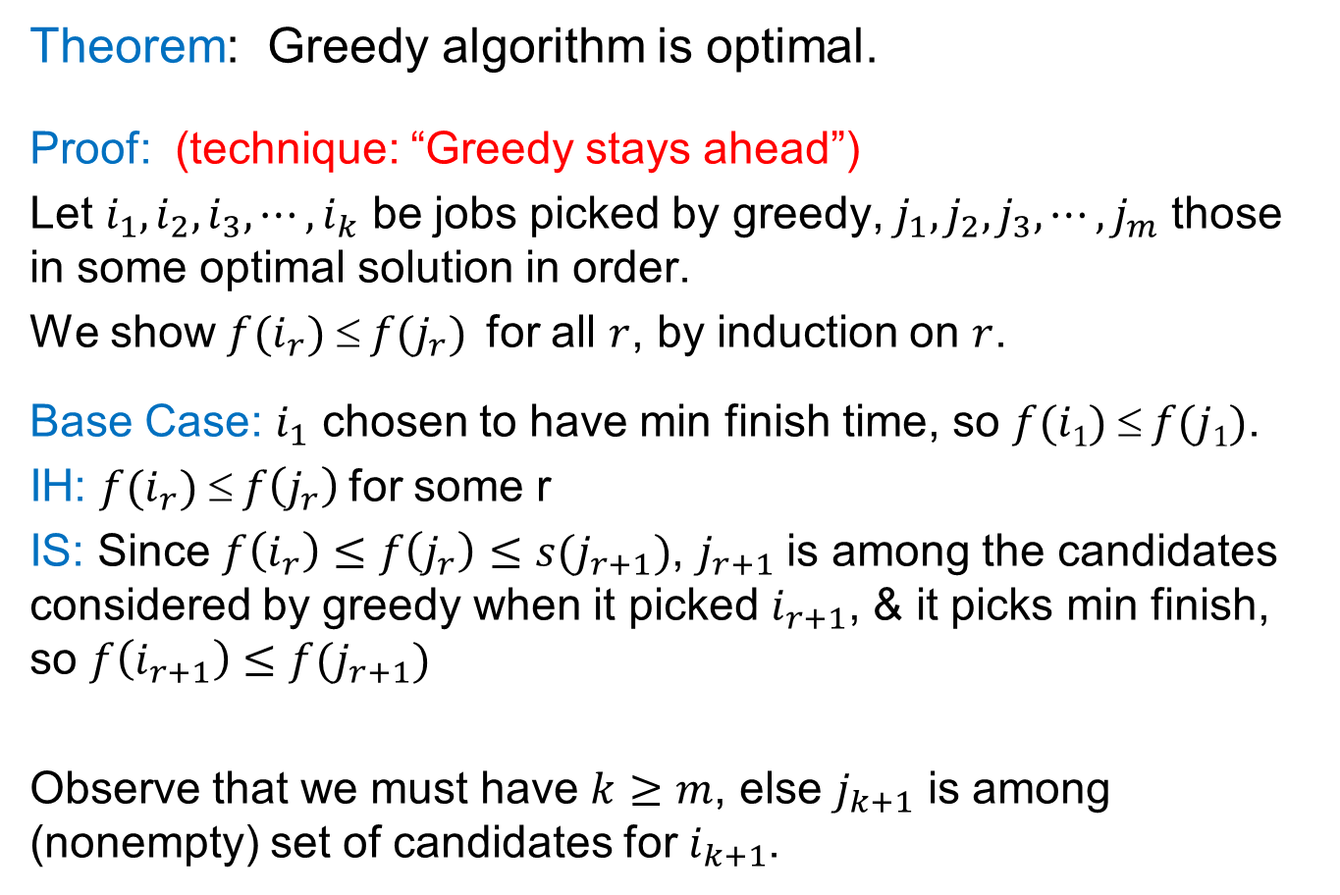
Correctness
Theorem: Greedy algorithm is optimal.
Proof: (technique: “Greedy stays ahead”)
Let $i_{1},i_{2},i_{3},⋯,i_{k}$ be jobs picked by greedy, $j_{1},j_{2},j_{3},⋯,j_{m}$ those in some optimal solution in order.
We show $f(i_{r})  f(j_{r})$ for all $r$, by induction on $r$.
Base Case: $i_{1}$ chosen to have min finish time, so $f(i1)  f(j1)$.
IH: $f(i_{r}) ≤ f\left(j_{r}\right)$ for some r
IS: Since $f\left(i_{r}\right)≤f\left(j_{r}\right)≤s(j_{r+1})$, $j_{r+1}$ is among the candidates considered by greedy when it picked $i_{r+1}$, & it picks min finish, so $f\left(i_{r+1}\right)≤f(j_{r+1})$
Observe that we must have $k≥m$, else $j_{k+1}$ is among (nonempty) set of candidates for $i_{k+1}$.

Slide 5
CSE 421
Greedy Algorithms / Interval Partitioning
Yin Tat Lee

Slide 6

Interval Partitioning
  Lecture $j$ starts at $s(j)$ and finishes at $f(j)$.
  Goal: find minimum number of classrooms to schedule all lectures so that no two occur at the same time in the same room.
Room 4
e
j
Room 3
c
d
g
Room 2
b
h
Room 1
a
f
i
9
9:30
10
10:30
11
11:30
12
12:30
1
1:30
2
2:30
3
3:30
4
4:30
Time

Slide 7
Interval Partitioning
Note: graph coloring is hard in general, but graphs corresponding to interval intersections are simpler.
Room 4
E
J
Room 3
C
D
G
Room 2
B
H
Room 1
A
F
I
e
j
c
d
g
b
h
a
f
i
9
9:30
10
10:30
11
11:30
12
12:30
1
1:30
2
2:30
3
3:30
4
4:30
Time

Slide 8
A Better Schedule
This one uses only 3 classrooms
c
d
f
j
b
g
i
a
e
h
9
9:30
10
10:30
11
11:30
12
12:30
1
1:30
2
2:30
3
3:30
4
4:30
Time

Slide 9

A Greedy Algorithm
Greedy algorithm: Consider lectures in increasing order of finish time: assign lecture to any compatible classroom.
Correctness: This is wrong!
Sort intervals by finish time so that f₁ ≤ f₂ ≤ ... ≤ f_{n}.
d ← 0
for j = 1 to n {
if (lect j is compatible with some classroom k, $1≤k≤d$)
schedule lecture j in classroom k
else
allocate a new classroom d + 1
schedule lecture j in classroom d + 1
d ← d + 1
}

Slide 10
Example
In the interval scheduling problem, we want to ignore super long job.
In this problem, we need to schedule all the jobs.
Picking them tightly is important.
a
b
c
d
Time
0
1
2
3
4
5
6
Greedy by finish time gives:
OPT:
c
a
d
a
b
c
b
d
Time
Time
0
1
2
3
4
5
6
0
1
2
3
4
5
6

Slide 11
A Greedy Algorithm
Greedy algorithm: Consider lectures in increasing order of start time: assign lecture to any compatible classroom.
Implementation: Exercise!
Sort intervals by starting time so that s₁ ≤ s₂ ≤ ... ≤ s_{n}.
d ← 0
for j = 1 to n {
if (lect j is compatible with some classroom k, $1≤k≤d$)
schedule lecture j in classroom k
else
allocate a new classroom d + 1
schedule lecture j in classroom d + 1
d ← d + 1
}

Slide 12
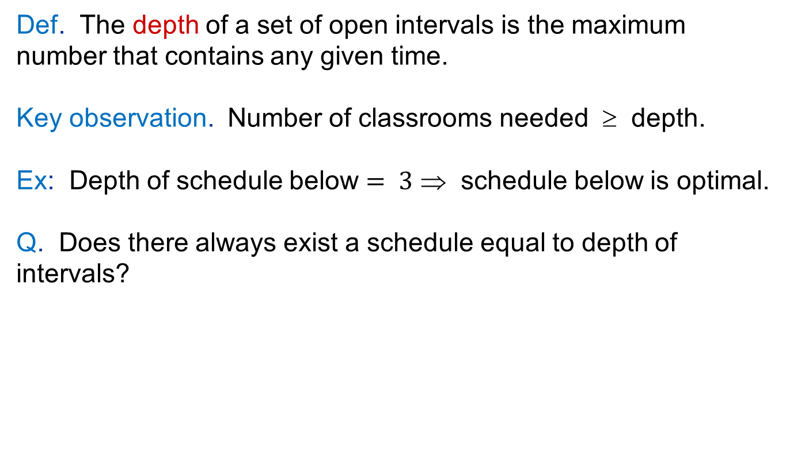
A Structural Lower-Bound on OPT
Def. The depth of a set of open intervals is the maximum number that contains any given time.
Key observation. Number of classrooms needed ≥ depth.
Ex: Depth of schedule below $= 3$ ⇒ schedule below is optimal.
Q. Does there always exist a schedule equal to depth of intervals?
c
d
f
j
b
g
i
a
e
h
9
9:30
10
10:30
11
11:30
12
12:30
1
1:30
2
2:30
3
3:30
4
4:30
Time

Slide 13
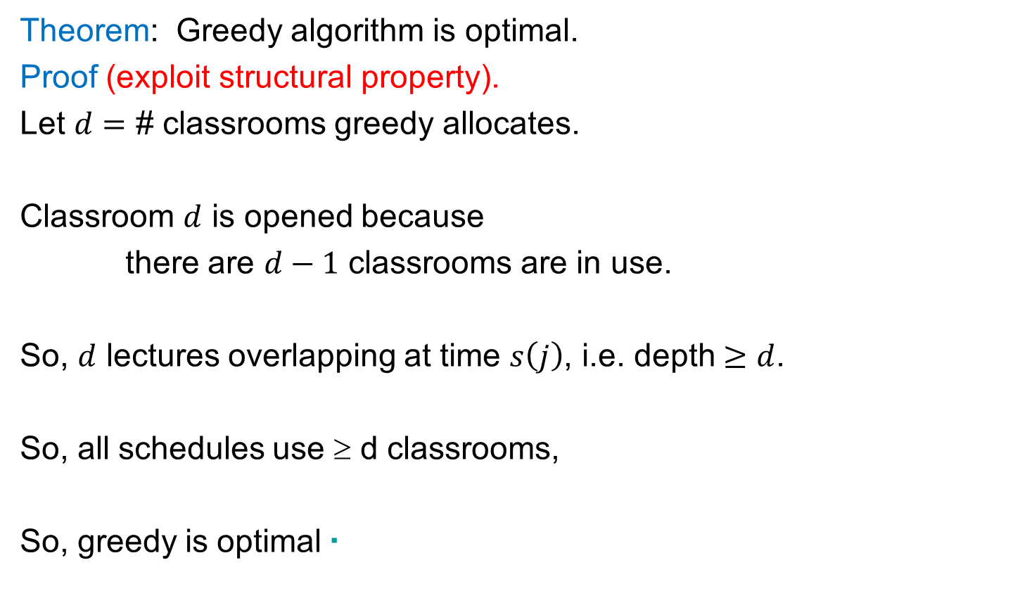
Correctness
Theorem: Greedy algorithm is optimal.
Proof (exploit structural property).
Let $d=$ # classrooms greedy allocates.
Classroom $d$ is opened because
there are $d−1$ classrooms are in use.
So, $d$ lectures overlapping at time $s\left(j\right)$, i.e. depth $≥d$.
So, all schedules use ≥ d classrooms,
So, greedy is optimal ▪

Slide 14
CSE 421
Greedy Algorithms / Minimizing Lateness
Yin Tat Lee

Slide 15
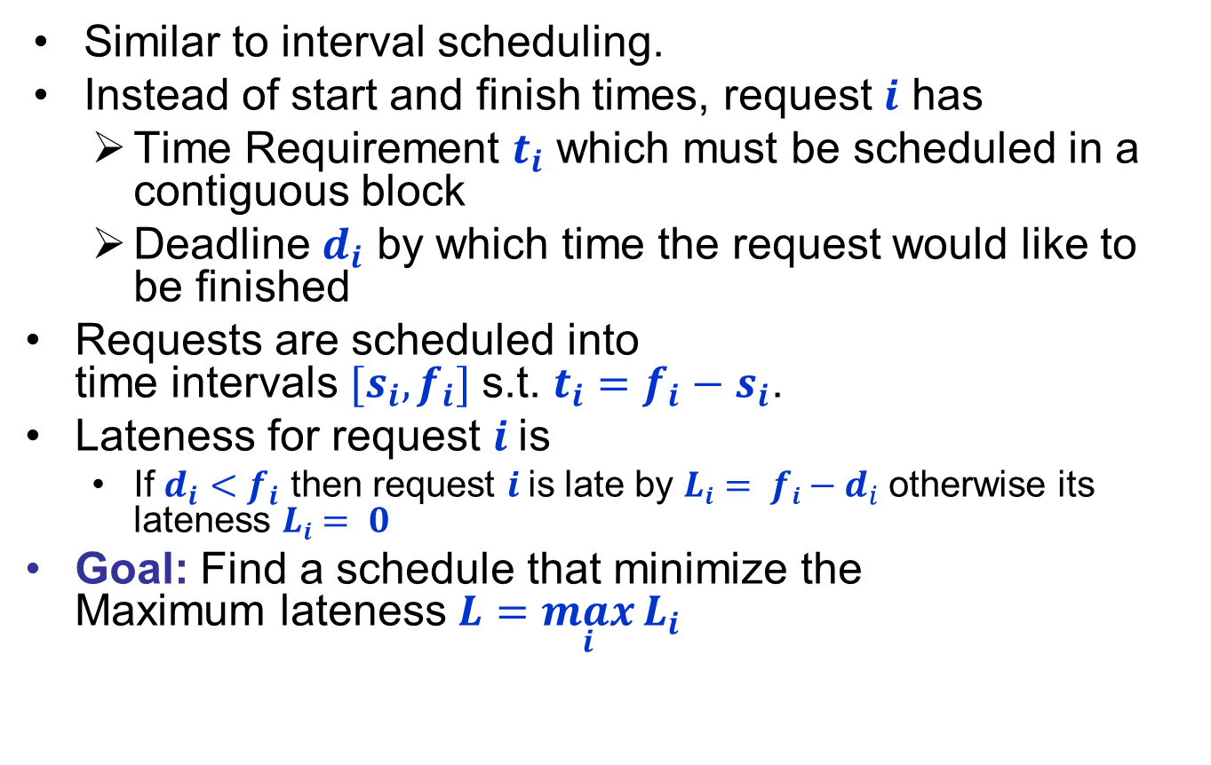


Scheduling to Minimizing Lateness
Similar to interval scheduling.
Instead of start and finish times, request $i$ has
  Time Requirement $t_{i}$ which must be scheduled in a contiguous block
  Deadline $d_{i}$ by which time the request would like to be finished
Requests are scheduled into
time intervals $[s_{i},f_{i}]$s.t. $t_{i}=f_{i}−s_{i}$.
Lateness for request $i$is
  If $d_{i}<f_{i}$ then request $i$is late by $Li= fi−d_{i}$otherwise its lateness $Li= 0$
Goal: Find a schedule that minimize the
Maximum lateness $L=\max_{i}{L_{i}}$
1
2
3
4
5
6
$$t_{j}$$
3
2
1
4
3
2
$$d_{j}$$
6
8
9
9
14
15
lateness = 2
lateness = 0
max lateness = 6
d₃ = 9
d₂ = 8
d₆ = 15
d₁ = 6
d₅ = 14
d₄ = 9
0
1
2
3
4
5
6
7
8
9
10
11
12
13
14
15

Slide 16
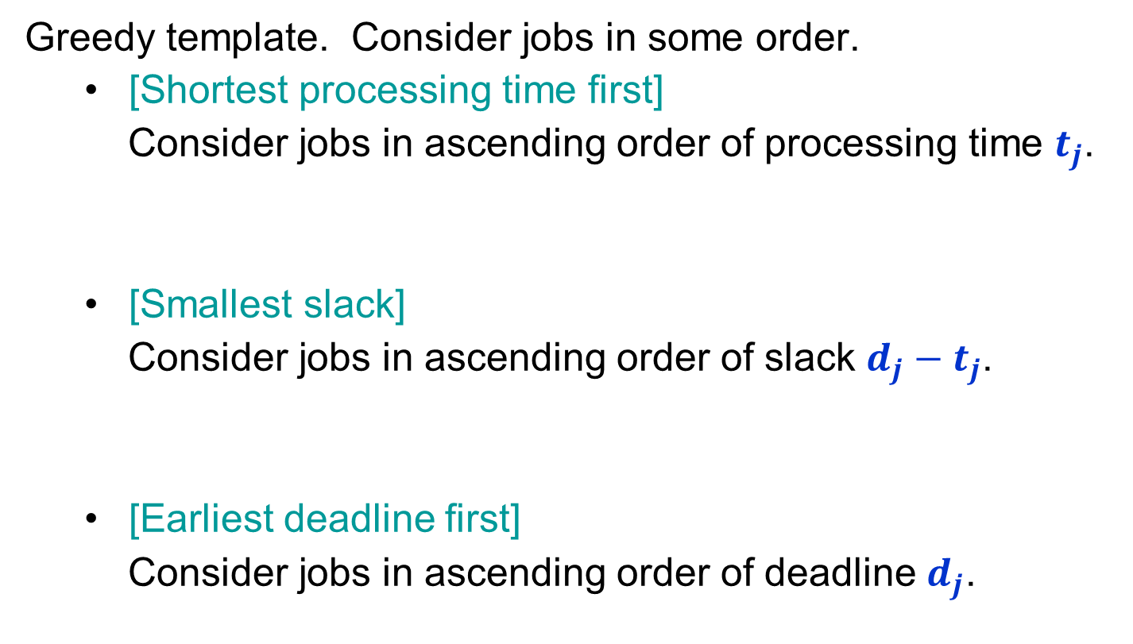
Minimizing Lateness:
Greedy Algorithms
Greedy template. Consider jobs in some order.
  [Shortest processing time first]
  Consider jobs in ascending order of processing time $t_{j}$.
  [Smallest slack]
  Consider jobs in ascending order of slack $d_{j}−t_{j}$.
  [Earliest deadline first]
  Consider jobs in ascending order of deadline $d_{j}$.
1
2
t_{j}
1
10
d_{j}
100
10
counterexample
1
2
t_{j}
1
10
d_{j}
2
10
counterexample

Slide 17

Greedy Algorithm:
Earliest Deadline First
Sort deadlines in increasing order $(d_{1}≤d_{2}≤⋯≤d_{n})$
$$f  0$$
for $i←1$ to $n$ to
$s_{i}  f$
$fi  s_{i}+t_{i}$
$f  f_{i}$
end for
1
2
3
4
5
6
$$t_{j}$$
3
2
1
4
3
2
$$d_{j}$$
6
8
9
9
14
15
max lateness = 1
d₁ = 6
d₂ = 8
d₃ = 9
d₄ = 9
d₅ = 14
d₆ = 15
0
1
2
3
4
5
6
7
8
9
10
11
12
13
14
15

Slide 18
Minimizing Lateness: No Idle Time
Observation.
There exists an optimal schedule with no idle time.
Observation.
The greedy schedule has no idle time.
d = 4
d = 6
d = 12
0
1
2
3
4
5
6
7
8
9
10
11
d = 4
d = 6
d = 12
0
1
2
3
4
5
6
7
8
9
10
11

Slide 19

Proof for Greedy Algorithm:
Exchange Argument
We will show that if there is another schedule $O$ (think optimal schedule) then we can gradually change $O$ so that
  at each step the maximum lateness in $O$ never gets worse.
  it eventually becomes the same cost as $A$.

Slide 20

Minimizing Lateness: Inversions
Definition
An adjacent inversion in schedule $S$ is a pair of jobs $i$ and $j$ such that
  $d_{i}<d_{j}$
  Job $i$ is scheduled immediately after Job $j$
Observation
Greedy schedule has no adjacent inversions.
inversion
before swap
j
i

Slide 21
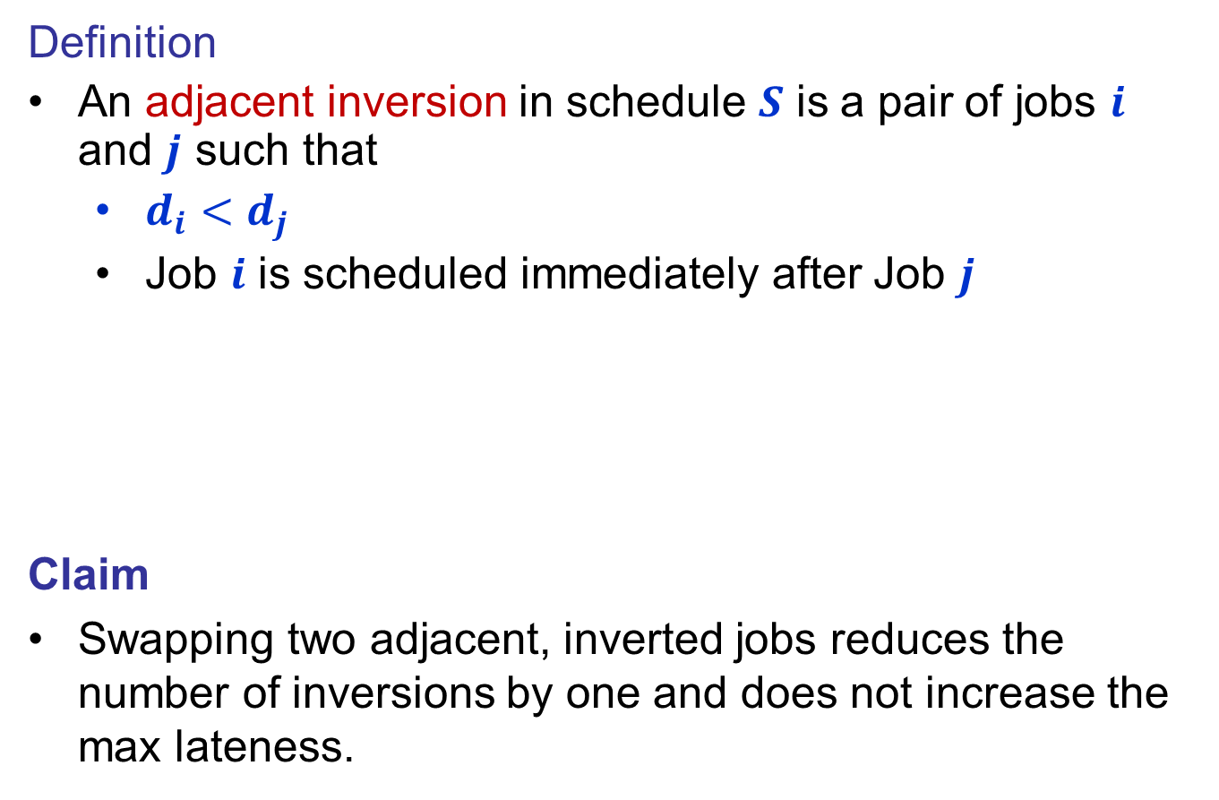


Minimizing Lateness: Inversions
Definition
An adjacent inversion in schedule $S$ is a pair of jobs $i$ and $j$ such that
  $d_{i}<d_{j}$
  Job $i$ is scheduled immediately after Job $j$
Claim
Swapping two adjacent, inverted jobs reduces the number of inversions by one and does not increase the max lateness.
inversion
$$f_{i}$$
before swap
j
i
after swap
i
j
$$f_{j}^{′}$$

Slide 22
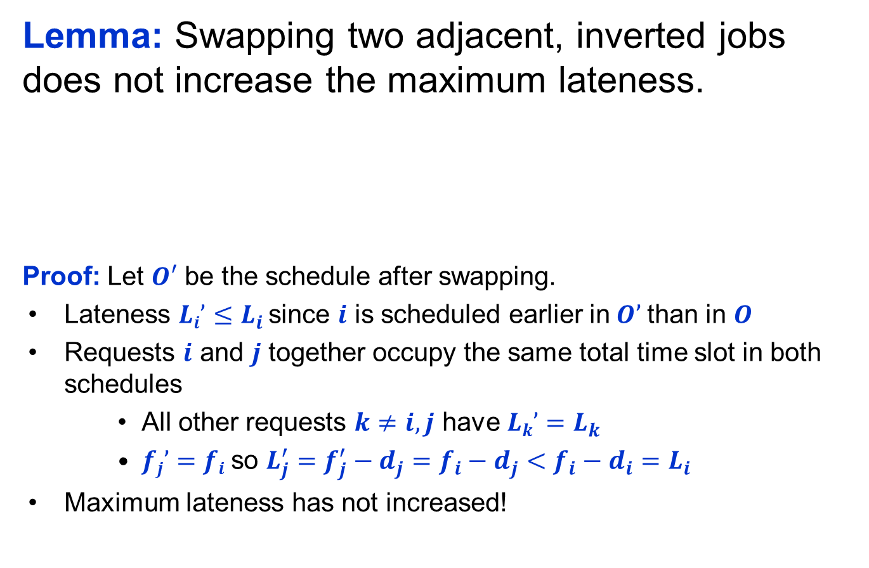


Minimizing Lateness: Inversions
Lemma: Swapping two adjacent, inverted jobs does not increase the maximum lateness.
Proof: Let $O′$ be the schedule after swapping.
Lateness $Li’≤L_{i}$ since $i$ is scheduled earlier in$O’$than in $O$
Requests $i$ and $j$ together occupy the same total time slot in both schedules
    All other requests $k≠i,j$ have $Lk’=L_{k}$
    $fj’=fi$so $L_{j}^{′}=f_{j}^{′}−d_{j}=f_{i}−d_{j}<f_{i}−d_{i}=L_{i}$
Maximum lateness has not increased!
inversion
$$f_{i}$$
before swap
j
i
after swap
i
j
$$f_{j}^{′}$$

Slide 23
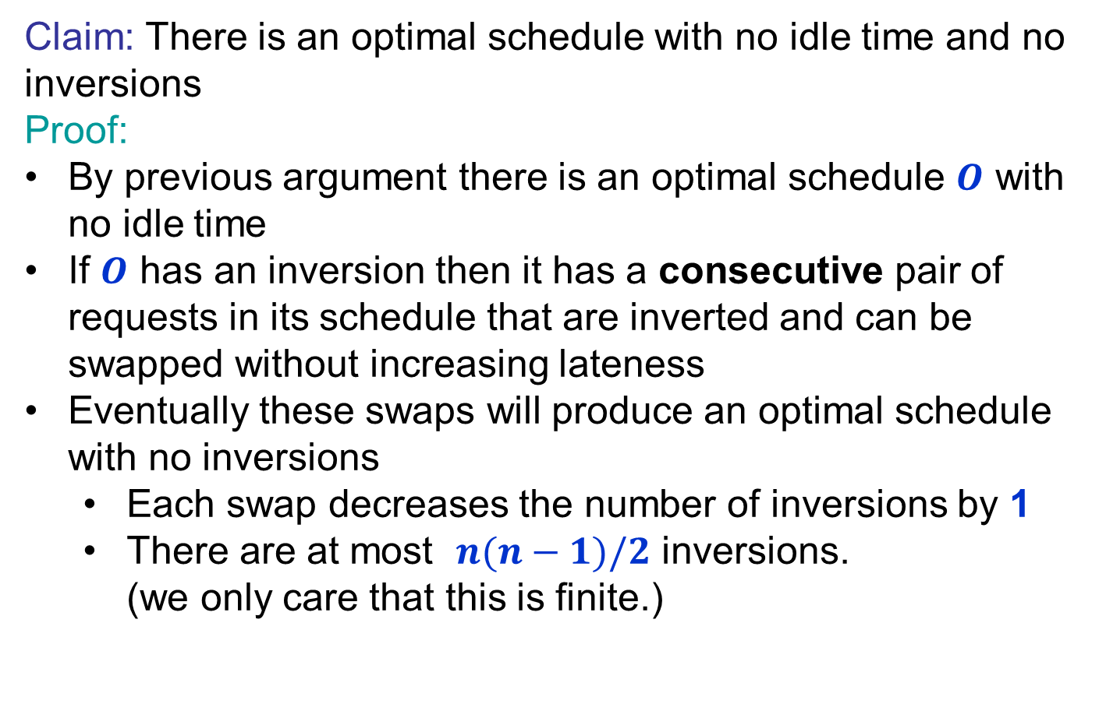
Optimal schedules and inversions
Claim: There is an optimal schedule with no idle time and no inversions
Proof:
By previous argument there is an optimal schedule $O$ with no idle time
If $O$ has an inversion then it has a consecutive pair of requests in its schedule that are inverted and can be swapped without increasing lateness
Eventually these swaps will produce an optimal schedule with no inversions
  Each swap decreases the number of inversions by 1
  There are at most $n(n−1)/2$ inversions.
  (we only care that this is finite.)

Slide 24
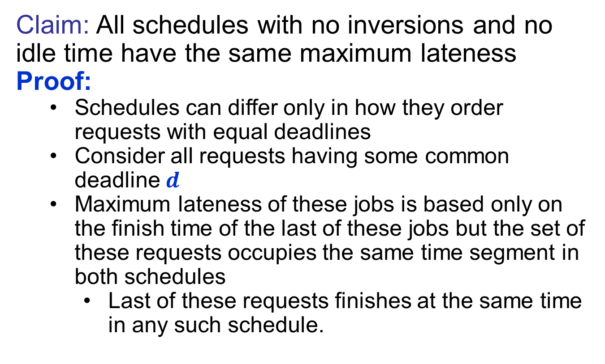
Idleness and Inversions are the only issue
Claim: All schedules with no inversions and no idle time have the same maximum lateness
Proof:
  Schedules can differ only in how they order requests with equal deadlines
  Consider all requests having some common deadline $d$
  Maximum lateness of these jobs is based only on the finish time of the last of these jobs but the set of these requests occupies the same time segment in both schedules
    Last of these requests finishes at the same time in any such schedule.

