Slide 1
CSE 421: Introduction to Algorithms
Complexity
Yin-Tat Lee

Slide 2
Definition for Efficiency in this course
Worst case complexity:
The worst case running time $T(n)$ of an algorithm is
max # steps algorithm takes on any input of size $n$.
Definition of 1 step in this course:
only simple operations (+,*,-,=,if,call,…).
each operation takes one time step.
each memory access takes one time step.
no fancy stuff (add two matrices, copy long string,…).
Definition of efficiency in this course:
An algorithm is efficient if it has polynomial worst case runtime.

Slide 3
Time Complexity on Worst Case Inputs
T(N)
$$2N log2N$$
Time
$$N \log_{2}N$$
Problem size N

Slide 4
O-Notation
Given two positive functions $f$ and $g$
$f\left(n\right)=O(g\left(n\right))$ if there is a constant $C>0$ and $N$ st
$f\left(n\right)≤Cg\left(n\right)$ for all $n>N$
$f\left(n\right)=Ω(g\left(n\right))$ if there is a constant $C>0$ and $N$ st
$f\left(n\right)≥Cg\left(n\right)$ for all $n>N$
$f\left(n\right)=Θ(g\left(n\right))$ if $f\left(n\right)=O(g\left(n\right))$ and $f\left(n\right)=Ω(g\left(n\right))$, namely
There is a constant $C_{1},C_{2}>0$ and $N$ st
$C_{1}g(n)≤f\left(n\right)≤C_{2}g\left(n\right)$ for all $n>N$

Slide 5
Common Asymptotic Bounds
Polynomials:
$a_{0}+a_{1}n+…+a_{d}n^{d}$ is $O\left(n^{d}\right)$
Logarithms:
$\log_{a}{n}=O(\log_{b}{n)}$ for all constants $a,b>0$
Logarithms: log grows slower than every polynomial
For all $x>0$, $\log{n=O(n^{x})}$
$n\log{n}=O\left(n^{1.01}\right)$

Slide 6
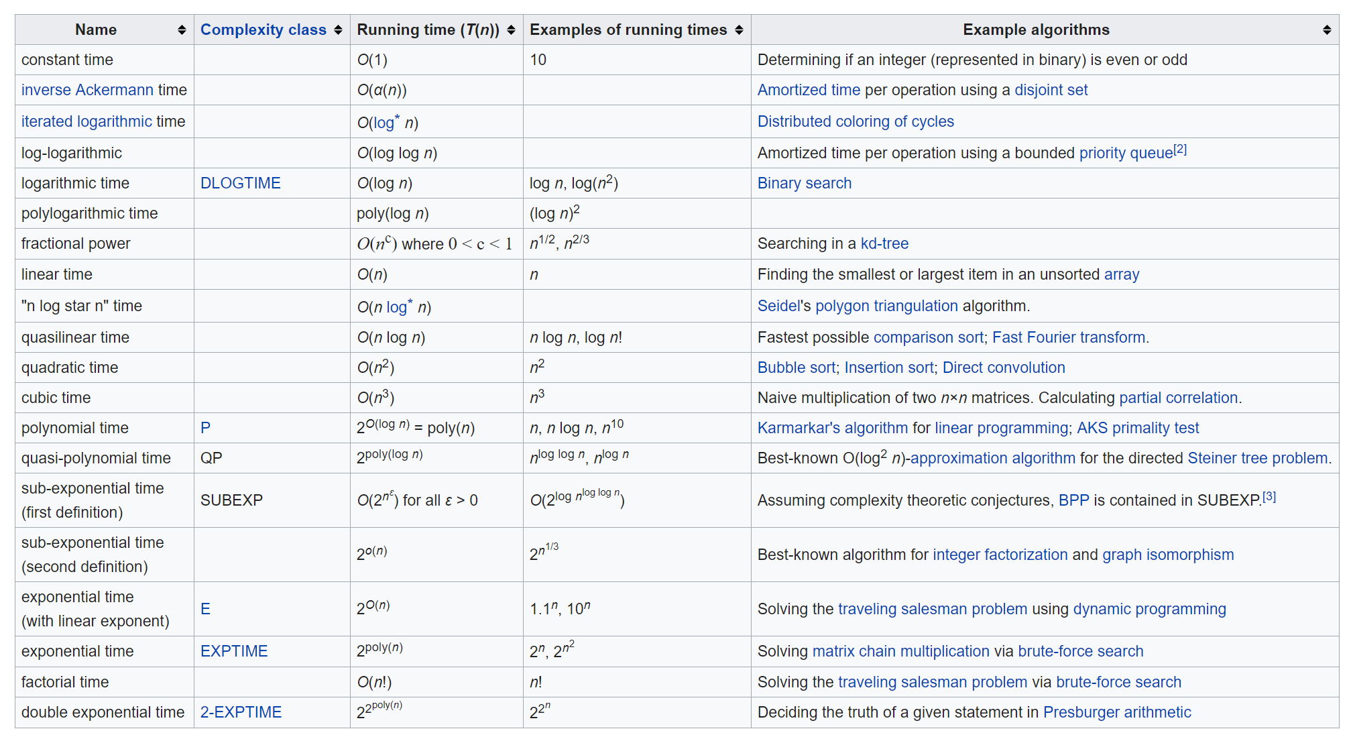
Running Time
An algorithm runs in polynomial time if $T\left(n\right)=n^{O(1)}$.
Equivalently, $T\left(n\right)=O(n^{d})$ for some constant d.
Stable matching!

Slide 7
Why it matters?
Suppose we can do 1 million operations per second.
not only get very big, but do so abruptly, which likely yields erratic performance on small instances
Update: RTX 2080 Ti do 13.4 Tflops/sec ($1.3×{10}^{13}$)
It brings down the 31,710 years to 20 hour.
However, $2^{100}$ operations still takes billions of years.

Slide 8
Why “Polynomial”?
Point is not that $n2000$ is a practical bound, or that the differences among $n$ and $2n$ and $n2$ are negligible.
Rather, simple theoretical tools may not easily capture such differences, whereas exponentials are qualitatively different from polynomials, so more amenable to theoretical analysis.
“My problem is in P” is a starting point for a more detailed analysis
“My problem is not in P” may suggest that you need to shift to a more tractable variant

Slide 9
Other Complexities
This symbols means out of syllabus.
Average Case Complexity:
avg # steps algorithm takes
Communication Complexity:
max # communication algorithm send between servers
Space Complexity:
max # space algorithm needs
Parallel Complexity:
max length of the longest series of operations that have to be performed sequentially due to data dependencies
Energy Complexity: $⋯$
Landauer's principle: Take at least ${10}^{−21}$ J to erase a bit in room temp.
(Current specialized hardware takes around ${10}^{−15}$ J.)

Slide 10
In Class Exercise
Arrange in the increasing order of asymptotic growth:
$n^{5/3}$.
$n^{\sqrt{n}\log{n}}$.
$n\log^{11}{n}$.
$n 2^{\sqrt{\frac{\log{n}}{\log{\log{n}}}}}$.
$n^{3}$.
Different ways to solve maxflow.
Will explain one of them this quarter.

Slide 11
CSE 421: Introduction to Algorithms
Graph
Yin-Tat Lee

Slide 12
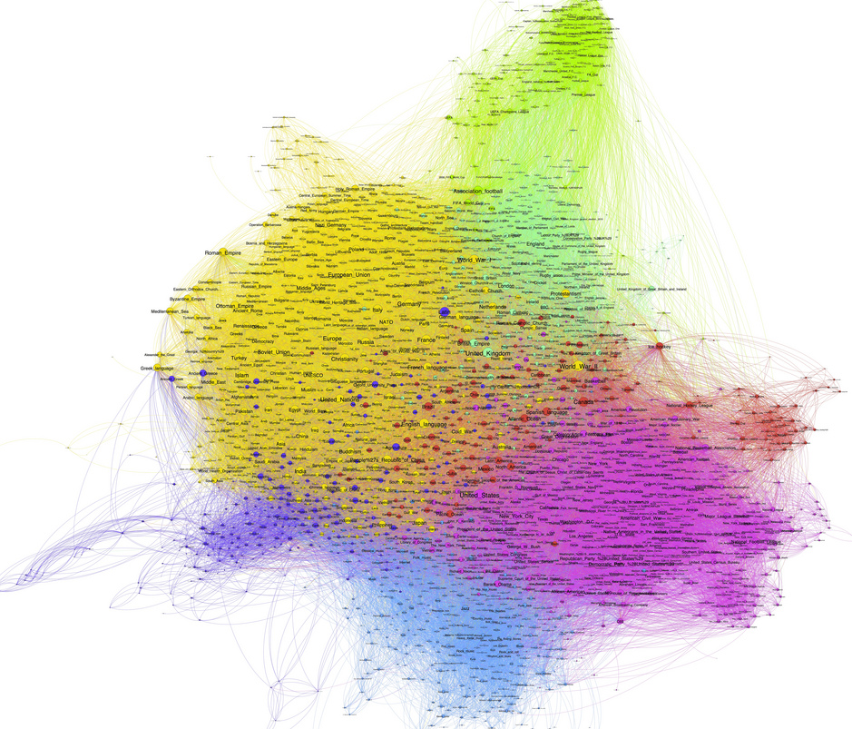
Graphs
Examples:
Transportation networks
Communication networks
Internet
Social networks
Dependency networks

Slide 13
Undirected Graphs G=(V,E)
A
2
10
3
Disconnected graph
11
12
4
8
Multi edges
13
B
9
Isolated vertices
6
Self loop
7

Slide 14
Graphs don’t Live in Flat Land
Geometrical drawing is mentally convenient, but mathematically irrelevant:
4 drawings of a single graph:
A
7
4
3
A
A
4
7
7
4
7
4
3
A
3
3

Slide 15
Directed Graphs
1
2
10
3
self loop
11
12
4
8
13
5
9
Multi edge
6
7

Slide 16
Terminology
Degree of a vertex: # edges that touch that vertex
deg(6)=3
Connected: Graph is connected if there is a path between every two vertices
Connected component: Maximal set of connected vertices
3
5
4
1
6
2
7
10

Slide 17
Terminology (cont’d)
Path: A sequence of distinct vertices
s.t. each vertex is connected
to the next vertex with an edge
Cycle: Path of length > 2 that has
the same start and end
Tree: A connected graph with no cycles
3
5
6
4
1
2
10
1
2
5
4
3
6

Slide 18
Degree 1 vertices
Claim: If G has no cycle, then it has a vertex of degree $≤1$
(Every tree has a leaf)
Proof: (By contradiction)
Suppose every vertex has degree $≥2.$
Start from a vertex $v_{1}$ and follow a path, $v_{1},…,v_{i}$ when we are at $v_{i}$ we choose the next vertex to be different from $v_{i−1}.$ We can do so because $\deg\left(v_{i}\right)≥2.$
The first time that we see a repeated vertex ($v_{j}=v_{i})$ we get a cycle.
We always get a repeated vertex because $G$ has finitely many vertices
$$v_{1}$$
$$v_{2}$$
$$v_{3}$$
$$v_{4}$$
$$v_{5}$$

Slide 19
Trees and Induction
Claim: Show that every tree with $n$ vertices has $n−1$ edges.
Proof: (Induction on $n$.)
Base Case: $n=1$, the tree has no edge
Inductive Step: Let $T$ be a tree with $n$ vertices.
So, $T$ has a vertex $v$ of degree $1$.
Remove $v$ and the neighboring edge, and let $T’$ be the new graph.
We claim $T’$ is a tree: It has no cycle, and it must be connected.
So, $T’$ has $n−2$ edges and $T$ has $n−1$ edges.

Slide 20
Exercise: Degree Sum
Claim: In any undirected graph, the number of edges is equal to $\left(1/2\right)\sum_{vertex v}{deg⁡(v)}$
Pf: $\sum_{vertex v}{deg⁡(v)}$ counts every edge of the graph exactly twice; once from each end of the edge.
3
5
4
1
6
2
|E|=8
$$\sum_{vertex v}{\deg\left(v\right)=2+2+1+1+3+2+3+2=16}$$
7
10

Slide 21
Exercise: Odd Degree Vertices
Claim: In any undirected graph, the number of odd degree vertices is even
Pf: In previous claim we showed sum of all vertex degrees is even. So there must be even number of odd degree vertices, because sum of odd number of odd numbers is odd.
3
5
4
1
6
2
4 odd degree vertices
3, 4, 5, 6
7
10

Slide 22
#edges
Let $G=(V,E)$ be a graph with $n=|V|$ vertices and $m=\left|E\right|$ edges.
Claim: $0≤m≤\left({n \atop 2}\right)=\frac{n\left(n−1\right)}{2}=O(n^{2})$
Pf: Since every edge connects two distinct vertices (i.e., G has no loops)
and no two edges connect the same pair of vertices (i.e., G has no multi-edges)
It has at most $\left({n \atop 2}\right)$ edges.

Slide 23
Sparse Graphs
A graph is called sparse if $m≪n^{2}$ and it is called dense otherwise.
Sparse graphs are very common in practice
Friendships in social network
Planar graphs
Web graph
Q: Which is a better running time $O(n+m)$ vs $O(n^{2})$?
A: $O(n+m)=O(n^{2})$, but $O(n+m)$ is usually much better.

Slide 24
Storing Graphs (Internally in ALG)
Vertex set $V=\left\{v_{1},…,v_{n}\right\}.$
Adjacency Matrix: A
For all, $i,j, A\left[i,j\right]=1$ iff $\left(v_{i},v_{j}\right)∈E$
Storage: $n^{2}$ bits
Advantage:
$O(1)$ test for presence or absence of edges
Disadvantage:
Inefficient for sparse graphs both in storage and edge-access
1
2
4
3
$$\begin{matrix} & 1 & 2 & 3 & 4 \\ 1 & 0 & 0 & 0 & 1 \\ 2 & 0 & 0 & 1 & 1 \\ 3 & 0 & 1 & 0 & 1 \\ 4 & 1 & 1 & 1 & 0\end{matrix}$$

Slide 25
Storing Graphs (Internally in ALG)
Adjacency List:
O(n+m) words
Advantage
Compact for sparse
Easily see all edges
Disadvantage
No O(1) edge test
More complex data structure
If $O(1)$ edge test is needed, one can use a hash table.
1
2
4
3
1
4
2
3
4
3
2
4
4
1
2
3

