Slide 1
CSE 421
Linear Programs
Yin Tat Lee

Slide 2
Linear System of Equations
In high school we learn Gaussian elimination algorithm to solve a system of linear equations
$$x_{1}+x_{3}=7 \\ 2x_{2}+x_{1}=5 \\ 3x_{1}+7x_{2}−x_{3}=1$$
We set $x_{3}=7−x_{1}$ and we substitute in the following equations.
Then we substitute $x_{2}=\frac{{5−x}_{1}}{2}$ in to the third equations.
The third equational uniquely defines $x_{1}$

Slide 3
Linear Programming
Optimize a linear function subject to linear inequalities
$$\max{ 3x_{1}+4x_{3}} \\ s.t., { x}_{1}+x_{2}≤5 \\ { x}_{3}−x_{1}=4 \\ x_{3}−x_{2}≥−5 \\ x_{1},x_{2},x_{3}≥0$$
We can have inequalities,
We can have a linear objective functions

Slide 4
Applications of Linear Programming
Generalizes: Ax=b, 2-person zero-sum games, shortest path, max-flow, matching, multicommodity flow, MST, min weighted arborescence, …
Why significant?
We can solve linear programming in polynomial time.
We can model many practical problems with a linear model and solve it with linear programming
Linear Programming in Practice:
There are very fast implementations: CPLEX, Gorubi, ….
CPLEX can solve LPs with millions of variables/constraints in seconds

Slide 5
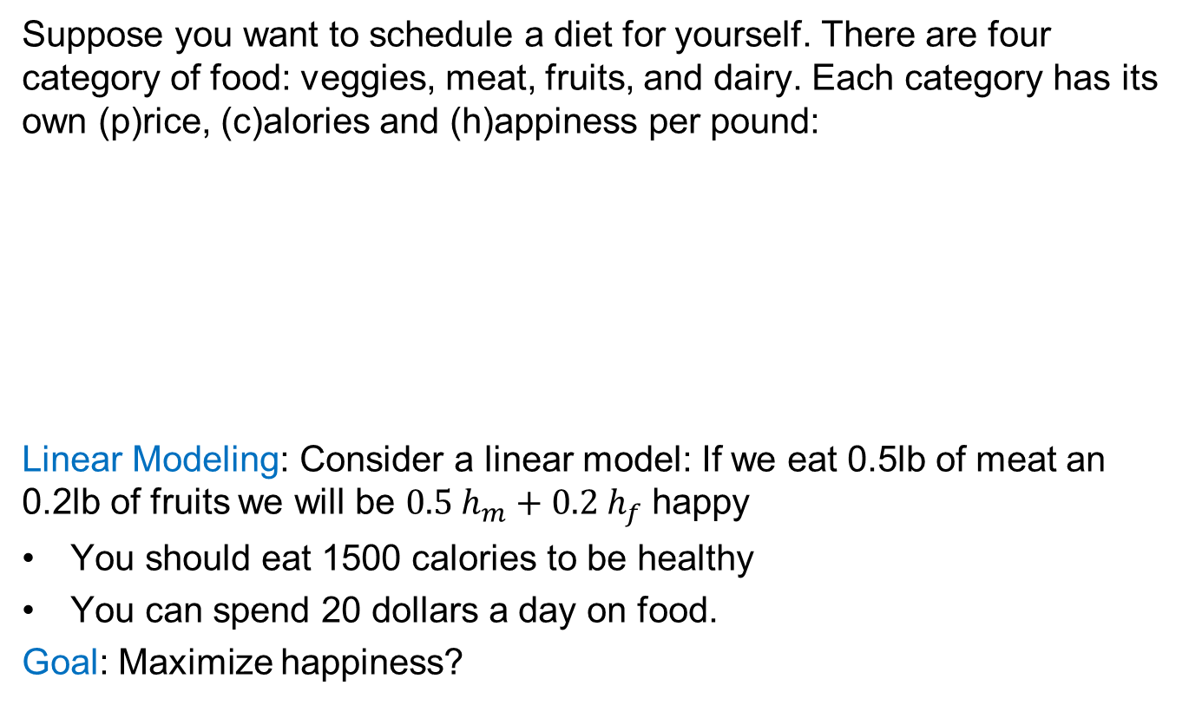
Example 1: Diet Problem
Suppose you want to schedule a diet for yourself. There are four category of food: veggies, meat, fruits, and dairy. Each category has its own (p)rice, (c)alories and (h)appiness per pound:
Linear Modeling: Consider a linear model: If we eat 0.5lb of meat an 0.2lb of fruits we will be $0.5{ h}_{m}+0.2 h_{f}$ happy
You should eat 1500 calories to be healthy
You can spend 20 dollars a day on food.
Goal: Maximize happiness?
 | veggies | meat | fruits | dairy
price | $$p_{v}$$ | $$p_{m}$$ | $$p_{f}$$ | $$p_{d}$$
calorie | $$c_{v}$$ | $$c_{m}$$ | $$c_{f}$$ | $$c_{d}$$
happiness | $$h_{v}$$ | $$h_{m}$$ | $$h_{f}$$ | $$h_{d}$$

Slide 6
Diet Problem by LP
You should eat 1500 calaroies to be healthy
You can spend 20 dollars a day on food.
Goal: Maximize happiness?
 | veggies | meat | fruits | dairy
price | $$p_{v}$$ | $$p_{m}$$ | $$p_{f}$$ | $$p_{d}$$
calorie | $$c_{v}$$ | $$c_{m}$$ | $$c_{f}$$ | $$c_{d}$$
happiness | $$h_{v}$$ | $$h_{m}$$ | $$h_{f}$$ | $$h_{d}$$
$$\max{ x_{v}h_{v}+x_{m}h_{m}+x_{f}h_{f}+x_{d}h_{d}} \\ s.t. x_{v}p_{v}+x_{m}p_{m}+x_{f}p_{f}+x_{d}p_{d}≤20 \\ x_{v}c_{v}+x_{m}c_{m}+x_{f}c_{f}+x_{d}c_{d}≤1500 \\ x_{v},x_{m},x_{f},x_{d}≥0$$
#pounds of veggies, meat, fruits, dairy to eat per day

Slide 7
How to Design an LP?
Define the set of variables
Put constraints on your variables,
should they be nonnegative?
Write down the constraints
If a constraint is not linear try to approximate it with a linear constraint
Write down the objective function
If it is not linear approximation with a linear function
Decide if it is a minimize/maximization problem

Slide 8
Example 2: Max Flow
Define the set of variables
For every edge $e$ let $x_{e}$ be the flow on the edge $e$
Put constraints on your variables
$x_{e}≥0$ for all edge e (The flow is nonnegative)
Write down the constraints
$x_{e}≤c(e)$ for every edge e, (Capacity constraints)
$\sum_{e out of v}{x_{e}}=\sum_{e in to v}{x_{e}}$ $∀v≠s,t$ (Conservation constraints)
Write down the objective function
$\sum_{e out of s}{x_{e}}$
Decide if it is a minimize/maximization problem
max

Slide 9

Example 2: Max Flow
$$\max{ \sum_{e out of s}{x_{e}}} \\ s.t. \sum_{e out of v}{x_{e}=\sum_{e in to v}{x_{e}}} ∀v≠s,t$$
$$x_{e}≤c\left(e\right) ∀e$$
$$x_{e}≥0 ∀e$$

Slide 10

Example 3: Min Cost Max Flow
Suppose we can route 100 gallons of water from $s$ to $t.$
But for every pipe edge $e$ we have to pay $p\left(e\right)$
for each gallon of water that we send through $e.$
Goal: Send 100 gallons of water from $s$ to $t$ with minimum possible cost
$$\min{ \sum_{e∈E}{{p\left(e\right)⋅x}_{e}}} \\ s.t. \sum_{e out of v}{x_{e}=\sum_{e in to v}{x_{e}}} ∀v≠s,t \\ \sum_{e out of s}{x_{e}=100}$$
$$x_{e}≤c\left(e\right) ∀e$$
$$x_{e}≥0 ∀e$$

Slide 11
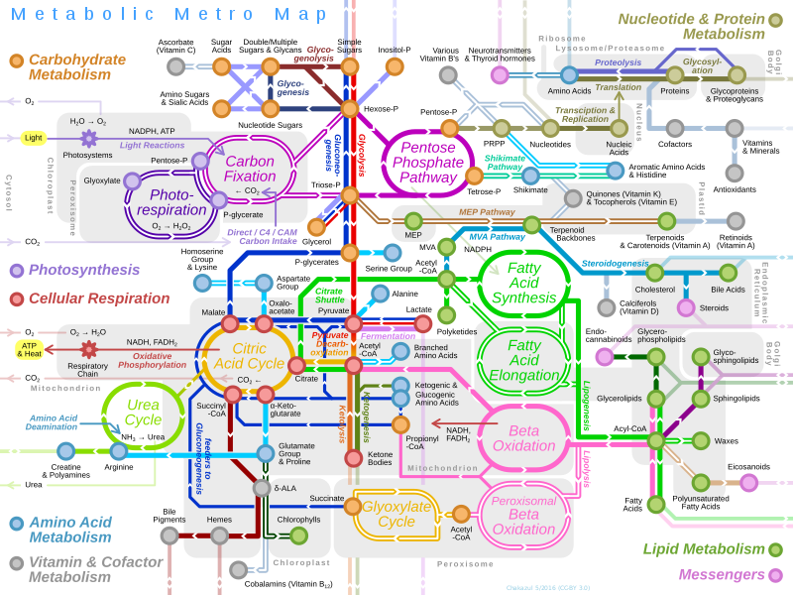
Example 4: Metabolic Network
Let $v_{i}$ are the rate of different chemical reaction in your body.
It satisfies mass conversation (translate to linear inequality).
It satisfies some upper and lower bound.
Optimizing certain function in your body is corresponding to solving a linear program!
How you find that LP? DNA!
https://vmh.uni.lu/#reconmap
Disclaimer: I suspect your biology is better than mine.

Slide 12
Summary (Linear Programming)
Linear programming is one of the biggest advances in 20th century
It is being used in many areas of science: Mechanics, Physics, Operations Research, and in CS: AI, Machine Learning, Theory, …
Almost all problems that we talked can be solved with LPs, Why not use LPs?
In some sense, current fastest algorithm for maxflow is based on LP!
Maybe one day, I need to rewrite CSE 421.
☹ But I need to able to teach the current 421 well first.
There is rich theory of LP-duality which generalizes max-flow min-cut theorem

