Slide 1
CSE 421
Applications
Yin Tat Lee

Slide 2
Project Selection
Given a DAG G=(V,E) representing
precedence constraints on tasks
(a task points to its predecessors)
a profit value p(v) for each task v∈V
(may be positive or negative)
Find a set A⊆V of tasks that is closed under predecessors,
(i.e. if (u,v)∈E and u∈A then v∈A)
that maximizes Profit(A)=Σ_{v∈A} p(v)
-1
2
4
3
8
-5
-6
-3
10
4
11
12
-13
Each task points to its predecessor tasks
14

Slide 3
Extended Graph
s
-1
2
4
3
8
-5
-6
-3
10
4
11
12
-13
14
t

Slide 4
Extended Graph G’
s
For each vertex v
If p(v)≥0 add (s,v) edge
with capacity p(v)
If p(v)<0 add (v,t) edge
with capacity –p(v)
10
-1
2
4
3
8
-5
-6
-3
10
4
11
12
5
-13
14
t

Slide 5
Extended Graph G’
Want: Set capacities on edges of G so that for minimum s-t-cut $(S,\overline{S})$ in G’, the set A=S-{s}
satisfies precedence constraints
has maximum possible profit in G
Cut capacity with S={s} is just C=Σ_{v: p(v)≥0} p(v)
Profit(A) ≤ C for any set A
To satisfy constraints, don’t want any original edges of G going forward across the minimum cut
That would correspond to a task in A=S-{s} that had a predecessor not in A=S-{s}
Set capacity of each of the edges of G to $+∞$.

Slide 6
Extended Graph G’
Capacity C=Σ_{v: p(v)≥0} p(v)
s
10
-1
2
4
3
8
-5
-6
-3
10
4
11
12
5
-13
14
t

Slide 7
Extended Graph G’
s
10
Cut value
=13+3+2+3+4
=13+3
+C-4-8-10-11-12-14
-1
2
4
3
8
-5
-6
-3
10
4
11
12
5
-13
14
t

Slide 8
Project Selection
Claim Any s-t-cut $(S,\overline{S})$ in G’ such that A=S-{s} satisfies
precedence constraints and
has capacity c(S,T)=C - Σ_{v∈A} p(v) = C - Profit(A)
Corollary A minimum cut $(S,\overline{S})$ in G’ yields an optimal solution A=S-{s} to the project selection problem
Algorithm Compute maximum flow f in G’, find the set S of nodes reachable from s in G’_{f} and return S-{s}

Slide 9
Proof of Claim
A=S-{s} satisfies precedence constraints
No edge of G crosses forward out of A since those edges have capacity $+∞$
Only forward edges cut are of the form
(v,t) for v∈A or (s,v) for v∉A
The (v,t) edges for v∈A contribute Σ_{v∈A:p(v)<0} -p(v) = - Σ_{v∈A:p(v)<0} p(v)
The (s,v) edges for v∉A contribute Σ_{v∉A: p(v)≥0} p(v)=C-Σ_{v∈A: p(v)≥0} p(v)
Therefore the total capacity of the cut is c(S,T) = C - Σ_{v∈A} p(v) =C-Profit(A)

Slide 10
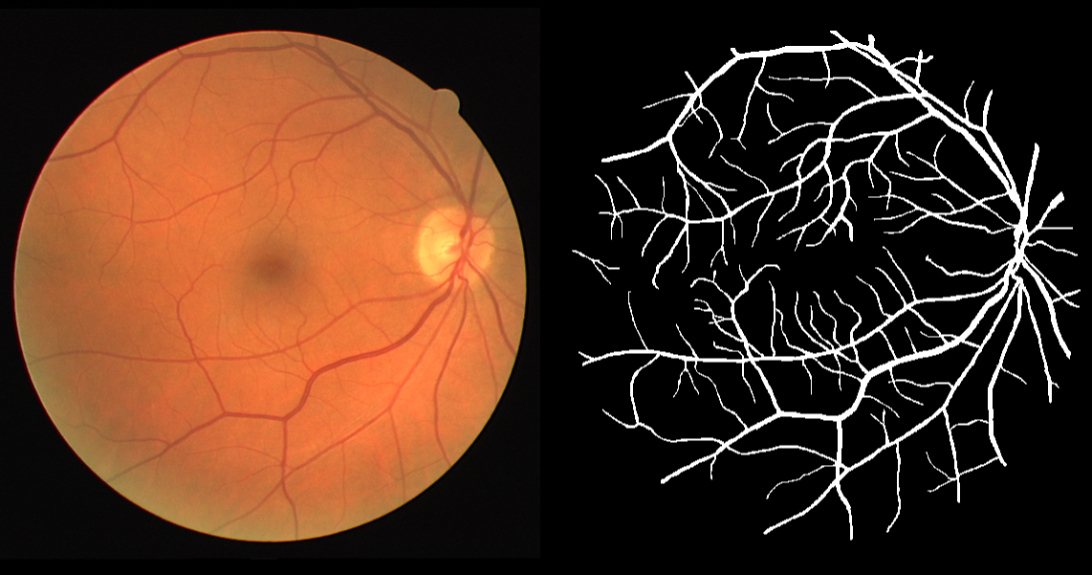
Image Segmentation
Given an image we want to separate
foreground from background
Important problem in image processing.
Divide image into coherent regions.

Slide 11
Foreground / background segmentation
Label each pixel as foreground/background.
$V$ = set of pixels, $E$ = pairs of neighboring pixels.
$a_{i}$ is the original image.
$a_{i}≫0$ means we prefer to label $i$ in foreground.
$p_{i,j}≥0$ is separation penalty for labeling one of $i$ and j as foreground, and the other as background.
Goals:
Find partition $(S, \overline{S})$ that minimizes:
$$−\sum_{i∈S}{a_{i}}+\sum_{\begin{aligned}\left(i,j\right)∈E \\ i∈S,j∈\overline{S}\end{aligned}}{p_{i,j}}$$
where $S$ is the foreground.

Slide 12
Min cut Formulation
$G′ = (V′, E′).$
Add s to correspond to foreground;
Add t to correspond to background;
Use two anti-parallel edges instead of undirected edge.
p_{ij}
p_{ij}
p_{ij}
p_{ij}
$a_{j}$ if $a_{j}>0$
s
i
j
t
$−a_{j}$ if $a_{j}<0$
$$G′$$

Slide 13
Min cut Formulation (cont’d)
Consider min cut $(S, \overline{S})$ in G’. ($S$ = foreground.)
$$cap\left(S, \overline{S}\right)=\sum_{i∈S}{−a_{i}}1_{a_{i}<0}+\sum_{i∈\overline{S}}{a_{i}}1_{a_{i}>0}+\sum_{\begin{aligned}\left(i,j\right)∈E \\ i∈S,j∈\overline{S}\end{aligned}}{p_{i,j}}$$
$=−\sum_{i∈S}{a_{i}}+\sum_{i∈S}{a_{i}}1_{a_{i}>0}+\sum_{i∈\overline{S}}{a_{i}}1_{a_{i}>0}+\sum_{⋯}{p_{i,j}}$
$=−\sum_{i∈S}{a_{i}}+\sum_{i}{a_{i}}+\sum_{⋯}{p_{i,j}}$
$=−\sum_{i∈S}{a_{i}}+\sum_{⋯}{p_{i,j}}+constant$
Precisely, what we want to minimize.
p_{ij}
$a_{j}$ if $a_{j}>0$
s
i
j
t
$$S$$
$−a_{j}$ if $a_{j}<0$
$$G′$$

Slide 14
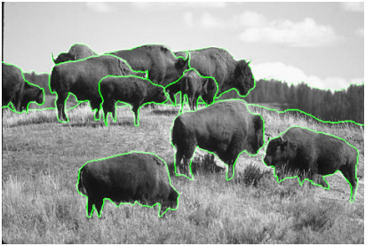
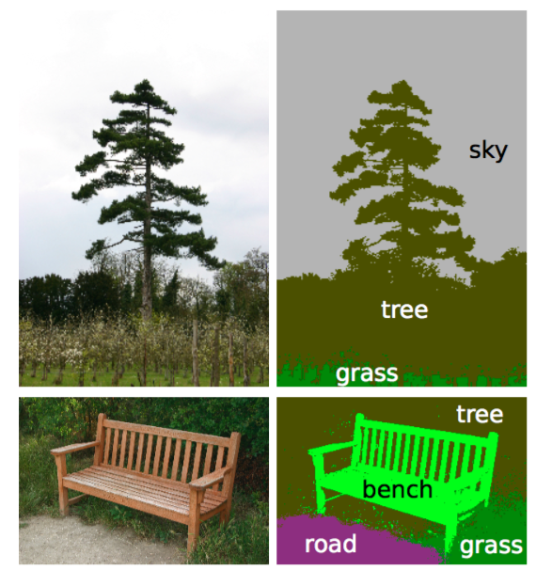
Reality
The main difficulty is to come up with a good model.
May want to have human interaction.
Segmentation may be real-valued instead of {0,1}.
There are many more than 1 objects.
May need labeling.
Augmenting path is not great for GPU.

