Slide 1
CSE 421
Max Flow Min Cut Problem
Yin Tat Lee

Slide 2
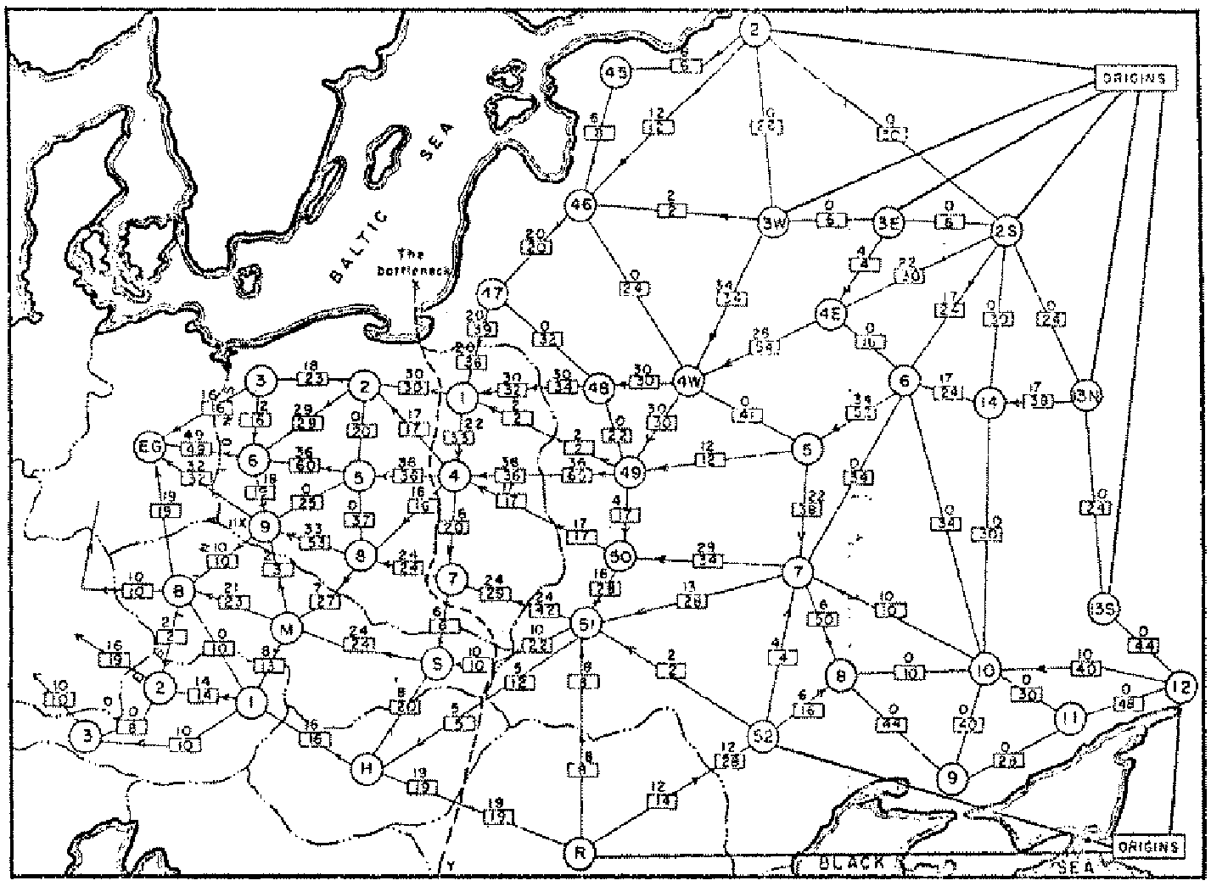
Soviet Rail Network
“Unclassified” on May 21, 1999.

Slide 3
Network Flow Applications
Max flow and min cut.
Two very rich algorithmic problems.
Cornerstone problems in combinatorial optimization.
Beautiful mathematical duality.
Nontrivial applications / reductions.
Data mining.
Project selection.
Airline scheduling.
Bipartite matching.
Baseball elimination.
Image segmentation.
Network connectivity.

Slide 4

Minimum s-t Cut Problem
  Given a directed graph G = (V, E) = directed graph and two distinguished nodes: s = source, t = sink.
  Suppose each directed edge e has a nonnegative capacity $c(e)$
Goal: Find a cut separating $s,t$ that cuts the minimum capacity of edges.
2
9
5
10
4
15
15
10
source
s
5
3
8
6
10
t
sink
4
6
15
10
capacity
15
4
30
7

Slide 5

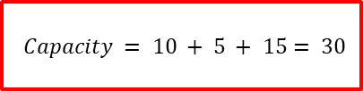
s-t cuts
Def. An s-t cut is a partition (A, B) of V with s ∈ A and t ∈ B.
Def. The capacity of a cut (A, B): $cap\left(A,B\right)=\sum_{\left(u,v\right):u∈A,v∈B}{c(u,v)}$
$$Capacity = 10 + 5 + 15= 30$$
2
9
5
10
4
15
15
10
s
5
3
8
6
10
t
A
4
6
15
10
15
4
30
7

Slide 6

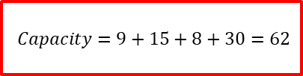
s-t cuts
Def. An s-t cut is a partition (A, B) of V with s ∈ A and t ∈ B.
Def. The capacity of a cut (A, B): $cap\left(A,B\right)=\sum_{\left(u,v\right):u∈A,v∈B}{c(u,v)}$
$$Capacity=9+15+8+30=62$$
2
9
5
10
4
15
15
10
s
5
3
8
6
10
t
A
4
6
15
10
15
4
30
7

Slide 7

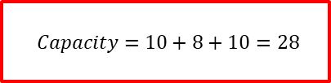
Minimum s-t Cut Problem
  Given a directed graph G = (V, E) = directed graph and two distinguished nodes: s = source, t = sink.
  Suppose each directed edge e has a nonnegative capacity $c(e)$
Goal: Find a s-t cut of minimum capacity
2
5
$$Capacity=10+8+10=28$$
9
10
4
15
15
10
source
s
5
3
8
6
10
t
sink
4
6
15
10
capacity
15
4
30
7

Slide 8

s-t Flows
Def. An s-t flow is a function that satisfies:
For each $e∈E:$ $0≤f\left(e\right)≤c(e)$ (capacity)
For each $v∈V−\{s,t\}$: $\sum_{e in to v}{f(e)}=\sum_{e out of v}{f(e)}$ (conservation)
Def. The value of a flow f is: $v\left(f\right)=\sum_{e out of s}{f(e)}$
0
2
9
5
4
0
0
10
4
4
15
15
0
10
0
4
4
s
5
3
8
6
10
t
0
0
capacity
4
0
6
15
0
10
15
flow
0
Value = 4
0
4
30
7

Slide 9
s-t Flows
Def. An s-t flow is a function that satisfies:
For each $e∈E:$ $0≤f\left(e\right)≤c(e)$ (capacity)
For each $v∈V−\{s,t\}$: $\sum_{e in to v}{f(e)}=\sum_{e out of v}{f(e)}$ (conservation)
Def. The value of a flow f is: $v\left(f\right)=\sum_{e out of s}{f(e)}$
6
2
9
5
10
0
6
10
4
4
15
15
0
10
3
8
8
s
5
3
8
6
10
t
1
10
capacity
4
0
6
15
0
10
15
flow
11
Value = 24
11
4
30
7

Slide 10
Maximum s-t Flow Problem
Goal: Find a s-t flow of largest value.
9
2
9
5
10
1
9
10
4
0
15
15
0
10
4
8
9
s
5
3
8
6
10
t
4
10
capacity
4
0
6
15
0
10
15
flow
14
Value = 28
14
4
30
7

Slide 11

Flows and Cuts
Flow value lemma. Let f be any flow, and let (A, B) be any s-t cut. Then, the net flow sent across the cut is equal to the amount leaving s.
$$\sum_{e out of A}{f\left(e\right)−\sum_{e in to A}{f\left(e\right)=v(f)}}$$
6
2
9
5
10
0
6
10
4
4
15
15
0
10
3
8
8
s
5
3
8
6
10
t
1
10
capacity
4
0
6
15
0
10
15
flow
11
Value = 24
11
4
30
7

Slide 12

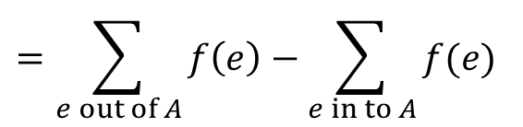


Proof of Flow value Lemma
Flow value lemma. Let f be any flow, and let (A, B) be any s-t cut. Then, the net flow sent across the cut is equal to the amount leaving s.
$$\sum_{e out of A}{f\left(e\right)−\sum_{e in to A}{f\left(e\right)=v(f)}}$$
Proof.
$$v\left(f\right)=\sum_{e out of s}{f(e)}$$
$$=\sum_{v∈A}{\left(\sum_{e out of v}{f\left(e\right)−\sum_{e in to v}{f(e)}}\right)}$$
By conservation of flow,
all terms except v=s are 0
All contributions due to
internal edges cancel out
$$=\sum_{e out of A}{f\left(e\right)−\sum_{e in to A}{f(e)}}$$

Slide 13

Weak Duality of Flows and Cuts
Flow value lemma. Let f be any flow, and let (A, B) be any s-t cut. Then the value of the flow is at most the capacity of the cut.
$$v\left(f\right)≤cap(A,B)$$
v(f)=24, capacity=9+15+8+30=62
6
2
9
5
10
0
6
10
4
4
15
15
0
10
3
8
8
s
5
3
8
6
10
t
1
10
capacity
4
0
6
15
0
10
15
flow
11
11
4
30
7

Slide 14

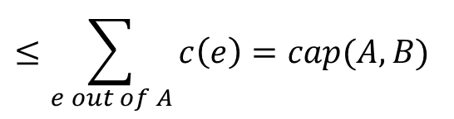

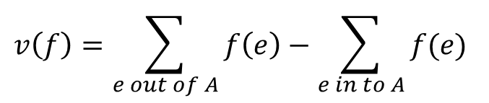
Weak Duality of Flows and Cuts
Flow value lemma. Let f be any flow, and let (A, B) be any s-t cut. Then the value of the flow is at most the capacity of the cut.
$$v\left(f\right)≤cap(A,B)$$
Proof.
$$v\left(f\right)=\sum_{e out of A}{f\left(e\right)−\sum_{e in to A}{f(e)}}$$
A
B
4
8
t
$$≤\sum_{e out of A}{f(e)}$$
6
5
s
7
$$≤\sum_{e out of A}{c\left(e\right)}=cap(A,B)$$
6

Slide 15

Certificate of Optimality
Corollary: Suppose there is a s-t cut (A,B) such that
$$v\left(f\right)=cap\left(A,B\right)$$
Then, f is a maximum flow and (A,B) is a minimum cut.
v(f)=28, cap(A,B)=28
2
9
5
10
1
9
10
4
0
15
15
0
10
4
8
9
s
5
3
8
6
10
t
4
10
capacity
4
0
6
15
0
10
15
flow
14
14
4
30
7

Slide 16
A Greedy Algorithm for Max Flow
  Start with f(e) = 0 for all edge e ∈ E.
  Find an s-t path P where each edge has f(e) < c(e).
  Augment flow along path P.
  Repeat until you get stuck.
1
20
0
0
20
10
s
30
0
20
t
10
20
0
0
2
20

Slide 17
A Greedy Algorithm for Max Flow
  Start with f(e) = 0 for all edge e ∈ E.
  Find an s-t path P where each edge has f(e) < c(e).
  Augment flow along path P.
  Repeat until you get stuck.
1
1
20
0
20
10
20
10
20
10
s
30
20
t
s
30
10
t
10
20
10
20
0
20
10
20
Greedy = 20
2
OPT = 30
2

Slide 18
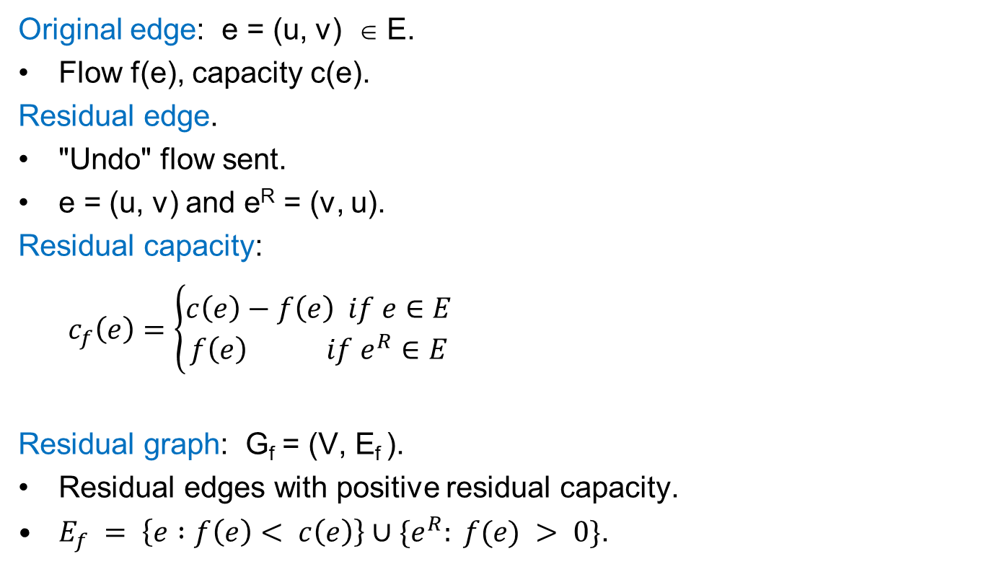
Residual Graph
capacity
Original edge: e = (u, v) ∈ E.
Flow f(e), capacity c(e).
Residual edge.
"Undo" flow sent.
e = (u, v) and e^{R} = (v, u).
Residual capacity:
$c_{f}\left(e\right)=\left\{\begin{aligned}c\left(e\right)−f\left(e\right) if e∈E \\ f\left(e\right) if e^{R}∈E\end{aligned}\right.$
Residual graph: G_{f} = (V, E_{f} ).
Residual edges with positive residual capacity.
$E_{f} = \left\{e :f\left(e\right)< c\left(e\right)\right\}∪\{e^{R}: f(e) > 0\}$.
u
17
v
6
flow
residual capacity
u
11
v
6
residual capacity

Slide 19
Ford-Fulkerson Alg: Greedy on G_{f}
0
2
4
4
capacity
G:
0
0
0
0
10
2
0
8
6
10
s
10
3
9
5
10
t
0
0
0
2
4
4
Find Path
G_{f}:
10
2
8
6
10
s
10
3
9
5
10
t

Slide 20
Ford-Fulkerson Alg: Greedy on G_{f}
Update Flow
4
2
4
4
capacity
G:
4
4
0
0
10
2
0
8
6
10
s
10
3
9
5
10
t
0
0
0
2
4
4
G_{f}:
10
2
8
6
10
s
10
3
9
5
10
t

Slide 21
Ford-Fulkerson Alg: Greedy on G_{f}
4
2
4
4
capacity
G:
4
4
0
0
10
2
0
8
6
10
s
10
3
9
5
10
t
0
0
0
4
Update Residual
2
4
G_{f}:
4
4
6
2
8
6
6
s
10
3
9
5
10
t

Slide 22
Ford-Fulkerson Alg: Greedy on G_{f}
4
2
4
4
capacity
G:
4
4
0
0
10
2
0
8
6
10
s
10
3
9
5
10
t
0
0
0
4
Find Path
2
4
G_{f}:
4
4
6
2
8
6
6
s
10
3
9
5
10
t

Slide 23
Ford-Fulkerson Alg: Greedy on G_{f}
Update Flow
4
2
4
4
capacity
G:
6
4
0
0
10
2
2
8
6
10
s
10
3
9
5
10
t
0
2
2
4
2
4
G_{f}:
4
4
6
2
8
6
6
s
10
3
9
5
10
t

Slide 24
Ford-Fulkerson Alg: Greedy on G_{f}
4
2
4
4
capacity
G:
6
4
0
0
10
2
2
8
6
10
s
10
3
9
5
10
t
0
2
2
4
Update Residual
2
4
G_{f}:
6
4
4
2
8
6
6
s
10
3
7
5
8
t
2
2

Slide 25
Ford-Fulkerson Alg: Greedy on G_{f}
4
2
4
4
capacity
G:
6
4
0
0
10
2
2
8
6
10
s
10
3
9
5
10
t
0
2
2
4
Find Path
2
4
G_{f}:
6
4
4
2
8
6
6
s
10
3
7
5
8
t
2
2

Slide 26
Ford-Fulkerson Alg: Greedy on G_{f}
Update Flow
4
2
4
4
capacity
G:
10
4
4
0
10
2
2
8
6
10
s
10
3
9
5
10
t
0
2
6
4
2
4
G_{f}:
6
4
4
2
8
6
6
s
10
3
7
5
8
t
2
2

Slide 27
Ford-Fulkerson Alg: Greedy on G_{f}
4
2
4
4
capacity
G:
10
4
4
0
10
2
2
8
6
10
s
10
3
9
5
10
t
0
2
6
4
Update Residual
2
4
G_{f}:
4
10
4
2
4
6
6
s
10
3
7
5
4
t
2
6

Slide 28
Ford-Fulkerson Alg: Greedy on G_{f}
4
2
4
4
capacity
G:
10
4
4
0
10
2
2
8
6
10
s
10
3
9
5
10
t
0
2
6
4
Find Path
2
4
G_{f}:
4
10
4
2
4
6
6
s
10
3
7
5
4
t
2
6

Slide 29
Ford-Fulkerson Alg: Greedy on G_{f}
4
Update Flow
2
4
4
capacity
G:
10
6
6
2
10
2
0
8
6
10
s
10
3
9
5
10
t
2
2
6
4
2
4
G_{f}:
4
10
4
2
4
6
6
s
10
3
7
5
4
t
2
6

Slide 30
Ford-Fulkerson Alg: Greedy on G_{f}
4
2
4
4
capacity
G:
10
6
6
2
10
2
0
8
6
10
s
10
3
9
5
10
t
2
2
6
4
Update Residual
2
4
G_{f}:
6
10
4
6
2
2
2
4
s
8
3
7
5
4
t
2
2
6

Slide 31
Ford-Fulkerson Alg: Greedy on G_{f}
4
2
4
4
capacity
G:
10
6
6
2
10
2
0
8
6
10
s
10
3
9
5
10
t
2
2
6
4
Find Path
2
4
G_{f}:
6
10
4
6
2
2
2
4
s
8
3
7
5
4
t
2
2
6

Slide 32
Ford-Fulkerson Alg: Greedy on G_{f}
Update Flow
4
2
4
4
capacity
G:
10
6
6
2
10
2
0
8
6
10
s
10
3
9
5
10
t
6
6
10
4
2
4
G_{f}:
6
10
4
6
2
2
2
4
s
8
3
7
5
4
t
2
2
6

Slide 33
Ford-Fulkerson Alg: Greedy on G_{f}
4
2
4
4
capacity
G:
10
6
6
2
10
2
0
8
6
10
s
10
3
9
5
10
t
6
6
10
4
Update Residual
2
4
G_{f}:
6
10
4
6
2
2
2
4
s
4
3
3
5
t
6
6
10

Slide 34
Ford-Fulkerson Alg: Greedy on G_{f}
4
2
4
4
capacity
G:
10
6
6
2
10
2
0
8
6
10
s
10
3
9
5
10
t
6
6
10
4
Find Path
2
4
G_{f}:
6
10
4
6
2
2
4
2
s
4
3
3
5
t
6
6
10

Slide 35
Ford-Fulkerson Alg: Greedy on G_{f}
Update FLow
4
2
4
4
capacity
G:
10
9
6
5
10
2
0
8
6
10
s
10
3
9
5
10
t
9
9
10
4
2
4
G_{f}:
6
10
4
6
2
2
4
2
s
4
3
3
5
t
6
6
10

Slide 36
Ford-Fulkerson Alg: Greedy on G_{f}
4
2
4
4
capacity
G:
10
9
6
5
10
2
0
8
6
10
s
10
3
9
5
10
t
9
9
10
4
Find Path
2
4
G_{f}:
6
10
1
9
2
2
1
5
s
1
3
5
t
9
9
10

