Slide 1
CSE 421
Divide and Conquer
Yin Tat Lee

Slide 2
Master Theorem
Suppose $T\left(n\right)=a T\left(\frac{n}{b}\right)+cn^{k}$ for all $n>b.$ Then,
If $a<b^{k}$ then $T\left(n\right)=Θ\left(n^{k}\right)$
If $a=b^{k}$ then $T\left(n\right)=Θ\left(n^{k}log n\right)$
If $a>b^{k}$ then $T\left(n\right)=Θ\left(n^{\log_{b}a}\right)$
Works even if it is $\left\lceil \frac{n}{b}\right\rceil$ instead of $\frac{n}{b}.$
We also need $a≥1,b>1 , k≥0$ and $T\left(n\right)=O(1)$ for $n≤b.$

Slide 3
Master Theorem
Suppose $T\left(n\right)=a T\left(\frac{n}{b}\right)+cn^{k}$ for all $n>b.$ Then,
If $a<b^{k}$ then $T\left(n\right)=Θ\left(n^{k}\right)$
If $a=b^{k}$ then $T\left(n\right)=Θ\left(n^{k}log n\right)$
If $a>b^{k}$ then $T\left(n\right)=Θ\left(n^{\log_{b}a}\right)$
Example: For mergesort algorithm we have
$$T\left(n\right)=2T\left(\frac{n}{2}\right)+O\left(n\right).$$
So, $k=1,a=b^{k}$ and $T\left(n\right)=Θ(n\log{n)}$

Slide 4
Proving Master Theorem
Problem size
$$T\left(n\right)=aT(n/b)+cn^{d}$$
# probs
cost
$$n$$
$$a$$
$$1$$
$$cn^{k}$$
$$n/b$$
$$a$$
$$a⋅c{\left(n/b\right)}^{k}$$
$$d=\log_{b}n$$
$$n/b^{2}$$
$$a2$$
$$a^{2}⋅c{\left(n/b^{2}\right)}^{k}$$
$$a^{d}⋅c{\left(n/b^{d}\right)}^{k}$$
$$1$$
$$ad$$
$$T\left(n\right)=\sum_{i=0}^{d=\log_{b}{n}}{a^{i}c{\left(\frac{n}{b^{i}}\right)}^{k}}$$

Slide 5
Master Theorem
Suppose $T\left(n\right)=a T\left(\frac{n}{b}\right)+cn^{k}$ for all $n>b.$ Then,
If $a<b^{k}$ then $T\left(n\right)=Θ\left(n^{k}\right)$
If $a=b^{k}$ then $T\left(n\right)=Θ\left(n^{k}log n\right)$
If $a>b^{k}$ then $T\left(n\right)=Θ\left(n^{\log_{b}a}\right)$
# of problems increases slower
than the decreases of cost.
First term dominates.
# of problems increases faster
than the decreases of cost
Last term dominates.

Slide 6
A Useful Identity
Theorem: $1+x+x^{2}+…+x^{d}=\frac{x^{d+1}−1}{x−1}$
Proof: Let $S=1+x+x^{2}+…+x^{d}$
Then, $xS=x+x^{2}+…+x^{d+1}$
So, $xS−S=x^{d+1}−1$
i.e., $S\left(x−1\right)=x^{d+1}−1$
Therefore, $S=\frac{x^{d+1}−1}{x−1}$
Corollary:
$$1+x+x^{2}+…+x^{d}=\left\{\begin{aligned}O_{x}\left(1\right) if x<1 \\ d+1 if x=1 \\ O_{x}\left(x^{d+1}\right) if x>1\end{aligned}\right.$$
$O_{x}$ means the hidden
constant depends on $x$

Slide 7
Solve: $T\left(n\right)=aT\left(\frac{n}{b}\right)+cn^{k}$
Corollary:
$$1+x+x^{2}+…+x^{d}=\left\{\begin{aligned}Θ_{x}\left(1\right) if x<1 \\ Θ\left(d\right) if x=1 \\ Θ_{x}\left(x^{d+1}\right) if x>1\end{aligned}\right.$$
Going back, we have
$$T\left(n\right)=\sum_{i=0}^{d=\log_{b}{n}}{a^{i}c{\left(\frac{n}{b^{i}}\right)}^{k}}=cn^{k}\sum_{i=0}^{d=\log_{b}{n}}{{\left(\frac{a}{b^{k}}\right)}^{i}}$$
Hence, we have
$$T\left(n\right)=Θ\left(n^{k}\right)\left\{\begin{aligned}1 if a<b^{k} \\ \log_{b}{n} if a=b^{k} \\ {\left(\frac{a}{b^{k}}\right)}^{\log_{b}{n}}if a>b^{k}\end{aligned}\right.$$
constant depends on $a,b,c$

Slide 8
Solve: $T\left(n\right)=aT\left(\frac{n}{b}\right)+cn^{k}$
$$T\left(n\right)=Θ\left(n^{k}\right)\left\{\begin{aligned}1 if a<b^{k} \\ \log_{b}{n} if a=b^{k} \\ {\left(\frac{a}{b^{k}}\right)}^{\log_{b}{n}}if a>b^{k}\end{aligned}\right.$$
For $a<b^{k}$, we simply have $T\left(n\right)=Θ\left(n^{k}\right)$.
For $a=b^{k}$, we have $T\left(n\right)=Θ\left(n^{k}\log_{b}{n}\right)=Θ(n^{k}\log{n})$.
For $a>b^{k}$, we have $T\left(n\right)=Θ\left(n^{k}{\left(\frac{a}{b^{k}}\right)}^{\log_{b}{n}}\right)=Θ(n^{\log_{b}{a}})$.
$b^{k\log_{b}{n}}$
$={\left(b^{\log_{b}{n}}\right)}^{k}$
$=n^{k}$
$$a^{\log_{b}{n}}$$
$$={{(b}^{\log_{b}{a}})}^{\log_{b}{n}}$$
$$={{(b}^{\log_{b}{n}})}^{\log_{b}{a}}$$
$=n^{\log_{b}{a}}$

Slide 9
Median

Slide 10
Selecting k-th smallest
Problem: Given numbers $x_{1},…,x_{n}$ and an integer $1≤k≤n$ output the $k$-th smallest number
$$Sel(\left\{x_{1},…,x_{n}\right\},k)$$
A simple algorithm: Sort the numbers in time $O(n log⁡n)$then return the $k$-th smallest in the array.
Can we do better?
Yes, in time $O(n)$ if $k=1$ or $k=2.$
Can we do $O\left(n\right)$ for all possible values of k?

Slide 11
An Idea
Choose a number $w$ from $x_{1},…,x_{n}$
Define
$S_{<}\left(w\right)=\left\{x_{i}:x_{i}<w\right\}$
$S_{=}\left(w\right)=\left\{x_{i}:x_{i}=w\right\}$
$S_{>}\left(w\right)=\left\{x_{i}:x_{i}>w\right\}$
Solve the problem recursively as follows:
If $k≤{|S}_{<}(w)|$, output $Sel(S_{<}\left(w\right),k)$
Else if $k≤\left|S_{<}\left(w\right)\right|+\left|S_{=}\left(w\right)\right|$, output w
Else output $Sel(S_{>}\left(w\right),k−|S_{<}\left(w\right)|−|S_{=}\left(w\right)|)$
Ideally want $\left|S_{<}\left(w\right)\right|,{|S}_{>}(w)|≤n/2$. In this case ALG runs in $O\left(n\right)+O\left(\frac{n}{2}\right)+O\left(\frac{n}{4}\right)+…+O\left(1\right)=O\left(n\right).$
Can be computed in
linear time

Slide 12
How to choose w?
Suppose we choose w uniformly at random
similar to the pivot in quicksort.
Then, $𝔼\left[\left|S_{<}\left(w\right)\right|\right]=𝔼\left[\left|S_{>}\left(w\right)\right|\right]=n/2.$ Algorithm runs in $O(n)$ in expectation.
Can we get $O(n)$ running time deterministically?
Partition numbers into sets of size 3.
Sort each set (takes O(n))
$w=Sel(midpoints,n/6$)
$$≤$$
$$≤$$
$$≤$$
$$≤$$
$$≤$$
$$≤$$
$$≤$$
$$≤$$
$$≤$$
$$≤$$
$$≤$$
$$≤$$
$$≤$$
$$≤$$
$$w$$
$$≤$$
$$≤$$
$$≤$$
$$≤$$
$$≤$$
$$≤$$
$$≤$$
$$≤$$
$$≤$$
$$≤$$
$$≤$$
$$≤$$
$$≤$$
$$≤$$

Slide 13
How to lower bound $\left|S_{<}\left(w\right)\right|,|S_{>}\left(w\right)|$?
Assume all numbers are distinct for simplicity.
$$>w$$
$\left|S_{<}\left(w\right)\right|≥2\left(\frac{n}{6}\right)=\frac{n}{3}$
$\left|S_{>}\left(w\right)\right|≥2\left(\frac{n}{6}\right)=\frac{n}{3}.$
So, what is the running time?
$$<$$
$$<$$
$$<$$
$$<$$
$$<$$
$$<$$
$$<$$
$$<$$
$$<$$
$$<$$
$$<$$
w
$$<$$
$$<$$
$$<$$
$$<$$
$$<$$
$$<$$
$$<$$
$$<$$
$$<$$
$$<$$
$$<$$
$$<$$
$$<$$
$$<$$
$$<$$
$$<$$
$$<$$
$$<$$
$$<$$
$$<$$
$$<$$
$$<w$$
$$\frac{n}{3}≤{|S}_{<}\left(w\right)|,\left|S_{>}\left(w\right)\right|≤\frac{2n}{3}$$

Slide 14
Asymptotic Running Time?
Assume all numbers are distinct for simplicity.
If $k≤{|S}_{<}(w)|$, output $Sel(S_{<}\left(w\right),k)$
Else if $k≤\left|S_{<}\left(w\right)\right|+\left|S_{=}\left(w\right)\right|$, output w
Else output $Sel(S_{>}\left(w\right),k−|S_{<}\left(w\right)|−|S_{=}\left(w\right)|)$
Where $\frac{n}{3}≤\left|S_{<}\left(w\right)\right|,\left|S_{>}\left(w\right)\right|≤\frac{2n}{3}$
$$T\left(n\right)=T\left(\frac{n}{3}\right)+T\left(\frac{2n}{3}\right)+O\left(n\right)⇒T\left(n\right)=O(n log n)$$
$$<$$
$$<$$
$$<$$
$$<$$
$$<$$
$$<$$
$$<$$
$$<$$
$$<$$
$$<$$
$$<$$
$$w$$
$$<$$
$$<$$
$$<$$
$$<$$
$$<$$
$$<$$
$$<$$
$$<$$
$$<$$
$$<$$
$$<$$
$$<$$
$$<$$
$$<$$
$$<$$
$$<$$
$$<$$
$$<$$
$$<$$
$$<$$
$$<$$
$O(n log⁡n)$ again?
So, what is the point?

Slide 15
An Improved Idea
$$>w$$
Partition into n/5 sets. Sort each set and set $w=Sel(midpoints,n/10$)
$\left|S_{<}\left(w\right)\right|≥3\left(\frac{n}{10}\right)=\frac{3n}{10}$
$\left|S_{>}\left(w\right)\right|≥3\left(\frac{n}{10}\right)=\frac{3n}{10}$
$$T\left(n\right)=T\left(\frac{n}{5}\right)+T\left(\frac{7n}{10}\right)+O\left(n\right)⇒T\left(n\right)=O(n)$$
$$<$$
$$<$$
$$<$$
$$<$$
$$<$$
$$<$$
$$<$$
$$<$$
$$<$$
$$<$$
$$<$$
$$<$$
$$<$$
$$<$$
$$<$$
$$<$$
$$<$$
$$<$$
$$<$$
$$<$$
$$<$$
$$<$$
$$<$$
$$<$$
$$<$$
$$<$$
$$<$$
$$<$$
$$<$$
$$<$$
$$<$$
$$<$$
$$<$$
$$<$$
$$<$$
$$<$$
$$<$$
$$<$$
$$<$$
$$<$$
$$<$$
$$<$$
$$<$$
$$<$$
$$<$$
$$<$$
$$<$$
$$<$$
$$<$$
$$<$$
$$<$$
$$<$$
$$<$$
$$<$$
$$<w$$
$$\frac{3n}{10}≤{|S}_{<}\left(w\right)|,\left|S_{>}\left(w\right)\right|≤\frac{7n}{10}$$

Slide 16
An Improved Idea
Sel(S, k) {
$n←\left|S\right|$
If (n < ??) return ??
Partition S into n/5 sets of size 5
Sort each set of size 5 and let M be the set of medians, so |M|=n/5
Let w=Sel(M,n/10)
For i=1 to n{
If $x_{i}<w$ add x to $S_{<}\left(w\right)$
If $x_{i}>w$ add x to $S_{>}\left(w\right)$
If $x_{i}=w$ add x to $S_{=}(w)$
}
If ($k≤|S_{<}\left(w\right)|)$
return Sel($S_{<}\left(w\right),k)$
else if ($k≤\left|S_{<}\left(w\right)\right|+|S_{=}\left(w\right)|)$
return w;
else
return Sel($S_{>}\left(w\right),k−\left|S_{<}\left(w\right)\right|−{|S}_{=}(w)|)$
}
We can maintain each
set in an array

Slide 17
Integer Multiplication

Slide 18
Integer Arithmetic
1
1
1
1
1
1
0
1
Add: Given two $n$-bit integers
$a$ and $b$, compute $a+b$.
Multiply: Given two $n$-bit integers $a$ and $b$, compute $a×b$. The “grade school” method:
1
1
0
1
0
1
0
1
Add
+
0
1
1
1
1
1
0
1
1
0
1
0
1
0
0
1
0
$O(n)$ bit operations.
1
1
0
1
0
1
0
1
*
0
1
1
1
1
1
0
1
1
1
0
1
0
1
0
1
Multiply
0
0
0
0
0
0
0
0
1
1
0
1
0
1
0
1
1
1
0
1
0
1
0
1
1
1
0
1
0
1
0
1
$O(n^{2})$ bit operations.
1
1
0
1
0
1
0
1
1
1
0
1
0
1
0
1
0
0
0
0
0
0
0
0
0
1
1
0
1
0
0
0
0
0
0
0
0
0
0
1
18

Slide 19
Divide and Conquer
Let $x,y$ be two $n$-bit integers
Write $x=2^{n/2}x_{1}+x_{0}$ and $y=2^{n/2}y_{1}+y_{0}$
where $x_{0},x_{1},y_{0},y_{1}$ are all $n/2$-bit integers.
Therefore,
$$T\left(n\right)=4T\left(\frac{n}{2}\right)+Θ(n)$$
So,
$$T\left(n\right)=Θ\left(n^{2}\right).$$
$x=2^{n/2}⋅x_{1}+x_{0}$
$y=2^{n/2}⋅y_{1}+y_{0}$
$xy=\left(2^{n/2}{⋅x}_{1}+x_{0}\right)\left(2^{n/2}⋅y_{1}+y_{0}\right)$
$=2^{n}⋅x_{1}y_{1}+2^{n/2}⋅\left(x_{1}y_{0}+x_{0}y_{1}\right)+x_{0}y_{0}$
We only need 3 values
$$x_{1}y_{1},x_{0}y_{0},x_{1}y_{0}+x_{0}y_{1}$$
Can we find all 3 by only
3 multiplication?

Slide 20
Key Trick: 4 multiplies at the price of 3
$x=2^{n/2}⋅x_{1}+x_{0}$
$y=2^{n/2}⋅y_{1}+y_{0}$
$xy=\left(2^{n/2}{⋅x}_{1}+x_{0}\right)\left(2^{n/2}⋅y_{1}+y_{0}\right)$
$=2^{n}⋅x_{1}y_{1}+2^{n/2}⋅\left(x_{1}y_{0}+x_{0}y_{1}\right)+x_{0}y_{0}$
$α=x_{1}+x_{0}$
$β=y_{1}+y_{0}$
$αβ=\left(x_{1}+x_{0}\right)\left(y_{1}+y_{0}\right)$
$=x_{1}y_{1}+\left(x_{1}y_{0}+x_{0}y_{1}\right)+x_{0}y_{0}$
$\left(x_{1}y_{0}+x_{0}y_{1}\right)=αβ−x_{1}y_{1}−x_{0}y_{0}$

Slide 21
Key Trick: 4 multiplies at the price of 3
Theorem [Karatsuba-Ofman, 1962] Can multiply two n-digit integers in O(n^{1.585…}) bit operations.
To multiply two n-bit integers:
Add two $n/2$ bit integers.
Multiply three $n/2$-bit integers.
Add, subtract, and shift $n/2$-bit integers to obtain result.
$$T\left(n\right)=3T\left(\frac{n}{2}\right)+O\left(n\right)⇒T\left(n\right)=O\left(n^{\log_{2}{3}}\right)=O(n^{1.585…})$$
$x=2^{n/2}⋅x_{1}+x_{0}⇒α=x_{1}+x_{0}$
$y=2^{n/2}⋅y_{1}+y_{0}⇒β=y_{1}+y_{0}$
$xy=\left(2^{n/2}{⋅x}_{1}+x_{0}\right)\left(2^{n/2}⋅y_{1}+y_{0}\right)$
$=2^{n}⋅x_{1}y_{1}+2^{n/2}⋅\left(x_{1}y_{0}+x_{0}y_{1}\right)+x_{0}y_{0}$
A
$$αβ−A−B$$
B

Slide 22
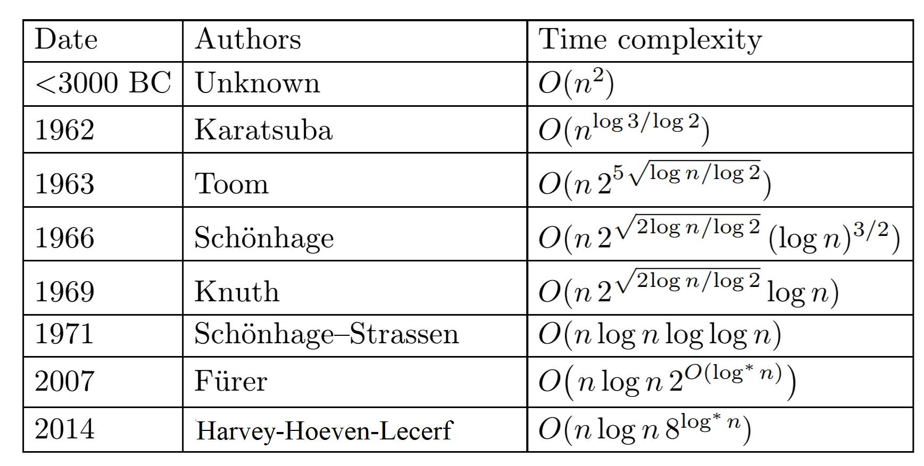
Integer Multiplication (Summary)
Amusing exercise: generalize Karatsuba to do 5 size $n/3$ subproblems
This gives $Θ\left(n^{1.46…}\right)$ time algorithm
Still open problem.

Slide 23
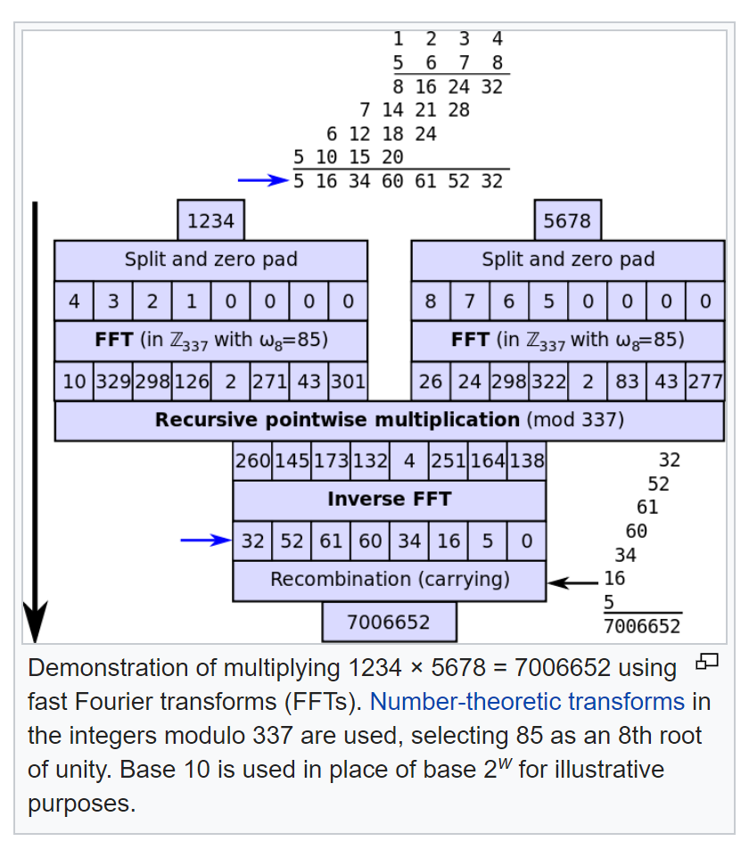
Integer Multiplication (Summary)

Slide 24
Matrix Multiplication

Slide 25
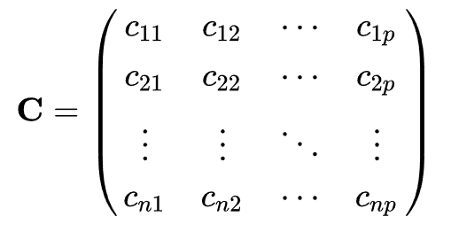
Multiplying Matrices
Let $A$ be an $n×m$ matrix, $B$ be an $m×p$ matrix.
Then, $C=AB$ is an $n×p$ matrix
such that
Question: Why matrix multiplication is defined in such way?

Slide 26
Multiplying Matrices

Slide 27
Multiplying Matrices

Slide 28
Multiplying Matrices
A₁₁
A₁₂
B₁₁
B₁₂
A₂₁
A₂₂
B₂₁
B₂₂
A₁₁B₁₁+A₁₂B₂₁
A₁₁B₁₂+A₁₂B₂₂
A₂₁B₁₁+A₂₂B₂₁
A₂₁B₁₂+A₂₂B₂₂

Slide 29
Simple Divide and Conquer
$T(n)=8T(n/2)+4{\left(\frac{n}{2}\right)}^{2}=8T(n/2)+n2$
So, $T\left(n\right)=Θ\left(n^{\log_{2}8}\right)=Θ(n^{3})$
A₁₁
A₁₂
B₁₁
B₁₂
A₂₁
A₂₂
B₂₁
B₂₂
A₁₁B₁₁+A₁₂B₂₁
A₁₁B₁₂+A₁₂B₂₂
=
A₂₁B₁₁+A₂₂B₂₁
A₂₁B₁₂+A₂₂B₂₂

Slide 30
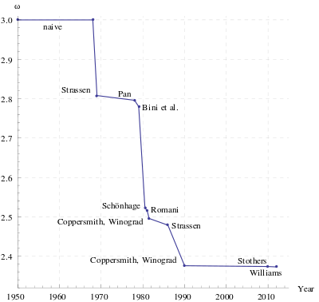
Strassen’s Divide and Conquer Algorithm
Strassen’s algorithm
Multiply $2×2$ matrices using $7$ instead of $8$ multiplications (and $18$ additions)
$$T\left(n\right)=7T\left(\frac{n}{2}\right)+18n$$
Hence, we have $T\left(n\right)=O\left(n^{\log_{2}{7}}\right).$
Useful when $n\sim 500$.
One of the most important open problem:
Solve matrix multiplication in $O(n^{2}\log^{O\left(1\right)}n)$ time
I am curious how large $n$ need?

Slide 31
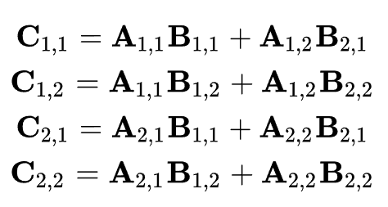
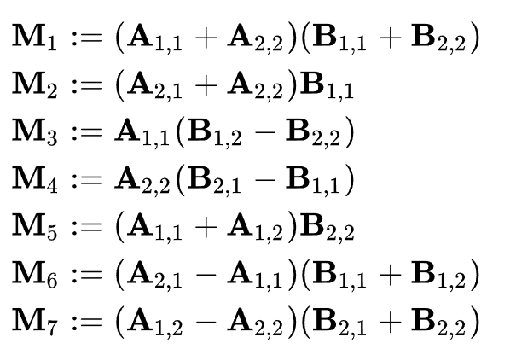
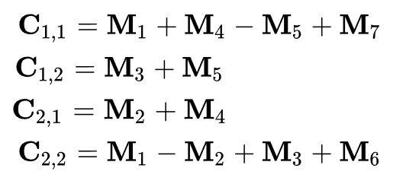
Strassen’s Divide and Conquer Algorithm
Naive
Strassen
How did Strassen come up with his matrix multiplication method?
Stackexchange: I've been told no-one really knows, anything would be mainly speculation.

