Slide 1
CSE 421
Greedy Algorithms / Minimum Spanning Tree
Yin Tat Lee

Slide 2
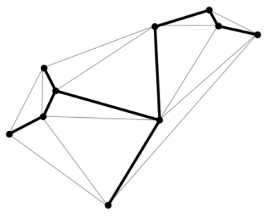
Spanning Tree
Given a connected undirected graph $G = \left(V, E\right)$.
We call $T$ is a spanning tree of $G$ if
All edges in $T$ are from $E$.
$T$ includes all of the vertices of $G$.
$$T$$
$$G$$

Slide 3
Why spanning tree?
Many problems is easy for tree.
General framework:
Approximate the graph by a tree.
Solve the problem on a tree.
We have covered different tree:
BFS tree / Dijkstra tree
Remember all shortest paths from $s$.
DFS tree
Compute lowest common ancestor.
There are many other different trees depending on applications.

Slide 4
Minimum Spanning Tree (MST)
Given a connected undirected graph $G$ with weights $c_{e}≥0$.
An MST $T$ is a spanning tree whose sum of edge weights is minimized.
4
24
4
23
9
6
9
6
18
5
5
11
16
11
8
8
7
7
10
14
21
$$G = (V, E)$$
$$c\left(T\right)=\sum_{e∈T}{c_{e}=50}$$
Applications: Network design, …

Slide 5
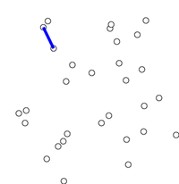
Kruskal’s Algorithm [1956]
Kruskal(G, c) {
Sort edges weights so that $c_{1}≤c_{2}≤⋯≤c_{m}$.
$T←∅$
foreach ($u∈V$) make a set containing singleton $\{u\}$
for $i=1$ to $m$
Let $\left(u,v\right)=e_{i}$
if ($u$ and $v$ are in different sets) {
$T← T∪\{e_{i}\}$
merge the sets containing $u$ and $v$
}
return $T$
}
Question:
How to find maximum spanning tree?
Kruskal
Prim
Sort edges weight.
Add edges whenever it does not create cycle.
add the cheapest edge from the tree to another vertex.

Slide 6
Cuts
S
V-S
In a graph $G=(V,E)$, a cut is a bipartition of V into disjoint sets $S,V−S$ for some $S⊆V.$ We write it as $(S,V−S)$.
An edge $e=\{u,v\}$ is in the cut $(S,V−S)$ if exactly one of $u,v$ is in $S$.
x
v
u
S
V-S

Slide 7
Properties of the OPT
Simplifying assumption: All edge costs $c_{e}$ are distinct.
Cut property: Let $S$ be any subset of nodes (called a cut), and let $e$ be the min cost edge with exactly one endpoint in $S$. Then every MST contains $e$.
Cycle property. Let $C$ be any cycle, and let $f$ be the max cost edge belonging to $C$. Then no MST contains $f$.
7
10
7
S
V-S
2
3
4
5
5
red edge is in the MST
Green edge is not in the MST

Slide 8
Cycles and Cuts
Claim. A cycle crosses a cut (from $S$ to $V−S$) an even number of times.
Proof. (by picture)
C
S
V - S
u
Every time the cycle crosses a cut, it goes from $S$ to $V−S$ or from $V−S$ to $S$.

Slide 9
Cut Property: Proof
Simplifying assumption: All edge costs $c_{e}$ are distinct.
Cut property. Let $S$ be any subset of nodes, and let $e$ be the min cost edge with exactly one endpoint in $S$. Then the $T^{∗}$ contains $e$.
Proof. By contradiction
Suppose $e = \{u,v\}$ does not belong to $T^{∗}$.
Adding $e$ to $T^{∗}$ creates a cycle $C$ in $T^{∗}$.
There is a path from $u$ to $v$ in $T^{∗}$ ⇒ there exists another edge, say $f$, that leaves $S$.
$T = T^{∗}  \{e\} − \{f\}$ is also a spanning tree.
Since $c_{e}<c_{f}$, $c\left(T\right)<c(T^{∗})$.
This is a contradiction.
(coz all tree has $n−1$ edges)
f
S
u
e
v
T*

Slide 10
Cycle Property: Proof
Simplifying assumption: All edge costs $c_{e}$ are distinct.
Cycle property: Let $C$ be any cycle in $G$, and let $f$ be the max cost edge belonging to $C$. Then the MST $T^{∗}$ does not contain $f$.
Proof. By contradiction
Suppose $f$ belongs to $T^{∗}$.
Deleting $f$ from $T^{∗}$ cuts $T^{∗}$ into two connected components.
There exists another edge, say $e$, that is in the cycle and connects the components.
$T = T^{∗}  \{e\} − \{f\}$ is also a spanning tree.
Since $c_{e}<c_{f}$, $c\left(T\right)<c(T^{∗})$.
This is a contradiction.
Every connected graph has a spanning tree.
Hence it has at least $n−1$ edges.
f
S
e
T*

Slide 11
Proof of Correctness (Kruskal)
Consider edges in ascending order of weight.
Case 1: adding $e$ to $T$ creates a cycle,
$e$ is the maximum weight edge in that cycle.
cycle property show $e$ is not in any minimum spanning tree.
Case 2: $e=(u,v)$ is the minimum weight edge in the cut $S$ where $S$ is the set of nodes in $u$’s connected component.
So, $e$ is in all minimum spanning tree.
v
e
S
$$e$$
u
Case 1
Case 2
This proves MST is unique if weights are distinct.

Slide 12
Implementation: Kruskal’s Algorithm
Implementation. Use the union-find data structure.
Build set $T$ of edges in the MST.
Maintain a set for each connected component.
O($m log⁡n$) for sorting and O($m log⁡n$) for union-find
Kruskal(G, c) {
Sort edges weights so that $c_{1}≤c_{2}≤⋯≤c_{m}$.
$T←∅$
foreach ($u∈V$) make a set containing singleton $\{u\}$
for $i=1$ to $m$
Let $\left(u,v\right)=e_{i}$
if ($u$ and $v$ are in different sets) {
$T← T∪\{e_{i}\}$
merge the sets containing $u$ and $v$
}
return $T$
}

Slide 13
Union Find Data Structure
The goal is to have a data structure to tracks a set of elements partitioned into disjoint subsets.
Initially, we have {{1},{2},{3},{4},$⋯$}.
We need two operations:
Union($S_{1},S_{2})$: Merge subsets $S_{1}$ and $S_{2}$ into one.
Find$(x)$: Output the subset $S$ containing $x$.

Slide 14
Find
Each set is represented as a tree of pointers, where every vertex is labeled with longest path ending at the vertex
To check whether A,Q are in same connected component, follow pointers and check if root is the same.
D,2
W,1
A,1
B,0
P,0
Q,0
C,0
{W,P,Q}
{A,B,C,D}
So, the cost of $Find(x)$ is at most height of the set.

Slide 15
Union
You can get the same result by “Union by size”
Union: To merge two connected components, make the root with the smaller label point to the root with the bigger label (adjusting labels if necessary). Runs in $O(1)$ time
D,2
D,2
W,1
A,1
B,0
A,1
W,1
B,0
P,0
Q,0
P,0
Q,0
C,0
C,0
At most one label
must be adjusted
W,2
D,1
W,1
D,1
Q,0
A,0
Q,0
A,0

Slide 16
Depth vs Size: Correctness
Claim: If the label of a root is $k$, there are at least $2^{k}$ elements in the set.
Proof: By induction on $k$.
Base Case ($k=0$): this is true. The set has size $1$.
Inductive Step: If we merge roots with labels$k_{1}>k_{2}$, the number of vertices only increases while the label (height) stays the same.
If $k_{1}=k_{2}$, the merged tree has label (height) $k_{1}+1$,
and by induction, it has at least
$$2^{k_{1}}+2^{k_{2}}=2^{k_{1}+1}$$
elements.

Slide 17
Depth vs Size
Claim: If the label of a root is $k$, there are at least $2^{k}$ elements in the set.
Therefore, the depth of any tree in algorithm is at most $\log_{2}⁡n$
So, we can check if $u,v$ are in the
same component in time $O(log n)$
D,2
A,1
W,1
B,0
P,0
Q,0
C,0

Slide 18
Kruskal’s Algorithm with Union Find
Implementation. Use the union-find data structure.
Build set $T$ of edges in the MST.
Maintain a set for each connected component.
O(m log n) for sorting and O(m log n) for union-find
Kruskal(G, c) {
Sort edges weights so that $c_{1}≤c_{2}≤⋯≤c_{m}$.
$T←∅$
foreach ($u∈V$) make a set containing singleton $\{u\}$
for $i=1$ to $m$
Let $\left(u,v\right)=e_{i}$
if ($u$ and $v$ are in different sets) {
$T← T∪\{e_{i}\}$
merge the sets containing $u$ and $v$
}
return $T$
}
Find roots and compare
Merge at the roots

Slide 19
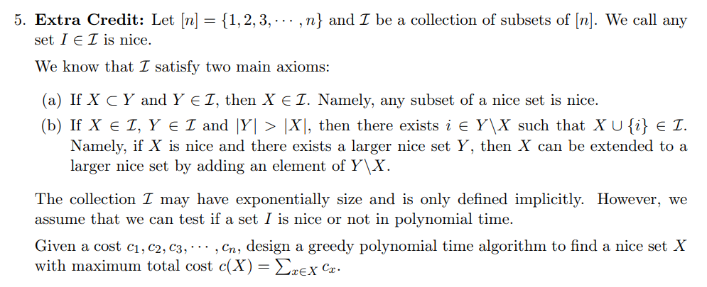
HW3 Extra
Let $[n]$ be all edges of $G$.
Let $I$ be the collection of subsets of edges without cycles.
Any nice set $X∈I$ is a forest.
Maximum $c(X)$ over nice set $X$ is same as finding maximum spanning tree.
The answer for this question is basically Kruskal’s Algorithm

Slide 20
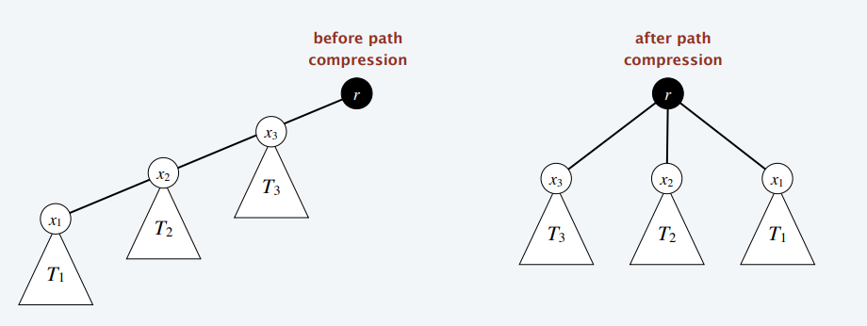
Find: Path Compression
After finding the root $r$ of the tree containing $x$,
Change the parent points of all nodes along the path to $r$ directly.
Find(x) {
If $x≠parent(x)$
$parent(x)←Find(parent\left(x\right))$
return $parent(x)$
}

Slide 21
Union by height/size + Path Compression
In 1972, Fischer proved this it takes $O(n\log{\log{n}})$ time to do
$O(n)$ find and $n−1$ union.
In 1973, Hopcroft-Ullman improve the bound to $O(n\log^{∗}{n})$.
In 1975, Tarjan improved the bound to $O(n α\left(n\right))$.
Finally, in 1989, Fredman-Saks proved this is optimal.

Slide 22
What is $α(n)$?
Inverse Ackermann function $α(n)$.
Define
$α_{1}\left(n\right)=\left\lceil n/2\right\rceil$.
$α_{2}\left(n\right)=\left\lceil \lg{n}\right\rceil =\#$ of times we divide $n$ by two until we reach $1$.
$α_{3}\left(n\right)=\lg^{∗}{n}=\#$ of times we apply $lg$ until we reach $1$.
$α_{4}\left(n\right)=\#$ of times we apply $\lg^{∗}$ until we reach $1$.
Define $α\left(n\right)=\min{\{k:α_{k}\left(n\right)≤3\}}$.
Any number $n$ I can write down satisfies $α\left(n\right)≤3$.

