Slide 1
CSE 421: Introduction to Algorithms
Stable Matching
Yin-Tat Lee

Slide 2
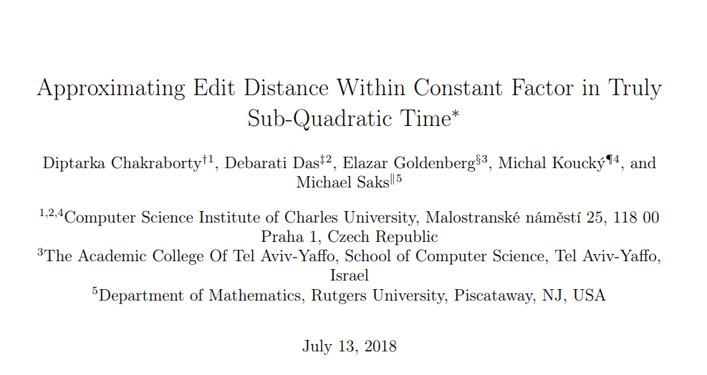
Quiz
Best paper on FOCS 2018
Input: two $n$-bit strings $s_{1}$ and $s_{2}$.
$s_{1}=AGGCTACC$
$s_{2}=CAGGCTAC$
Output: minimum number of insertions/deletions to transform $s_{1}$ into $s_{2}$.
Algorithm: ????
Even if the objective is precisely defined, we are often not ready to start coding right away!
After this quarter, you should able to solve it by $O(n^{2})$ time.
Open problem: Is $O(n^{1.999})$ possible? (Probably not due to Strong ETH)
Message: Don’t be discouraged if it takes 30 years to solve a problem.
See arXiv:1804.04178
However, limit your time of each homework to just 10 years. There are 8 homework.

Slide 3
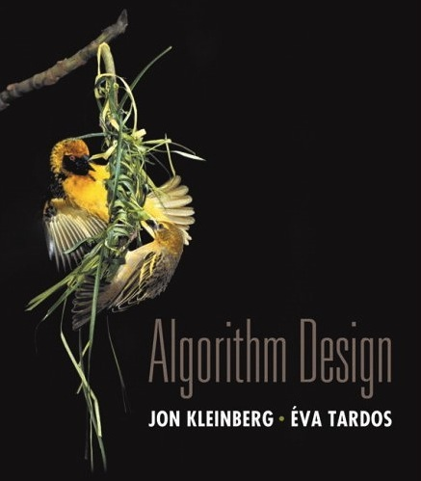
This Course
How to solve problems using computers, aka, algorithms.
Goal:
Learn some techniques to design algorithms
How to analyze the runtime
Understand some problems are difficult
Grading Scheme
Homework ~ 50% Weekly homework due on Wed before the class
Midterm ~ 15-20%
Final ~ 30-35%
HW 1 is already out! Due next Wed before class!
Feel free to eat in classroom.
Course textbook

Slide 4
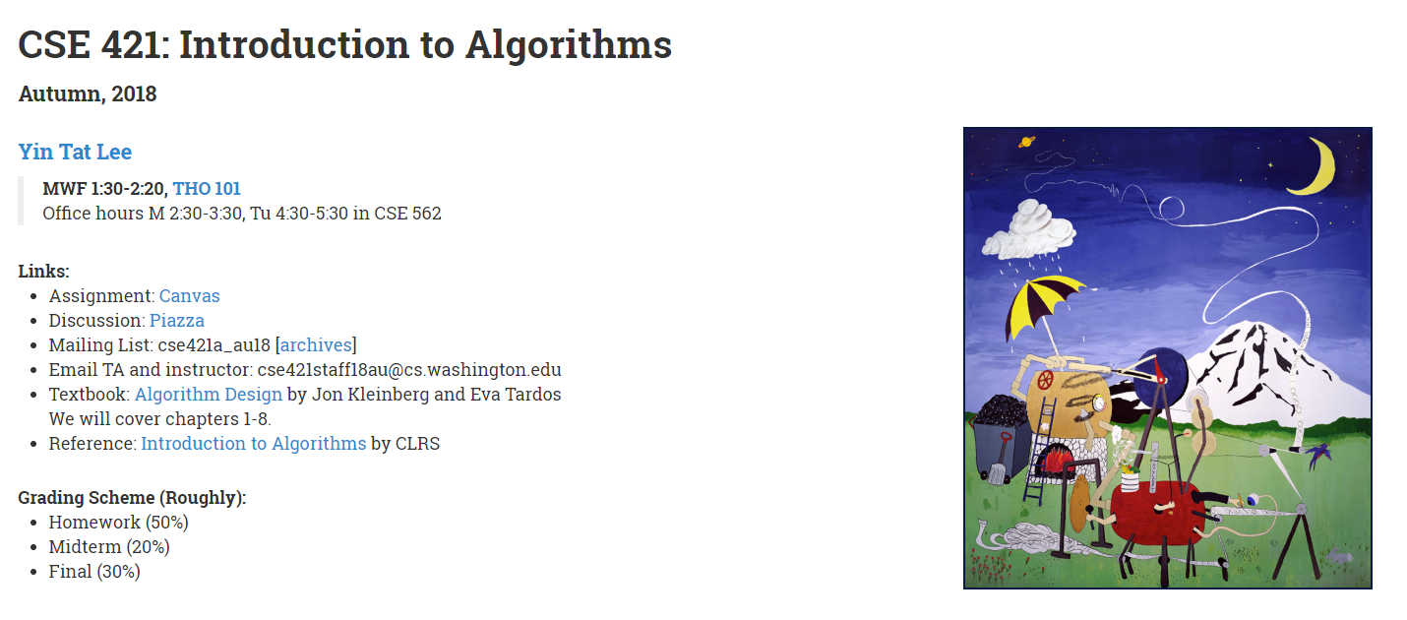
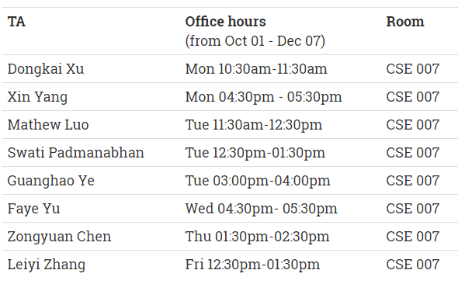
Where to get help?
Ask questions in the class!
Read the textbook!
Piazza: Online discussion forum.
Office hours:
Myself: M 2:30-3:30, Tu 4:30-5:30 in CSE 562
Last year we used Canvas. Students said Piazza is better.
Website: cs.washington.edu/421
CSE 007
(starting from next Monday)

Slide 5
Yin-Tat’s Research
Study theoretical computer science.
Among others, I gave the (theoretically) fastest algorithms for
Linear Programs
Network flow
Two topics that we will discuss in this course.
Some problems in this course are still a hot area of research!

Slide 6
Stable Matching Problem
Given $n$ men and $n$ women, find a “stable matching”.
We know the preference of all people.
favorite
least favorite
favorite
least favorite
1st
2nd
3rd
1st
2nd
3rd
Xavier
Amy
Brenda
Claire
Amy
Yuri
Xavier
Zoran
Yuri
Brenda
Amy
Claire
Brenda
Xavier
Yuri
Zoran
Zoran
Amy
Brenda
Claire
Claire
Xavier
Yuri
Zoran
Men’s Preference Profile
Women’s Preference Profile

Slide 7
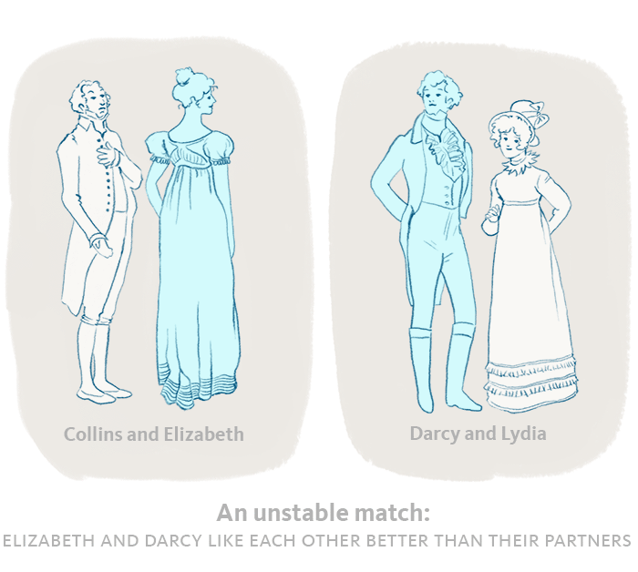
Stable Matching
Perfect matching:
Each man gets exactly one woman.
Each woman gets exactly one man.
Stability: no incentive to exchange
an unmatched pair m-w is unstable
if man m and woman w prefer each other to current partners.

Slide 8
Stable Matching
Perfect matching:
Each man gets exactly one woman.
Each woman gets exactly one man.
Stability: no incentive to exchange
an unmatched pair m-w is unstable
if man m and woman w prefer each other to current partners.
Stable matching: perfect matching with no unstable pairs.
Stable matching problem: Given the preference lists of $n$ men and $n$ women, find a stable matching if one exists.
m
w

Slide 9
Example
Question. Is assignment X-C, Y-B, Z-A stable?
favorite
least favorite
favorite
least favorite
1st
2nd
3rd
1st
2nd
3rd
Xavier
Amy
Brenda
Claire
Amy
Yuri
Xavier
Zoran
Yuri
Brenda
Amy
Claire
Brenda
Xavier
Yuri
Zoran
Zoran
Amy
Brenda
Claire
Claire
Xavier
Yuri
Zoran
Men’s Preference Profile
Women’s Preference Profile

Slide 10
Example
Question. Is assignment X-C, Y-B, Z-A stable?
Answer. No. Brenda and Xavier will hook up.
favorite
least favorite
favorite
least favorite
1st
2nd
3rd
1st
2nd
3rd
Xavier
Amy
Brenda
Claire
Amy
Yuri
Xavier
Zoran
Yuri
Brenda
Amy
Claire
Brenda
Xavier
Yuri
Zoran
Zoran
Amy
Brenda
Claire
Claire
Xavier
Yuri
Zoran
Men’s Preference Profile
Women’s Preference Profile

Slide 11
Example (cont’d)
Question: Is assignment X-A, Y-B, Z-C stable?
Answer: Yes. (X, Y are happy. No one want Z.)
favorite
least favorite
favorite
least favorite
1st
2nd
3rd
1st
2nd
3rd
Xavier
Amy
Brenda
Claire
Amy
Yuri
Xavier
Zoran
Yuri
Brenda
Amy
Claire
Brenda
Xavier
Yuri
Zoran
Zoran
Amy
Brenda
Claire
Claire
Xavier
Yuri
Zoran
Men’s Preference Profile
Women’s Preference Profile

Slide 12
Existence of Stable Matchings
Question. Do stable matchings always exist?
Answer. Yes, but not obvious.
Stable roommate problem:
2n people; each person ranks others from 1 to 2n-1.
Assign roommate pairs so that no unstable pairs.
Stable matchings do not always exist for stable roommate problem.
1st
2nd
3rd
Adam
B
C
D
A-B, C-D ⇒ B-C unstable A-C, B-D ⇒ A-B unstable A-D, B-C ⇒ A-C unstable
Bob
C
A
D
Chris
A
B
D
David
A
B
C
Notes:
Suffixes to check all 3 possible matchings: {A-B, C-D}, {A-C, B-D}, {A-D, B-C}

Slide 13
Propose-And-Reject Algorithm [Gale-Shapley’62]
Initialize each person to be free.
while (some man is free and hasn't proposed to every woman) {
Choose such a man m
w = 1st woman on m's list to whom m has not yet proposed
if (w is free)
assign m and w to be engaged
else if (w prefers m to her fiancé m')
assign m and w to be engaged, and m' to be free
else
w rejects m
}
Switch the pdf for an example.

Slide 14
Main Properties of the algorithm
Tips: When stuck, try to list out properties of the algorithms.
Observation 1: Men propose to women in decreasing order of preference.
Observation 2: Once a woman is matched, she never becomes unmatched; she only "trades up."
Poll Time
Notes:
Ob1: If men get rejected. They will propose to the next one (less favorable one) in the list.
Ob2: In the algorithm, woman only switches partner when she get a better proposal.

Slide 15
What do we need to prove?
The algorithm ends.
How many iterations it takes?
The output is correct.
It find a perfect matching that is stable.
Notes:
Termination: For each step, there is a man m proposed to woman w.
Note that m will not proposed to w anymore.
There are n^2 pair of (m,w).
Hence, it takes at most n^2 steps.
Perfectness:

Slide 16
Proof of Correctness: Termination
Each step, a man proposed to a new woman.
There are $n×n=n^{2}$ possible man-to-woman proposals.
Therefore, it takes at most $n^{2}$ iterations.
1st
2nd
3rd
4th
5th
1st
2nd
3rd
4th
5th
Victor
A
B
C
D
E
Amy
W
X
Y
Z
V
Walter
B
C
D
A
E
Brenda
X
Y
Z
V
W
Xavier
C
D
A
B
E
Claire
Y
Z
V
W
X
Yuri
D
A
B
C
E
Diane
Z
V
W
X
Y
Zoran
A
B
C
D
E
Erika
V
W
X
Y
Z
n(n-1) + 1 proposals required

Slide 17
Proof of Correctness: Perfection
Claim. All men and women get matched.
Proof. (by contradiction)
Suppose, for sake of contradiction, that Zoran is not matched upon termination of algorithm.
Then some woman, say Amy, is not matched upon termination.
(Observation 2: once women matched, they never becoming unmatched.) Amy was never proposed to.
But, Zoran proposes to everyone, since he ends up unmatched.

Slide 18
Proof of Correctness: Stability
Claim. No unstable pairs.
Proof. (by contradiction)
Suppose A-Z is an unstable pair: each prefers each other to the partner in Gale-Shapley matching.
Case 1: Z never proposed to A.
⇒ Z prefers his GS partner to A.
⇒ A-Z is stable.
Case 2: Z proposed to A.
⇒ A rejected Z (right away or later)
⇒ A prefers her GS partner to Z.
⇒ A-Z is stable.
In either case A-Z is stable, a contradiction.
men propose in decreasing order of preference
women only trade up

Slide 19
Summary
Stable matching problem: Given n men and n women, and their preferences, find a stable matching.
Gale-Shapley algorithm: Guarantees to find a stable matching for any problem instance.
Q: How to implement GS algorithm efficiently?
Q: If there are multiple stable matchings, which one does GS find?

Slide 20
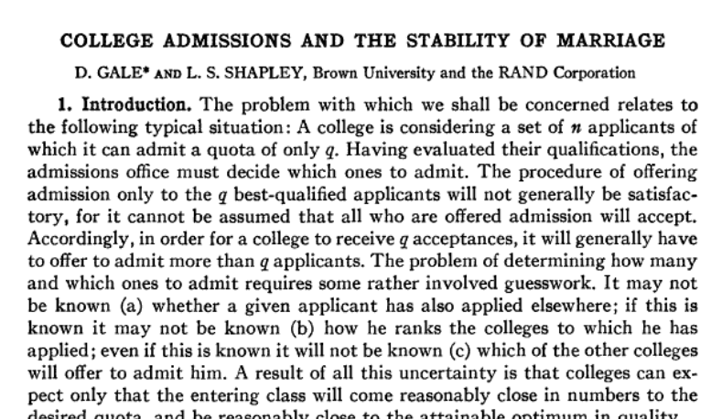
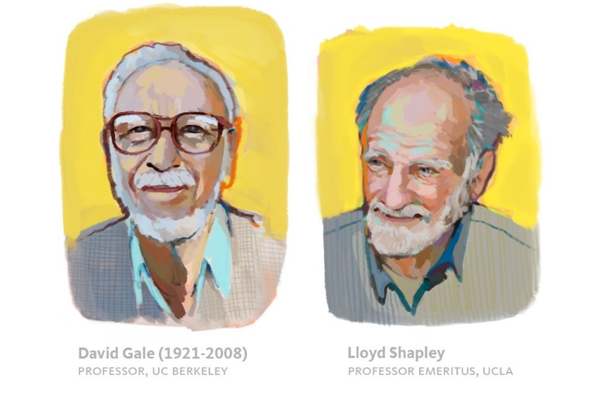
Why this problem is important?
In 1962, Gale and Shapley published the paper
“College Admissions and the Stability of Marriage”
To
“The American Mathematical Monthly”

Slide 21
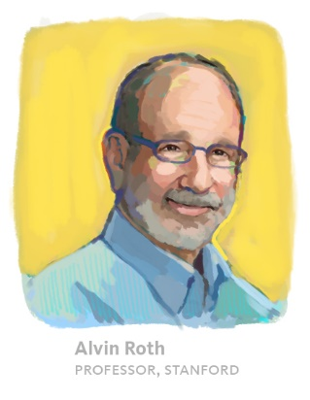
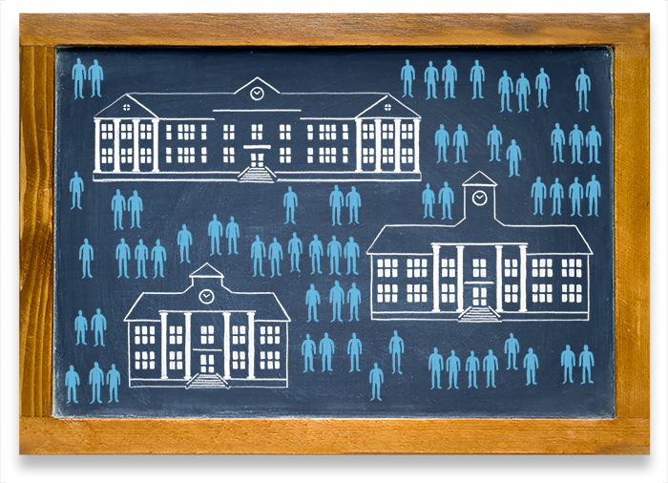
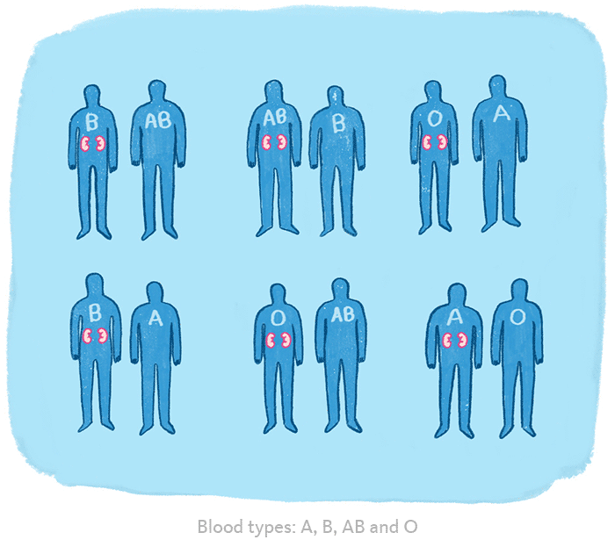
Why this problem is important?
Alvin Roth modified the Gale-Shapley algorithm and apply it to
National Residency Match Program (NRMP), a system that assigns new doctors to hospitals around the country. (90s)
Public high school assignment process (00s)
Helping transplant patients find a match (2004)
(Saved >1,000 people every year!)
Reference: https://medium.com/@UofCalifornia/how-a-matchmaking-algorithm-saved-lives-2a65ac448698
Notes:
https://forward.com/news/breaking-news/164327/alvin-roth-transformed-kidney-donation-system/

Slide 22
Why this problem is important?
Some of the problems in this course may seem obscure or pointless.
But their abstraction allows for variety of applications.
Shapley and Roth got the Nobel Prize (Economic) in 2012.
(David Gale passed away in 2008.)

