Slide 1
CSE 421 Algorithms
NP-Complete
P
Richard Anderson
Lecture 29
Complexity Theory

Slide 2
Announcements
Final exam,
Monday, December 14, 2:30-4:20 pm
Comprehensive (2/3 post midterm, 1/3 pre midterm)
Review session
Today, 2:30-4:30 pm. Lowe 101
Online course evaluations available

Slide 3
NP Complete Problems
Circuit Satisfiability
Formula Satisfiability
3-SAT
Graph Problems
Independent Set
Vertex Cover
Clique
Path Problems
Hamiltonian cycle
Hamiltonian path
Partition Problems
Three dimensional matching
Exact cover
Graph Coloring
Number problems
Subset sum
Integer linear programming
Scheduling with release times and deadlines

Slide 4
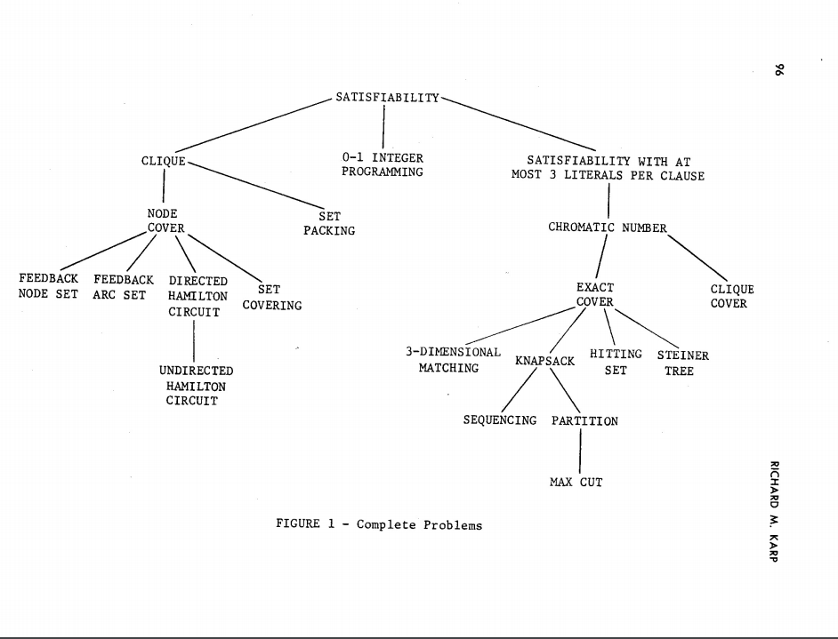
Karp’s 21 NP Complete Problems

Slide 5
What we don’t know
P vs. NP
NP-Complete
P = NP
P

Slide 6
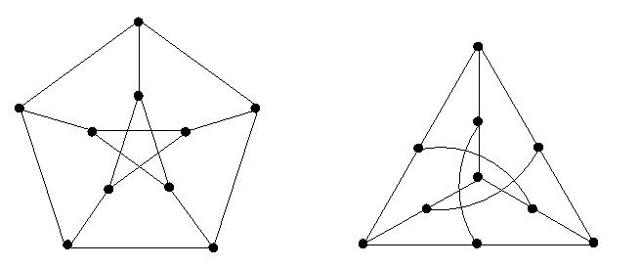
If P != NP, is there anything in between
Yes, Ladner [1975]
Problems not known to be in P or NP Complete
Factorization
Discrete Log
Graph Isomorphism
Solve g^{k} = b over a finite group

Slide 7
Coping with NP Completeness
Approximation Algorithms
Christofides algorithm for TSP (Undirected graphs satisfying triangle inequality)
Solution guarantees on greedy algorithms
Bin packing

Slide 8
Christofides Algorithm (simplified)
4
3
4
3
4
1
4
1
2
2
5
5
5
3
5
3
6
6
4
4
3
3
4
3
4
3
2
2
5
6
5
6

Slide 9
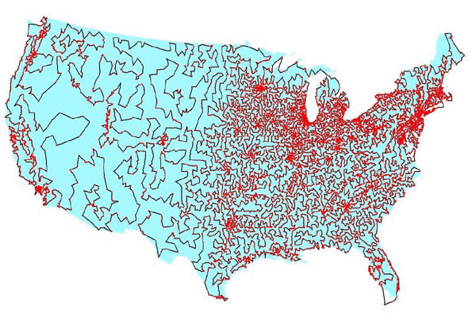
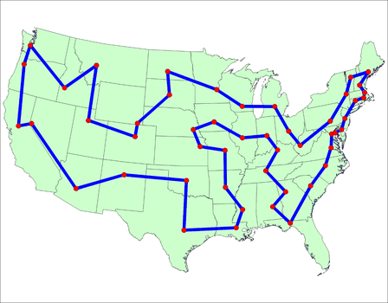
Coping with NP-Completeness
Branch and Bound
Euclidean TSP

Slide 10
Coping with NP-Completeness
Local Search
Modify solution until a local minimum is reached
Interchange algorithm for TSP
Recoloring algorithms
Simulated annealing

Slide 11
Complexity Theory
Computational requirements to recognize languages
Models of Computation
Resources
Hierarchies
All Languages
Decidable Languages
Context Free Languages
Regular Languages

Slide 12
Time complexity
P: (Deterministic) Polynomial Time
NP: Non-deterministic Polynomial Time
EXP: Exponential Time

Slide 13
Space Complexity
Amount of Space (Exclusive of Input)
L: Logspace, problems that can be solved in O(log n) space for input of size n
Related to Parallel Complexity
PSPACE, problems that can be required in a polynomial amount of space

Slide 14
So what is beyond NP?

Slide 15
NP vs. Co-NP
Given a Boolean formula, is it true for some choice of inputs
Given a Boolean formula, is it true for all choices of inputs

Slide 16
Problems beyond NP
Exact TSP, Given a graph with edge lengths and an integer K, does the minimum tour have length K
Minimum circuit, Given a circuit C, is it true that there is no smaller circuit that computes the same function a C

Slide 17
Polynomial Hierarchy
Level 1
∃X₁ Φ(X₁), ∀X₁ Φ(X₁)
Level 2
∀X₁∃X₂ Φ(X₁,X₂), ∃X₁∀X₂ Φ(X₁,X₂)
Level 3
∀X₁∃X₂∀X₃ Φ(X₁,X₂,X₃), ∃X₁∀X₂∃X₃ Φ(X₁,X₂,X₃)

Slide 18
Polynomial Space
Quantified Boolean Expressions
∃X₁∀X₂∃X₃...∃X_{n-1}∀X_{n} Φ(X₁,X₂,X₃…X_{n-1}X_{n})
Space bounded games
Competitive Facility Location Problem
Counting problems
The number of Hamiltonian Circuits in a graph

