Slide 1
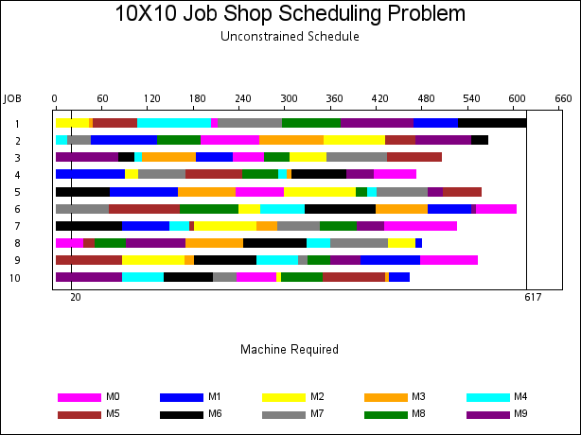
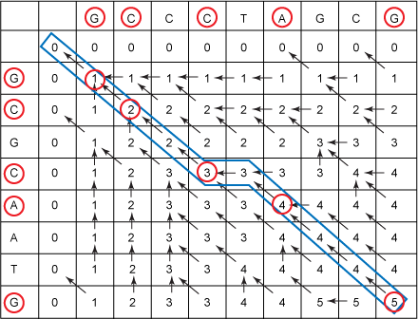
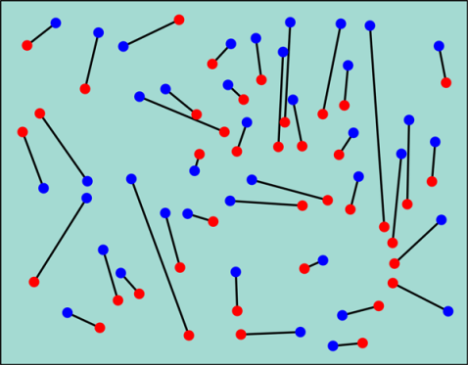
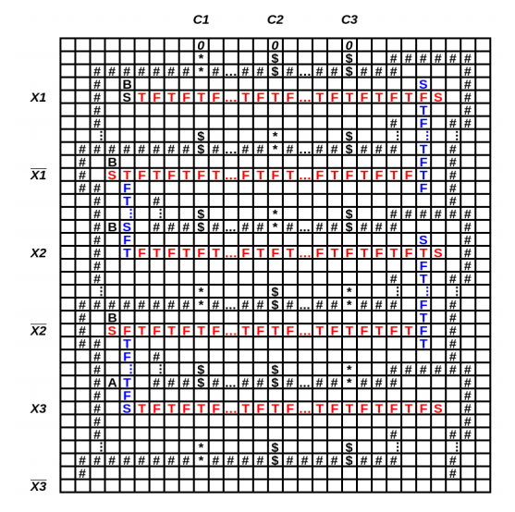
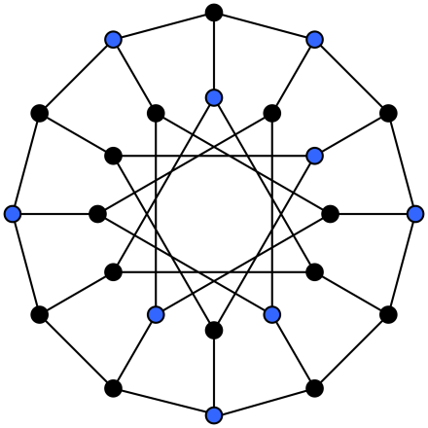
Five Problems
CSE 421
Richard Anderson
Autumn 2016, Lecture 3

Slide 2
Announcements
Course website
Office hours
Richard Anderson
Monday, 2:30 pm - 3:30 pm, CSE 582
Wednesday, 2:30 pm - 3:30 pm, CSE 582
Deepali Aneja
Monday, 5:30 pm - 6:30 pm, CSE 220
Max Horton
Monday, 4:30 pm – 5:30 pm, CSE 220
Tuesday, 2:00 pm – 3:00 pm, CSE 218
Ben Jones
Tuesday, 1:00 pm – 2:00 pm, CSE 218
Friday, 2:30 pm – 3:30 pm, CSE 220
//courses.cs.washington.edu/courses/cse421/16au/

Slide 3
Theory of Algorithms
What is expertise?
How do experts differ from novices?
Point of slide – experts have a
Structure of knowledge

Slide 4
Introduction of five problems
Show the types of problems we will be considering in the class
Examples of important types of problems
Similar looking problems with very different characteristics
Problems
Scheduling
Weighted Scheduling
Bipartite Matching
Maximum Independent Set
Competitive Facility Location

Slide 5
What is a problem?
Example: Minimum Spanning Tree
Instance
Solution
Constraints on solution
Measure of value
Graph
Set of edges
Tree constraints
Edge costs

Slide 6
Problem: Scheduling
Suppose that you own a banquet hall
You have a series of requests for use of the hall: (s₁, f₁), (s₂, f₂), . . .
Find a set of requests as large as possible with no overlap

Slide 7
What is the largest solution?

Slide 8
Greedy Algorithm
Test elements one at a time if they can be members of the solution
If an element is not ruled out by earlier choices, add it to the solution
Many possible choices for ordering (length, start time, end time)
For this problem, considering the jobs by increasing end time works

Slide 9
Suppose we add values?
(s_{i}, f_{i}, v_{i}), start time, finish time, payment
Maximize value of elements in the solution
5
2
1
1
2
4
1
3
1
6

Slide 10
Greedy Algorithms
1
Earliest finish time
Maximum value
Give counter examples to show these algorithms don’t find the maximum value solution
2
2
2
3

Slide 11
Dynamic Programming
Requests R₁, R₂, R₃, . . .
Assume requests are in increasing order of finish time (f₁ < f₂ < f₃ . . .)
Opt_{i} is the maximum value solution of {R₁, R₂, . . ., R_{i}} containing R_{i}
Opt_{i} = Max{ j | f_{j} < s_{i} }[Opt_{j} + v_{i}]

Slide 12
Matching
Given a bipartite graph G=(U,V,E), find a subset of the edges M of maximum size with no common endpoints.
Application:
U: Professors
V: Courses
(u,v) in E if Prof. u can teach course v

Slide 13
Find a maximum matching

Slide 14
Augmenting Path Algorithm
s
t
Trace path from s to t to
show augmenting path

Slide 15
Reduction to network flow
More general problem
Send flow from source to sink
Flow subject to capacities at edges
Flow conserved at vertices
Can solve matching as a flow problem

Slide 16
Maximum Independent Set
Given an undirected graph G=(V,E), find a set I of vertices such that there are no edges between vertices of I
Find a set I as large as possible

Slide 17
Find a Maximum Independent Set
A
C
D
B
E
F
G
H
K
J
L
O
S
I
N
T
M
R
Q
U
P

Slide 18
Verification: Prove the graph has an independent set of size 8

Slide 19
Key characteristic
Hard to find a solution
Easy to verify a solution once you have one
Other problems like this
Hamiltonian circuit
Clique
Subset sum
Graph coloring

Slide 20
NP-Completeness
Theory of Hard Problems
A large number of problems are known to be equivalent
Very elegant theory

Slide 21
Are there even harder problems?
Simple game:
Players alternating selecting nodes in a graph
Score points associated with node
Remove nodes neighbors
When neither can move, player with most points wins
4
3
2
6
5
2
3
4
1
6

Slide 22
5
6
4
6
5
5
6
4
1
6
2
1
4
2
5
8
7
8
5
4
4
5
4
3
4

Slide 23
Competitive Facility Location
Choose location for a facility
Value associated with placement
Restriction on placing facilities too close together
Competitive
Different companies place facilities
E.g., KFC and McDonald’s

Slide 24
Complexity theory
These problems are P-Space complete instead of NP-Complete
Appear to be much harder
No obvious certificate
G has a Maximum Independent Set of size 10
Player 1 wins by at least 10 points

Slide 25
Summary
Scheduling
Weighted Scheduling
Bipartite Matching
Maximum Independent Set
Competitive Scheduling

