Slide 1
CSE 421 Algorithms
Richard Anderson
Lecture 21
Shortest Paths and Network Flow

Slide 2
Shortest Paths with Dynamic Programming

Slide 3
Shortest Path Problem
Dijkstra’s Single Source Shortest Paths Algorithm
O(mlog n) time, positive cost edges
Bellman-Ford Algorithm
O(mn) time for graphs with negative cost edges

Slide 4
Shortest paths with a fixed number of edges
Find the shortest path from v to w with exactly k edges

Slide 5
Express as a recurrence
Opt_{k}(w) = min_{x} [Opt_{k-1}(x) + c_{xw}]
Opt₀(w) = 0 if v=w and infinity otherwise

Slide 6
Algorithm, Version 1
foreach w
M[0, w] = infinity;
M[0, v] = 0;
for i = 1 to n-1
foreach w
M[i, w] = min_{x}(M[i-1,x] + cost[x,w]);

Slide 7
Algorithm, Version 2
foreach w
M[0, w] = infinity;
M[0, v] = 0;
for i = 1 to n-1
foreach w
M[i, w] = min(M[i-1, w], min_{x}(M[i-1,x] + cost[x,w]))

Slide 8
Algorithm, Version 3
foreach w
M[w] = infinity;
M[v] = 0;
for i = 1 to n-1
foreach w
M[w] = min(M[w], min_{x}(M[x] + cost[x,w]))

Slide 9
Correctness Proof for Algorithm 3
Key lemma – at the end of iteration i, for all w, M[w] <= M[i, w];
Reconstructing the path:
Set P[w] = x, whenever M[w] is updated from vertex x

Slide 10
If the pointer graph has a cycle, then the graph has a negative cost cycle
If P[w] = x then M[w] >= M[x] + cost(x,w)
Equal when w is updated
M[x] could be reduced after update
Let v₁, v₂,…v_{k} be a cycle in the pointer graph with (v_{k},v₁) the last edge added
Just before the update
M[v_{j}] >= M[v_{j+1}] + cost(v_{j+1}, v_{j}) for j < k
M[v_{k}] > M[v₁] + cost(v₁, v_{k})
Adding everything up
0 > cost(v₁,v₂) + cost(v₂,v₃) + … + cost(v_{k}, v₁)
v₁
v₄
v₂
v₃

Slide 11
Negative Cycles
If the pointer graph has a cycle, then the graph has a negative cycle
Therefore: if the graph has no negative cycles, then the pointer graph has no negative cycles

Slide 12
Finding negative cost cycles
What if you want to find negative cost cycles?
2
-2
3
5
2
-3
2
1
6
2
2
-5
2
4

Slide 13
Foreign Exchange Arbitrage
USD
1.2
1.2
 | USD | EUR | CAD
USD | ------ | 0.8 | 1.2
EUR | 1.2 | ------ | 1.6
CAD | 0.8 | 0.6 | -----
EUR
CAD
0.6
USD
0.8
0.8
EUR
CAD
1.6

Slide 14
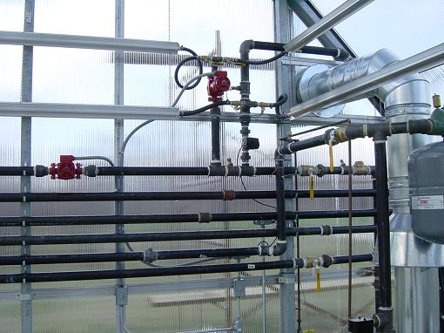
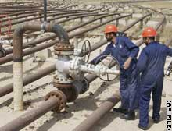
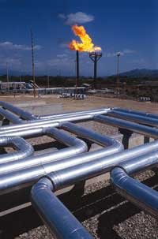
Network Flow

Slide 15
Outline
Network flow definitions
Flow examples
Augmenting Paths
Residual Graph
Ford Fulkerson Algorithm
Cuts
Maxflow-MinCut Theorem

Slide 16
Network Flow Definitions
Capacity
Source, Sink
Capacity Condition
Conservation Condition
Value of a flow

Slide 17
Flow Example
u
20
10
s
30
t
10
20
v

Slide 18
Flow assignment and the residual graph
u
u
15/20
0/10
5
10
15
s
15/30
t
15
15
s
t
5
5/10
20/20
5
20
v
v

Slide 19
Network Flow Definitions
Flowgraph: Directed graph with distinguished vertices s (source) and t (sink)
Capacities on the edges, c(e) >= 0
Problem, assign flows f(e) to the edges such that:
0 <= f(e) <= c(e)
Flow is conserved at vertices other than s and t
Flow conservation: flow going into a vertex equals the flow going out
The flow leaving the source is a large as possible

Slide 20
Flow Example
20
20
a
d
g
5
20
5
5
10
5
5
5
20
s
20
b
20
e
h
30
t
20
10
5
5
20
5
20
20
c
f
i
20
20

Slide 21
Find a maximum flow
Value of flow:
20
20
a
d
g
5
20
5
5
20
5
5
5
20
s
30
b
20
e
h
30
t
20
10
5
5
20
5
25
20
c
f
i
20
10
Construct a maximum flow and indicate the flow value

Slide 22
Find a maximum flow
MAX FLOW 65
20
20
20
20
a
d
g
20
5
20
5
5
20
5
5
5
20
5
20
s
25
30
b
20
20
e
h
30
t
20
20
30
20
5
10
5
15
5
15
20
5
5
25
20
c
f
i
20
20
10
10
Discussion slide

Slide 23
Augmenting Path Algorithm
Augmenting path
Vertices v₁,v₂,…,v_{k}
v₁ = s, v_{k} = t
Possible to add b units of flow between v_{j} and v_{j+1} for j = 1 … k-1
u
10/20
0/10
s
10/30
t
5/10
15/20
v

Slide 24
Find two augmenting paths
2/5
2/2
0/1
2/4
3/4
3/4
3/3
1/3
1/3
3/3
s
t
3/3
2/2
3/3
1/3
3/3
1/3
2/2
1/3

Slide 25
Residual Graph
Flow graph showing the remaining capacity
Flow graph G, Residual Graph G_{R}
G: edge e from u to v with capacity c and flow f
G_{R}: edge e’ from u to v with capacity c – f
G_{R}: edge e’’ from v to u with capacity f

Slide 26
Residual Graph
u
u
15/20
0/10
5
10
15
s
15/30
t
15
15
s
t
5
5/10
20/20
5
20
v
v

Slide 27
Build the residual graph
3/5
d
g
2/4
3/3
s
1/5
1/5
1/1
t
3/3
e
h
2/5
1/1
Residual graph:
d
g
s
t
e
h

Slide 28
Augmenting Path Lemma
Let P = v₁, v₂, …, v_{k} be a path from s to t with minimum capacity b in the residual graph.
b units of flow can be added along the path P in the flow graph.
u
u
5
10
15/20
0/10
15
s
15
15
t
s
15/30
t
5
5
20
5/10
20/20
v
v

Slide 29
Proof
Add b units of flow along the path P
What do we need to verify to show we have a valid flow after we do this?

Slide 30
Ford-Fulkerson Algorithm (1956)
while not done
Construct residual graph G_{R}
Find an s-t path P in G_{R} with capacity b > 0
Add b units along in G
If the sum of the capacities of edges leaving S is at most C, then the algorithm takes at most C iterations

