Slide 1
CSE 417 Algorithms and Complexity
Winter 2023
Lecture 14
Finishing Minimum Spanning Trees

Slide 2
Announcements
Midterm, Wednesday, Feb 8
Closed book, closed notes, no calculators
Time limit: 50 minutes
Answer the problems on the exam paper.
If you need extra space use the back of a page
Problems are not of equal difficulty, if you get stuck on a problem, move on.
``Justify your answer'' means give a short and convincing explanation. Depending on the situation, justifications can involve counter examples, or cite results established in the text or in lecture.

Slide 3
Minimum Spanning Tree
15
t
a
6
9
14
3
4
e
10
13
c
s
21
20
15
17
2
7
g
b
8
u
f
22
1
12
16
v

Slide 4
Greedy Algorithms for Minimum Spanning Tree
Prim’s Algorithm: Extend a tree by including the cheapest out going edge
Kruskal’s Algorithm: Add the cheapest edge that joins disjoint components
4
b
c
20
5
11
8
a
d
7
22
e

Slide 5
Application: Clustering
Given a collection of points in an r- dimensional space and an integer K, divide the points into K sets that are closest together

Slide 6
Distance clustering
Divide the data set into K subsets to maximize the distance between any pair of sets
dist (S₁, S₂) = min {dist(x, y) | x in S₁, y in S₂}

Slide 7
Divide into 2 clusters

Slide 8
Divide into 3 clusters

Slide 9
Divide into 4 clusters

Slide 10
Distance Clustering Algorithm
Let C = {{v₁}, {v₂},. . ., {v_{n}}}; T = { }
while |C| > K
Let e = (u, v) with u in C_{i} and v in C_{j} be the minimum cost edge joining distinct sets in C
Replace C_{i} and C_{j} by C_{i} U C_{j}

Slide 11
K-clustering

Slide 12
Shortest paths in directed graphs vs undirected graphs
2
d
2
d
a
1
a
1
4
5
4
5
4
4
4
e
4
e
1
c
1
c
s
2
s
2
3
3
3
3
2
2
6
g
6
g
b
b
7
3
7
3
f
f

Slide 13
What about the minimum spanning tree of a directed graph?
Must specify the root r
Branching: Out tree with root r
2
d
2
d
1
a
1
a
5
4
5
4
4
4
4
4
e
e
1
1
c
c
r
2
r
2
3
3
3
3
2
2
6
g
6
g
b
b
3
7
3
7
f
f
Assume all vertices reachable from r
Also called an arborescence

Slide 14
Finding a minimum branching
r
r
10
2
10
2
1
4
4
2
2
2
2
8
4
4

Slide 15
Another MST Algorithm
Choose minimum cost edge into each vertex
Merge into components
Repeat until done
15
t
a
6
9
14
3
4
e
10
13
c
s
11
20
5
17
2
7
g
b
8
u
f
22
1
12
16
v

Slide 16
Idea for branching algorithm
Select minimum cost edge going into each vertex
If graph is a branching then done
Otherwise collapse cycles and repeat
r

Slide 17
Midterm Questions????

Slide 18
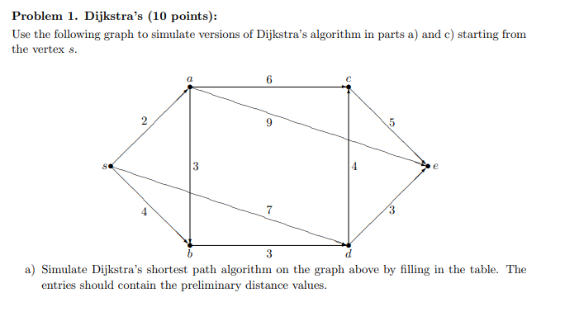

Slide 19
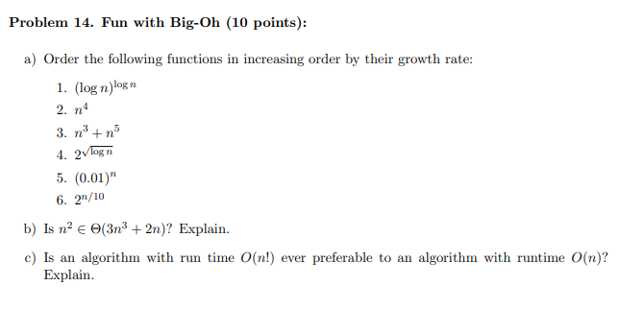

Slide 21
