Slide 1
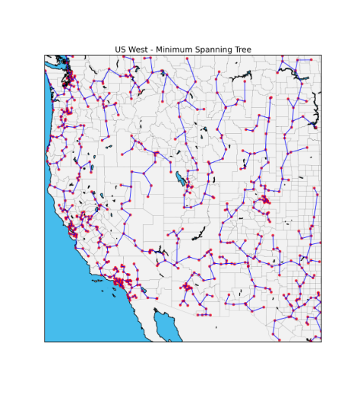
CSE 417 Algorithms and Complexity
Autumn 2023
Lecture 13
Minimum Spanning Trees

Slide 2
Announcements
Midterm, Monday, October 30
Topics: Material Presented in Lecture
Stable Matching
Graphs and simple graph algorithms
Breadth First Search
Topological Sort
Greedy Algorithms
Interval Scheduling Problems
Graph Coloring
Shortest Paths Algorithms
Minimum Spanning Tree Algorithms

Slide 3
Minimum Spanning Tree
15
t
a
6
9
14
3
4
e
10
13
c
s
21
20
15
17
2
7
g
b
8
u
f
22
1
12
16
v

Slide 4
Greedy Algorithms for Minimum Spanning Tree
Prim’s Algorithm: Extend a tree by including the cheapest out going edge
Kruskal’s Algorithm: Add the cheapest edge that joins disjoint components
4
b
c
20
5
11
8
a
d
7
22
e

Slide 5
Greedy Algorithm 1 Prim’s Algorithm
Extend a tree by including the cheapest out going edge
15
t
a
6
14
3
9
4
e
10
13
c
s
11
20
5
Construct the MST with Prim’s algorithm starting from vertex a
Label the edges in order of insertion
17
2
7
g
b
8
u
f
22
1
12
16
v

Slide 6
Greedy Algorithm 2 Kruskal’s Algorithm
Add the cheapest edge that joins disjoint components
15
t
a
6
14
3
9
4
e
10
13
c
s
11
20
5
17
2
7
Construct the MST with Kruskal’s algorithm
Label the edges in order of insertion
g
b
8
u
f
22
1
12
16
v

Slide 7
Why do the greedy algorithms work?
For simplicity, assume all edge costs are distinct

Slide 8
Edge inclusion lemma
Let S be a subset of V, and suppose e = (u, v) is the minimum cost edge of E, with u in S and v in V-S
e is in every minimum spanning tree of G
Or equivalently, if e is not in T, then T is not a minimum spanning tree
e
S
V - S

Slide 9
Proof
e is the minimum cost edge between S and V-S
Suppose T is a spanning tree that does not contain e
Add e to T, this creates a cycle
The cycle must have some edge e₁ = (u₁, v₁) with u₁ in S and v₁ in V-S
T₁ = T – {e₁} + {e} is a spanning tree with lower cost
Hence, T is not a minimum spanning tree
e₁
S
V - S
e

Slide 10
Optimality Proofs
Prim’s Algorithm computes a MST
Kruskal’s Algorithm computes a MST
Show that when an edge is added to the MST by Prim or Kruskal, the edge is the minimum cost edge between S and V-S for some set S.

Slide 11
Prim’s Algorithm
S = { a }; T = { };
while S != V
choose the minimum cost edge e = (u,v), with u in S, and v in V-S
add e to T
add v to S

Slide 12
Prove Prim’s algorithm computes an MST
Show an edge e is in the MST when it is added to T

Slide 13
Kruskal’s Algorithm
Let C = {{v₁}, {v₂}, . . ., {v_{n}}}; T = { }
while |C| > 1
Let e = (u, v) with u in C_{i} and v in C_{j} be the minimum cost edge joining distinct sets in C
Replace C_{i} and C_{j} by C_{i} U C_{j}
Add e to T

Slide 14
Prove Kruskal’s algorithm computes an MST
Show an edge e is in the MST when it is added to T

Slide 15
MST Implementation and runtime
Prim’s Algorithm
Implementation, runtime: just like Dijkstra’s algorithm
Use a heap, runtime O(m log n)
Kruskal’s Algorithm
Sorting edges by cost: O(m log n)
Managing connected components uses the Union-Find data structure
Amazing, pointer based data structure
Very interesting mathematical result

Slide 16
Disjoint Set ADT
Data: set of pairwise disjoint sets.
Required operations
Union – merge two sets to create their union
Find – determine which set an item appears in
Check Find(v) ≠ Find(w) to determine if (v,w) joins separate components
Do Union(v,w) to merge sets
16

Slide 17
Up-Tree for DS Union/Find
Observation: we will only traverse these trees upward from any given node to find the root.
Idea: reverse the pointers (make them point up from child to parent). The result is an up-tree.
Initial state
1
2
3
4
5
6
7
Intermediate
state
1
3
7
2
5
4
Roots are the names of each set.
6

