Slide 1
Sign2Text
Anthony John Gibbon
Akeem Jenkins
Fabian Kidarsa
Jared Krinke
John Kurkowski

Slide 2
UML Class Diagrams

Slide 3
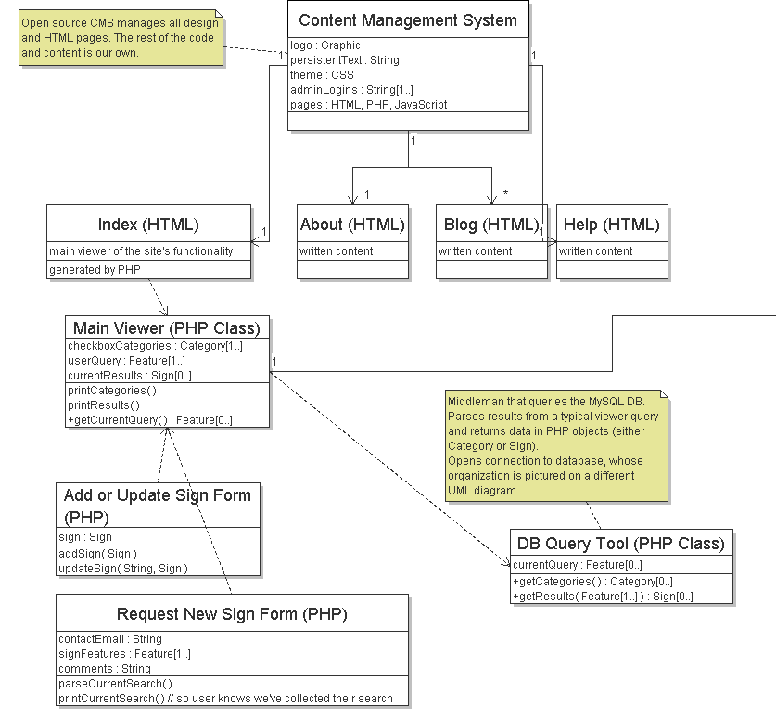
More

Slide 4
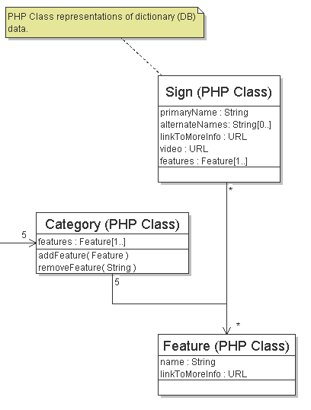
UML: cont

Slide 5
Sequence Diagrams

Slide 6
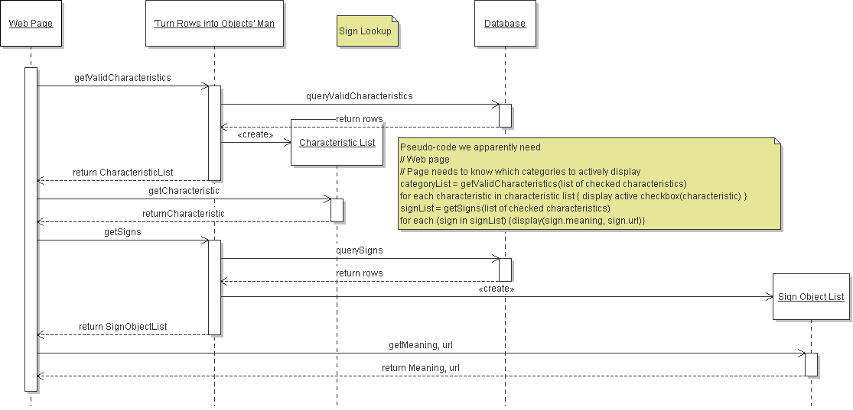
Sequence Diagram: look

Slide 7
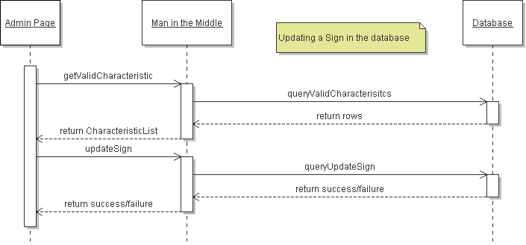
Sequence Diagram: Sign Update
procedure UpdateSign
signChar = getValidCharacteristic("apple");
signChar = "some new value";
if (updateSign(signChar) == success)
end procedure
else
print "Update of sign characteristic failed"
endif
end procedure

Slide 8
Schedule

Slide 9
Thank You

