Slide 1
Lecture 28: Concurrency Continued…
Lecture Participation Poll #28
Log onto pollev.com/cse374
Or
Text CSE374 to 22333
CSE 374: Intermediate Programming Concepts and Tools

Slide 2
Administrivia
HW 5 (final HW) posted
Final review assignment posted!
End of quarter due date Wednesday December 16th @ 9pm

Slide 3
Concurrency vs Parallelism
parallelism refers to running things simultaneously on separate resources (ex. Separate CPUs)
concurrency refers to running multiple threads on a shared resources
Concurrency is one person cooking multiple dishes at the same time.
Parallelism is having multiple people (possibly cooking the same dish).
Allows processes to run ‘in the background’
Responsiveness – allow GUI to respond while computation happens
CPU utilization – allow CPU to compute while waiting (waiting for data, for input)
isolation – keep threads separate so errors in one don’t affect the others

Slide 4
Concurrency
A search engine could run concurrently:
Example: Execute queries one at a time, but issue I/O requests against different files/disks simultaneously
Could read from several index files at once, processing the I/O results as they arrive
Example: Web server could execute multiple queries at the same time
While one is waiting for I/O, another can be executing on the CPU
Use multiple “workers”
As a query arrives, create a new “worker” to handle it
The “worker” reads the query from the network, issues read requests against files, assembles results and writes to the network
The “worker” uses blocking I/O; the “worker” alternates between consuming CPU cycles and blocking on I/O
The OS context switches between “workers”
While one is blocked on I/O, another can use the CPU
Multiple “workers’” I/O requests can be issued at once
So what should we use for our “workers”?

Slide 5
Threads
In most modern OS’s threads are the unit of scheduling.
Separate the concept of a process from the “thread of execution”
Threads are contained within a process
Usually called a thread, this is a sequential execution stream within a process
Cohabit the same address space
Threads within a process see the same heap and globals and can communicate with each other through variables and memory
Each thread has its own stack
But, they can interfere with each other – need synchronization for shared resources
Advantages:
They execute concurrently like processes
You (mostly) write sequential-looking code
Threads can run in parallel if you have multiple CPUs/cores
Disadvantages:
If threads share data, you need locks or other synchronization
Very bug-prone and difficult to debug
Threads can introduce overhead
Lock contention, context switch overhead, and other issues
Need language support for threads
A Process has a unique: address space, OS resources, and security attributes
A Thread has a unique: stack, stack pointer, program counter, and registers
Threads are the unit of scheduling and processes are their containers; every process has at least one thread running in it

Slide 6
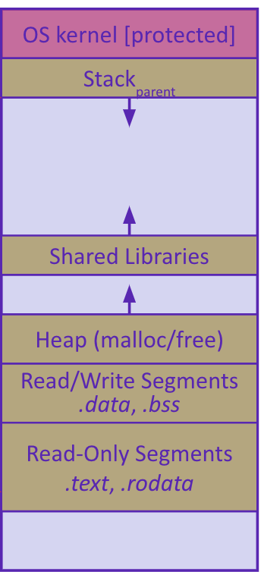
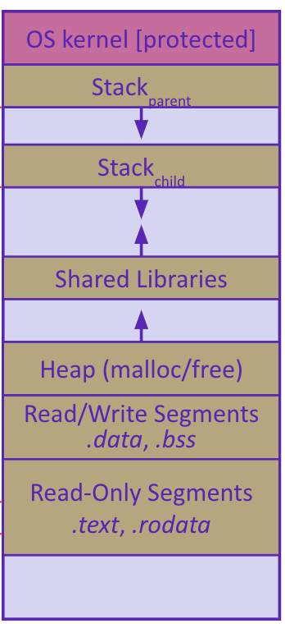
Address Spaces
Before creating a thread
One thread of execution running in the address space
One PC, stack, SP
That main thread invokes a function to create a new thread
-> pthread_create() ->
After creating a thread
Two threads of execution running in the address space
Original thread (parent) and new thread (child)
New stack created for child thread
Child thread has its own values of the PC and SP
Both threads share the other segments (code, heap, globals)
They can cooperatively modify shared data
Single threaded address space
Multi-threaded address space

Slide 7
POSIX Threads and Pthread functions
The POSIX APIs for dealing with threads
Declared in pthread.h
Not part of the C/C++ language (cf. Java)
To enable support for multithreading, must include -pthread flag when compiling and linking with gcc command
POSIX stands for Portable Operating System Interface, pthread conforms to POSIX standard for threading
gcc –g –Wall –std=c11 –pthread –o main main.c
Example Usage
pthread_t thread ID;
the threadID keeps track of to which thread we are referring
pthread_create takes a function plinter and arguments to trigger separate thread
int pthread_create(pthread_t *thread, const pthread_attr_t *attr, void *(*start routing) (void*), void *arg);
note – pthread_create takes two generic (untyped) pointers
interprets the first as a function pointer and the second as an argument pointer
int pthread_join(pthread_t thread, void **value_ptr);
puts calling thread ‘on hold’ until ‘thread’ completes – useful for waiting to thread to exit
https://pubs.opengroup.org/onlinepubs/7908799/xsh/pthread.h.html

Slide 8
Creating and Terminating Threads
int pthread_create( pthread_t* thread, const pthread_attr_t* attr,
void* (*start_routine)(void*), void* arg);
Creates a new thread into *thread, with attributes *attr (NULL means default attributes)
Returns 0 on success and an error number on error (can check against error constants)
The new thread runs start_routine(arg)
Equivalent of exit(retval); for a thread instead of a process
The thread will automatically exit once it returns from start_routine()
void pthread_exit(void* retval);

Slide 9
Multi Threaded Example
void do_one_thing(int *pnum_times) {
int i, j, x;
for (i = 0; i < 4; i++) {
printf("doing one thing\n");
for (j = 0; j < 10000; j++) x = x + i;
(*pnum_times)++;
}
}
#include <stdio.h>
#include <pthread.h>
void do_one_thing(int *);
void do_another_thing(int *);
void do_wrap_up(int, int);
int main() {
pthread_t thread1, thread2;
int r1 = 0, r2 = 0;
pthread_create(&thread1, NULL, (void *) do_one_thing, (void *) &r1);
pthread_create(&thread2, NULL, (void *) do_another_thing, (void *) &r2);
pthread_join(thread1, NULL);
pthread_join(thread2, NULL);
do_wrap_up(r1, r2);
}
void do_another_thing(int *pnum_times) {
int i, j, x;
for (i = 0; i < 4; i++) {
printf("doing another \n");
for (j = 0; j < 10000; j++) x = x + i;
(*pnum_times)++;
}
}
void do_wrap_up(int one_times, int another_times) {
int total;
total = one_times + another_times; printf("All done,
one thing %d, another %d for a total of
%d\n", one_times, another_times, total);
}

Slide 10
Parallel Processing
common pattern for expensive computations (such as data processing)
split up the work, give each piece to a thread (fork)
wait until all are done, then combine answers (join)
to avoid bottlenecks, each thread should have about the same about of work
performance will always be less than perfect speedup
what about when all threads need access to the same mutable memory?

Slide 11
After forking threads
Waits for the thread specified by thread to terminate
The thread equivalent of waitpid()
The exit status of the terminated thread is placed in *retval
Mark thread specified by thread as detached – it will clean up its resources as soon as it terminates
int pthread_join(pthread_t thread, void** retval);
int pthread_detach(pthread_t thread);

Slide 12
Race Conditions
A race condition happens when the result of a computation depends upon scheduling of multiple threads, ie the order in which the processor executes instructions.
Bad interleavings is when the code exposes bad intermediate state.
example: the getBalance() -> setBalance() calls exposed intermediate state.
Bad interleavings are incorrect from the programmatic logical perspective:
in the bank example, we lost money or allowed balances to go below 0.
Data races - Even if we can't have a line-by-line interleaving, we can still have race conditions
what seems like an "atomic" operation, like setting "balance_ = amount" or "return balance_", is actually NOT guaranteed to be an atomic operation at the compiled machine-code level.
whenever you have the potential to read+write or write+write on different threads, you MUST synchronize access to the shared memory (with a lock or similar).

Slide 13
Data Races
Two memory accesses form a data race if different threads access the same location, and at least one is a write, and they occur one after another
Means that the result of a program can vary depending on chance (which thread ran first?)
Data races might interfere in painful, non-obvious ways, depending on the specifics of the data structure
Example: two threads try to read from and write to the same shared memory location
Could get “correct” answer
Could accidentally read old value
One thread’s work could get “lost”
Example: two threads try to push an item onto the head of the linked list at the same time
Could get “correct” answer
Could get different ordering of items
Could break the data structure!

Slide 14
A Data Race
two threads are running at the same time, and therefore, because we cannot guarantee the exact speed at which each thread runs, we could get into a bad situation
have a bank account x with a balance of $150
thread T1 calls x.withdrawal(100) and thread T2 calls x.withdrawal(100) right afterwards
two transactions are attempting to happen on the same account
what SHOULD happen is that one of the transactions succeeds in withdrawing 100, and the other throws an exception because the remaining balance of $50 is insufficient
T1 reads the balance (150) and stores it in variable b
T2 executes completely, deducting 100 from the account to leave a balance of 50
rest of the function on T1 executes, comparing 150 with 100 (ok) and then setting the balance to $50
We've lost a transaction!
https://courses.cs.washington.edu/courses/cse374/18sp/lectures/24-concurrency-1.html
Notes:
https://courses.cs.washington.edu/courses/cse374/18sp/lectures/24-concurrency-1.html

Slide 15
Synchronization
Synchronization is the act of preventing two (or more) concurrently running threads from interfering with each other when operating on shared data
Need some mechanism to coordinate the threads
“Let me go first, then you can go”
Many different coordination mechanisms have been invented
Goals of synchronization:
Liveness – ability to execute in a timely manner (informally, “something good happens”)
Safety – avoid unintended interactions with shared data structures (informally, “nothing bad happens”)

Slide 16
Lock Synchronization
Use a “Lock” to grant access to a critical section so that only one thread can operate there at a time
Executed in an uninterruptible
an operation we want to be done all at once
operation must be the right size (atomic unit)
too big program runs sequentially
too small program has data races
Lock Acquire
Wait until the lock is free, then take it
Lock Release
Release the lock
If other threads are waiting, wake exactly one up to pass lock to
// non-critical code
lock.acquire();
// critical section
lock.release();
// non-critical code
loop/idle if locked

Slide 17
Example
What if we use a lock on the refrigerator?
Probably overkill – what if roommate wanted to get eggs?
For performance reasons, only put what is necessary in the critical section
Only lock the milk
But lock all steps that must run uninterrupted (i.e. must run as an atomic unit)
If your fridge has no milk, then go out and buy some more
What could go wrong?
If you live alone:
If you live with a roommate:
fridge.lock()
if (!milk) {
buy milk
}
fridge.unlock()
milk_lock.lock()
if (!milk) {
buy milk
}
milk_lock.unlock()

Slide 18
pthreads and Locks
Another term for a lock is a mutex (“mutual exclusion”)
pthread.h defines datatype pthread_mutex_t
pthread_mutex_init()
Initializes a mutex with specified attributes
pthread_mutex_lock()
Acquire the lock – blocks if already locked
pthread_mutex_unlock()
Releases the lock
pthread_mutex_destroy()
“Uninitializes” a mutex – clean up when done
int pthread_mutex_init(pthread_mutex_t* mutex, const pthread_mutexattr_t* attr);
int pthread_mutex_lock(pthread_mutex_t* mutex);
int pthread_mutex_unlock(pthread_mutex_t* mutex);
int pthread_mutex_destroy(pthread_mutex_t* mutex);

Slide 19
deadlocks
All of this locking/unlocking is tricky, and it is easy to forget. As an alternative, C++ provides something called a "lock guard" which simplifies the act of using a mutex:
void deposit(double amount) { std::lock_guard<std::mutex> lock(m_); // locks mutex m_ in the lock_guard constructor // mutex is now locked setBalanceWithLock(getBalance() + amount); // When deposit() returns, the stack-allocated lock_guard will be deleted, // calling the destructor and releasing the mutex. }
Notes:
If one function that locks the mutex tries to call another function that locks the mutex, we will have a deadlock since the second function will not be able to lock the mutex until the first function returns, but the first function won't return until the second function finishes executing. We're stuck! To prevent this, we often add a private helper function that doesn't lock, which we can call instead.
We need to make sure to unlock the mutex before throwing an exception as well, since otherwise we will never release the lock.
A "lock guard" is a special type of object that locks the mutex in the constructor, and unlocks the mutex in the destructor. If we allocate the lock guard on the stack, then as soon as it is created, we can guarantee that we have locked the mutex, and the destructor will automatically be called when the lock guard goes out of scope. We don't have to remember to unlock in all cases! This even works for the exception case.
Deadlocks
How about if we want to write a transferTo function to transfer an amount from account A to account B?
void transferTo(double amount, BankAccount& other) { m_.lock(); other.m_.lock(); setBalanceInternal(getBalance() - amount); other.setBalanceInternal(other.getBalance() + amount); other.m_.unlock(); m_.unlock(); } Since now we are dealing with two different accounts, we will have to lock the mutexes of both accounts before doing any balance transfer. So first we call lock() on the current object's mutex, then we call lock() on the other object's mutex.
Unfortunately, this logic can produce a deadlock. Why? Consider that we have account A and account B, and on thread T1, we are trying to transfer $50 from A to B and on thread T2, we are trying to transfer $20 from B to A. We can model this with a bad interleaving:
Thread T1: A.transferTo(50, B); Thread T2: B.transferTo(20, A); m_.lock(); // Locks A's mutex m_.lock(); // Lock's B's mutex other.m_.lock(); // Waits for B's mutex other.m_.lock() // Waits for A's mutex Object A locks A's mutex, while Object B locks B's mutex. Then each of them wait for the other object's mutex to become available - which will never happen because they are both waiting for the other object to be finished! We have a DEADLOCK.
Solutions to this situation:
Use smaller critical sections. We might lock A's mutex only around the modification of A's balance, and lock B's mutex when modifying B's balance. But this is not ideal because then we expose an intermediate state in which A's account has been debited but the funds haven't been put in B's account yet - we've temporarily lost money, which isn't great.
Use larger critical sections. We could add a single lock for all bank accounts that must be acquired before doing multi-account transactions. This is correct, but it means that we can only do one transaction at a time throughout the entire bank, even if the accounts aren't related to each other. This is a performance loss.
Always lock mutexes in a specific order. For instance, in this case, we can choose to always lock the mutex of the account with the lower account id first, then lock the id of the higher account id. This works because account ids are unique and immutable, thus we can rely on them without synchronization. Something like this:
void transferTo(double amount, BankAccount& other) { bool thisIsFirst = getAccountId() < other.getAccountId(); if (thisIsFirst) { m_.lock(); other.m_.lock(); } else { other.m_.lock(); m_.lock(); } setBalanceInternal(getBalance() - amount); other.setBalanceInternal(other.getBalance() + amount); if (thisIsFirst) { other.m_.unlock(); m_.unlock(); } else { m_.unlock(); other.m_.unlock(); } }

Slide 20
Synchronization Example
https://courses.cs.washington.edu/courses/cse374/20sp/lectures/cppcode/BankAccountThread.h
https://courses.cs.washington.edu/courses/cse374/20sp/lectures/cppcode/BankAccountThread.cpp

Slide 21
Concurrency Take Aways
For every memory location, you should obey at least one of the following:
Make it thread-local - whenever possible, avoid sharing resources between threads
make a copy for each thread.
Make it immutable - Whenever possible, do not update objects; make new objects instead.
If a location is only read (never written), then no synchronization is necessary.
Simultaneous reads are not data races, and not a problem.
Make access synchronized, ie use locks and other primitives to prevent race conditions.
No data races. Never allow two threads to read/write or write/write a location at the same time. In C, a program with a data race is almost always wrong.
Think of what operations need to be atomic. Consider atomicity first, then figure out how to implement it with locks).
Consistent locking. For each location that should be synchronized, have a lock that is ALWAYS locked when reading or writing that location.
Use built-in libraries whenever possible. Concurrency is extremely tricky and difficult to get right; experts have spent countless hours building tools for you to use to make your code safe.

Slide 22
Questions

