Slide 1
Lecture 27: Concurrency
Lecture Participation Poll #27
Log onto pollev.com/cse374
Or
Text CSE374 to 22333
CSE 374: Intermediate Programming Concepts and Tools

Slide 2
Administrivia
HW 5 (final HW) posted
Final review assignment coming
End of quarter due date Wednesday December 16th @ 9pm

Slide 3
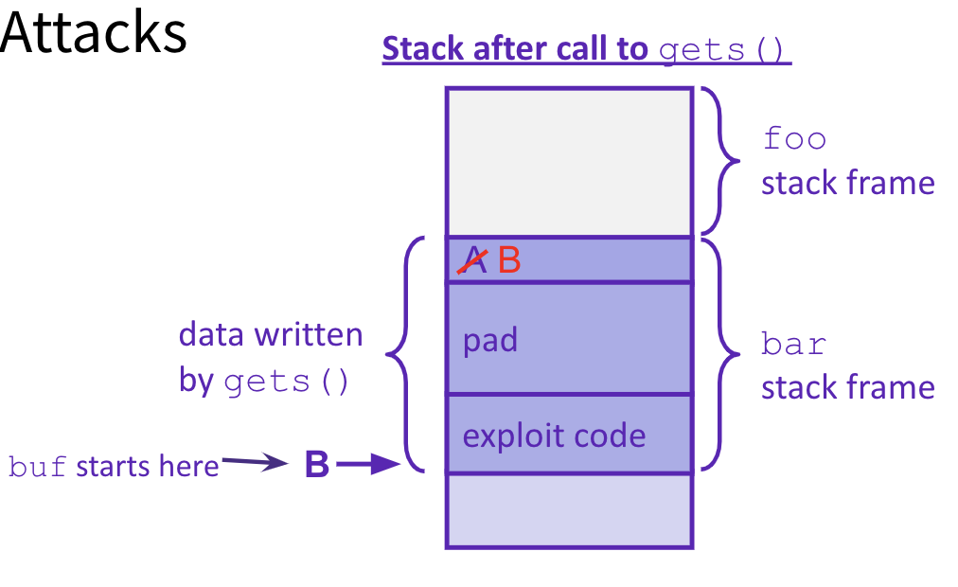
Malicious Buffer Overflow – Code Injection
void foo(){
bar();
A:...
}
Buffer overflow bugs can allow attackers to execute arbitrary code on victim machines
Distressingly common in real programs
Input string contains byte representation of executable code
Overwrite return address A with address of buffer B
When bar() executes ret, will jump to exploit code
return address A
int bar() {
char buf[64];
gets(buf);
...
return ...;
}
https://arstechnica.com/gadgets/2020/12/iphone-zero-click-wi-fi-exploit-is-one-of-the-most-breathtaking-hacks-ever/

Slide 4
Change return to last frame
Skip the line "x = 1;" in the main function by modifying function's return address.
Identify where the return address is in relation to the local variable buffer1
Figure out how many bytes the actual compiled C instruction "x=1;" takes, so that we can increment by that many bytes
Use GDB
break function
break right at beginning of function execution
x buffer1
prints the location of buffer1
info frame
"rip" will hold the location of the return address
print <rip-location> - <buffer1-location>
prints the number of bytes between buffer1 and rip
disassemble main
shows the machine code and how many bytes each instruction takes up.
We identify the line that calls function, then see that the next // instruction moves 1 into x. That instruction takes 7 bytes, so we
have now found the second number!
void bufferplay (int a, int b, int c) {
char buffer1[5];
uintptr_t ret; //holds an address
//calculate the address of the return pointer
ret = (uintptr_t) buffer1 + 0; //change to be address of return
//treat that number like a pointer,
//and change the value in it
*((uintptr_t*)ret) += 0; //change to add how much to advance
}
int main(int argc, char** argv) {
int x;
x = 0;
printf("before: %d\n",x);
bufferplay (1,2,3);
x = 1; // want to skip this line
printf("after: %d\n",x);
return 0;
}

Slide 5
Trigger malicious program
Attacker Program
int bar(char *arg, char *out) {
strcpy(out, arg);
return 0;
}
void foo(char *argv[]) {
char buf[256];
bar(argv[1], buf);
}
int main(int argc, char *argv[]) {
if (argc != 2) {
fprintf(stderr, "target1: argc != 2\n");
exit(1);
}
foo(argv);
return 0;
}
int main(void) {
char *args[3];
char *env[1];
args[0] = "/tmp/target";
args[2] = NULL;
env[0] = NULL;
args[1] = (char*) malloc(sizeof(char)*265);
memset(args[1], 0x90, 264);
// Null-terminate the string.
args[1][264] = '\0’;
// Add in the attack code to the front of the argument. memcpy(args[1], shellcode, strlen(shellcode));
*(uintptr_t*)(args[1] + 264) = 0x7fffffffdb90;
// call the victim program.
execve("/tmp/target", args, env); }
used gdb - there are 264 bytes between buf and return address, so we malloc space for 264, characters plus one for the null terminator.
set the memory to a value to ensure no null-termination in string before final character.
0x90 is also a byte that means "no-op" in terms of byte instructions.
Victim Program
Store address of buf at appropriate location in string

Slide 6
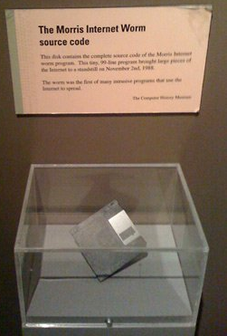
Hack – Internet Worm
Original “Internet worm” (1988)
Exploited vulnerability in gets() method used in Finger protocol
Worm attacked fingerd server with phony argument
finger "exploit-code padding new-return-addr"
Exploit code: executed a root shell on the victim machine with a direct connection to the attacker
Worm spread from machine to machine automatically
denial of service attack – flood machine with so many requests it is overloaded and unavailable to its intended users
took down 6000 machines, took days to get machine back online
government estimated damage $100,000 to $10,000,000
Written by Robert Morris while a grad student at Cornell, but launched it from the MIT computer system
meant to be an intellectual experiment, but made it too damaging by accident
Now a professor at MIT, first person convicted under the ‘86 Computer Fraud and Abuse Act

Slide 7
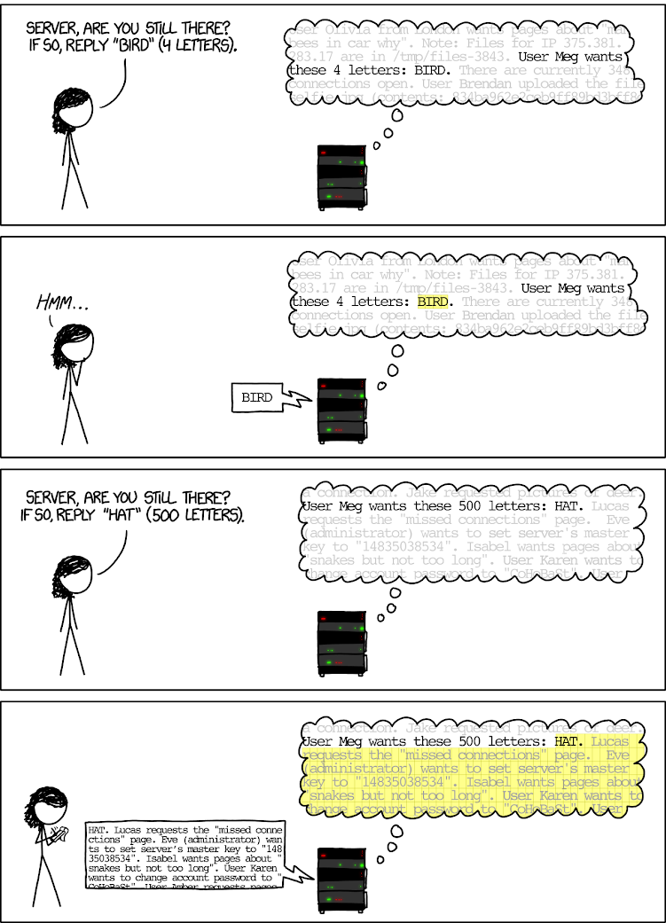
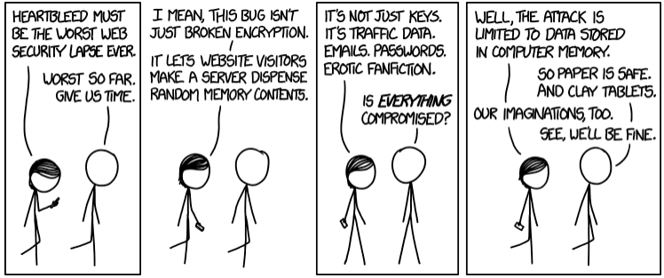
Hack - Heartbleed
Buffer over-read in Open-Source Security Library
when program reads beyond end of intended data from a buffer and reads
maliciously designed input - “Heartbeat” packet sent out
Specifies length of message and server echoes it back
Library just “trusted” this length
Allowed attackers to read contents of memory anywhere they wanted
Est. 17% of internet affected
Similar issue in Cloudbleed (2017)

Slide 8
Protect Your Code!
Employ system-level protections
Code on the Stack is not executable
Randomized Stack offsets
Avoid overflow vulnerabilities
Use library routines that limit string lengths
Use a language that makes them impossible
Have compiler use “stack canaries”
place special value (“canary”) on stack just beyond buffer

Slide 9
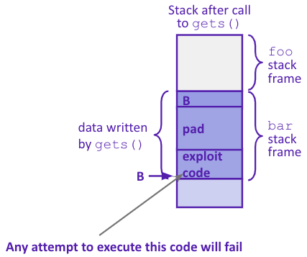
System Level Protections
Non-executable code segments
In traditional x86, can mark region of memory as either “read-only” or “writeable”
Can execute anything readable
x86-64 added explicit “execute” permission
Stack marked as non-executable
Do NOT execute code in Stack, Static Data, or Heap regions
Hardware support needed

Slide 10
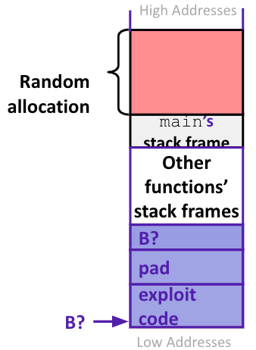
System Level Protections
Many embedded devices do not have feature to mark code as “non-executable”
Cars
Smart homes
Pacemakers
Randomized stack offsets
At start of program, allocate random amount of space on stack
Shifts stack addresses for entire program
Addresses will vary from one run to another
Makes it difficult for hacker to predict beginning of inserted code

Slide 11
Avoid Overflow Vulnerabilities
Use library routines that limit string lengths
fgets instead of gets (2nd argument to fgets sets limit)
strncpy instead of strcpy
Don’t use scanf with %s conversion specification
Use fgets to read the string
Or use %ns where n is a suitable integer
Or… don’t use C - use a language that does array index bounds check
Buffer overflow is impossible in Java
ArrayIndexOutOfBoundsException
Rust language was designed with security in mind
Panics on index out of bounds, plus more protections
/* Echo Line */ void echo() { char buf[8]; /* Way too small! */ fgets(buf, 8, stdin); puts(buf); }

Slide 12
Stack Canaries
Basic Idea: place special value (“canary”) on stack just beyond buffer
Secret value that is randomized before main()
Placed between buffer and return address
Check for corruption before exiting function
GCC implementation
-fstack-protector
unix>./buf
Enter string: 12345678
12345678
unix> ./buf
Enter string: 123456789
*** stack smashing detected ***

Slide 13
Sequential Programming
Only one query is being processed at a time
All other queries queue up behind the first one
And clients queue up behind the queries …
what we’ve been doing so far
sequential programming demands finishing one sequence before starting the next one
Even while processing one query, the CPU is idle the vast majority of the time
It is blocked waiting for I/O to complete
Disk I/O can be very, very slow (10 million times slower …)
At most one I/O operation is in flight at a time
Missed opportunities to speed I/O up
Separate devices in parallel, better scheduling of a single device, etc.
performance improvements can only be made by improving hardware
Moore’s Law

Slide 14
Concurrency vs Parallelism
parallelism refers to running things simultaneously on separate resources (ex. Separate CPUs)
concurrency refers to running multiple threads on a shared resources
Concurrency is one person cooking multiple dishes at the same time.
Parallelism is having multiple people (possibly cooking the same dish).
Allows processes to run ‘in the background’
Responsiveness – allow GUI to respond while computation happens
CPU utilization – allow CPU to compute while waiting (waiting for data, for input)
isolation – keep threads separate so errors in one don’t affect the others

Slide 15
Concurrency
A search engine could run concurrently:
Example: Execute queries one at a time, but issue I/O requests against different files/disks simultaneously
Could read from several index files at once, processing the I/O results as they arrive
Example: Web server could execute multiple queries at the same time
While one is waiting for I/O, another can be executing on the CPU
Use multiple “workers”
As a query arrives, create a new “worker” to handle it
The “worker” reads the query from the network, issues read requests against files, assembles results and writes to the network
The “worker” uses blocking I/O; the “worker” alternates between consuming CPU cycles and blocking on I/O
The OS context switches between “workers”
While one is blocked on I/O, another can use the CPU
Multiple “workers’” I/O requests can be issued at once
So what should we use for our “workers”?

Slide 16
Threads
In most modern OS’s threads are the unit of scheduling.
Separate the concept of a process from the “thread of execution”
Threads are contained within a process
Usually called a thread, this is a sequential execution stream within a process
Cohabit the same address space
Threads within a process see the same heap and globals and can communicate with each other through variables and memory
Each thread has its own stack
But, they can interfere with each other – need synchronization for shared resources
Advantages:
They execute concurrently like processes
You (mostly) write sequential-looking code
Threads can run in parallel if you have multiple CPUs/cores
Disadvantages:
If threads share data, you need locks or other synchronization
Very bug-prone and difficult to debug
Threads can introduce overhead
Lock contention, context switch overhead, and other issues
Need language support for threads
A Process has a unique: address space, OS resources, and security attributes
A Thread has a unique: stack, stack pointer, program counter, and registers
Threads are the unit of scheduling and processes are their containers; every process has at least one thread running in it

Slide 17
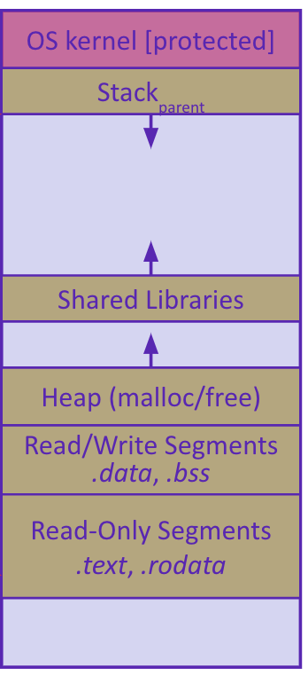
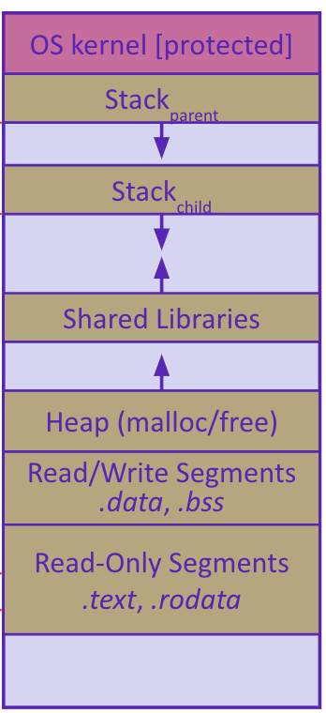
Address Spaces
Single threaded address space
Before creating a thread
One thread of execution running in the address space
One PC, stack, SP
That main thread invokes a function to create a new thread
Typically pthread_create()
Multi-threaded address space
After creating a thread
Two threads of execution running in the address space
Original thread (parent) and new thread (child)
New stack created for child thread
Child thread has its own values of the PC and SP
Both threads share the other segments (code, heap, globals)
They can cooperatively modify shared data

Slide 18
Threads Example
main() { while (1) {
string query_words[] = GetNextQuery();
CreateThread(ProcessQuery(query_words));
}
}
doclist Lookup(string word) {
bucket = hash(word);
hitlist = file.read(bucket);
foreach hit in hitlist
doclist.append(file.read(hit));
return doclist;
}
ProcessQuery(string query_words[]) {
results = Lookup(query_words[0]);
foreach word in query[1..n]
results = results.intersect(Lookup(word));
Display(results);
}

Slide 19
Creating and Terminating Threads
int pthread_create( pthread_t* thread, const pthread_attr_t* attr,
void* (*start_routine)(void*), void* arg);
Creates a new thread into *thread, with attributes *attr (NULL means default attributes)
Returns 0 on success and an error number on error (can check against error constants)
The new thread runs start_routine(arg)
Equivalent of exit(retval); for a thread instead of a process
The thread will automatically exit once it returns from start_routine()
void pthread_exit(void* retval);

Slide 20
After forking threads
Waits for the thread specified by thread to terminate
The thread equivalent of waitpid()
The exit status of the terminated thread is placed in *retval
Mark thread specified by thread as detached – it will clean up its resources as soon as it terminates
int pthread_join(pthread_t thread, void** retval);
int pthread_detach(pthread_t thread);

Slide 21
POSIX Threads and Pthread functions
The POSIX APIs for dealing with threads
Declared in pthread.h
Not part of the C/C++ language (cf. Java)
To enable support for multithreading, must include -pthread flag when compiling and linking with gcc command
POSIX stands for Portable Operating System Interface, pthread conforms to POSIX standard for threading
gcc –g –Wall –std=c11 –pthread –o main main.c
Example Usage
pthread_t thread ID;
the threadID keeps track of to which thread we are referring
pthread_create takes a function plinter and arguments to trigger separate thread
int pthread_create(pthread_t *thread, const pthread_attr_t *attr, void *(*start routing) (void*), void *arg);
note – pthread_create takes two generic (untyped) pointers
interprets the first as a function pointer and the second as an argument pointer
int pthread_join(pthread_t thread, void **value_ptr);
puts calling thread ‘on hold’ until ‘thread’ completes – useful for waiting to thread to exit
https://pubs.opengroup.org/onlinepubs/7908799/xsh/pthread.h.html

Slide 22
Data Races
Two memory accesses form a data race if different threads access the same location, and at least one is a write, and they occur one after another
Means that the result of a program can vary depending on chance (which thread ran first?)
Data races might interfere in painful, non-obvious ways, depending on the specifics of the data structure
Example: two threads try to read from and write to the same shared memory location
Could get “correct” answer
Could accidentally read old value
One thread’s work could get “lost”
Example: two threads try to push an item onto the head of the linked list at the same time
Could get “correct” answer
Could get different ordering of items
Could break the data structure!

Slide 23
Synchronization
Synchronization is the act of preventing two (or more) concurrently running threads from interfering with each other when operating on shared data
Need some mechanism to coordinate the threads
“Let me go first, then you can go”
Many different coordination mechanisms have been invented
Goals of synchronization:
Liveness – ability to execute in a timely manner (informally, “something good happens”)
Safety – avoid unintended interactions with shared data structures (informally, “nothing bad happens”)

Slide 24
Lock Synchronization
Use a “Lock” to grant access to a critical section so that only one thread can operate there at a time
Executed in an uninterruptible (i.e. atomic) manner
Lock Acquire
Wait until the lock is free, then take it
Lock Release
Release the lock
If other threads are waiting, wake exactly one up to pass lock to
// non-critical code
lock.acquire();
// critical section
lock.release();
// non-critical code
loop/idle if locked

Slide 25
Example
What if we use a lock on the refrigerator?
Probably overkill – what if roommate wanted to get eggs?
For performance reasons, only put what is necessary in the critical section
Only lock the milk
But lock all steps that must run uninterrupted (i.e. must run as an atomic unit)
If your fridge has no milk, then go out and buy some more
What could go wrong?
If you live alone:
If you live with a roommate:
fridge.lock()
if (!milk) {
buy milk
}
fridge.unlock()
milk_lock.lock()
if (!milk) {
buy milk
}
milk_lock.unlock()

Slide 26
pthreads and Locks
Another term for a lock is a mutex (“mutual exclusion”)
pthread.h defines datatype pthread_mutex_t
pthread_mutex_init()
Initializes a mutex with specified attributes
pthread_mutex_lock()
Acquire the lock – blocks if already locked
pthread_mutex_unlock()
Releases the lock
pthread_mutex_destroy()
“Uninitializes” a mutex – clean up when done
int pthread_mutex_init(pthread_mutex_t* mutex, const pthread_mutexattr_t* attr);
int pthread_mutex_lock(pthread_mutex_t* mutex);
int pthread_mutex_unlock(pthread_mutex_t* mutex);
int pthread_mutex_destroy(pthread_mutex_t* mutex);

Slide 27
Memory Consideration
if one thread did nothing of interest to any other thread, why bother running?
threads must communicate and coordinate
use results from other threads, and coordinate access to shared resources
simplest ways to not mess each other up:
don’t access same memory (complete isolation)
don’t write to shared memory (write isolation)
next simplest
one thread doesn’t run until/unless another is done

Slide 28
Parallel Processing
common pattern for expensive computations (such as data processing)
split up the work, give each piece to a thread (fork)
wait until all are done, then combine answers (join)
to avoid bottlenecks, each thread should have about the same about of work
performance will always be less than perfect speedup
what about when all threads need access to the same mutable memory?

Slide 29
multiple threads with one memory
often you have a bunch of threads running at once and they might need rthe same mutable (writable) memory at the same time but probably not
want to be correct, but not sacrifice parallelism
example: bunch of threads processing bank transactions

Slide 30
data races

Slide 31
Questions

Slide 32
Protected Buffer Disassembly (buf)
400607: sub $0x18,%rsp
40060b: mov %fs:0x28,%rax
400614: mov %rax,0x8(%rsp)
400619: xor %eax,%eax
... ... call printf ...
400625: mov %rsp,%rdi
400628: callq 400510 <gets@plt>
40062d: mov %rsp,%rdi
400630: callq 4004d0 <puts@plt>
400635: mov 0x8(%rsp),%rax
40063a: xor %fs:0x28,%rax
400643: jne 40064a <echo+0x43>
400645: add $0x18,%rsp
400649: retq
40064a: callq 4004f0 <__stack_chk_fail@plt>

Slide 33
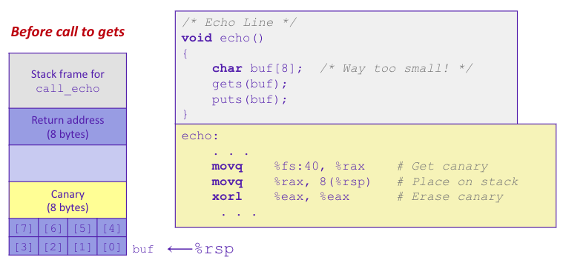
Setting up Canary

Slide 34
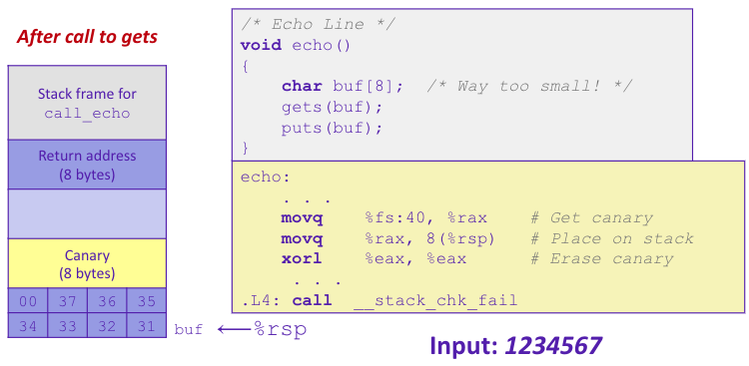
Checking Canary

