Slide 1
Lecture 26: Security
Lecture Participation Poll #26
Log onto pollev.com/cse374
Or
Text CSE374 to 22333
CSE 374: Intermediate Programming Concepts and Tools

Slide 2
Administrivia
HW 5 (final HW) posted
Final review assignment will release last week of quarter
End of quarter due date Wednesday December 16th @ 9pm

Slide 3
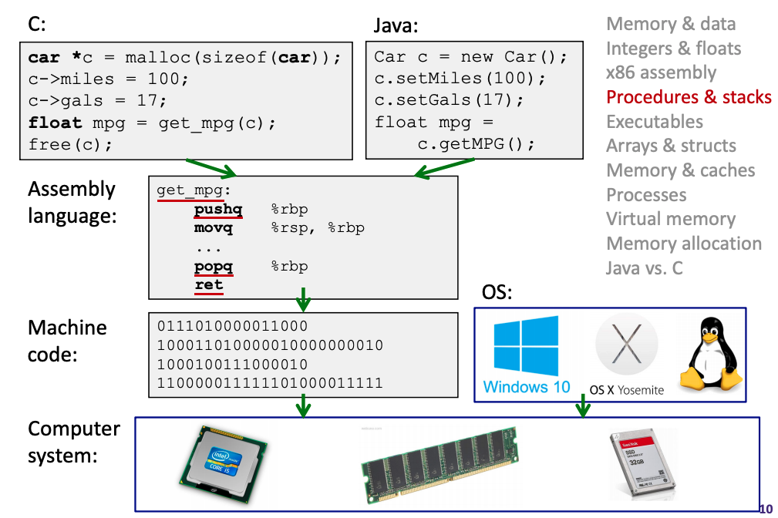
Human to Computer Roadmap

Slide 4
Assembly Instruction Basics
Items in Assembly fall into one of 3 operand categories:
Immediate: Constant integer data
Examples: $0x400, $-533
Like C literal, but prefixed with ‘$’
Encoded with 1, 2, 4, or 8 bytes
Register: 1 of 16 integer registers
Examples: %rax, %r13
Memory: Consecutive bytes of memory at a computed address
Simplest example: (%rax)
Assembly instructions fall into one of 3 categories:
Transfer data between memory and register
Load data from memory into register
%reg = Mem[address]
Store register data into memory
Mem[address] = %reg
Perform arithmetic operation on register or memory data
c = a + b; z = x << y; i = h & g;
Control flow: what instruction to execute next
Unconditional jumps to/from procedures
Conditional branches
Register | Use(s)
%rdi | 1st argument (x)
%rsi | 2nd argument (y)
%rax | return value

Slide 5
Example: Moving Data
Assume we have two variables called rax and rdx.
Which assembly instruction does *rdx = rax?
movq %rdx, %rax
movq (%rdx), %rax
movq %rax, (%rdx)
movq (%rax), %rdx
General form: mov_ source, destination
Missing letter (_) specifies size of operands
Lots of these in typical code
Examples:
movb src, dst
Move 1-byte “byte”
movw src, dst
Move 2-byte “word”
movl src, dst
Move 4-byte “long word”
movq src, dst
Move 8-byte “quad word”
 | Source | Dest | Src, Dest | C Analog
movq | Imm | Reg | movq $0x4, %rax | rax = 4;
 |  | Mem | movq $-147, (%rax) | *rax = -147;
 | Reg | Reg | movq %rax, %rdx | rdx = rax;
 |  | Mem | movq %rax, (%rdx) | *rdx = rax;
 | Mem | Reg | movq (%rax), %rdx | rdx = *rax;

Slide 6
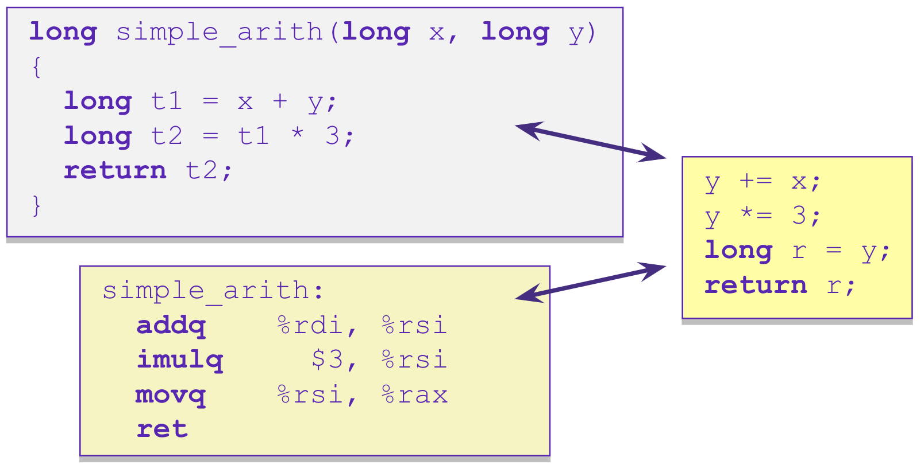
Example: Arithmetic Operations
Register | Use(s)
%rdi | 1st argument (x)
%rsi | 2nd argument (y)
%rax | return value

Slide 7
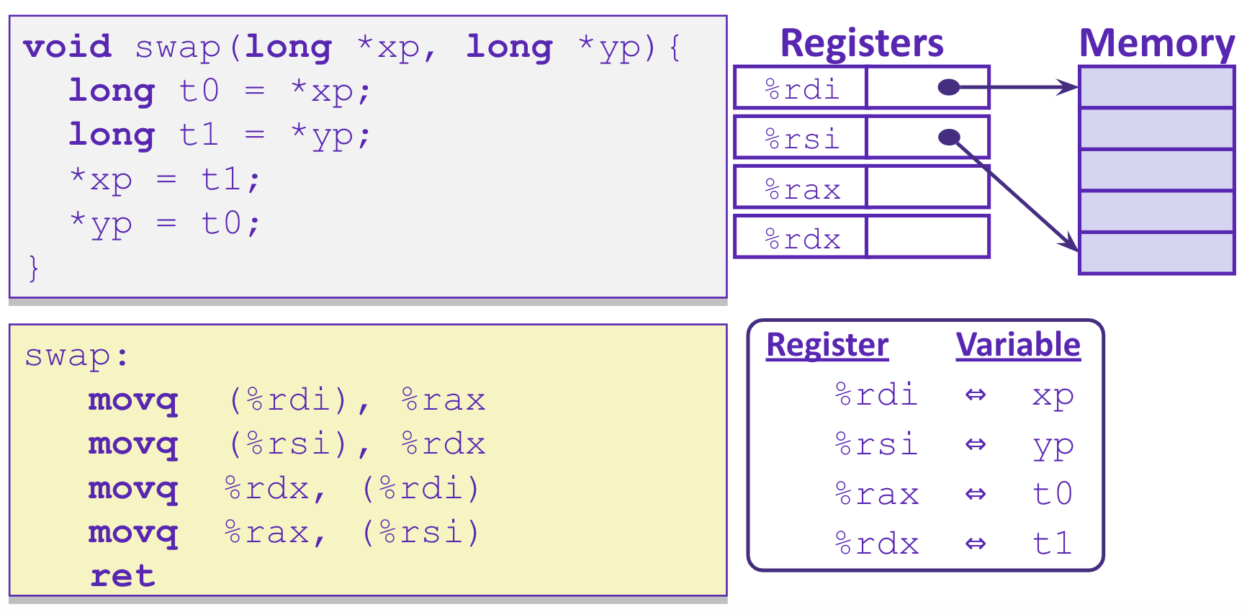
Example: swap()

Slide 8
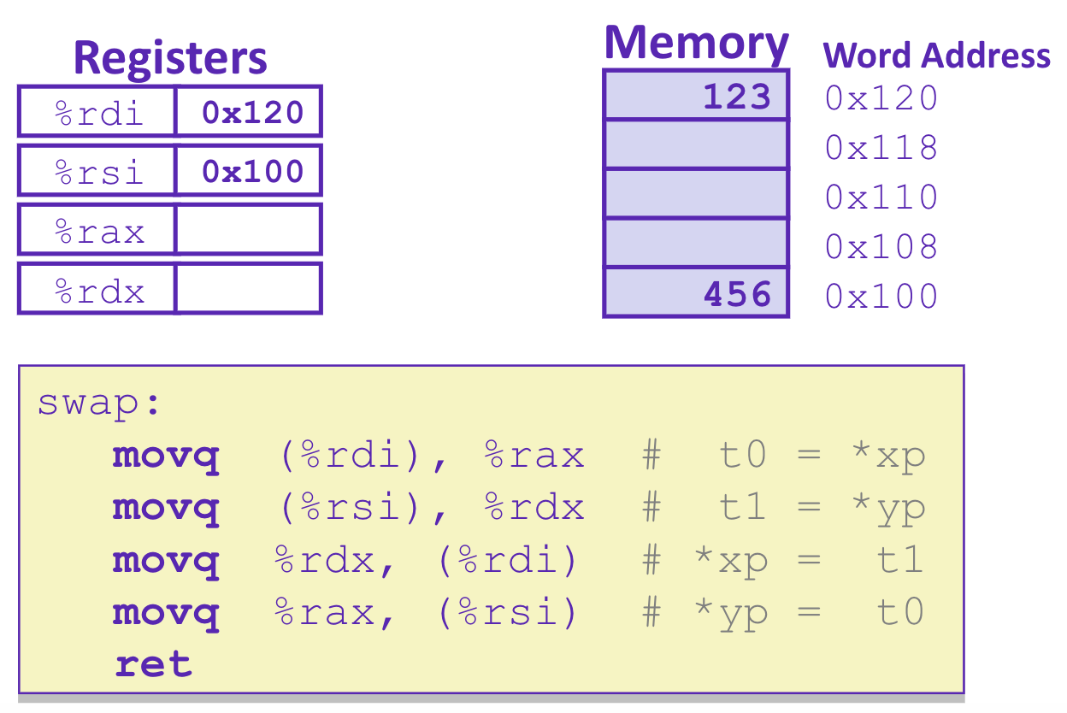
Example: swap()
123
456

Slide 9
Example: swap()
456
123
456
123

Slide 10
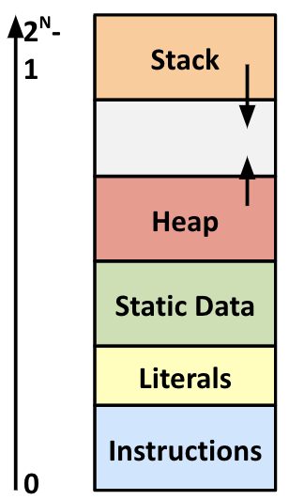
Where does everything go?
char big_array[1L<<24]; /* 16 MB */
char huge_array[1L<<31]; /* 2 GB */
int global = 0;
int useless() { return 0; }
int main()
{
void *p1, *p2, *p3, *p4;
int local = 0;
p1 = malloc(1L << 28); /* 256 MB */
p2 = malloc(1L << 8); /* 256 B */
p3 = malloc(1L << 32); /* 4 GB */
p4 = malloc(1L << 8); /* 256 B */
/* Some print statements ... */
}

Slide 11
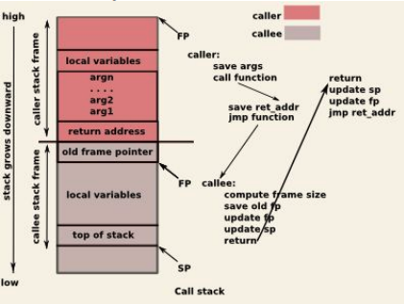
Function Pointers & Frames
Coded instructions are translated into numerical values stored in memory and fed into the processor for execution
function pointer – address of a function stored in memory, pointing to the start of the block of memory storing the set of instructions expressed by the function.
stack frames - section of the stack that is set aside for each function call
frame pushed onto the stack when the function is called and popped off when the function returns.
each frame contains: arguments, return address, pointer to last frame, local variables

Slide 12
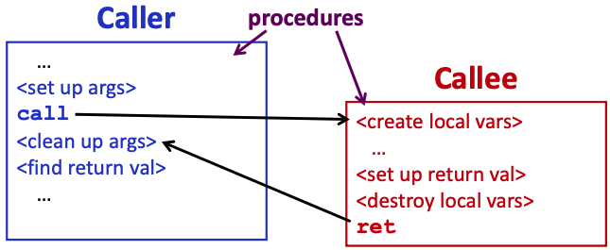
Procedure Call Overview
Coordinating between function memory frames
Callee must know where to find arguments
Callee must know where to find return address
Caller must know where to find return value
Caller and Callee run on the same CPU, so they use the same registers
calling convention - convention of where to leave/find things
caller saves contents of %rax before triggering callee that returns value (to prevent lose due to overwrite)
callee places return value into %rax
for values greater than 8 bytes, return pointer

Slide 13
What is a Buffer?
A buffer is an array used to temporarily store data
You’ve probably seen “video buffering…”
Functions that accept user input set aside memory for incoming data
Specify size of buffer before you know size of user input
void echo() {
char buf[8];
gets(buf);
puts(buf);
}

Slide 14
Unix buffer overflow vulnerability
Implementation of Unix gets()
C does not check array bounds, no way to specify limit on number of characters to read into a function
arrays in C/C++ don’t store their length
Many Unix/Linux/C functions don’t check argument sizes
strcpy: copies string of arbitrary length to a destination
scanf, fscanf, sscanf,
Allows overflowing (writing past the end) of buffers (arrays)
Buffer Overflow - Writing past the end of an array
Provides opportunities for malicious programs
Stack grows “backwards” in memory
Data and instructions both stored in the same memory
surprisingly easy to exploit, programmers often leave code open to attacks
/* Get string from stdin */
char* gets(char* dest) { int c = getchar();
char* p = dest;
while (c != EOF && c != '\n') {
*p++ = c;
c = getchar();
}
*p = '\0';
return dest;
}
pointer to
start of an array
Same as:
*p = c;
p++;

Slide 15
Buffer Overflow
Stack grows down towards lower addresses
Buffer grows up towards higher addresses
If we write past the end of the array, we overwrite data on the stack!
Enter input: hello
Enter input: helloabcdef
-> no overflow
-> overflow!

Slide 16
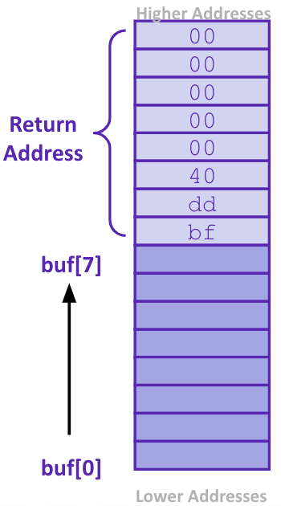
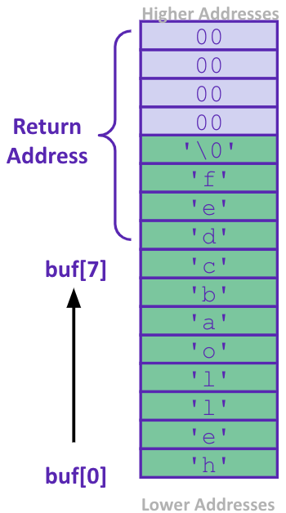
What happens when there is an overflow?
Buffer overflows on the stack can overwrite “interesting” data
Attackers just choose the right inputs
Simplest form (sometimes called “stack smashing”)
Unchecked length on string input into bounded array causes overwriting of stack data
Try to change the return address of the current procedure
Why is this a big deal?
It was the #1 technical cause of security vulnerabilities
#1 overall cause is social engineering / user ignorance
Enter input: helloabcdef
We’ve lost our way!
Lost address of function pointer telling us which instruction to return to

Slide 17
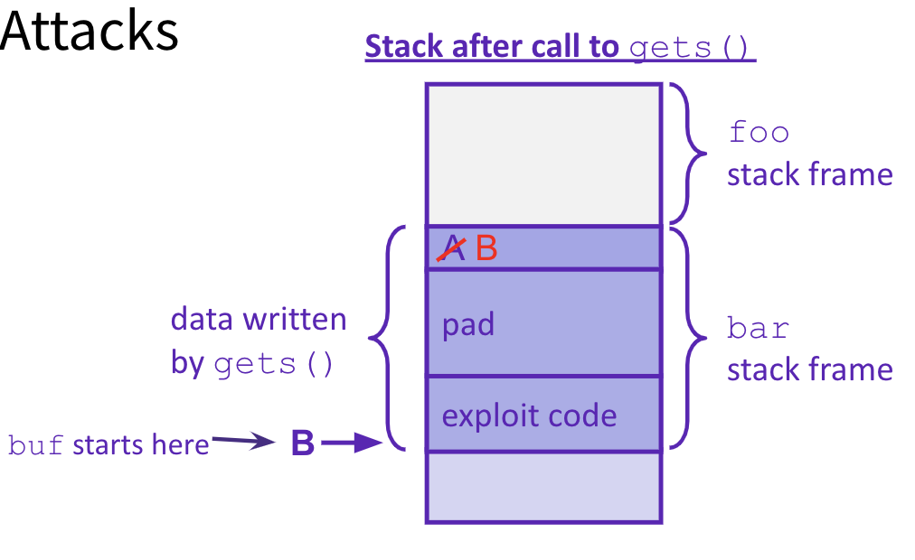
Malicious Buffer Overflow – Code Injection
void foo(){
bar();
A:...
}
Buffer overflow bugs can allow attackers to execute arbitrary code on victim machines
Distressingly common in real programs
Input string contains byte representation of executable code
Overwrite return address A with address of buffer B
When bar() executes ret, will jump to exploit code
return address A
int bar() {
char buf[64];
gets(buf);
...
return ...;
}
https://arstechnica.com/gadgets/2020/12/iphone-zero-click-wi-fi-exploit-is-one-of-the-most-breathtaking-hacks-ever/

Slide 18
Change return to last frame
Skip the line "x = 1;" in the main function by modifying function's return address.
Identify where the return address is in relation to the local variable buffer1
Figure out how many bytes the actual compiled C instruction "x=1;" takes, so that we can increment by that many bytes
Use GDB
break function
break right at beginning of function execution
x buffer1
prints the location of buffer1
info frame
"rip" will hold the location of the return address
print <rip-location> - <buffer1-location>
prints the number of bytes between buffer1 and rip
disassemble main
shows the machine code and how many bytes each instruction takes up.
We identify the line that calls function, then see that the next // instruction moves 1 into x. That instruction takes 7 bytes, so we
have now found the second number!
void bufferplay (int a, int b, int c) {
char buffer1[5];
uintptr_t ret; //holds an address
//calculate the address of the return pointer
ret = (uintptr_t) buffer1 + 0; //change to be address of return
//treat that number like a pointer,
//and change the value in it
*((uintptr_t*)ret) += 0; //change to add how much to advance
}
int main(int argc, char** argv) {
int x;
x = 0;
printf("before: %d\n",x);
bufferplay (1,2,3);
x = 1; // want to skip this line
printf("after: %d\n",x);
return 0;
}

Slide 19
Trigger malicious program
Attacker Program
int bar(char *arg, char *out) {
strcpy(out, arg);
return 0;
}
void foo(char *argv[]) {
char buf[256];
bar(argv[1], buf);
}
int main(int argc, char *argv[]) {
if (argc != 2) {
fprintf(stderr, "target1: argc != 2\n");
exit(1);
}
foo(argv);
return 0;
}
int main(void) {
char *args[3];
char *env[1];
args[0] = "/tmp/target";
args[2] = NULL;
env[0] = NULL;
args[1] = (char*) malloc(sizeof(char)*265);
memset(args[1], 0x90, 264);
// Null-terminate the string.
args[1][264] = '\0’;
// Add in the attack code to the front of the argument. memcpy(args[1], shellcode, strlen(shellcode));
*(uintptr_t*)(args[1] + 264) = 0x7fffffffdb90;
// call the victim program.
execve("/tmp/target", args, env); }
used gdb - there are 264 bytes between buf and return address, so we malloc space for 264, characters plus one for the null terminator.
set the memory to a value to ensure no null-termination in string before final character.
0x90 is also a byte that means "no-op" in terms of byte instructions.
Victim Program
Store address of buf at appropriate location in string

Slide 20
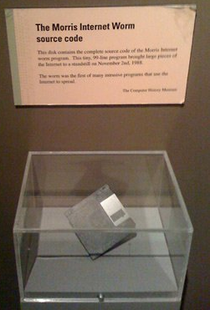
Hack – Internet Worm
Original “Internet worm” (1988)
Exploited vulnerability in gets() method used in Finger protocol
Worm attacked fingerd server with phony argument
finger "exploit-code padding new-return-addr"
Exploit code: executed a root shell on the victim machine with a direct connection to the attacker
Worm spread from machine to machine automatically
denial of service attack – flood machine with so many requests it is overloaded and unavailable to its intended users
took down 6000 machines, took days to get machine back online
government estimated damage $100,000 to $10,000,000
Written by Robert Morris while a grad student at Cornell, but launched it from the MIT computer system
meant to be an intellectual experiment, but made it too damaging by accident
Now a professor at MIT, first person convicted under the ‘86 Computer Fraud and Abuse Act

Slide 21
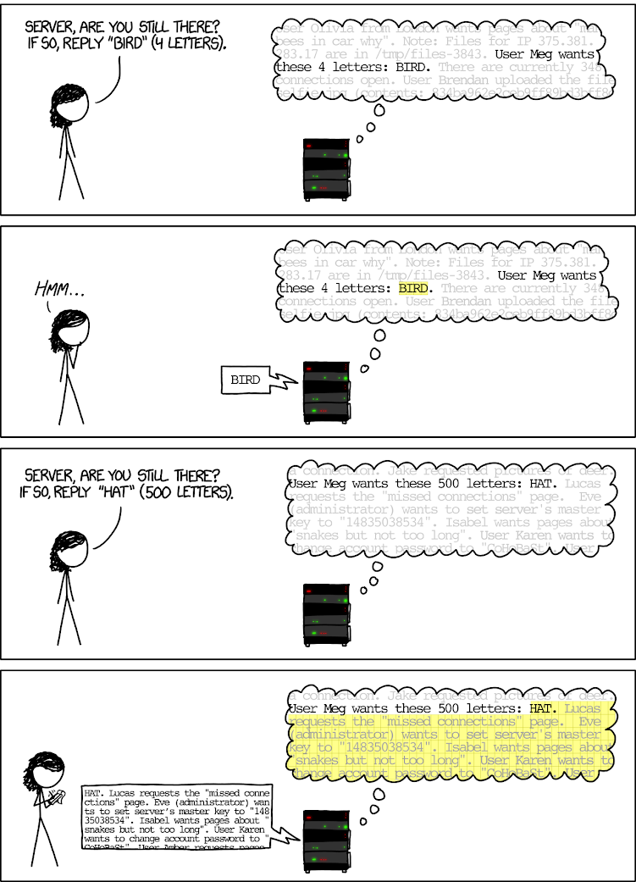
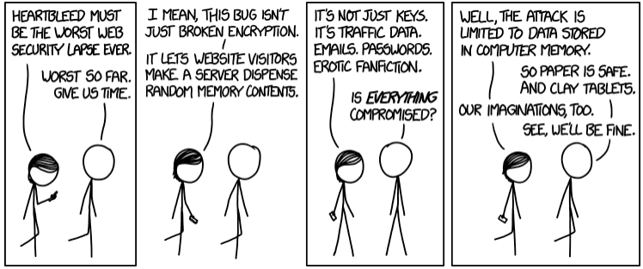
Hack - Heartbleed
Buffer over-read in Open-Source Security Library
when program reads beyond end of intended data from a buffer and reads
maliciously designed input - “Heartbeat” packet sent out
Specifies length of message and server echoes it back
Library just “trusted” this length
Allowed attackers to read contents of memory anywhere they wanted
Est. 17% of internet affected
Similar issue in Cloudbleed (2017)

Slide 22
Protect Your Code!
Employ system-level protections
Code on the Stack is not executable
Randomized Stack offsets
Avoid overflow vulnerabilities
Use library routines that limit string lengths
Use a language that makes them impossible
Have compiler use “stack canaries”
place special value (“canary”) on stack just beyond buffer

Slide 23
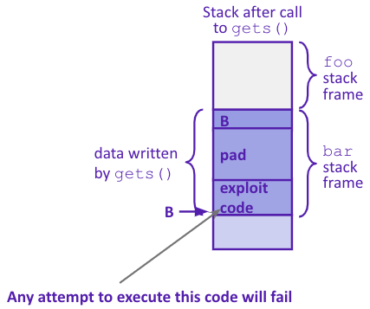
System Level Protections
Non-executable code segments
In traditional x86, can mark region of memory as either “read-only” or “writeable”
Can execute anything readable
x86-64 added explicit “execute” permission
Stack marked as non-executable
Do NOT execute code in Stack, Static Data, or Heap regions
Hardware support needed

Slide 24
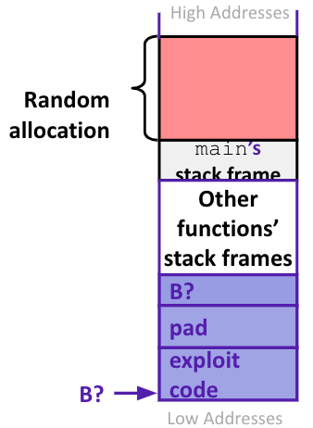
System Level Protections
Many embedded devices do not have feature to mark code as “non-executable”
Cars
Smart homes
Pacemakers
Randomized stack offsets
At start of program, allocate random amount of space on stack
Shifts stack addresses for entire program
Addresses will vary from one run to another
Makes it difficult for hacker to predict beginning of inserted code

Slide 25
Avoid Overflow Vulnerabilities
Use library routines that limit string lengths
fgets instead of gets (2nd argument to fgets sets limit)
strncpy instead of strcpy
Don’t use scanf with %s conversion specification
Use fgets to read the string
Or use %ns where n is a suitable integer
Or… don’t use C - use a language that does array index bounds check
Buffer overflow is impossible in Java
ArrayIndexOutOfBoundsException
Rust language was designed with security in mind
Panics on index out of bounds, plus more protections
/* Echo Line */ void echo() { char buf[8]; /* Way too small! */ fgets(buf, 8, stdin); puts(buf); }

Slide 26
Stack Canaries
Basic Idea: place special value (“canary”) on stack just beyond buffer
Secret value that is randomized before main()
Placed between buffer and return address
Check for corruption before exiting function
GCC implementation
-fstack-protector
unix>./buf
Enter string: 12345678
12345678
unix> ./buf
Enter string: 123456789
*** stack smashing detected ***

Slide 27
What is Concurrency?
Running multiple processes simultaneously
running separate programs simultaneously
running two different ‘threads’ in on program
Each ’process’ is one ‘thread’
parallelism refers to running things simultaneously on separate resources (ex. Separate CPUs)
concurrency refers to running multiple threads on a shared resources
sequential programming demands finishing one sequence before starting the next one
previously, performance improvements could only be made by improving hardware
Moore’s Law
Allows processes to run ‘in the background’
Responsiveness – allow GUI to respond while computation happens
CPU utilization – allow CPU to compute while waiting (waiting for data, for input)
isolation – keep threads separate so errors in one don’t affect the others

Slide 28
Concurrency
C and Java support parallelism similarly
one pile of code, globals, heap
multiple ”stack + program counter’s” – called threads
threads are run or pre-empted by a scheduler
threads all share the same memory
Various synchronization mechanisms control when threads run
don’t run until I’m done with this
C: the POSIX Threads (pthreads) library)
#include <pthread.h>
pass –lpthread to gcc (when linking)
pthread_create takes a function pointer and arguments, run as a separate thread
Java: built into the language
subclass java.lang.Thread, and override the run method
create a Thread object and call its start method
any object can ”be synchronized on” (later today)

Slide 29
Pthread functions
pthread_t thread ID;
the threadID keeps trak of to which thread we are referring
int pthread_create(pthread_t *thread, const pthread_attr_t *attr, void *(*start routing) (void*), void *arg);
note – pthread_create takes two generic (untyped) pointers
interprets the first as a function pointer and the second as an argument pointer
int pthread_join(pthread_t thread, void **value_ptr);
puts calling thread ‘on hold’ until ‘thread’ completes – useful for waiting to thread to exit
https://pubs.opengroup.org/onlinepubs/7908799/xsh/pthread.h.html

Slide 30
Memory Consideration
if one thread did nothing of interest to any other thread, why bother running?
threads must communicate and coordinate
use results from other threads, and coordinate access to shared resources
simplest ways to not mess each other up:
don’t access same memory (complete isolation)
don’t write to shared memory (write isolation)
next simplest
one thread doesn’t run until/unless another is done

Slide 31
Parallel Processing
common pattern for expensive computations (such as data processing)
split up the work, give each piece to a thread (fork)
wait until all are done, then combine answers (join)
to avoid bottlenecks, each thread should have about the same about of work
performance will always be less than perfect speedup
what about when all threads need access to the same mutable memory?

Slide 32
multiple threads with one memory
often you have a bunch of threads running at once and they might need rthe same mutable (writable) memory at the same time but probably not
want to be correct, but not sacrifice parallelism
example: bunch of threads processing bank transactions

Slide 33
data races

Slide 34
Questions

Slide 35
Protected Buffer Disassembly (buf)
400607: sub $0x18,%rsp
40060b: mov %fs:0x28,%rax
400614: mov %rax,0x8(%rsp)
400619: xor %eax,%eax
... ... call printf ...
400625: mov %rsp,%rdi
400628: callq 400510 <gets@plt>
40062d: mov %rsp,%rdi
400630: callq 4004d0 <puts@plt>
400635: mov 0x8(%rsp),%rax
40063a: xor %fs:0x28,%rax
400643: jne 40064a <echo+0x43>
400645: add $0x18,%rsp
400649: retq
40064a: callq 4004f0 <__stack_chk_fail@plt>

Slide 36
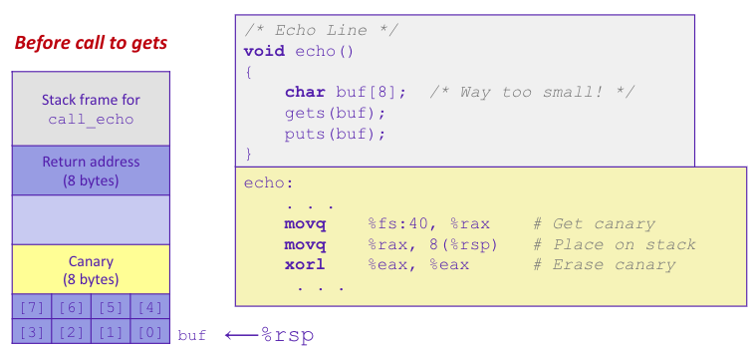
Setting up Canary

Slide 37
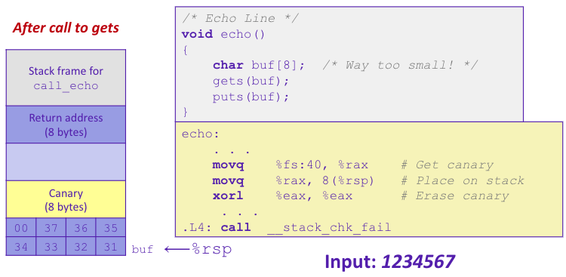
Checking Canary

