Slide 1
Lecture 25: Assembly
Lecture Participation Poll #25
Log onto pollev.com/cse374
Or
Text CSE374 to 22333
CSE 374: Intermediate Programming Concepts and Tools

Slide 2
Administrivia
Decriminalizing Our College Campuses Date: Thursday, December 3, 2020
Time: 6-8 pm
Location: Zoom link will be emailed to everyone who RSVPs
RSVP link: https://forms.gle/5FSZQsFTgAaYKUh56
HW 4 posted -> Extra credit due date Thursday Dec 3rd
HW 5 (final HW) coming later today
HW 6 extra credit releasing next week
2 more exercises coming – 1 later today, 1 next week
Final review assignment will release last week of quarter
End of quarter due date Wednesday December 16th @ 9pm
THANK YOU FOR YOUR PATIENCE

Slide 3
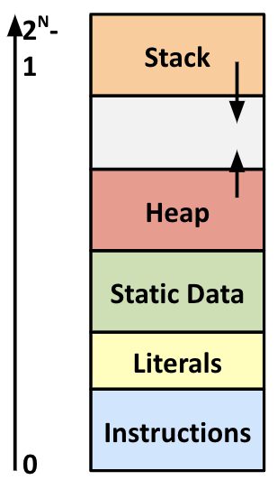
Review: General Memory Layout
Stack
Local variables (procedure context)
Heap
Dynamically allocated as needed
malloc(), calloc(), new, …
Statically allocated Data
Read/write: global variables (Static Data)
Read-only: string literals (Literals)
Code/Instructions
Executable machine instructions
Read-only

Slide 4
Where does everything go?
char big_array[1L<<24]; /* 16 MB */
char huge_array[1L<<31]; /* 2 GB */
int global = 0;
int useless() { return 0; }
int main()
{
void *p1, *p2, *p3, *p4;
int local = 0;
p1 = malloc(1L << 28); /* 256 MB */
p2 = malloc(1L << 8); /* 256 B */
p3 = malloc(1L << 32); /* 4 GB */
p4 = malloc(1L << 8); /* 256 B */
/* Some print statements ... */
}

Slide 5
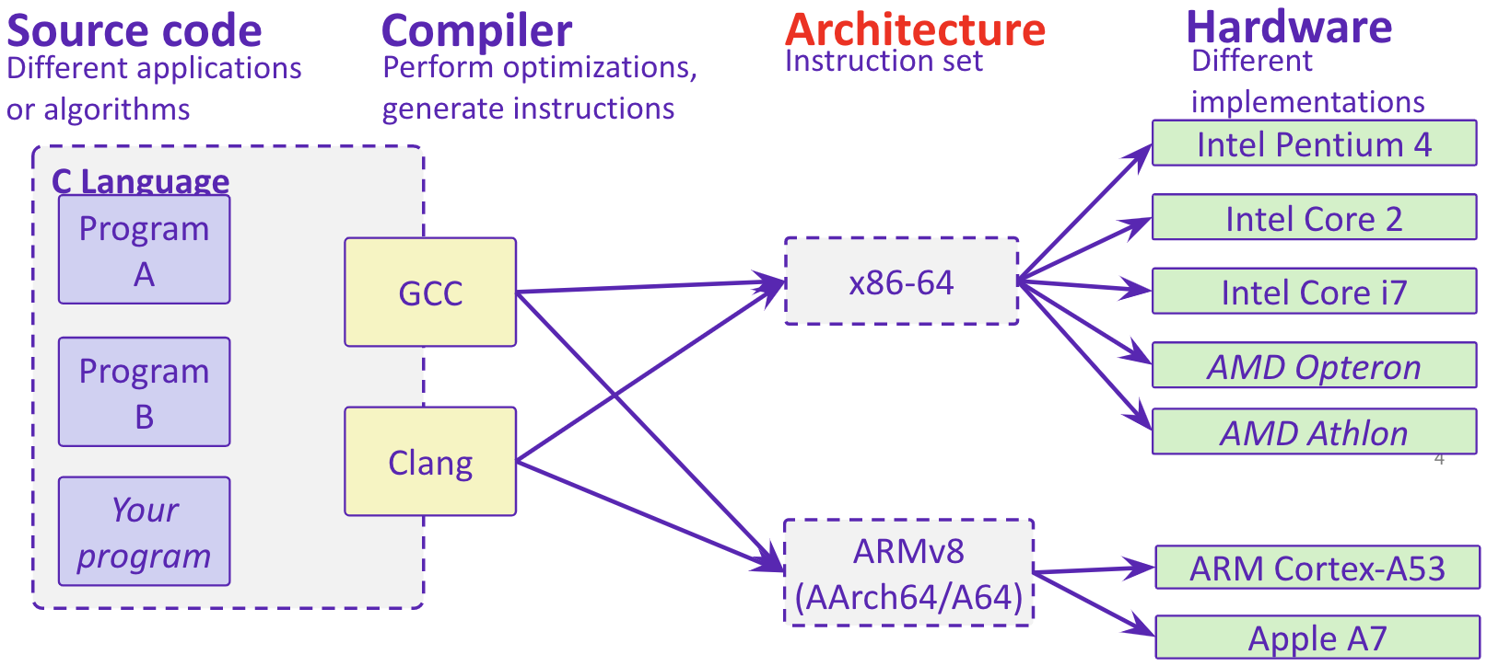
Hardware Software Interface

Slide 6
From Human to Computer
C /C++ is translated directly into assembly by compiler
Other languages may be translated into another form
Java is translated into an assembly-like form, which is then run by the Java interpreter/runtime
The Java runtime is executing assembly instructions!
Some languages are directly interpreted without being translated into another form
Most Bash implementations will directly interpret the commands without compiling
Python can do either. It can be used as an interpreter or compile scripts
Assembler translates assembly into machine code
C
#include <stdio.h>
int main()
{
char name[20];
…
return 0;
}
Assembly
Machine Code
push ebp
mov ebp, esp
sub esp, 0C0h
83 ec 08
83 e4 f0
b8 00 00 00 00
83 c0 0f
Compiler
Assembler

Slide 7
Computer Architecture
Instruction Set Architecture (ISA): The ”programming language” of the processor, the syntax and language of how to give commands to the processor.
There are a set of ISAs that are supported by a larger collection of microarchitectures
Ex: x86, ARM ISA, TI DSPs ISA
The ISA defines:
The system’s state (e.g. registers, memory, program counter)
The instructions the CPU can execute
The effect that each of these instructions will have on the system state
Microarchitecture: The way a specific processor executes a given ISA based on the processor’s design.
The Microarchitecture defines how the data (data path) moves through the parts of the processor (control path), often represented as a data flow diagram.
microarchitecture dictates the flow of instructions through items within the processor such as logic gates, registers, Arithmetic Logic Units (ALUs)

Slide 8
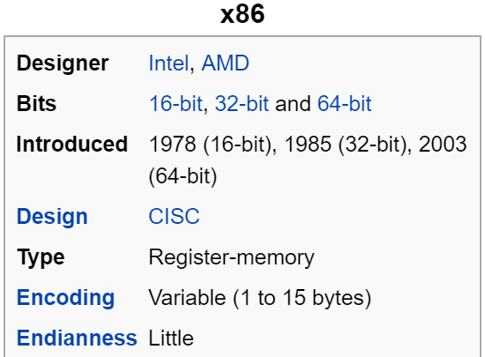
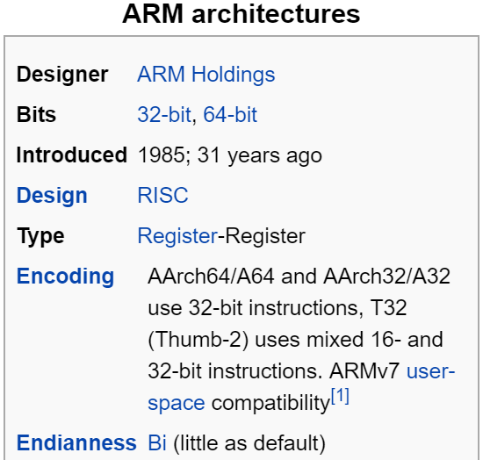
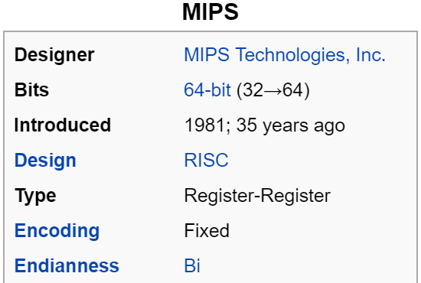
Mainstream ISAs
Digital home & networking
(Blu-ray, Playstation 2)
MIPS instruction set
Macbooks & PCs
(Core i3, i5, i7, M)
x86-64 instruction set
Smartphone (and similar) devices
(iPhone, iPad, Raspberry Pi)
ARM instruction set

Slide 9
So… who writes assembly?
Chances are, you’ll never write a program in assembly!
BUT understanding assembly is the key to the machine-level execution model.
Some use cases for assembly:
When working in embedded where you can’t trust the compiler to reduce program size as efficiently as possible
When special purpose subroutines are required that are not possible in higher level languages
Behavior of programs in the presence of bugs
When high-level language model breaks down
Tuning program performance
Implementing systems software
Fighting malicious software
Distributed software is in binary form

Slide 10
Assembly Programmer’s View
Programmer-visible state
PC: the Program Counter (%rip in x86-64)
Address of next instruction
Named registers
Heavily used program data
Condition codes
Store status information about most recent arithmetic operation
Used for conditional branching

Slide 11
Registers
A location in the CPU that stores a small amount of data, which can be accessed very quickly (once every clock cycle)
Registers have names, not addresses
In assembly, they start with % (e.g. %rsi)
Registers are at the heart of assembly programming
They are a precious commodity in all architectures, but especially x86
Memory
Addresses (EX: 0x7FFFD024C3DC)
Big ~ 8 GiB
Slow ~50-100 ns
Dynamic - Can “grow” as needed while program runs
Registers
Names (EX: %rdi)
Small - (16 x 8 B) = 128 B
Fast - sub-nanosecond timescale
Static - fixed number in hardware

Slide 12
Assembly Instruction Basics
Assembly instructions fall into one of 3 categories:
Transfer data between memory and register
Load data from memory into register
%reg = Mem[address]
Store register data into memory
Mem[address] = %reg
Perform arithmetic operation on register or memory data
c = a + b; z = x << y; i = h & g;
Control flow: what instruction to execute next
Unconditional jumps to/from procedures
Conditional branches
Items in Assembly fall into one of 3 operand categories:
Immediate: Constant integer data
Examples: $0x400, $-533
Like C literal, but prefixed with ‘$’
Encoded with 1, 2, 4, or 8 bytes
Register: 1 of 16 integer registers
Examples: %rax, %r13
Memory: Consecutive bytes of memory at a computed address
Simplest example: (%rax)

Slide 13
Example: Moving Data
Assume we have two variables called rax and rdx.
Which assembly instruction does *rdx = rax?
movq %rdx, %rax
movq (%rdx), %rax
movq %rax, (%rdx)
movq (%rax), %rdx
General form: mov_ source, destination
Missing letter (_) specifies size of operands
Lots of these in typical code
Examples:
movb src, dst
Move 1-byte “byte”
movw src, dst
Move 2-byte “word”
movl src, dst
Move 4-byte “long word”
movq src, dst
Move 8-byte “quad word”
 | Source | Dest | Src, Dest | C Analog
movq | Imm | Reg | movq $0x4, %rax | rax = 4;
 |  | Mem | movq $-147, (%rax) | *rax = -147;
 | Reg | Reg | movq %rax, %rdx | rdx = rax;
 |  | Mem | movq %rax, (%rdx) | *rdx = rax;
 | Mem | Reg | movq (%rax), %rdx | rdx = *rax;

Slide 14
Arithmetic Operation Instructions
Binary (two-operand) Instructions:
Beware argument order!
How do you implement
“r3 = r1 + r2”?
Format | Computation
addq src, dst | dst = dst + src | (dst += src)
subq src, dst | dst = dst – src
imulq src, dst | dst = dst * src | signed mult
shrq src, dst | dst = dst >> src
shlq src, dst | dst = dst << src | (same as salq)
xorq src, dst | dst = dst ^ src
andq src, dst | dst = dst & src
orq src, dst | dst = dst | src
q = operand size specifier
(e.g. b, w, l, q = 1, 2, 4, 8)

Slide 15
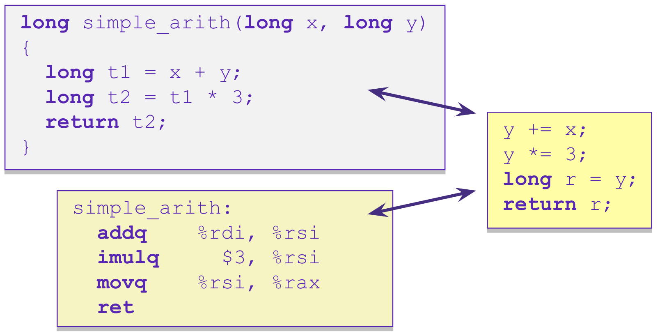
Example: Arithmetic Operations
Register | Use(s)
%rdi | 1st argument (x)
%rsi | 2nd argument (y)
%rax | return value

Slide 16
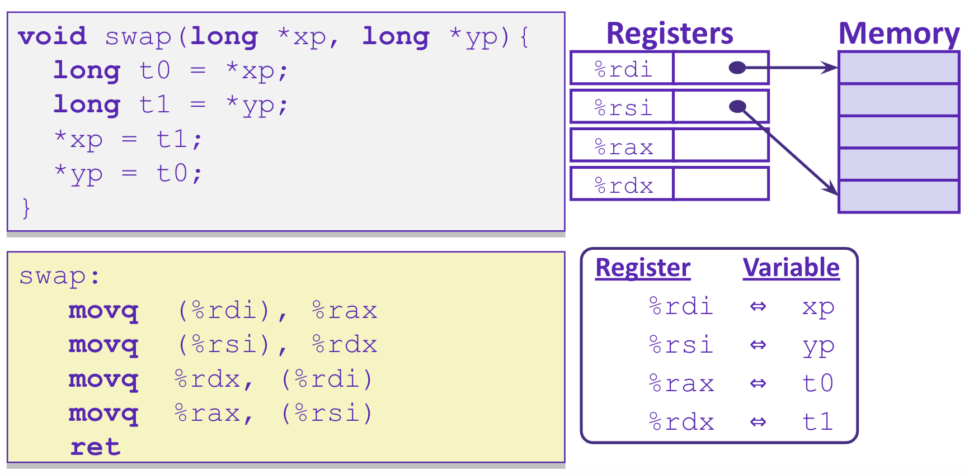
Example: swap()

Slide 17
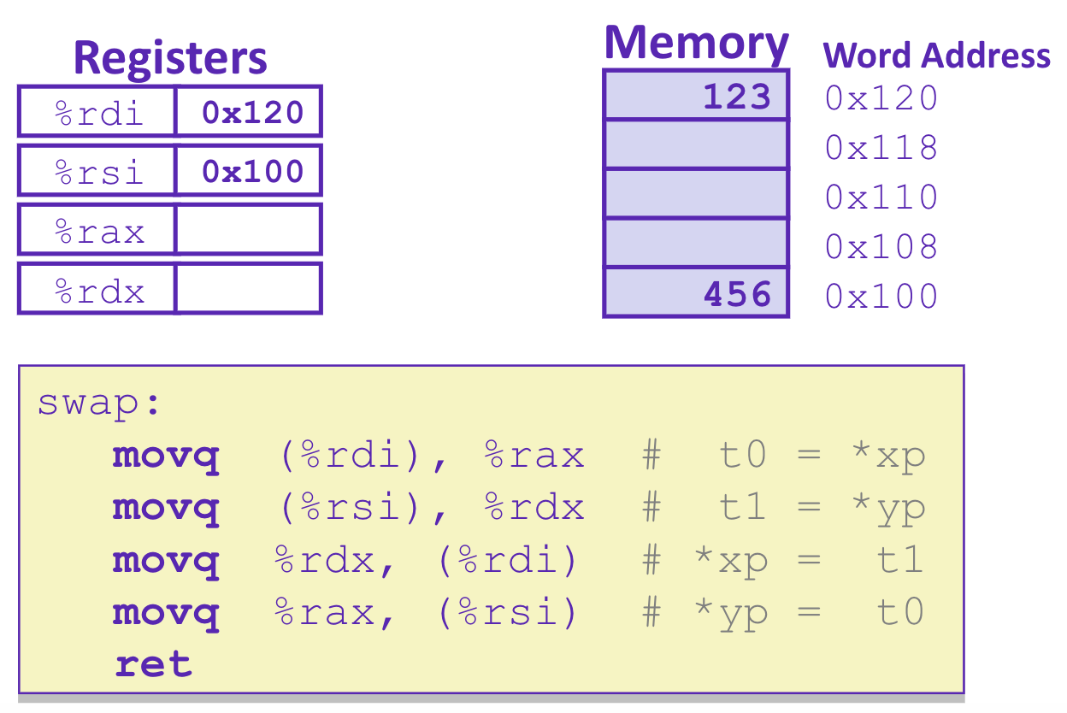
Example: swap()
123
456

Slide 18
Example: swap()
456
123
456
123

Slide 19
Where does everything go?
char big_array[1L<<24]; /* 16 MB */
char huge_array[1L<<31]; /* 2 GB */
int global = 0;
int useless() { return 0; }
int main()
{
void *p1, *p2, *p3, *p4;
int local = 0;
p1 = malloc(1L << 28); /* 256 MB */
p2 = malloc(1L << 8); /* 256 B */
p3 = malloc(1L << 32); /* 4 GB */
p4 = malloc(1L << 8); /* 256 B */
/* Some print statements ... */
}

Slide 20
Buffer Overflow
A buffer is an array used to temporarily store data
You’ve probably seen “video buffering…”
The video is being written into a buffer before being played
Buffers can also store user input
C does not check array bounds
Many Unix/Linux/C functions don’t check argument sizes
Allows overflowing (writing past the end) of buffers (arrays)
“Buffer Overflow” = Writing past the end of an array
Characteristics of the traditional Linux memory layout provide opportunities for malicious programs
Stack grows “backwards” in memory
Data and instructions both stored in the same memory

Slide 21
Buffer Overflow
Stack grows down towards lower addresses
Buffer grows up towards higher addresses
If we write past the end of the array, we overwrite data on the stack!
Enter input: hello
Enter input: helloabcdef
-> no overflow
-> overflow!

Slide 22
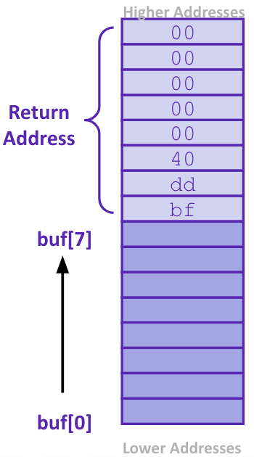
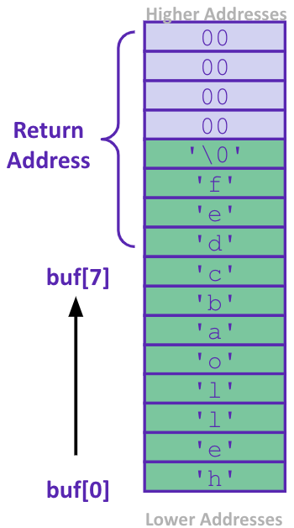
What happens when there is an overflow?
Buffer overflows on the stack can overwrite “interesting” data
Attackers just choose the right inputs
Simplest form (sometimes called “stack smashing”)
Unchecked length on string input into bounded array causes overwriting of stack data
Try to change the return address of the current procedure
Why is this a big deal?
It was the #1 technical cause of security vulnerabilities
#1 overall cause is social engineering / user ignorance
Enter input: helloabcdef
We’ve lost our way!
Lost address of function pointer telling us which instruction to return to

Slide 23
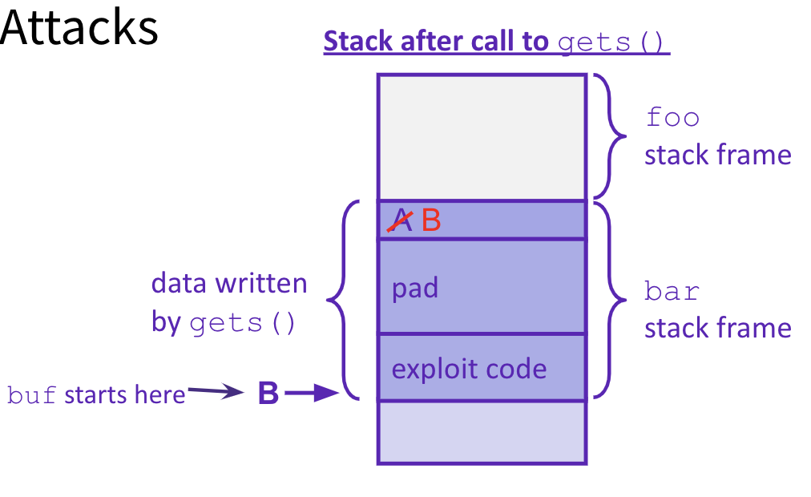
Malicious Buffer Overflow – Code Injection
void foo(){
bar();
A:...
}
Buffer overflow bugs can allow attackers to execute arbitrary code on victim machines
Distressingly common in real programs
Input string contains byte representation of executable code
Overwrite return address A with address of buffer B
When bar() executes ret, will jump to exploit code
return address A
int bar() {
char buf[64];
gets(buf);
...
return ...;
}
https://www.gao.gov/assets/700/694913.pdf

Slide 24
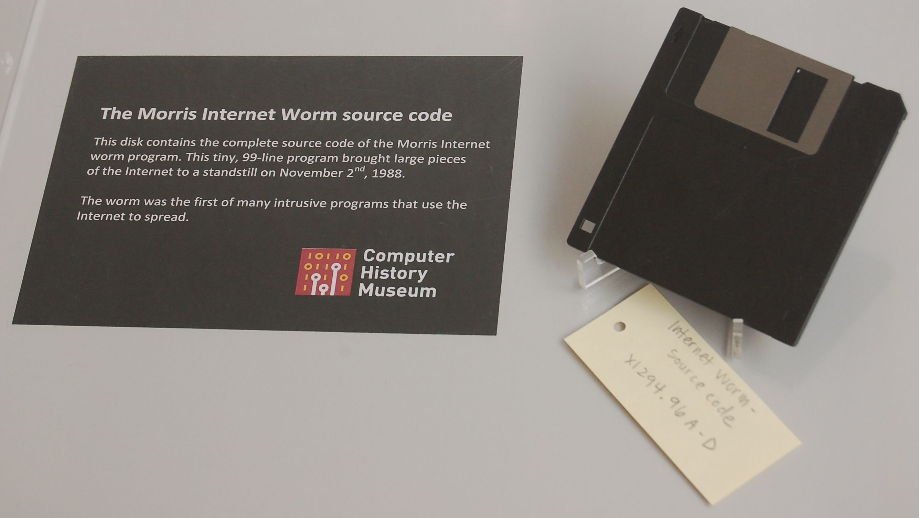
Examples
Heartbleed (2014, affected 17% of servers)
Buffer over-read in OpenSSL
“Heartbeat” packet
Specifies length of message and server echoes it back
Library just “trusted” this length
Allowed attackers to read contents of memory anywhere they wanted
Est. 17% of Internet affected
Similar issue in Cloudbleed (2017)
Original “Internet worm” (1988)
Early versions of the finger server (fingerd) used gets() to read the argument sent by the client: finger droh@cs.cmu.edu
Worm attacked fingerd server with phony argument:
finger "exploit-code padding new-return-addr"
Exploit code: executed a root shell on the victim machine with a direct connection to the attacker
Robert Morris is now a professor at MIT, first person convicted under the ‘86 Computer Fraud and Abuse Act

Slide 25
Protect Your Code!
Employ system-level protections
Code on the Stack is not executable
Randomized Stack offsets
Avoid overflow vulnerabilities
Use library routines that limit string lengths
Use a language that makes them impossible
Have compiler use “stack canaries”
place special value (“canary”) on stack just beyond buffer

Slide 26
System Level Protections
Non-executable code segments
In traditional x86, can mark region of memory as either “read-only” or “writeable”
Can execute anything readable
x86-64 added explicit “execute” permission
Stack marked as non-executable
Do NOT execute code in Stack, Static Data, or Heap regions
Hardware support needed
Works well, but can’t always use it
Many embedded devices do not have this protection
Cars
Smart homes
Pacemakers
Some exploits still work!
Randomized stack offsets
At start of program, allocate random amount of space on stack
Shifts stack addresses for entire program
Addresses will vary from one run to another
Makes it difficult for hacker to predict beginning of inserted code

Slide 27
Avoid Overflow Vulnerabilities
Use library routines that limit string lengths
fgets instead of gets (2nd argument to fgets sets limit)
strncpy instead of strcpy
Don’t use scanf with %s conversion specification
Use fgets to read the string
Or use %ns where n is a suitable integer
Alternatively, don’t use C - use a language that does array index bounds check
Buffer overflow is impossible in Java
ArrayIndexOutOfBoundsException
Rust language was designed with security in mind
Panics on index out of bounds, plus more protections
/* Echo Line */ void echo() { char buf[8]; /* Way too small! */ fgets(buf, 8, stdin); puts(buf); }

Slide 28
Stack Canaries
Basic Idea: place special value (“canary”) on stack just beyond buffer
Secret value that is randomized before main()
Placed between buffer and return address
Check for corruption before exiting function
GCC implementation
-fstack-protector
unix>./buf
Enter string: 12345678
12345678
unix> ./buf
Enter string: 123456789
*** stack smashing detected ***

Slide 29
Questions

