Slide 1
Lecture 22: C++ Inheritance
Lecture Participation Poll #22
Log onto pollev.com/cse374
Or
Text CSE374 to 22333
CSE 374: Intermediate Programming Concepts and Tools

Slide 2
Administrivia
HW 3 posted Friday -> Extra credit due date Wednesday Nov 25th @ 9pm
End of quarter due date Wednesday December 16th @ 9pm

Slide 3
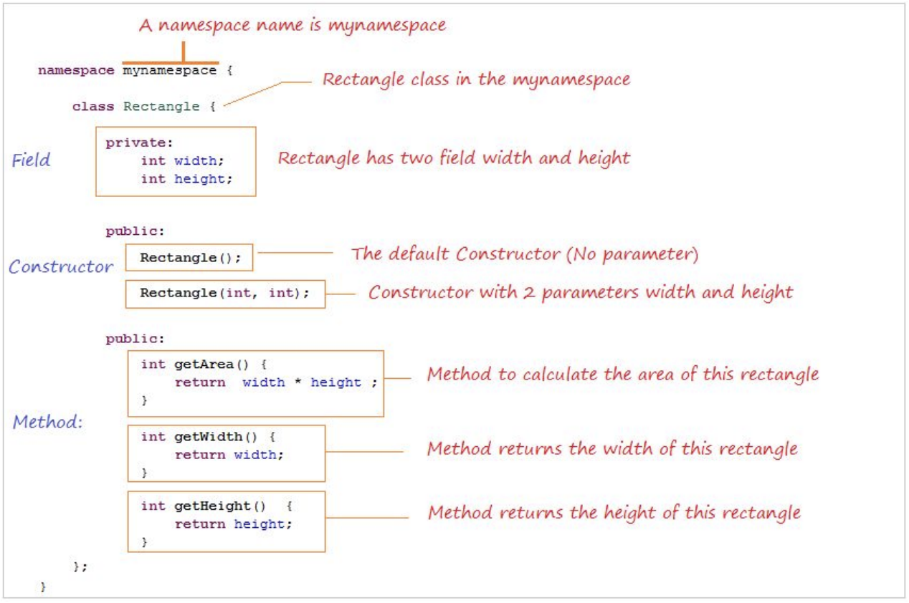
Anatomy of C++ Class
Rectangle.h

Slide 4
Access Control
Access modifiers for members:
public: accessible to all parts of the program
private: accessible to the member functions of the class
Private to class, not object instances
protected: accessible to member functions of the class and any derived classes (subclasses – more to come, later)
Reminders:
Access modifiers apply to all members that follow until another access modifier is reached
If no access modifier is specified, struct members default to public and class members default to private

Slide 5
Class Definition (Member declaration)
Point.h
#ifndef POINT_H_
#define POINT_H_
class Point {
public:
Point(const int x, const int y); // constructor
int get_x() const { return x_; } // inline member function
int get_y() const { return y_; } // inline member function
double Distance(const Point& p) const; // member function
void SetLocation(const int x, const int y); // member function
private:
int x_; // data member
int y_; // data member
}; // class Point
#endif // POINT_H_

Slide 6
Class Member Definition
Point.cpp
#include <cmath>
#include "Point.h"
Point::Point(const int x, const int y) {
x_ = x;
this->y_ = y; // "this->" is optional unless name conflicts
}
double Point::Distance(const Point& p) const {
// We can access p’s x_ and y_ variables either through the
// get_x(), get_y() accessor functions or the x_, y_ private
// member variables directly, since we’re in a member
// function of the same class.
double distance = (x_ - p.get_x()) * (x_ - p.get_x());
distance += (y_ - p.y_) * (y_ - p.y_);
return sqrt(distance);
}
void Point::SetLocation(const int x, const int y) {
x_ = x;
y_ = y;
}

Slide 7
Class Usage
usePoint.cpp
#include <iostream>
#include "Point.h"
using namespace std;
int main(int argc, char** argv) {
Point p1(1, 2); // allocate a new Point on the Stack
Point p2(4, 6); // allocate a new Point on the Stack
cout << "p1 is: (" << p1.get_x() << ", ";
cout << p1.get_y() << ")" << endl;
cout << "p2 is: (" << p2.get_x() << ", ";
cout << p2.get_y() << ")" << endl;
cout << "dist : " << p1.Distance(p2) << endl;
return 0;
}
To allocate on the heap use the “new” keyword
Point* p1 = new Point(1, 2);

Slide 8
Constructors in C++
A constructor (ctor) initializes a newly-instantiated object
A class can have multiple constructors that differ in parameters
Which one is invoked depends on how the object is instantiated
Written with the class name as the method name:
Point(const int x, const int y);
C++ will automatically create a synthesized default constructor if you have no user-defined constructors
Takes no arguments and calls the default ctor on all non-“plain old data” (non-POD) member variables
Synthesized default ctor will fail if you have non-initialized const or reference data members
4 different types of constructors
default constructor – takes zero arguments. If you don’t define any constructors the compiler will generate one of these for you (just like Java)
copy constructor – takes a single parameter which is a const reference(const T&) to another object of the same type, and initializes the fields of the new object as a copy of the fields in the referenced object
user-defined constructors – initialize fields and take whatever arguments you specify
conversion constructors – implicit, take a single argument. If you want a single argument constructor that is not implicit must use the keyword “explicit” like: explicit String(const char* raw);

Slide 9
Synthesized Default Constructor
SimplePoint.h
class SimplePoint {
public:
// no constructors declared!
int get_x() const { return x_; } // inline member function
int get_y() const { return y_; } // inline member function
double Distance(const SimplePoint& p) const;
void SetLocation(int x, int y);
private:
int x_; // data member
int y_; // data member
}; // class SimplePoint
SimplePoint.cpp
#include "SimplePoint.h"
... // definitions for Distance() and SetLocation()
int main(int argc, char** argv) {
SimplePoint x; // invokes synthesized default constructor
return EXIT_SUCCESS;
}

Slide 10
Synthesized Default Constructor
If you define any constructors, C++ assumes you have defined all the ones you intend to be available and will not add any others
#include "SimplePoint.h"
// defining a constructor with two arguments
SimplePoint::SimplePoint(const int x, const int y) {
x_ = x;
y_ = y;
}
void foo() {
SimplePoint x; // compiler error: if you define any
// ctors, C++ will NOT synthesize a
// default constructor for you.
SimplePoint y(1, 2); // works: invokes the 2-int-arguments
// constructor
}

Slide 11
Overloading Constructors
#include "SimplePoint.h"
// default constructor
SimplePoint::SimplePoint() {
x_ = 0;
y_ = 0;
}
// constructor with two arguments
SimplePoint::SimplePoint(const int x, const int y) {
x_ = x;
y_ = y;
}
void foo() {
SimplePoint x; // invokes the default constructor
SimplePoint y(1, 2); // invokes the 2-int-arguments ctor
SimplePoint a[3]; // invokes the default ctor 3 times
}

Slide 12
Copy Constructors
C++ has the notion of a copy constructor (cctor)
Used to create a new object as a copy of an existing object
Initializer lists can also be used in copy constructors
initializes a new bag of bits (new variable or parameter)
assignment (=) replaces an existing value with a new one
may need to clean up old state (free heap data?)
Point::Point(const int x, const int y) : x_(x), y_(y) { }
// copy constructor
Point::Point(const Point& copyme) {
x_ = copyme.x_;
y_ = copyme.y_;
}
void foo() {
Point x(1, 2); // invokes the 2-int-arguments constructor
Point y(x); // invokes the copy constructor
Point z = y; // also invokes the copy constructor
}

Slide 13
Synthesized Copy Constructor
If you don’t define your own copy constructor, C++ will synthesize one for you
It will do a shallow copy of all of the fields (i.e. member variables) of your class
Sometimes the right thing; sometimes the wrong thing
#include "SimplePoint.h"
... // definitions for Distance() and SetLocation()
int main(int argc, char** argv) {
SimplePoint x;
SimplePoint y(x); // invokes synthesized copy constructor
...
return EXIT_SUCCESS;
}

Slide 14
When Do Copies Happen?
The copy constructor is invoked if:
You initialize an object from another object of the same type:
You pass a non-reference object as a value parameter to a function:
You return a non-reference object value from a function:
Point x; // default ctor
Point y(x); // copy ctor
Point z = y; // copy ctor
void foo(Point x) { ... }
Point y; // default ctor
foo(y); // copy ctor
Point foo() {
Point y; // default ctor
return y; // copy ctor
}

Slide 15
Initialization Lists
C++ lets you optionally declare an initialization list as part of a constructor definition
Initializes fields according to parameters in the list
The following two are (nearly) identical:
Point::Point(const int x, const int y) {
x_ = x;
y_ = y;
std::cout << "Point constructed: (" << x_ << ",";
std::cout << y_<< ")" << std::endl;
}
// constructor with an initialization list
Point::Point(const int x, const int y) : x_(x), y_(y) {
std::cout << "Point constructed: (" << x_ << ",";
std::cout << y_<< ")" << std::endl;
}

Slide 16
Initialization vs Construction
Data members in initializer list are initialized in the order they are defined in the class, not by the initialization list ordering
Data members that don’t appear in the initialization list are default initialized/constructed before body is executed
Initialization preferred to assignment to avoid extra steps
Never mix the two styles
class Point3D {
public:
// constructor with 3 int arguments
Point3D(const int x, const int y, const int z) : y_(y), x_(x) {
z_ = z;
}
private:
int x_, y_, z_; // data members
}; // class Point3D
First, initialization list is applied.
Next, constructor body is executed.

Slide 17
Destructors
C++ has the notion of a destructor (dtor)
Like “free” in c. In fact, invokes free under the hood to clean up when freeing memory
Invoked automatically when a class instance is deleted, goes out of scope, etc. (even via exceptions or other causes!)
Do not need to call destructors explicitly
Place to put your cleanup code – free any dynamic storage or other resources owned by the object
Standard C++ idiom for managing dynamic resources
Slogan: “Resource Acquisition Is Initialization” (RAII)
Point::~Point() { // destructor
// do any cleanup needed when a Point object goes away
// (nothing to do here since we have no dynamic resources)
}

Slide 18
Nonmember Functions
“Nonmember functions” are just normal functions that happen to use some class
Called like a regular function instead of as a member of a class object instance
These do not have access to the class’ private members
Useful nonmember functions often included as part of interface to a class
Declaration goes in header file, but outside of class definition
A class can give a nonmember function (or class) access to its non-public members by declaring it as a friend within its definition
Not a class member, but has access privileges as if it were
friend functions are usually unnecessary if your class includes appropriate “getter” public functions
class Complex {
...
friend std::istream& operator>>(std::istream& in, Complex& a);
...
}; // class Complex
Complex.cpp
std::istream& operator>>(std::istream& in, Complex& a) {
...
}
Complex.h

Slide 19
Inheritance in C++
Inheritance is the formal establishment of hierarchical relationships between classes in order to facilitate the sharing of behaviors
A parent-child “is-a” relationship between classes
A child (derived class) extends a parent (base class)
Benefits:
Code reuse
Children can automatically inherit code from parents
Polymorphism
Ability to redefine existing behavior but preserve the interface
Children can override the behavior of the parent
Others can make calls on objects without knowing which part of the inheritance tree it is in
Extensibility
Children can add behavior
Java | C++
Superclass | Base Class
Subclass | Derived Class

Slide 20
Inheritance Design Example: Stock Portfolio
Stock
symbol_ total_shares_ total_cost_ current_price_
GetMarketValue() GetProfit() GetCost()
DividendStock
symbol_ total_shares_ total_cost_ current_price_ dividends_
GetMarketValue() GetProfit() GetCost()
Cash
amount_
GetMarketValue()
A portfolio represents a person’s financial investments
Each asset has a cost (i.e. how much was paid for it) and a market value (i.e. how much it is worth)
The difference between the cost and market value is the profit (or loss)
Different assets compute market value in different ways
A stock that you own has a ticker symbol (e.g. “GOOG”), a number of shares, share price paid, and current share price
A dividend stock is a stock that also has dividend payments
Cash is an asset that never incurs a profit or loss
Stock
symbol_ total_shares_ total_cost_ current_price_
GetMarketValue() GetProfit() GetCost()
DividendStock
symbol_ total_shares_ total_cost_ current_price_ dividends_
GetMarketValue() GetProfit() GetCost()
Asset (abstract)
GetMarketValue() GetProfit() GetCost()
Cash
amount_
GetMarketValue()

Slide 21
Class Derivation List
Comma-separated list of classes to inherit from:
Focus on single inheritance, but multiple inheritance possible
Almost always use “public” inheritance
Acts like extends does in Java
Any member that is non-private in the base class is the same in the derived class; both interface and implementation inheritance
Except that constructors, destructors, copy constructor, and assignment operator are never inherited
public: visible to all other classes
protected: visible to current class and its derived classes
private: visible only to the current class
Use protected for class members only when:
Class is designed to be extended by derived classes
Derived classes must have access but clients should not be allowed
#include "BaseClass.h"
class Name : public BaseClass { ... };
#include "BaseClass.h"
#include "BaseClass2.h" class Name : public BaseClass, public BaseClass2 { ... };

Slide 22
Inheritance Design Example: Stock Portfolio
Stock
symbol_ total_shares_ total_cost_ current_price_
GetMarketValue() GetProfit() GetCost()
 | DividendStock
 | dividends_
 | GetMarketValue() GetProfit() GetCost() PayDividend()
Stock
symbol_ total_shares_ total_cost_ current_price_
GetMarketValue() GetProfit() GetCost()
A derived class:
Inherits the behavior and state (specification) of the base class
Overrides some of the base class’ member functions (opt.)
Extends the base class with new member functions, variables (opt.)

Slide 23
Polymorphism in C++
In Java: PromisedType var = new ActualType();
var is a reference (different term than C++ reference) to an object of ActualType on the Heap
ActualType must be the same class or a subclass of PromisedType
In C++: PromisedType* var_p = new ActualType();
var_p is a pointer to an object of ActualType on the Heap
ActualType must be the same or a derived class of PromisedType
(also works with references)
PromisedType defines the interface (i.e. what can be called on var_p), but ActualType may determine which version gets invoked

Slide 24
Questions

Slide 25
RAII
char* return_msg_c() {
int size = strlen("hello") + 1;
char* str = malloc(size);
strncpy(str, "hello", size);
return str;
}
"Resource Acquisition is Initialization"
Design pattern at the core of C++
When you create an object, acquire resources
Create = constructor
Acquire = allocate (e.g. memory, files)
When the object is destroyed, release resources
Destroy = destructor
Release = deallocate
When used correctly, makes code safer and easier to read
std::string return_msg_cpp() {
std::string str("hello");
return str;
}
using namespace std;
char* s1 = return_msg_c();
cout << s1 << endl;
string s2 = return_msg_cpp();
cout << s2 << endl;

Slide 26
Compiler Optimization
The compiler sometimes uses a “return by value optimization” or “move semantics” to eliminate unnecessary copies
Sometimes you might not see a constructor get invoked when you might expect it
Point foo() {
Point y; // default ctor
return y; // copy ctor? optimized?
}
Point x(1, 2); // two-ints-argument ctor
Point y = x; // copy ctor
Point z = foo(); // copy ctor? optimized?

Slide 27
Namespaces
Each namespace is a separate scope
Useful for avoiding symbol collisions!
Namespace definition:
namespace name { // declarations go here }
Doesn’t end with a semi-colon and doesn’t add to the indentation of its contents
Creates a new namespace name if it did not exist, otherwise adds to the existing namespace (!)
This means that components (e.g. classes, functions) of a namespace can be defined in multiple source files
Namespaces vs classes
They seems somewhat similar, but classes are not namespaces:
There are no instances/objects of a namespace; a namespace is just a group of logically-related things (classes, functions, etc.)
To access a member of a namespace, you must use the fully qualified name (i.e. nsp_name::member)
Unless you are using that namespace
You only used the fully qualified name of a class member when you are defining it outside of the scope of the class definition

Slide 28
Const
C++ introduces the “const” keyword which declares a value that cannot change
const int CURRENT_YEAR = 2020;

