Slide 1
Lecture 21: C++ Continued…
Lecture Participation Poll #21
Log onto pollev.com/cse374
Or
Text CSE374 to 22333
CSE 374: Intermediate Programming Concepts and Tools

Slide 2
Administrivia
HW 3 posted Friday -> Extra credit due date Wednesday Nov 25th @ 9pm
End of quarter due date Wednesday December 16th @ 9pm

Slide 3
Stack vs Heap
Java
Stack: cannot stack-allocate objects
Heap: can only directly allocate pointers to objects, all objects are dynamically allocated in the heap
new Thing(…) calls constructor, returns heap allocated pointer
garbage collector frees allocated memory, outside of programmer responsibility
C
Stack: can stack-allocate a struct, then initialize individual variables within stack as well, does not persist beyond single function
Heap: use malloc to dynamically allocate memory on the heap, must initialize data explicitly afterwards.
Must free this memory exactly once later.
Malloc returns untyped pointers.
C++
Stack: can directly stack-allocate or call a constructor that allocates a pointer in the stack to object constructed.
Heap: use of new keyword allocates space in heap for object, returns pointer to object which if stored in local variable will be saved in the stack. Can also simultaneously allocate and initialize heap data EG: new int(42)
Like C must deallocate dynamically allocated memory, but must use delete instead of free.

Slide 4
Allocating memory in C++
In C
int* arr = (int*) malloc(sizeof(int) * 100); // returns non-typed pointer
free(arr);
In C++, we have more modern syntax:
Array allocation
int* arr = new int[100];
delete [] arr; // [] required to free array memory
Non-array allocation
int* x = new int(4); // x stores the value 4
delete x;

Slide 5
new / delete
int* AllocateInt(int x) {
int* heapy_int = new int;
*heapy_int = x;
return heapy_int;
}
To allocate on the heap using C++, you use the new keyword instead of malloc() from stdlib.h
You can use new to allocate an object (e.g. new Point)
You can use new to allocate a primitive type (e.g. new int)
To deallocate a heap-allocated object or primitive, use the delete keyword instead of free() from stdlib.h
Don’t mix and match!
Never free() something allocated with new
Never delete something allocated with malloc()
Careful if you’re using a legacy C code library or module in C++
Point* AllocatePoint(int x, int y) {
Point* heapy_pt = new Point(x,y);
return heapy_pt;
}
heappoint.cpp
#include "Point.h"
// definitions of AllocateInt() and AllocatePoint()
int main() {
Point* x = AllocatePoint(1, 2);
int* y = AllocateInt(3);
cout << "x's x_ coord: " << x->get_x() << endl;
cout << "y: " << y << ", *y: " << *y << endl;
delete x;
delete y;
return EXIT_SUCCESS;
}

Slide 6
Malloc vs New
 | malloc() | new
What is it? | a function | an operator or keyword
How often used (in C)? | often | never
How often used (in C++)? | rarely | often
Allocated memory for | anything | arrays, structs, objects, primitives
Returns | a void* (should be cast) | appropriate pointer type (doesn’t need a cast)
When out of memory | returns NULL | throws an exception
Deallocating | free() | delete or delete[]

Slide 7
Dynamically Allocated Arrays
To dynamically allocate an array:
type* name = new type[size];
calls default (zero-argument) constructor for each element
convenient if there’s a good default for initialization
To dynamically deallocate an array:
Use delete[] name;
It is an incorrect to use “delete name;” on an array
The compiler probably won’t catch this, though (!) because it can’t always tell if name* was allocated with new type[size]; or new type;
Especially inside a function where a pointer parameter could point to a single item or an array and there’s no way to tell which!
Result of wrong delete is undefined behavior

Slide 8
Arrays Example (Primitives)
arrays.cpp
#include "Point.h"
int main() {
int stack_int;
int* heap_int = new int;
int* heap_int_init = new int(12);
int stack_arr[3];
int* heap_arr = new int[3];
int* heap_arr_init_val = new int[3]();
int* heap_arr_init_lst = new int[3]{4, 5}; // C++11
...
delete heap_int; //
delete heap_int_init; //
delete heap_arr; //
delete[] heap_arr_init_val; //
return EXIT_SUCCESS;
}

Slide 9
Arrays Example (Objects)
arrays.cpp
#include "Point.h"
int main() {
...
Point stack_pt(1, 2);
Point* heap_pt = new Point(1, 2);
Point* heap_pt_arr_err = new Point[2];
Point* heap_pt_arr_init_lst = new Point[2]{{1, 2}, {3, 4}}; // C++11
...
delete heap_pt;
delete[] heap_pt_arr_init_lst;
return EXIT_SUCCESS;
}

Slide 10
Pointers in C++
Work the same as in C, hooray!
A pointer is a variable containing an address
Modifying the pointer doesn’t modify what it points to, but you can access/modify what it points to by dereferencing
int main(int argc, char** argv) {
int x = 5, y = 10;
int* z = &x;
*z += 1; // sets x to 6
x += 1; // sets x (and *z) to 7
z = &y; // sets z to the address of y
*z += 1; // sets y (and *z) to 11
return EXIT_SUCCESS;
}

Slide 11
References in C++
A reference is an alias for another variable
Alias: another name that is bound to the aliased variable
Mutating a reference is mutating the aliased variable
Introduced in C++ as part of the language
int main(int argc, char** argv) {
int x = 5, y = 10;
int& z = x; // binds the name "z" to x
z += 1; // sets z (and x) to 6
x += 1; // sets x (and z) to 7
z = y; // sets z (and x) to the value of y
z += 1; // sets z (and x) to 11
return EXIT_SUCCESS;
}

Slide 12
Pass by Reference
C++ allows you to use real pass-by-reference
Client passes in an argument with normal syntax
Function uses reference parameters with normal syntax
Modifying a reference parameter modifies the caller’s argument!
In C all function arguments are copies
pointer arguments pass a copy of the address value, original values will be unaffected by changes to parameter
A stylistic choice, not mandated by the C++ language
Google C++ style guide suggests:
Input parameters:
Either use values (for primitive types like int or small structs/objects)
Or use const references (for complex struct/object instances)
Output parameters:
Use unchangeable pointers referencing changeable data
Ordering:
List input parameters first, then output parameters last
void swap(int& x, int& y) {
int tmp = x;
x = y;
y = tmp;
}
int main(int argc, char** argv) {
int a = 5, b = 10;
swap(a, b);
cout << "a: " << a << "; b: " << b << endl;
return EXIT_SUCCESS;
}

Slide 13
Structs in C vs Classes in C++
In C, a struct can only contain data fields
No methods and all fields are always accessible
In C++, struct and class are (nearly) the same!
Both can have methods and member visibility (public/private/protected)
Minor difference: members are default public in a struct and default private in a class
structs need to allocate heap memory so object will persist
Common style convention:
Use struct for simple bundles of data
Use class for abstractions with data + functions

Slide 14
Classes in C++
MyClass.h
namespace mynamespace {
class MyClass {
private:
type fieldOne;
type fieldTwo;
public:
MyClass();
MyClass(type, type);
public:
type functionOne() {
// function definition
}
type functionTwo() {
// function definition
}
};
}
Unlike C structs
Class definition is part of interface and should go in .h file
Private members still must be included in definition (!)
Typically put member function definitions into companion .cpp file with implementation details
Common exception: setter and getter methods
These files can also include non-member functions that use the class
Like java
Fields & methods, static vs instance, constructors
method overloading (functions, operators and constructors)
Not quite like Java
access-modifier (eg private) syntax
declaration separate from implementation (like C)
funny constructor syntax, default parameters (eg, …=0)
Not at all like Java
you can name files anything you want
Typically a combination of Name.cpp and Name.h for class Name
destructors and copy constructors
virtual vs non-virtual

Slide 15
Defining Classes in C++
Name.h
Class Definition (in a .h file)
class Name {
public:
// public member definitions & declarations go here
private:
// private member definitions & declarations go here
}; // close class Name
Class Member Definition (in a .cpp file)
Members can be functions (methods) or data (variables)
(1) define within the class definition OR (2) declare within the class definition and then define elsewhere
Name.cpp
returnType ClassName::MethodName(type1 param1, …, typeN paramN) {
// body statements
}

Slide 16
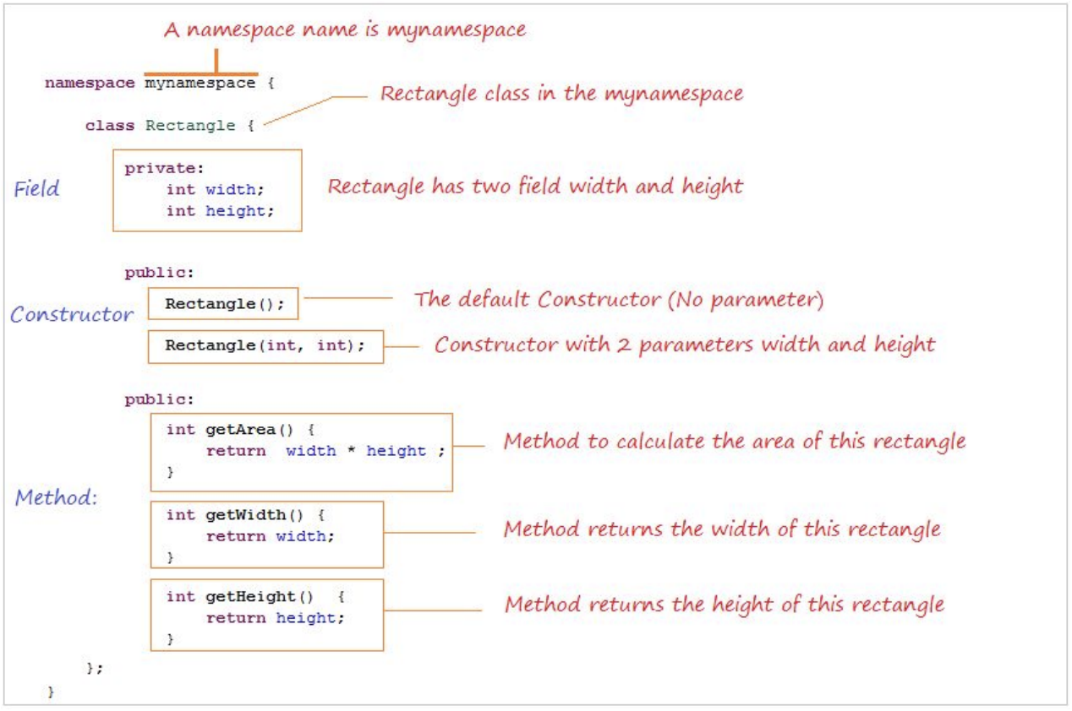
Anatomy of C++ Class
Rectangle.h

Slide 17
Access Control
Access modifiers for members:
public: accessible to all parts of the program
private: accessible to the member functions of the class
Private to class, not object instances
protected: accessible to member functions of the class and any derived classes (subclasses – more to come, later)
Reminders:
Access modifiers apply to all members that follow until another access modifier is reached
If no access modifier is specified, struct members default to public and class members default to private

Slide 18
Class Definition (Member declaration)
Point.h
#ifndef POINT_H_
#define POINT_H_
class Point {
public:
Point(const int x, const int y); // constructor
int get_x() const { return x_; } // inline member function
int get_y() const { return y_; } // inline member function
double Distance(const Point& p) const; // member function
void SetLocation(const int x, const int y); // member function
private:
int x_; // data member
int y_; // data member
}; // class Point
#endif // POINT_H_

Slide 19
Class Member Definition
Point.cpp
#include <cmath>
#include "Point.h"
Point::Point(const int x, const int y) {
x_ = x;
this->y_ = y; // "this->" is optional unless name conflicts
}
double Point::Distance(const Point& p) const {
// We can access p’s x_ and y_ variables either through the
// get_x(), get_y() accessor functions or the x_, y_ private
// member variables directly, since we’re in a member
// function of the same class.
double distance = (x_ - p.get_x()) * (x_ - p.get_x());
distance += (y_ - p.y_) * (y_ - p.y_);
return sqrt(distance);
}
void Point::SetLocation(const int x, const int y) {
x_ = x;
y_ = y;
}

Slide 20
Class Usage
usePoint.cpp
#include <iostream>
#include "Point.h"
using namespace std;
int main(int argc, char** argv) {
Point p1(1, 2); // allocate a new Point on the Stack
Point p2(4, 6); // allocate a new Point on the Stack
cout << "p1 is: (" << p1.get_x() << ", ";
cout << p1.get_y() << ")" << endl;
cout << "p2 is: (" << p2.get_x() << ", ";
cout << p2.get_y() << ")" << endl;
cout << "dist : " << p1.Distance(p2) << endl;
return 0;
}
To allocate on the heap use the “new” keyword
Point* p1 = new Point(1, 2);

Slide 21
Constructors in C++
A constructor (ctor) initializes a newly-instantiated object
A class can have multiple constructors that differ in parameters
Which one is invoked depends on how the object is instantiated
Written with the class name as the method name:
Point(const int x, const int y);
C++ will automatically create a synthesized default constructor if you have no user-defined constructors
Takes no arguments and calls the default ctor on all non-“plain old data” (non-POD) member variables
Synthesized default ctor will fail if you have non-initialized const or reference data members
4 different types of constructors
default constructor – takes zero arguments. If you don’t define any constructors the compiler will generate one of these for you (just like Java)
copy constructor – takes a single parameter which is a const reference(const T&) to another object of the same type, and initializes the fields of the new object as a copy of the fields in the referenced object
user-defined constructors – initialize fields and take whatever arguments you specify
conversion constructors – implicit, take a single argument. If you want a single argument constructor that is not implicit must use the keyword “explicit” like: explicit String(const char* raw);

Slide 22
Synthesized Default Constructor
SimplePoint.h
class SimplePoint {
public:
// no constructors declared!
int get_x() const { return x_; } // inline member function
int get_y() const { return y_; } // inline member function
double Distance(const SimplePoint& p) const;
void SetLocation(int x, int y);
private:
int x_; // data member
int y_; // data member
}; // class SimplePoint
SimplePoint.cpp
#include "SimplePoint.h"
... // definitions for Distance() and SetLocation()
int main(int argc, char** argv) {
SimplePoint x; // invokes synthesized default constructor
return EXIT_SUCCESS;
}

Slide 23
Synthesized Default Constructor
If you define any constructors, C++ assumes you have defined all the ones you intend to be available and will not add any others
#include "SimplePoint.h"
// defining a constructor with two arguments
SimplePoint::SimplePoint(const int x, const int y) {
x_ = x;
y_ = y;
}
void foo() {
SimplePoint x; // compiler error: if you define any
// ctors, C++ will NOT synthesize a
// default constructor for you.
SimplePoint y(1, 2); // works: invokes the 2-int-arguments
// constructor
}

Slide 24
Overloading Constructors
#include "SimplePoint.h"
// default constructor
SimplePoint::SimplePoint() {
x_ = 0;
y_ = 0;
}
// constructor with two arguments
SimplePoint::SimplePoint(const int x, const int y) {
x_ = x;
y_ = y;
}
void foo() {
SimplePoint x; // invokes the default constructor
SimplePoint y(1, 2); // invokes the 2-int-arguments ctor
SimplePoint a[3]; // invokes the default ctor 3 times
}

Slide 25
Copy Constructors
C++ has the notion of a copy constructor (cctor)
Used to create a new object as a copy of an existing object
Initializer lists can also be used in copy constructors
initializes a new bag of bits (new variable or parameter)
assignment (=) replaces an existing value with a new one
may need to clean up old state (free heap data?)
Point::Point(const int x, const int y) : x_(x), y_(y) { }
// copy constructor
Point::Point(const Point& copyme) {
x_ = copyme.x_;
y_ = copyme.y_;
}
void foo() {
Point x(1, 2); // invokes the 2-int-arguments constructor
Point y(x); // invokes the copy constructor
Point z = y; // also invokes the copy constructor
}

Slide 26
Synthesized Copy Constructor
If you don’t define your own copy constructor, C++ will synthesize one for you
It will do a shallow copy of all of the fields (i.e. member variables) of your class
Sometimes the right thing; sometimes the wrong thing
#include "SimplePoint.h"
... // definitions for Distance() and SetLocation()
int main(int argc, char** argv) {
SimplePoint x;
SimplePoint y(x); // invokes synthesized copy constructor
...
return EXIT_SUCCESS;
}

Slide 27
When Do Copies Happen?
The copy constructor is invoked if:
You initialize an object from another object of the same type:
You pass a non-reference object as a value parameter to a function:
You return a non-reference object value from a function:
Point x; // default ctor
Point y(x); // copy ctor
Point z = y; // copy ctor
void foo(Point x) { ... }
Point y; // default ctor
foo(y); // copy ctor
Point foo() {
Point y; // default ctor
return y; // copy ctor
}

Slide 28
Initialization Lists
C++ lets you optionally declare an initialization list as part of a constructor definition
Initializes fields according to parameters in the list
The following two are (nearly) identical:
Point::Point(const int x, const int y) {
x_ = x;
y_ = y;
std::cout << "Point constructed: (" << x_ << ",";
std::cout << y_<< ")" << std::endl;
}
// constructor with an initialization list
Point::Point(const int x, const int y) : x_(x), y_(y) {
std::cout << "Point constructed: (" << x_ << ",";
std::cout << y_<< ")" << std::endl;
}

Slide 29
Initialization vs Construction
Data members in initializer list are initialized in the order they are defined in the class, not by the initialization list ordering
Data members that don’t appear in the initialization list are default initialized/constructed before body is executed
Initialization preferred to assignment to avoid extra steps
Never mix the two styles
class Point3D {
public:
// constructor with 3 int arguments
Point3D(const int x, const int y, const int z) : y_(y), x_(x) {
z_ = z;
}
private:
int x_, y_, z_; // data members
}; // class Point3D
First, initialization list is applied.
Next, constructor body is executed.

Slide 30
Destructors
C++ has the notion of a destructor (dtor)
Like “free” in c. In fact, invokes free under the hood to clean up when freeing memory
Invoked automatically when a class instance is deleted, goes out of scope, etc. (even via exceptions or other causes!)
Do not need to call destructors explicitly
Place to put your cleanup code – free any dynamic storage or other resources owned by the object
Standard C++ idiom for managing dynamic resources
Slogan: “Resource Acquisition Is Initialization” (RAII)
Point::~Point() { // destructor
// do any cleanup needed when a Point object goes away
// (nothing to do here since we have no dynamic resources)
}

Slide 31
Nonmember Functions
“Nonmember functions” are just normal functions that happen to use some class
Called like a regular function instead of as a member of a class object instance
These do not have access to the class’ private members
Useful nonmember functions often included as part of interface to a class
Declaration goes in header file, but outside of class definition
A class can give a nonmember function (or class) access to its non-public members by declaring it as a friend within its definition
Not a class member, but has access privileges as if it were
friend functions are usually unnecessary if your class includes appropriate “getter” public functions
class Complex {
...
friend std::istream& operator>>(std::istream& in, Complex& a);
...
}; // class Complex
Complex.cpp
std::istream& operator>>(std::istream& in, Complex& a) {
...
}
Complex.h

Slide 32
Questions

Slide 33
RAII
char* return_msg_c() {
int size = strlen("hello") + 1;
char* str = malloc(size);
strncpy(str, "hello", size);
return str;
}
"Resource Acquisition is Initialization"
Design pattern at the core of C++
When you create an object, acquire resources
Create = constructor
Acquire = allocate (e.g. memory, files)
When the object is destroyed, release resources
Destroy = destructor
Release = deallocate
When used correctly, makes code safer and easier to read
std::string return_msg_cpp() {
std::string str("hello");
return str;
}
using namespace std;
char* s1 = return_msg_c();
cout << s1 << endl;
string s2 = return_msg_cpp();
cout << s2 << endl;

Slide 34
Compiler Optimization
The compiler sometimes uses a “return by value optimization” or “move semantics” to eliminate unnecessary copies
Sometimes you might not see a constructor get invoked when you might expect it
Point foo() {
Point y; // default ctor
return y; // copy ctor? optimized?
}
Point x(1, 2); // two-ints-argument ctor
Point y = x; // copy ctor
Point z = foo(); // copy ctor? optimized?

Slide 35
Namespaces
Each namespace is a separate scope
Useful for avoiding symbol collisions!
Namespace definition:
namespace name { // declarations go here }
Doesn’t end with a semi-colon and doesn’t add to the indentation of its contents
Creates a new namespace name if it did not exist, otherwise adds to the existing namespace (!)
This means that components (e.g. classes, functions) of a namespace can be defined in multiple source files
Namespaces vs classes
They seems somewhat similar, but classes are not namespaces:
There are no instances/objects of a namespace; a namespace is just a group of logically-related things (classes, functions, etc.)
To access a member of a namespace, you must use the fully qualified name (i.e. nsp_name::member)
Unless you are using that namespace
You only used the fully qualified name of a class member when you are defining it outside of the scope of the class definition

Slide 36
Const
C++ introduces the “const” keyword which declares a value that cannot change
const int CURRENT_YEAR = 2020;

