Slide 1
Lecture 19: Git!
CSE 374: Intermediate Programming Concepts and Tools

Slide 2
QUICK RECAP

Slide 3
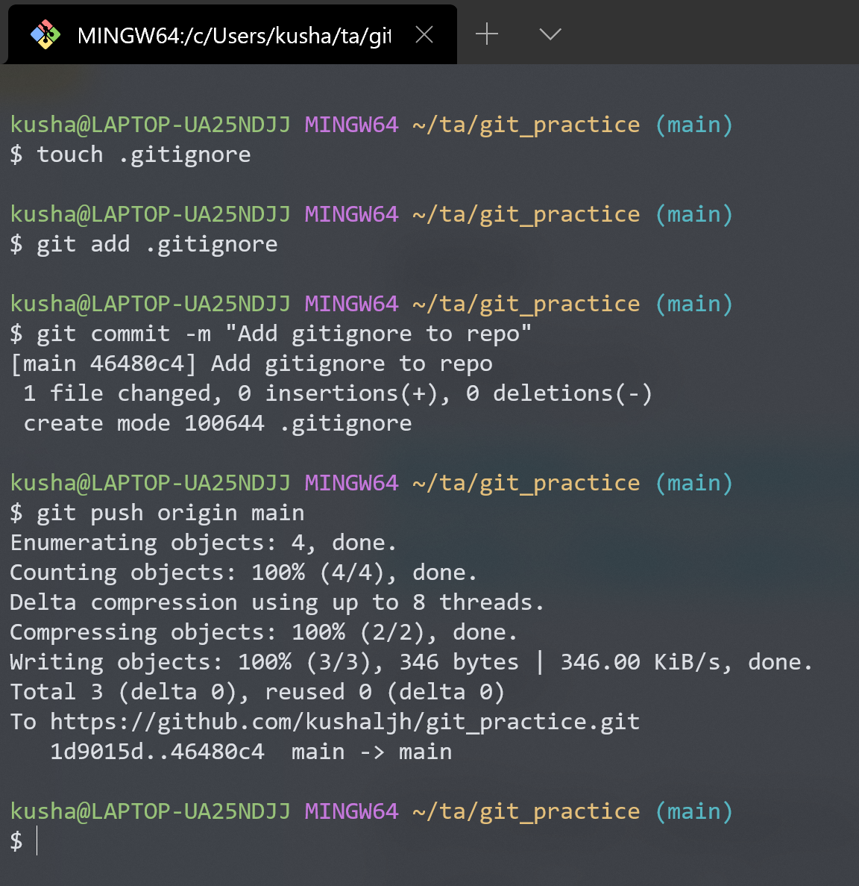
Some “git” commands
git init
Create a new empty git repo or convert an existing folder to a git repo
git add
Preparing edited files to be saved (committed) to a repo
git commit
Records (saves) changes to a repo
Accompanied by a short descriptive message
git push
Update the remote copy of the repo with the local changes and commits

Slide 4
Staging and committing overview
git init
Working changes
Staging area
git repo
git add .
git commit –m “message”

Slide 5
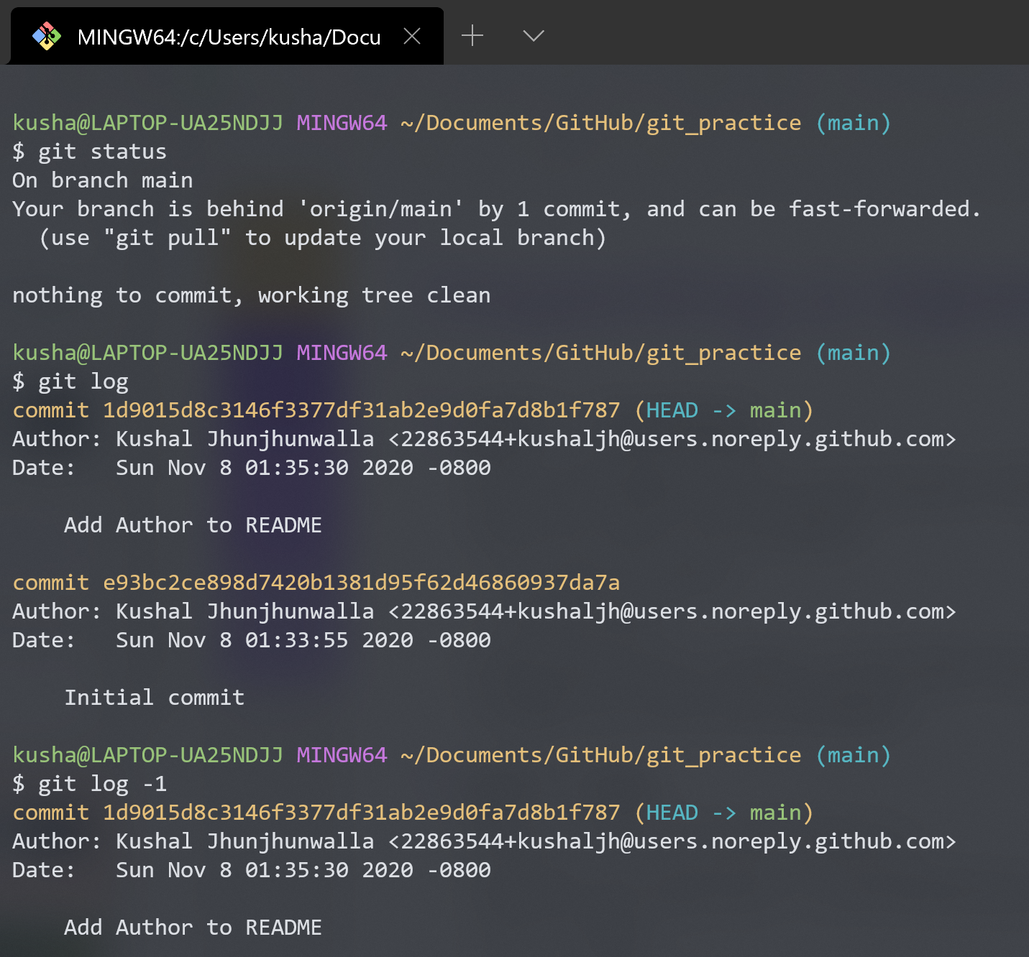
Inspecting a repository
git status
Lists the files which you have changed but not yet committed
Working directory
Staging area
Indicates how many commits have made but not yet pushed
git log
Shows the commit history
git log –graph --oneline
Shows branch info as a graph

Slide 6
Working with remote

Slide 7
git commands for interaction with remote
git clone
Cloning is the process of creating a working copy of the remote or local repository by passing the following command.
git clone username@git_server_hostname:/path_of_repository
git pull
If we have already cloned the repository and need to update local (only code) respect to the remote server
git pull origin main
git fetch
Fetching is the process of updating (only git information) the local git structure and information from remote repository
git fetch

Slide 8
Updating changes using pull
git pull

Slide 9
What’s next!
Branching, checkout
Merging, Merge (Pull) Requests
Conflicts
Interacting with a Git Server (GitHub / GitLab)

Slide 10
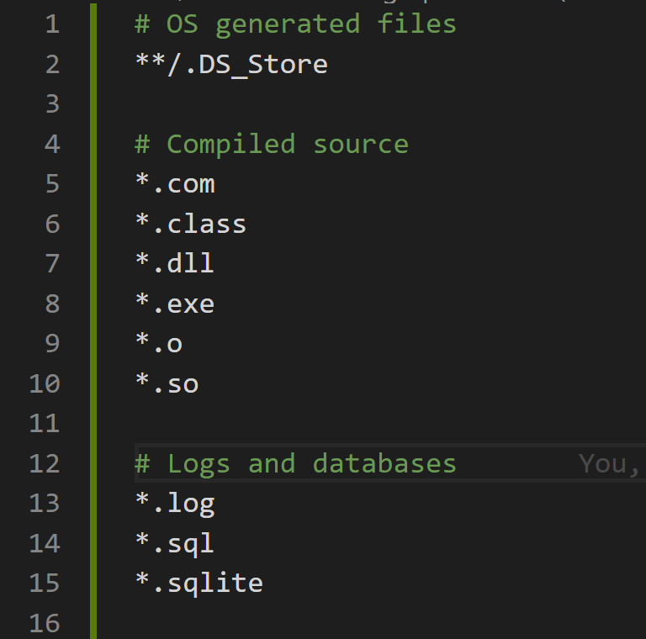
Skipping files using .gitignore
As a recap, generally we should not have these files in a git repo:
Object files (i.e. .class files, .o files) and executables
Huge media files (e.g. videos)
Credentials and system files (e.g. .DS_Store in Mac)
Its tedious to mention all the files you want to add into a repo every time you add your changes (and ensure you skip the others)
To skip above files you can create a file in the root of the git repo folder called .gitignore
This file should contain patterns in file names you would like to skip being added
https://github.com/github/gitignore

Slide 11
Working with a Git server
GitHub

Slide 12
GitHub profile

Slide 13
Creating a new repo on GitHub

Slide 14
Creating a new repo on GitHub

Slide 15
Creating a new repo on GitHub

Slide 16
Adding local files to the GitHub server

Slide 17
Checking the changes on GitHub

Slide 18
Branching

Slide 19
Collaboration - the ideal case
3 Collaborators
Kasey makes a change and updates the repo (git push)
Kalyani gets Kasey’s changes (git pull), edits some files and updates the repo (git push)
Kushal gets the latest changes that include both Kasey and Kalyani’s changes (git pull)
This goes on…
Ku
Kl
Ky
…

Slide 20
But …

Slide 21
Collaboration - the reality
3 Collaborators
Kasey makes a change and updates the repo
Kalyani and Kushal get Kasey’s changes, edit some files and Kalyani updates the repo while Kushal is still working on some edits
And here you see different people having different version histories
Kl
Ku
Ky
…

Slide 22
Error!!

Slide 23
Error!!

Slide 24
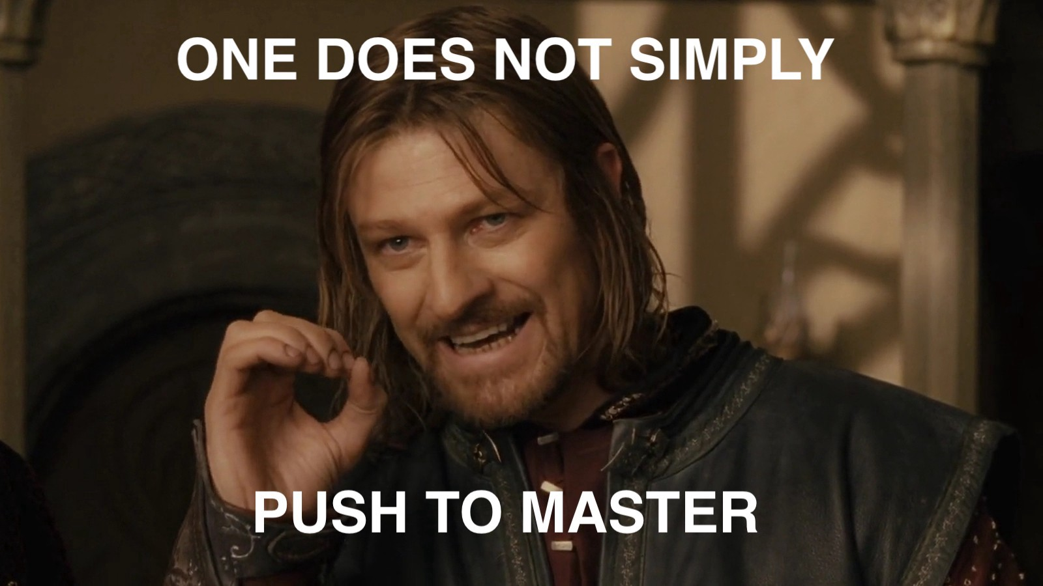

Slide 25
Git Branches
The scenario mentioned in the previous slides would be tough to solve if we used a single history across all collaborators.
Instead you can start your own history at any point by “branching” out of the main history for a repo
The master / main branch which is central history and hence the source of truth for the whole project
We create new version histories based on the main branch and give each of these a branch name
dev-kushal
Kl
Ku
Ky
…
master

Slide 26
Git Branches
Kushal’s improved workflow using branches!
Kushal creates a new branch called dev-kushal when she starts working
git branch dev-kushal
git checkout dev-kushal
OR
git checkout –b dev-kushal
Now she makes commits on this branch until she is ready to update master
dev-kushal
Kl
Ku
Ky
…
master

Slide 27
Git Merge
After Kushal is done with her work, she would like the changes from her branch dev-kushal be reflected in the master branch
Steps:
git checkout master
git merge dev-Kushal
If there are no changes that are made in the same lines by Kalyani and Kushal there are no conflicting differences, and the merge is good to go
If not, WE HAVE A MERGE CONFLICT!
Note: this is not the only workflow used for merging
M
Kl
Ku
dev-kushal
Ky
…
master

Slide 28
PULL before you start working!!

Slide 29
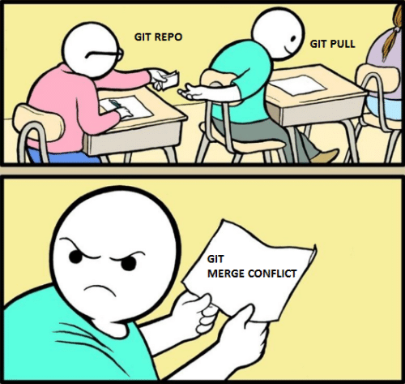

Slide 30
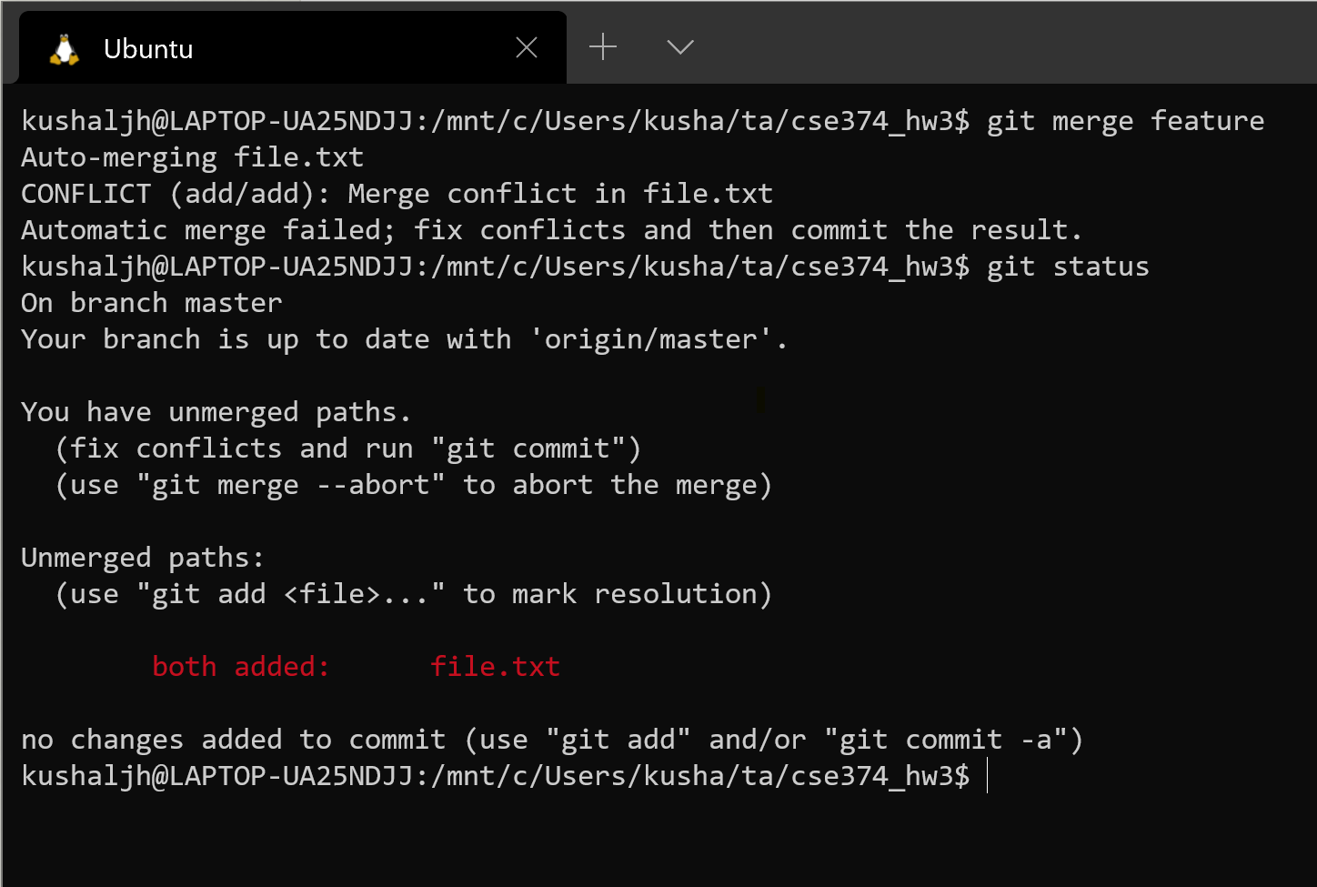
Merge conflicts
Merge conflicts happen when you are merging two branches that have a diff on the same line(s) of some file(s) in a repo
When running merge we run into an error in such a scenario

Slide 31
Looking for the conflict

Slide 32
Resolving the conflict

Slide 33
Checking the status

Slide 34
Adding resolved file and saving

Slide 35
Conflict resolved!!

Slide 36
Merge (Pull) Requests
This was nice to know but we generally do not merge branches into master locally
We use a Git server – GitHub / GitLab – to create a request to merge a feature branch into master
We must ensure that everyone on the project agrees to what is present in the master branch as this is our source of truth that everyone shares
The workflow is as follows:
Create a new branch
Add and commit changes to the branch and push it to GitHub
Create a Pull Request on GitHub
Other collaborators look at the PR and leave their feedback (this is generally called a Code Review)
Fix issues and then merge

Slide 37
Sample Pull Request

Slide 38
Working with branches & more
DEMO

Slide 40
Useful resources
Try Git (resources and tutorial)
The Git Cheat Sheet
Stack Overflow’s definitive guide for beginners
When you are terribly stuck with git
DO NOT PANIC! Even experienced developers get stuck with git issues
https://ohshitgit.com/
https://stackoverflow.com/questions/tagged/git

