Slide 1
Lecture 18: Git!
CSE 374: Intermediate Programming Concepts and Tools

Slide 2
Administrivia
HW 3 posted later today -> Extra credit due date Wednesday Nov 18th @ 9pm
HW 4 out Monday Nov 16th -> Extra credit due date Wednesday Nov 25th @ 9pm
HW 5 out Monday November 30th -> Extra credit due date Wednesday Dec 5th @ 9pm
HW 6 out Monday Dec 7th, Due end of quarter
Review Assignment #2 out Friday Nov 13th, Due Friday Nov 20th @ 9pm
Review Assignment #3 out Wednesday Dec 9th , Due end of quarter
End of quarter due date Wednesday December 16th @ 9pm

Slide 3
Does your file system look like this?

Slide 4
Issues faced
Multiple copies of the same files
Changes leading to scripts being broken with no way to go back
Accidental deletion of files
Lost computer leads to loss of files
Collaboration on a project can be difficult if each collaborator has their own copy

Slide 5
Version Control to the rescue!
Version control is software that keeps track of changes to a set of files
Version control enables multiple people to simultaneously work on a single project.
Places we see version control:
Microsoft Word allows us to undo our most recent changes (go back to a previous version)
In Google Docs you can see the version history of files, see who made these changes and revert back
You (hopefully) back up your computer to a cloud storage like Google Drive or Dropbox
Gradescope also allows you to look at your previous submission
Notes:
* Each person edits his or her own copy of the files and chooses when to share those changes with the rest of the team. Thus, temporary or partial edits by one person do not interfere with another person's work. Version control also enables one person you to use multiple computers to work on a project, so it is valuable even if you are working by yourself.

Slide 6
Version Control in Gradescope

Slide 7
Decentralized vs centralized storage
Remote Copy
Collaborator 1
Collaborator 3
Collaborator 1
Collaborator 3
Collaborator 2
Collaborator 2

Slide 8
Intro to Git
Git is a version control system optimized for text-based files
Git $≠$ GitHub
"origin" copy of the repo is stored on a Git server
The remote repository is the defacto central repository
Remote repositories are hosted on services like GitHub, Gitlab, or Bitbucket
Everyone shares changes by pushing their changes and pulling others' changes

Slide 9
Repository
A repository, commonly referred to as a repo, is a location where a project lives
Each collaborator has a copy of a repository for the project which they sync with the central copy
What should be inside of a repository?
Source code files (i.e. .c files, .java files, etc)
Build files (Makefiles, build.xml)
Images, general resources files
What should not be inside of a repository (generally)
Object files (i.e. .class files, .o files)
Executables
Huge media files (e.g. videos)
Any application credentials
System files (e.g. .DS_Store in Mac)

Slide 10
A repository's history is a series of "commits"
Each commit makes changes to the files in the repo
Commit history serves as a log of the changes everyone made
Commits are easy, and free! Commit early and often.
Ever accidentally deleted something and forgot what it was?
If you make a mistake, you can look at the changes since the last commit

Slide 11
What is a “commit”?
A "commit" is a single set of changes made to your repository
Essentially a version of the project you want to save
Also records:
The name of the author
The date and time
A "commit message": short sentence describing what that commit did
Identified by an ID, or "SHA"

Slide 12
Phases of Git
Notes:
Staging area has the changes that you want to save and not all changes as there may be some testing code that you do not want to share with others and therefore not want it to be reflected in the repo.

Slide 13
Phases of Git

Slide 14
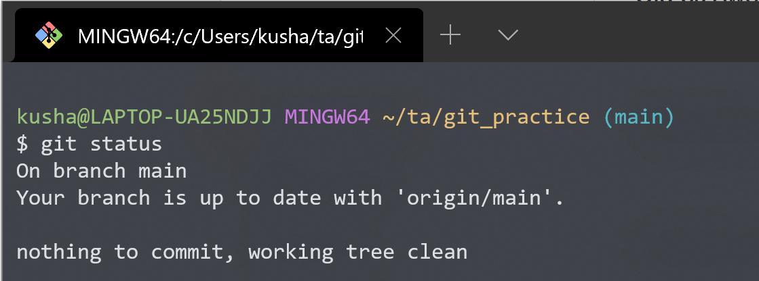
“git” command
The "git" command is the primary way of interacting with git
You must "cd" into the folder where your repo is stored, or any subfolder within it
Used like any other shell command!
There is a GUI available for most companies (e.g. GitHub Desktop)
Must be installed on your computer (already installed on klaatu)

Slide 15
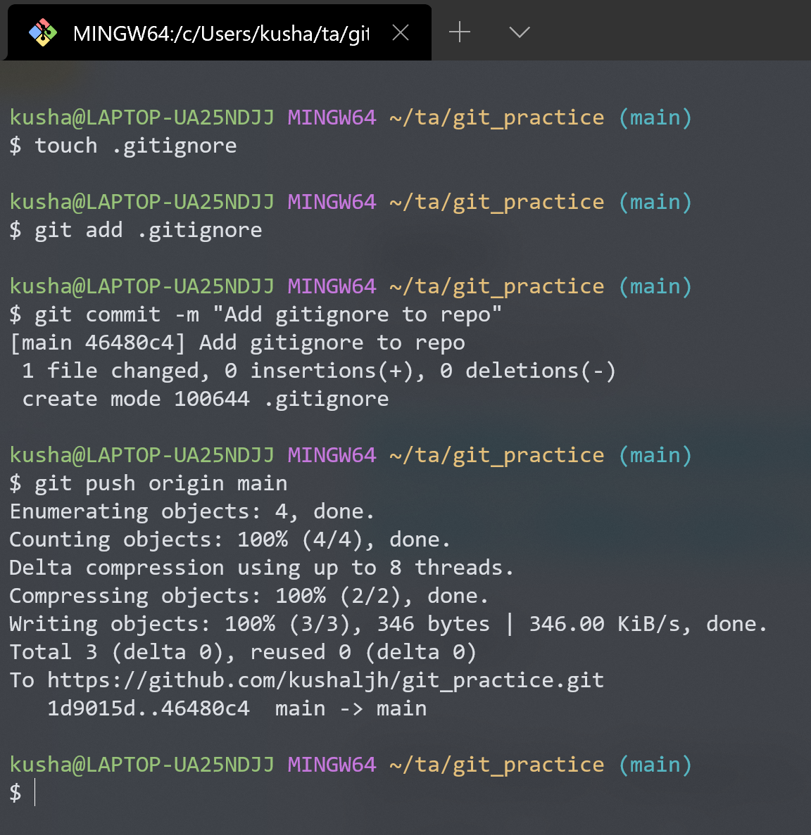
Some “git” commands
git init
Create a new empty git repo or convert an existing folder to a git repo
git add
Preparing edited files to be saved (committed) to a repo
git commit
Records (saves) changes to a repo
Accompanied by a short descriptive message
git push
Update the remote copy of the repo with the local changes and commits

Slide 16
Phases of Git

Slide 17
Staging and committing overview

Slide 18
Staging and committing overview
git init

Slide 19
Staging and committing overview
git init
git repo

Slide 20
Staging and committing overview
git init
Working changes
git repo

Slide 21
Staging and committing overview
git init
Working changes
Staging area
git repo
git add .

Slide 22
Staging and committing overview
git init
Working changes
Staging area
git repo
git add .
git commit –m “message”

Slide 23
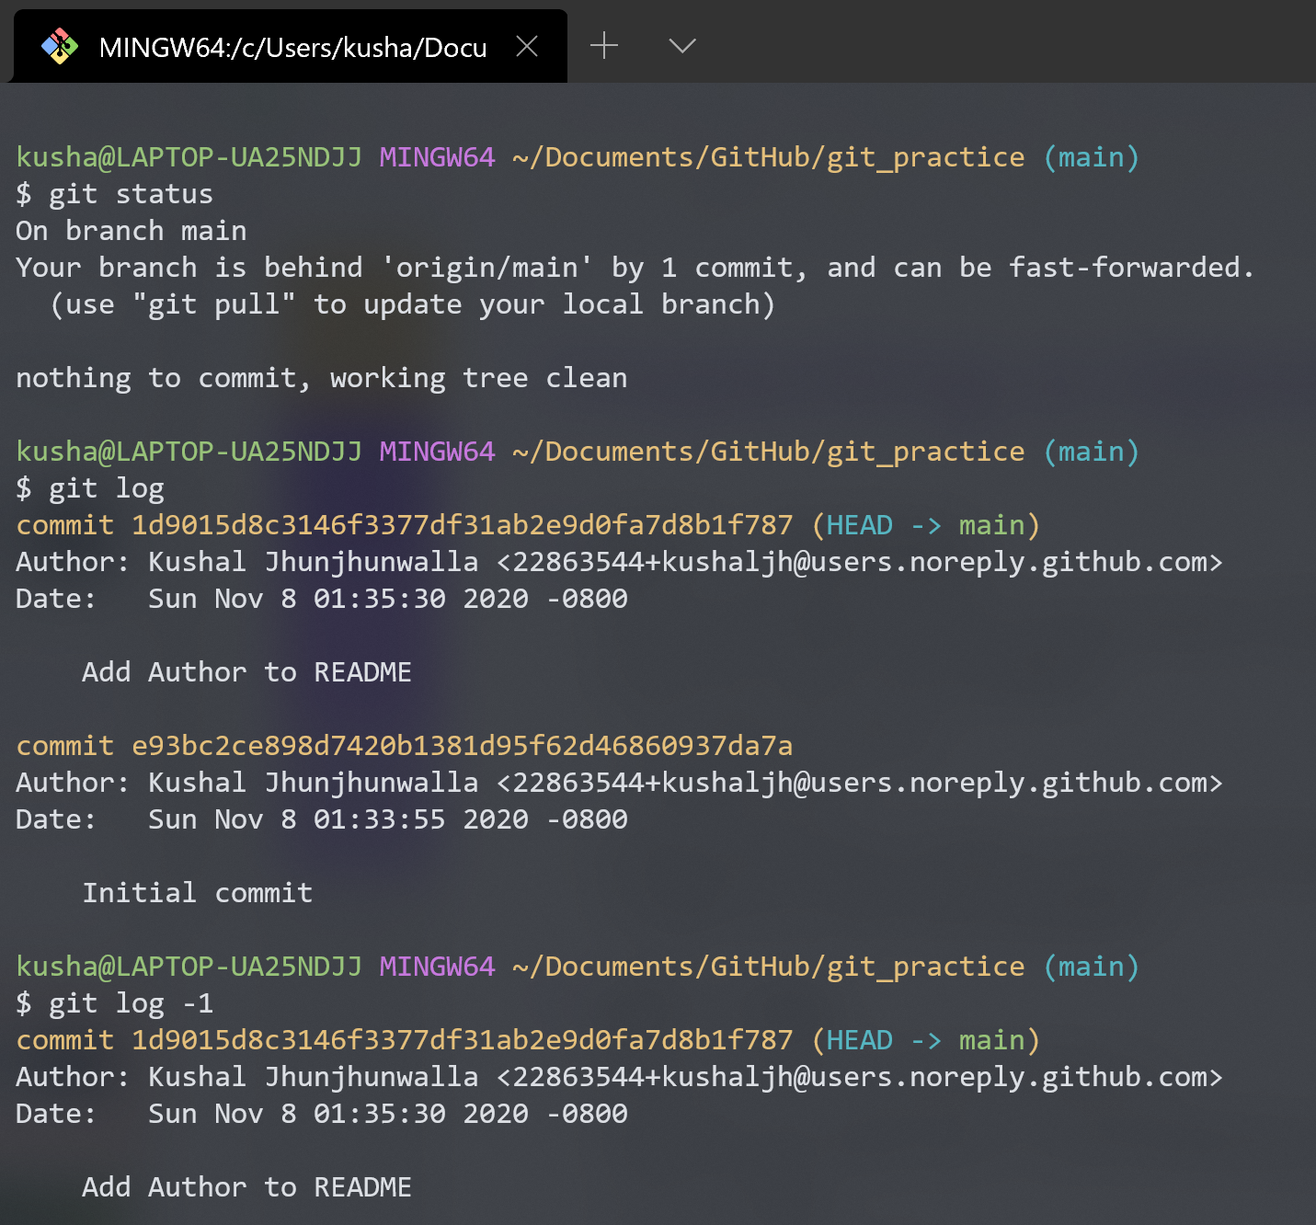
Inspecting a repository
git status
Lists the files which you have changed but not yet committed
Working directory
Staging area
Indicates how many commits have made but not yet pushed
git log
Shows the commit history
Option to see last n commits by adding –<n> flag
Press "q" to exit

Slide 24
Working with git locally
DEMO

Slide 25
Reference: Demo commands
mkdir test_git
cd test_git
git status
git init
touch file.txt
git status
git add file.txt
git status
git commit -m "Add first file"
git status

Slide 26
Working with remote

Slide 27
git commands for interaction with remote
git clone
Cloning is the process of creating a working copy of the remote or local repository by passing the following command.
git clone username@git_server_hostname:/path_of_repository
git pull
If we have already cloned the repository and need to update local (only code) respect to the remote server
git pull origin main
git fetch
Fetching is the process of updating (only git information) the local git structure and information from remote repository
git fetch

Slide 28
Updating changes using pull
git pull

Slide 29
What’s next!
Branching, checkout
Merging, Merge (Pull) Requests
Conflicts
Interacting with a Git Server (GitHub / GitLab)

Slide 30
Complete working (including fork)

Slide 31
Useful resources
Try Git (resources and tutorial)
The Git Cheat Sheet
Stack Overflow’s definitive guide for beginners
When you are terribly stuck with git
DO NOT PANIC! Even experienced developers get stuck with git issues
https://ohshitgit.com/
https://stackoverflow.com/questions/tagged/git

