Slide 1
Lecture 17: Memory Architecture
Lecture Participation Poll #17
Log onto pollev.com/cse374
Or
Text CSE374 to 22333
CSE 374: Intermediate Programming Concepts and Tools

Slide 2
Administrivia
Be kind to yourself and one another ☺
Reminder: Midpoint Deadline Friday November 6th at 9pm PST

Slide 3
Thought experiment
public int sum1(int n, int m, int[][] table) {
int output = 0;
for (int i = 0; i < n; i++) {
for (int j = 0; j < m; j++) {
output += table[i][j];
}
}
return output;
}
public int sum2(int n, int m, int[][] table) {
int output = 0;
for (int i = 0; i < n; i++) {
for (int j = 0; j < m; j++) {
output += table[j][i];
}
}
return output;
}
What do these two methods do?
What is the big-Θ
Θ(n*m)

Slide 4
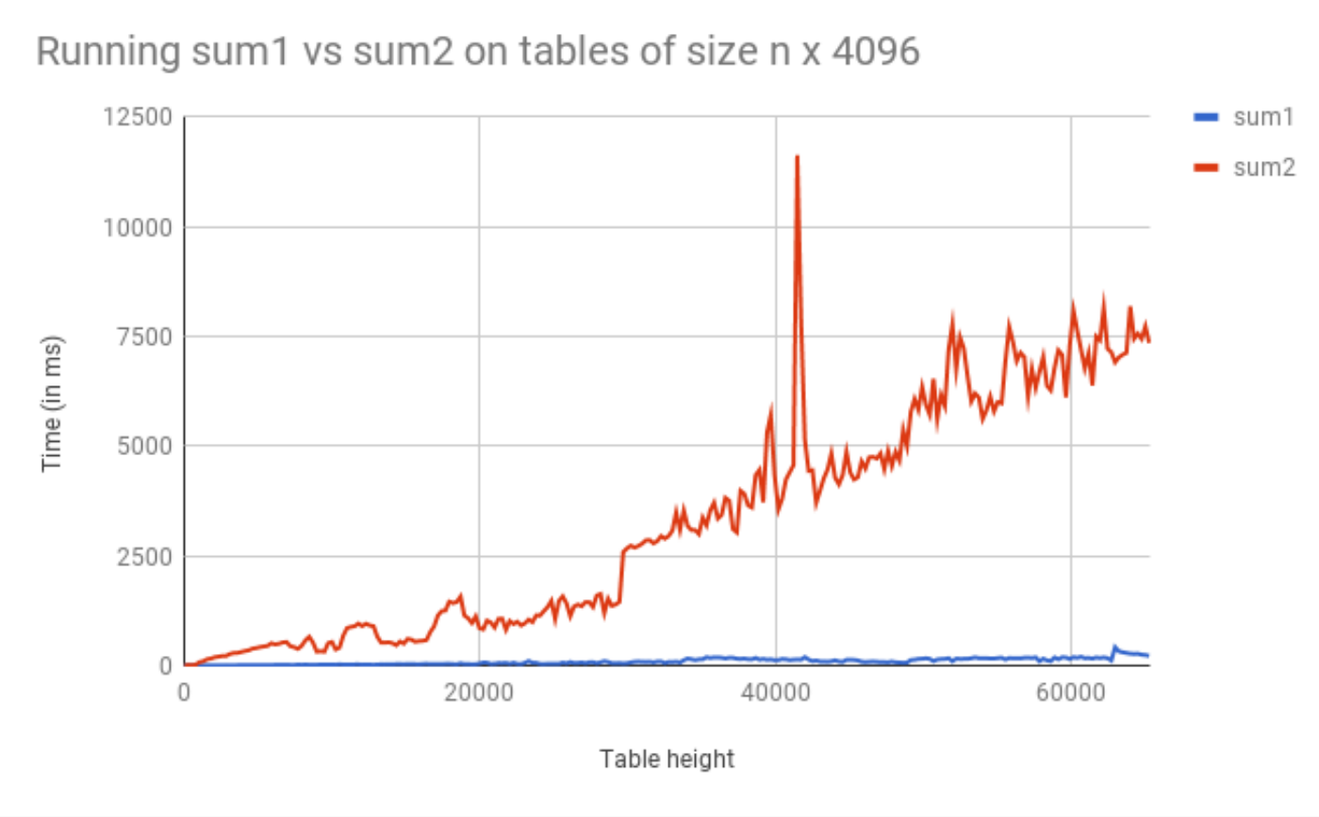
Thought Experiment Graphed

Slide 5
Incorrect Assumptions
Lies!
Accessing memory is a quick and constant-time operation
Sometimes accessing memory is cheaper and easier than at other times
Sometimes accessing memory is very slow

Slide 6
Memory Architecture
What is it? | Typical Size | Time
The brain of the computer! | 32 bits | ≈free
Extra memory to make accessing it faster | 128KB | 0.5 ns
Extra memory to make accessing it faster | 2MB | 7 ns
Working memory, what your programs need | 8GB | 100 ns
Large, longtime storage | 1 TB | 8,000,000 ns
CPU Register
L1 Cache
L2 Cache
RAM
Disk
Notes:
1 ns vs 8,000,000 is like 1 sec vs 3 months
It’s faster to do:
5 million arithmetic ops than 1 disk access
2500 L2 cache accesses than 1 disk access
400 RAM accesses than 1 disk access

Slide 7
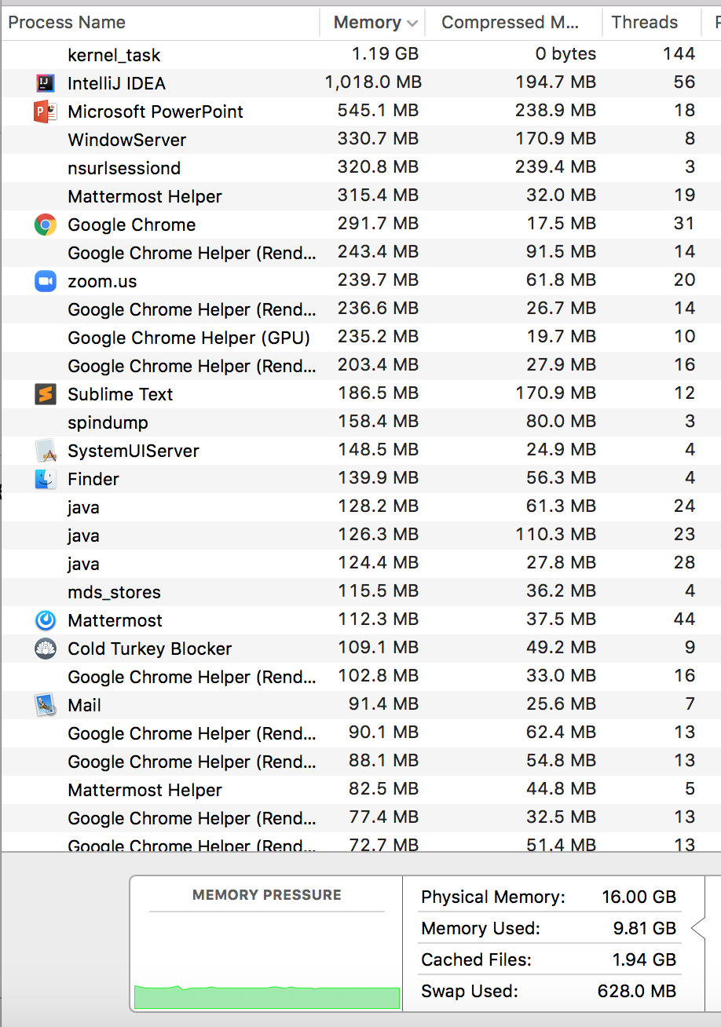
RAM (Random-Access Memory)
- RAM is where data gets stored for the programs you run. Think of it as the main memory storage location for your programs.
- RAM goes by a ton of different names: memory, main memory, RAM are all names for this same thing.
Notes:
RAM is a term frequently mentioned when purchasing computers and looking at the hardware details. For us programmers, RAM is the physical location where data gets stored for the programs we run. It’s the main location for data structures, variables, method calls, etc. that we create in our programs. When you look at this screenshot saying how much memory is being used, it’s talking about how much RAM. Somewhat frequently when things say ‘memory’ it really means RAM.

Slide 8
RAM can be represented as a huge array
This is a main takeaway
RAM:
addresses, storing stuff at specific locations
random access
Arrays
indices, storing stuff at specific locations
random access
=
If you’re interested in deeper than this : https://www.youtube.com/watch?v=fpnE6UAfbtU or take some EE classes?
CSE 373 SP 20- Zach Chun
Notes:
It turns out that for computer scientists / programming, we don’t have to know about the circuits and electricity that makes this green blob computer chip works. Luckily for us RAM can be thought of as a very big array -- this is how we should thing about RAM in our programs for us to be able to take advantage of it / understand how our programs interact with it.
RAM can be thought of as an array for 2 reasons in particular
you think of RAM having spaces for you to store stuff, just like you would in an array … and it also has indices (but for memory its called addresses) that describe where in RAM / the array a particular piece of data is located
Also just because of this Random access thing – you might have heard this before but people sometimes describe arrays as random access because you can access any random index in an array equally to other indices / easily. It’s the same for RAM (the computer chip one) – all addresses are easily accessed as all the others

Slide 9
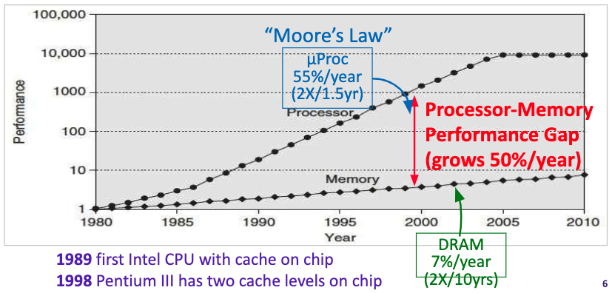
Processor – Memory Gap

Slide 10
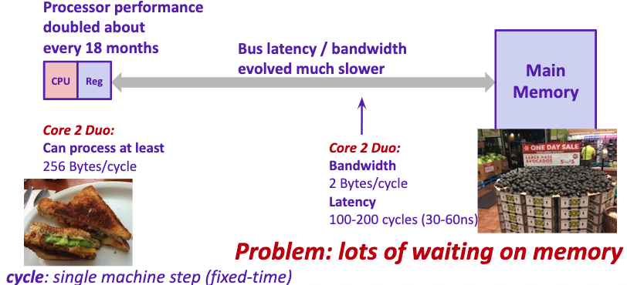
Problem: Processor-Memory Bottleneck

Slide 11
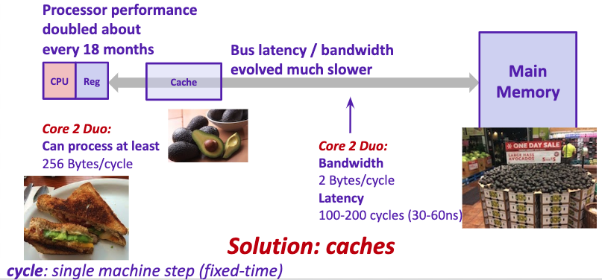
Problem: Processor-Memory Bottleneck

Slide 12
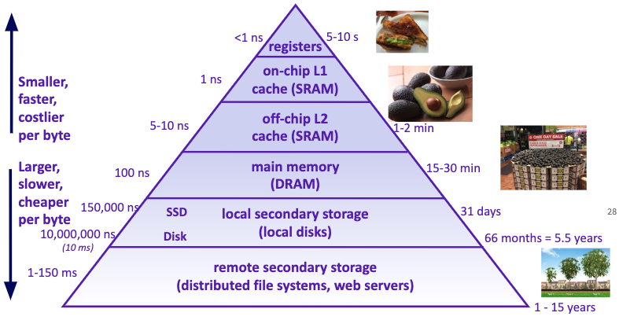
Example Memory Hierarchy

Slide 13
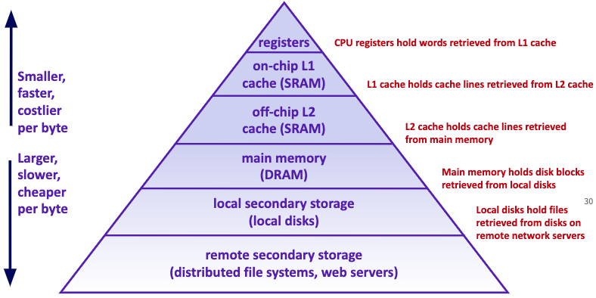
Example Memory Hierarchy

Slide 14
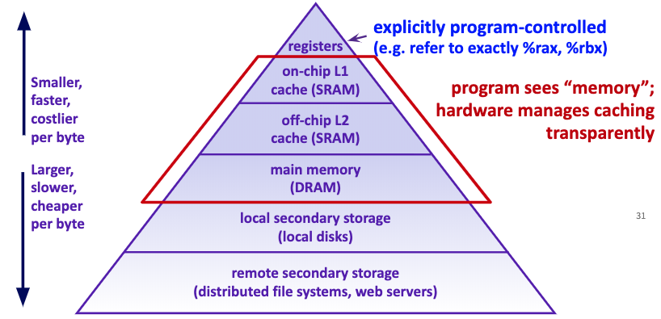
Example Memory Hierarchy

Slide 15
Review: Binary, Bits and Bytes
byte
The most commonly referred to unit of memory, a grouping of 8 bits
Can represent 265 different numbers (28)
1 Kilobyte = 1 thousand bytes (kb)
1 Megabyte = 1 million bytes (mb)
1 Gigabyte = 1 billion bytes (gb)
binary
A base-2 system of representing numbers using only 1s and 0s
- vs decimal, base 10, which has 9 symbols
bit
The smallest unit of computer memory represented as a single binary value either 0 or 1
Decimal | Decimal Break Down | Binary | Binary Break Down
0 | $$(0 ∗{10}^{0})$$ | 0 | $$(0 ∗2^{0})$$
1 | $$(1 ∗{10}^{0})$$ | 1 | $$(1∗2^{0})$$
10 | $$(1 ∗{10}^{1})+(0∗{10}^{0})$$ | 1010 | $$(1∗2^{3})+(0∗2^{2})+(1∗2^{1})+(0∗2^{0})$$
12 | $$(1 ∗{10}^{1})+(2∗{10}^{0})$$ | 1100 | $$(1∗2^{3})+(1∗2^{2})+(0∗2^{1})+(0∗2^{0})$$
127 | $$\left(1∗{10}^{2}\right)+(1 ∗{10}^{1})+(2∗{10}^{0})$$ | 01111111 | $$(0∗2^{7})+(1∗2^{6})+(1∗2^{5})+(1∗2^{4})(1∗2^{3})+(1∗2^{2})+(1∗2^{1})+(1∗2^{0})$$

Slide 16
Memory Architecture
Takeaways:
- the more memory a layer can store, the slower it is (generally)
- accessing the disk is very slow
Computer Design Decisions
Physics
Speed of light
Physical closeness to CPU
Cost
“good enough” to achieve speed
Balance between speed and space

Slide 17
Locality
How does the OS minimize disk accesses?
Spatial Locality
Computers try to partition memory you are likely to use close by
- Arrays
- Fields
Temporal Locality
Computers assume the memory you have just accessed you will likely access again in the near future

Slide 18
Leveraging Spatial Locality
When looking up address in “slow layer”
- bring in more than you need based on what’s near by
- cost of bringing 1 byte vs several bytes is the same
- Data Carpool!

Slide 19
Leveraging Temporal Locality
When looking up address in “slow layer”
Once we load something into RAM or cache, keep it around or a while
- But these layers are smaller
When do we “evict” memory to make room?

Slide 20
Moving Memory
Amount of memory moved from disk to RAM
- Called a “block” or “page”
≈4kb
Smallest unit of data on disk
Amount of memory moved from RAM to Cache
- called a “cache line”
≈64 bytes
Operating System is the Memory Boss
- controls page and cache line size
- decides when to move data to cache or evict

Slide 21
Example Revisited
public int sum1(int n, int m, int[][] table) {
int output = 0;
for (int i = 0; i < n; i++) {
for (int j = 0; j < m; j++) {
output += table[i][j];
}
}
return output;
}
public int sum2(int n, int m, int[][] table) {
int output = 0;
for (int i = 0; i < n; i++) {
for (int j = 0; j < m; j++) {
output += table[j][i];
}
}
return output;
}
Why does sum1 run so much faster than sum2?
sum1 takes advantage of spatial and temporal locality
0 | 1 | 2 | 3 | 4
0 | 1 | 2
‘a’ | ‘b’ | ‘c’
0 | 1 | 2
‘d’ | ‘e’ | ‘f’
0 | 1 | 2
‘g’ | ‘h’ | ‘i’
0 | 1 | 2
‘j’ | ‘k’ | ‘l’
0 | 1 | 2
‘m’ | ‘n’ | ‘o’

Slide 22
How memory is used and moves around
CSE 373 SP 20- Zach Chun
Notes:
Now that we understand the basics and can imagine memory just sitting there, we’re going to dive into how the computer uses RAM to actually run our programs.
But first… an analogy…. and we’re going to do this mad libs type thing.. can someone help me out and give me a number anywhere from 2 to 20?

Slide 23
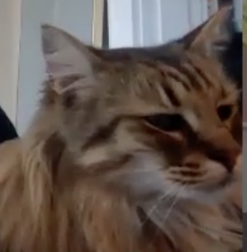
CSE 373 SP 20- Zach Chun
Notes:
Imagine you’re Mercy. Mercy has a problematic lifestyle where she eats a lot of tuna (maybe imagine 10 tuna fish) each day. This isn’t really a problem by itself, but it is when she has to travel to Safeway to get a tuna fish! How does Mercy go through this process?
Get hungry
Go to Safeway to get a tuna fish
Bring the tuna fish back home
Feel comfortable at home to eat the tuna fish
Get hungry again and repeat
Since Mercy is doing this multiple times every single day you can imagine that this gets very redundant. (The next few slides are all Mercy just repeating this). How can we improve this process and Mercy’s lifestyle? Skip to slide 35.

Slide 24
CSE 373 SP 20- Zach Chun

Slide 25
CSE 373 SP 20- Zach Chun

Slide 26
CSE 373 SP 20- Zach Chun

Slide 27
CSE 373 SP 20- Zach Chun

Slide 28
CSE 373 SP 20- Zach Chun

Slide 29
CSE 373 SP 20- Zach Chun

Slide 30
CSE 373 SP 20- Zach Chun

Slide 31
CSE 373 SP 20- Zach Chun

Slide 32
CSE 373 SP 20- Zach Chun

Slide 33
CSE 373 SP 20- Zach Chun

Slide 34
CSE 373 SP 20- Zach Chun

Slide 35
CSE 373 SP 20- Zach Chun

Slide 36
CSE 373 SP 20- Zach Chun

Slide 37
CSE 373 SP 20- Zach Chun

Slide 38
CSE 373 SP 20- Zach Chun

Slide 39
Solution to Mercy’s traveling problem
If we know Mercy is going to keep eating tuna . . . Why not buy a bunch during a single trip and save them all somewhere closer than the store?
Let’s get Mercy a refrigerator!
CSE 373 SP 20- Zach Chun

Slide 40
CSE 373 SP 20- Zach Chun
Notes:
If we bring a bunch of fish with Mercy back instead of just one… we can save the remaining Tuna fish for later! Even if we don’t eat them immediately they may be useful in the future. This is a key idea with caches.

Slide 41
CSE 373 SP 20- Zach Chun

Slide 42
CSE 373 SP 20- Zach Chun

Slide 43
Recap + connecting analogy back to computer
CSE 373 SP 20- Zach Chun

Slide 44
Before
CPU
CPU – kind of like the home / brain of your computer. Pretty much all computation is done here and data needs to move here to do anything significant with it (math, if checks, normal statement execution).
Data travels between RAM and the CPU, but it’s slow
RAM
CSE 373 SP 20- Zach Chun
Notes:
So in our analogy of Mercy and Safeway, there are a lot of parallels to how the computer actually works. RAM was like Safeway – that place that we have to travel to get some food (data) that we want. And it takes some medium amount of time to get there and back. Our house where we can eat food in computer-terms is the CPU (central processing unit) – which is like the brain of the computer. Pretty much all the computation needs to be done here (and we need the data located in the CPU before we can operate on it – like do math / if checks).

Slide 45
After
CPU
Cache!
Bring a bunch of food back when you go all the way to the store
Bring a bunch of data back when you go all the way to RAM
RAM
CSE 373 SP 20- Zach Chun
Notes:
So when we brought a bunch of food back with us for our refrigerator to store later… that act is just like how your computer automatically brings back a bunch of data when we go to RAM to store in our hardware cache.

Slide 46
Cache
Rough definition: a place to store some memory that’s smaller and closer to the CPU compared to RAM. Because caches are closer to the CPU (where your data generally needs to go to be computed / modified / acted on) getting data from cache to CPU is a lot quicker than from RAM to CPU. This means we love when the data we want to access is conveniently in the cache.
Generally we always store some data here in hopes that it will be used in the future and that we save ourselves the distance / time it takes to go to RAM.
Analogy from earlier: The refrigerator (a cache) in your house to store food closer to you than the store. Walking to your fridge is much quicker than walking to the store!
CSE 373 SP 20- Zach Chun

Slide 47
After
CPU
This is a big idea!
Cache!
Bring a bunch of food back when you go all the way to the store
Bring a bunch of data back when you go all the way to RAM
RAM
CSE 373 SP 20- Zach Chun

Slide 48
How is a bunch of memory taken from RAM?
This is a big idea (continued)!
Imagine you want to retrieve the 1 at index 4 in RAM
Your computer is smart enough to know to grab some of the surrounding data because computer designers think that it’s reasonably likely you’ll want to access that data too.
(You don’t have to do anything in your code for this to happen – it happens automatically every time you access data!)
To answer the title question, technically the term / units of transfer is in terms of ‘blocks’.
CSE 373 SP 20- Zach Chun

Slide 49
How is a bunch of memory taken from RAM? (continued)
CPU
original data (the 1) we wanted to look up gets passed back to the cpu
cache
all the data from the block gets brought to the cache
CSE 373 SP 20- Zach Chun

Slide 50
How does this pattern of memory grabbing affect our programs?
- This should have a major impact on programming with arrays. Say we access an index of an array that is stored in RAM. Because we grab a whole bunch of contiguous memory even when we just access one index in RAM, we’ll probably be grabbing other nearby parts of our array and storing that in our cache for quick access later.
Imagine that the below memory is just an entire array of length 13, with some data in it.
Just by accessing one element we bring the nearby elements back with us to the cache. In this case, it’s almost all of the array!
CSE 373 SP 20- Zach Chun

Slide 51
Another demo, but timed
https://repl.it/repls/MistyroseLinedTransformation
(takes about 15 seconds to run)
CSE 373 SP 20- Zach Chun

Slide 52
Appendix

