Slide 1
Lecture 15: Debugging in C
Lecture Participation Poll #15
Log onto pollev.com/cse374
Or
Text CSE374 to 22333
CSE 374: Intermediate Programming Concepts and Tools

Slide 2
Administrivia
Reminder: Midpoint Deadline Friday November 6th at 9pm PST
Will post grades to canvas sometime the week after

Slide 3
What is a Bug?
A bug is a difference between the design of a program and its implementation
Definition based on Ko & Meyers (2004)
We expected something different from what is happening
Examples of bugs
Expected factorial(5) to be 120, but it returned 0
Expected program to finish successfully, but crashed and printed "segmentation fault"
Expected normal output to be printed, but instead printed strange symbols

Slide 4
Debugging techniques
Comment out (or delete) code
tests to determine whether removed code was source of problem
Test one function at a time
Add print statements
Check if certain code is reachable
check current state of variables
test the edges
code often breaks at the beginning or end of the loop, the entry or exit of a function <- double check logic here
double check your logic in the odd/ rare exceptional case

Slide 5
Debugging Basics
Debugging strategies look like:
Describe a difference between expected and actual behavior
Hypothesize possible causes
Investigate possible causes (if not found, go to step 2)
Fix the code which was causing the bug
Vast majority of the time spent in steps 2 & 3

Slide 6
Hypothesize
Now, let's look at the code for factorial()
Select all the places where the error could be coming from
The if statement's "then" branch
The if statement's "else" branch
Somewhere else
int factorial(int x) {
if (x == 0) {
return x;
} else {
return x * factorial(x-1);
}
}

Slide 7
Investigate
Let's investigate the base case and recursive case
Base case is the "if then" branch
Recursive case is the "else" branch
int factorial(int x) {
if (x == 0) {
return x;
} else {
return x * factorial(x-1);
}
}
Case | Input | Math Equivalent | Expected | Actual
Base | factorial(0) | 0! = 1 | 1 | ???
Recursive | factorial(1) | 1! = 1 | 1 | ???
Recursive | factorial(2) | 2! = 1 * 2 | 2 | ???
Recursive | factorial(3) | 3! = 1 * 2 * 3 | 6 | ???

Slide 8
Investigate
One way to investigate is to write code to test different inputs
If we do this, we find that the base case has a problem
int factorial(int x) {
if (x == 0) {
return x;
} else {
return x * factorial(x-1);
}
}
Case | Input | Math Equivalent | Expected | Actual
Base | factorial(0) | 0! = 1 | 1 | 0
Recursive | factorial(1) | 1! = 1 | 1 | 0
Recursive | factorial(2) | 2! = 1 * 2 | 2 | 0
Recursive | factorial(3) | 3! = 1 * 2 * 3 | 6 | 0

Slide 9
Fix
int factorial(int x) {
if (x == 0) {
return x;
} else {
return x * factorial(x-1);
}
}
int factorial(int x) {
if (x == 0) {
return 1;
} else {
return x * factorial(x-1);
}
}
Case | Input | Math Equivalent | Expected | Actual
Base | factorial(0) | 0! = 1 | 1 | 1
Recursive | factorial(1) | 1! = 1 | 1 | 1
Recursive | factorial(2) | 2! = 1 * 2 | 2 | 2
Recursive | factorial(3) | 3! = 1 * 2 * 3 | 6 | 6

Slide 10
C Debugger
A debugger is a tool that lets you stop running programs, inspect values etc…
instead of relying on changing code (commenting out, printf) interactively examine variable values, pause and progress set-by-step
don’t expect the debugger to do the work, use it as a tool to test theories
Most modern IDEs have built in debugging functionality
‘gdb’ -> gnu debugger, standard part of linux development, supports many lan gyages
techniques are the same as in most debugging tools
can examine a running file
can also examine core files of previous crashed programs
Want to know which line we crashed at (backtrace)
Inspect variables during run time
Want to know which functions were called to get to this point (backtrace)

Slide 11
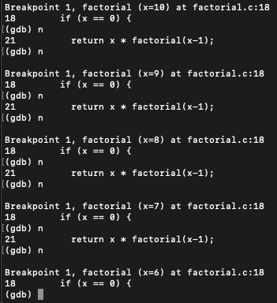
Meet gdb
Compile code with ‘-g’ flag (saves human readable info)
Open program with gdb <executable file>
start or restart the program: run <program args>
quit the program: kill
quit gdb: quit
Reference information: help
Most commands have short abbreviations
bt = backtrace
n = next
s = step
q = quit
<return> often repeats the last command
Notes:
gdb ./myexecutable
r - run [args] ...
q - quit
bt - backtrace
tui enable/disable
b - break (line number/function name)
n - next
s - step
c - continue

Slide 12
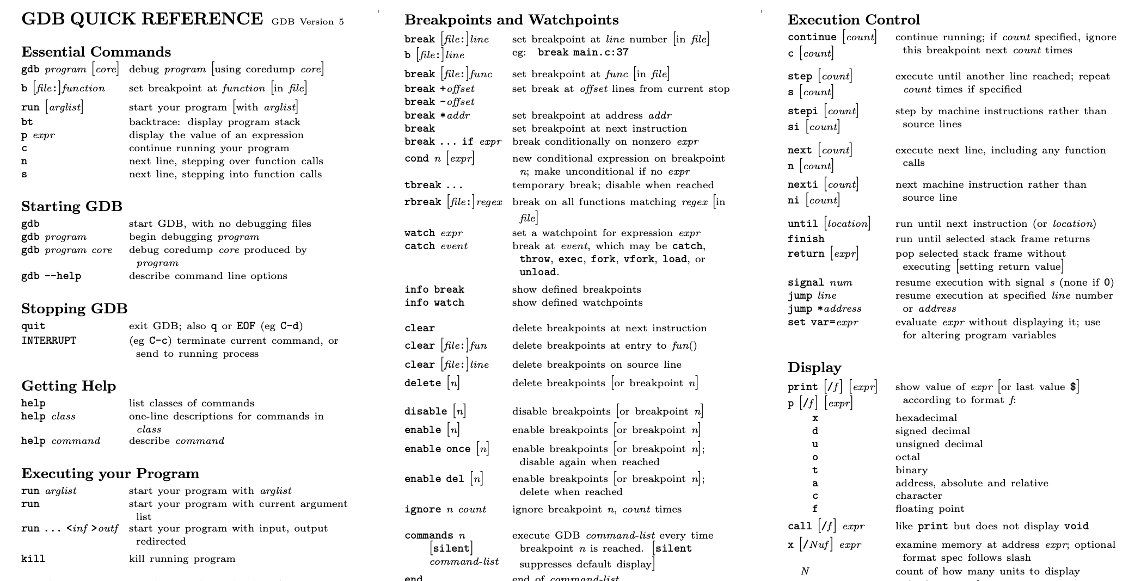
https://courses.cs.washington.edu/courses/cse374/19sp/refcard.pdf

Slide 13
Useful GDB Commands
bt – stack backtrace
up, down – change current stack frame
list – display source code (list n, list <function name>)
print expression – evaluate and print expression
display expression
re-evaluate and print expression every time execution pauses
undisplay – remove an expression from the recurring list
info locals – print all locals (but not parameters)
x (examine) – look at blocks of memory in various formats
If we get a segmentation fault:
gdb ./myprogram
Type "run" into GDB
When you get a segfault, type "backtrace" or "bt"
Look at the line numbers from the backtrace, starting from the top

Slide 14
Breakpoints
temporarily stop program running at given points
look at values in variables
test conditions
break function (or line-number)
conditional breakpoints
to skip a bunch of iterations
to do assertion checking
break – sets breakpoint
break <function name> | <line number> | <file>:<line number>
info break – print table of currently set breakpoints
clear – remove breakpoints
disable/enable temporarily turn breakpoints off/on
continue – resume execution to next breakpoint or end of program
step - execute next source line
next – execute next source line, but treat function calls as a single statement and don’t “step in”
finish – execute to the conclusion of the current function
how to recover if you meant “next” instead of “step”

Slide 15
gdb demo

Slide 16
reverse.c
Output is an empty C string, zero characters followed by a null terminator

Slide 17
Testing
Computers don’t make mistakes- people do!
“I’m almost done, I just need to make sure it works”
– Naive 14Xers
Software Test: a separate piece of code that exercises the code you are assessing by providing input to your code and finishes with an assertion of what the result should be.
Isolate
Break your code into small modules
Build in increments
Make a plan from simplest to most complex cases
Test as you go
As your code grows, so should your tests

Slide 18
Types of Tests
Black Box
Behavior only – ADT requirements
From an outside point of view
Does your code uphold its contracts with its users?
Performance/efficiency
White Box
Includes an understanding of the implementation
Written by the author as they develop their code
Break apart requirements into smaller steps
“unit tests” break implementation into single assertions

Slide 19
What to test?
Expected behavior
The main use case scenario
Does your code do what it should given friendly conditions?
Forbidden Input
What are all the ways the user can mess up?
Empty/Null
Protect yourself!
How do things get started?
Boundary/Edge Cases
First
last
Scale
Is there a difference between 10, 100, 1000, 10000 items?

Slide 20
Tips for testing
You cannot test every possible input, parameter value, etc.
Think of a limited set of tests likely to expose bugs.
Think about boundary cases
Positive; zero; negative numbers
Right at the edge of an array or collection's size
Think about empty cases and error cases
0, -1, null; an empty list or array
test behavior in combination
Maybe add usually works, but fails after you call remove
Make multiple calls; maybe size fails the second time only

Slide 21
Appendix

