Slide 1
Lecture 14: makefiles
Lecture Participation Poll #14
Log onto pollev.com/cse374
Or
Text CSE374 to 22333
CSE 374: Intermediate Programming Concepts and Tools

Slide 2
Administrivia
Assignments
HW2 Live - Soft Deadline EXTENDED Friday October 30th at 9pm PST
Autograder updated
Reminder: Midpoint Deadline Friday November 6th at 9pm PST
Review Assignment Live – Due Date EXTENDED Thursday October 29th at 9pm PST
24 hrs late 20% penalty
48 hrs late 50% penalty
Not accepted more than 48hrs late
Combination of autograding & handchecking
Reminder: Midpoint Deadline Friday November 6th at 9pm PST
Will post grades to canvas sometime the week after

Slide 3
Make Files
Make is a program which automates building dependency trees
List of rules written in a Makefile declares the commands which build each intermediate part
Helps you avoid manually typing gcc commands, easier and less prone to typos
Automates build process
Makefiles are a list of with Make rules which include:
Target - An output file to be generated, dependent on one or more sources
Source – Input source code to be built
Recipe - command to generate target
Makefile logic
Make builds based on structural organization of how code depends on other code as defined by includes
Recursive – if a source is also a target for other sources, must also evaluate its dependencies and remake as required
Make can check when you've last edited each file, and only build what is needed!
Files have "last modification date". make can check whether the sources are more recent than the target
Make isn’t language specific: recipe can be any valid shell command
run make command from within same folder
$make [ -f makefile] [ options ] … [ targets ] ../
Starts with first rule in file then follows dependency tree
-f specifies makefile name, if non provided will default to “Makefile”
if no target is specified will default to first listed in file
target: source
recipe
tab not spaces!
ll.o: ll.c ll.h
gcc -c ll.c
https://www.gnu.org/software/make/manual/make.html#Introduction

Slide 4
Makefile Example: Linked List
try_lists
#include "ll.h"
int main() {
Node *n1 = make_node(4, NULL);
// rest of main…
main.o
ll.o
main.c
#ifndef LL_H
#define LL_H
typedef struct Node {
// rest of Node def…
main.c
ll.h
ll.c
try_lists: ll.o main.o
gcc –o try_lists ll.o main.o
ll.o: ll.c ll.h
gcc –c ll.c –o ll.o
main.o: main.c ll.h
gcc –c main.c –o main.o
ll.h
#include <stdlib.h>
#include <stdio.h>
#include "ll.h"
Node *make_node(int value, Node *next) {
// rest of linked list code…
Makefile
ll.c

Slide 5
More Make Tools
CC = gcc
CGLAGS = -Wall
foo.o: foo.c foo.h bar.h
$(CC) $(CFLAGS) –c foo.c –o foo.o
make CFLAGS=-g
EXE=
ifdef WINDIR #defined on Windows
EXE=.exe
endif
widget$(EXE): foo.o bar.o
$(CC) $(CFLAGS) –o widget$(EXE)\
foo.o bar.o
OBJFILES = foo.o bar.o baz.o
widget: $(OBJFILES)
gcc –o widget $(OBJFILES)
%.o: %.c
$(CC) –c $(CFLAGS) $< -o $@
clean:
rm *.o widget
make variables help reduce repetitive typing and make alterations easier
can change variables from command line
enables us to reuse Makefiles on new projects
can use conditionals to choose variable settings
ifdef checks if a given variable is defined for conditional execution
ifndef checks if a given variable is NOT defined
Special characters:
$@ for target
$^ for all sources
$< for left-most source
\ enables multiline recipies
* functions as wildcard (use carefully)
% enables implicit rule definition by using % as a make specific wildcard
Makefile
http://cslibrary.stanford.edu/107/UnixProgrammingTools.pdf

Slide 6
Phony Targets
A target that doesn’t create the listed output
A way to force run commands regardless of dependency tree
Common uses:
all – used to list all top notes across multiple dependency trees
clean – cleans up files after usage
test – specifies test functionality
printing messages or info
CC = gcc
CGLAGS = -Wall
all: my_program your_program
my_program: foo.o bar.o
$(CC) $(CFLAGS) -o my_program foo.o bar.o
your_program: bar.o baz.o
$(CC) $(CFLAGS) –o your_program foo.o baz.o
#not shown: foo.o, bar.o, baz.o targets
clean:
rm *.o my_program your_program
all: try_lists test_suite
clean:
rm objectfiles
test: test_suite
./test_suite
Makefile

Slide 7
Example Makefile
variable definitions
CC = gcc
CGLAGS = -g –Wall –std=c11
try_lists: main.o ll.o
$(CC) $(CFLAGS) -o try_lists main.o ll.o
main.o: main.c ll.h
$(CC) $(CFLAGS) –c main.c
ll.o: ll.c ll.h
$(CC) $(CFILES) –c ll.c
clean:
rm *.o
try_lists
must include rules for each file
main.o
ll.o
rules define dependency hierarchy
main.c
ll.h
ll.c
Makefile

Slide 8
Example
#include <stdlib.h>
#include <string.h>
#include <ctype.h>
#include "speak.h"
#include "shout.h"
/* Write message m in uppercase to stdout */
void shout(char m[])
{
int len; /* message length */
char *mcopy; /* copy of original message */
int i;
len = strlen(m);
mcopy = (char *)malloc(len*sizeof(char)+1);
strcpy(mcopy,m);
for (i = 0; i < len; i++)
mcopy[i] = toupper(mcopy[i]);
speak(mcopy); free(mcopy);
}
talk
shout.o
main.o
speak.o
shout.c
shout.h
main.c
speak.h
speak.c
#include <stdio.h>
#include "speak.h"
/* Write message m to stdout */
void speak(char m[])
{
printf("%s\n", m);
}
#include "speak.h"
#include "shout.h"
/* Say HELLO and goodbye */
int main(int argc, char* argv[])
{
shout("hello");
speak("goodbye");
return 0;
}
speak.c
main.c
shout.c
#ifndef SHOUT_H
#define SHOUT_H
/* Write message m in uppercase to stdout */
void shout(char m[]);
#endif /* ifndef SHOUT_H */
#ifndef SPEAK_H
#define SPEAK_H
/* Write message m to stdout */
void speak(char m[]);
#endif /* ifndef SPEAK_H */
shout.h
speak.h

Slide 9
Example
talk
shout.o
main.o
speak.o
shout.c
shout.h
main.c
speak.h
speak.c
all: talk
# The executable
talk: main.o speak.o shout.o
gcc -Wall -std=c11 -g -o talk main.o speak.o shout.o
# Individual source files
speak.o: speak.c speak.h
gcc -Wall -std=c11 -g -c speak.c
shout.o: shout.c shout.h speak.h
gcc -Wall -std=c11 -g -c shout.c
main.o: main.c speak.h shout.h
gcc -Wall -std=c11 -g -c main.c
# A "phony" target to remove built files and backups clean: rm -f *.o talk *~
Makefile

Slide 10
Example
Makefile
talk
CC = gcc
# Compiler flags: -Wall for debugger warnings
# -std=c11 for updated standards
CFLAGS = -Wall -std=c11
ifdef DEBUG
CFLAGS += -g
endif
# The name of the program that we are producing.
TARGET = talk
# This is a "phony" target that tells
# make what other targets to build.
all: $(TARGET)
# All the .o files we need for our executable.
OBJS = main.o speak.o shout.o
# The executable
$(TARGET): $(OBJS)
$(CC) $(CFLAGS) -o talk $(OBJS)
shout.o
main.o
speak.o
shout.c
shout.h
main.c
speak.h
speak.c
# Individual source files
speak.o: speak.c speak.h
$(CC) $(CFLAGS) -c speak.c
shout.o: shout.c shout.h speak.h
$(CC) $(CFLAGS) -c shout.c
main.o: main.c speak.h shout.h
$(CC) $(CFLAGS) -c main.c
# A "phony" target to remove built files and backups
clean: rm -f *.o talk *~

Slide 11
Memory Leak
A memory leak occurs when code fails to deallocate dynamically allocated memory that is no longer used
forgetting to free a malloc—ed block
losing or changing the pointer to a malloc-ed block
Result – program’s memory will keep growing – your OS handles this
ok for short-lived programs because memory is deallocated when program ends
bad repercussions for long-lived programs
slow down processing over time
could exhaust all available memory -> program crash
other programs could get starved for memory

Slide 12
Common Memory Errors
int x[] = {1, 2, 3};
free(x);
x = (int*)malloc(M*sizeof(int));
free(x);
y = (int*)malloc(M*sizeof(int));
free(x);
x is a local variable stored in stack, cannot be freed
Double free and Forgetting to free memory “memory leak”
char** strings = (char**)malloc(sizeof(char)*5);
free(strings);
Mismatch of type - wrong allocation size
x = (int*)malloc(M*sizeof(int));
free(x);
y = (int*)malloc(M*sizeof(int));
for (i=0; i<M; i++)
y[i] = x[i];
Accessing freed memory

Slide 13
Common Memory Errors
int* foo()
{
int val = 0;
return &val;
}
#define LEN 8
int arr[LEN];
for (int i = 0; i <= LEN; i++)
arr[i] = 0;
dangling pointer
Out of bounds access
int foo()
{
int* arr = (int*)malloc(sizeof(int)*N);
read_n_ints(N, arr);
int sum = 0;
for (int i = 0; i < N; i++)
sum += arr[i];
return sum;
}
long val;
printf(“%d”, &val);
Dereferencing a non-pointer
int sum_int(int* arr, int len)
{
int sum;
for (int i = 0; i < len; i++)
sum += arr[i];
return sum;
}
memory leak – failing to free memory
Reading memory before allocation

Slide 14
Finding and Fixing Memory Errors
Valgrind is a tool that simulates your program to find memory errors
it can detect all of the errors we’ve discussed so far!
catches pointer errors during execution
prints summary of heap usage, including details of memory leaks
gcc -o myprogram myprogram.c
valgrind --leak-check=full myprogram arg1 ag
Can show:
Use of uninitialized memory
Reading/writing memory after it has been free'd
Reading/writing off the end of malloc'd blocks
Reading/writing inappropriate areas on the stack
Memory leaks -- where pointers to malloc'd blocks are lost forever
Mismatched use of malloc/new/new [] vs free/delete/delete []
Overlapping src and dst pointers in memcpy() and related functions

Slide 15
Valgrind Example
example1.c
terminal

Slide 16
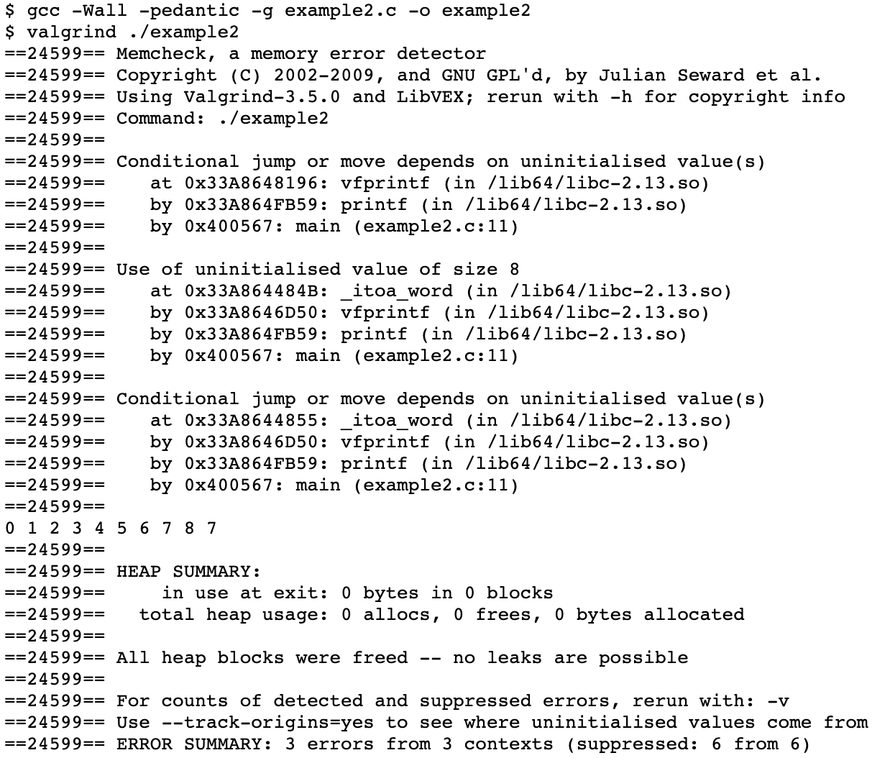
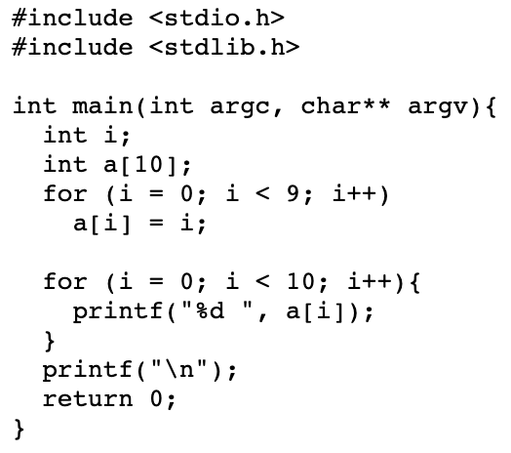
Valgrind EX2
example2.c
terminal

Slide 17
Appendix

Slide 18
File IO - working with strings
FILE *fopen(const char *path, const char *mode);
opens the file whose name is the string pointed to by path and associates a stream with it.
char *fgets(char *s, int size, FILE *stream);
reads in at most one less than size characters from stream and stores them into the buffer pointed to by s. Reading stops after an EOF or a newline. If a newline is read, it is stored into the buffer. A terminating null byte ('\0') is stored after the last character in the buffer.
int fprintf(FILE *stream, const char *format, ...);
It’s printf, but to a file.
int fputc(int c, FILE *stream); // print a single character
int fputs(const char *s, FILE *stream); // print a string

