Slide 1
Lecture 13: Multifile C Management
Lecture Participation Poll #13
Log onto pollev.com/cse374
Or
Text CSE374 to 22333
CSE 374: Intermediate Programming Concepts and Tools

Slide 2
Administrivia
Assignments
HW2 Live - Soft Deadline Thursday October 29th at 9pm PST
Autograder updated
HW3 coming later today – last assignment before midpoint deadline
Reminder: Midpoint Deadline Friday November 6th at 9pm PST
Review Assignment Live – Due Wednesday
24 hrs late 20% penalty
48 hrs late 50% penalty
Not accepted more than 48hrs late
Student survey: Week student survey

Slide 3
Linked Lists
#include <stdlib.h>
#include <stdio.h>
typedef struct Node {
int value;
struct Node *next;
} Node;
Node *make_node(int value, Node *next) {
Node *node = (Node*)malloc(sizeof(Node));
node->value = value;
node->next = next;
return node;
}
int main() {
Node *n1 = make_node(4, NULL);
Node *n2 = make_node(7, n1);
Node *n3 = make_node(3, n2);
printf(
"%d%d%d\n",
n3->value,
n3->next->value,
n3->next->next->value
);
free(n3);
free(n2);
free(n1);
}

Slide 4
Multi-File C Programming
You can split C into multiple files!
What if we wanted to use Linked List code in a different project?
If the linked list code is long, it can make files unwieldy
What if we want to separate our “main” from the struct definitions
Pass all “.c” files into gcc:
gcc -o try_lists ll.c main.c
Must include code header files to enable one file to see the other, otherwise you have linking errors

Slide 5
Sharing code across files
#include <stdlib.h>
#include <stdio.h>
typedef struct Node {
int value;
struct Node *next;
} Node;
Node *make_node(int value, Node *next);
int main() {
Node *n1 = make_node(4, NULL);
Node *n2 = make_node(7, n1);
Node *n3 = make_node(3, n2);
// rest of main…
}
Must always declare a function or struct in every file it’s used in
Thank goodness C lets us separate declarations and definitions ;)
Include function header as definition
Node *make_node (int value, Node *next);
Include struct type definition
typedef struct Node
{
int value;
struct Node *next;
} Node;
#include <stdlib.h>
typedef struct Node {
int value;
struct Node *next;
} Node;
Node *make_node(int value, Node *next);
Node *make_node(int value, Node *next) {
Node *node = (Node*)malloc(sizeof(Node));
node->value = value;
node->next = next;
return node;
}
main.c
ll.c

Slide 6
Header Files
typedef struct Node {
int value;
struct Node *next;
} Node;
Node *make_node(int value, Node *next);
ll.h
Copying your function declarations to every file you want to use them is not fun
If you forget to make a change to all of them, confusing errors occur!
A header file (.h) is a file which contains just declarations
#include inserts the contents of a header file into your .c file
Put declarations in a header, then include it in all other files
Two types of #include
#include <stdio.h>
Used to include external libraries. Does not look for other files that you created.
#include "myfile.h"
Used to include your own headers. Searches in the same folder as the rest of your code.
#include <stdlib.h>
#include <stdio.h>
#include "ll.h"
Node *make_node(int value, Node *next) {
Node *node = (Node*)malloc(sizeof(Node));
node->value = value;
node->next = next;
return node;
}
ll.c
#include "ll.h"
int main() {
Node *n1 = make_node(4, NULL);
Node *n2 = make_node(7, n1);
Node *n3 = make_node(3, n2);
// rest of main…
}
main.c

Slide 7
Header Guards
#ifndef LL_H
#define LL_H
typedef struct Node {
int value;
struct Node *next;
} Node;
Node *make_node(int value, Node *next);
#endif
Consider the following header structure:
Header A includes header B.
Header C includes header B.
A source code file includes headers A and C.
The code now includes two copies of header B!
Solution: "header guard”
Uses ifndef to check if header is already defined for this file
ll.h
#include <stdlib.h>
#include <stdio.h>
#include "ll.h"
Node *make_node(int value, Node *next) {
Node *node = (Node*)malloc(sizeof(Node));
node->value = value;
node->next = next;
return node;
}
#include "ll.h"
int main() {
Node *n1 = make_node(4, NULL);
Node *n2 = make_node(7, n1);
Node *n3 = make_node(3, n2);
// rest of main…
}
main.c
ll.c

Slide 8
Libraries & Object Files in C
Remember #include <stdio.h>?
Tells our .c file what function declarations are in stdio.h
but what about the function definitions? (i.e. the code)
We don't have access to stdio.c
Instead, we have a pre-compiled library that contains the function definitions
The stdio library is included by default with gcc
In C, these "libraries" are called object files
Object files contain the machine code for the functions within
When compiled, a function is turned into "machine code" which the physical CPU electronics can understand

Slide 9
Linking in C
Every time you have compiled something with gcc, you have actually been doing two things:
Compiling: Translating C code (a single .c file) into machine code stored in object files
Linking: Combining many object files into one executable
Why separate these two?
Compile each object once and re-use it for multiple executables
Building multiple programs which use some of the same source code doesn’t require recompilation
incremental compilation: Huge projects can take hours or days to compile from scratch! We can save time by only re-compiling what has changed.
Slow-to-compile files which you don't change often don't have to be re-compiled
Programmer code – source file
Compiled machine code – object file

Slide 10
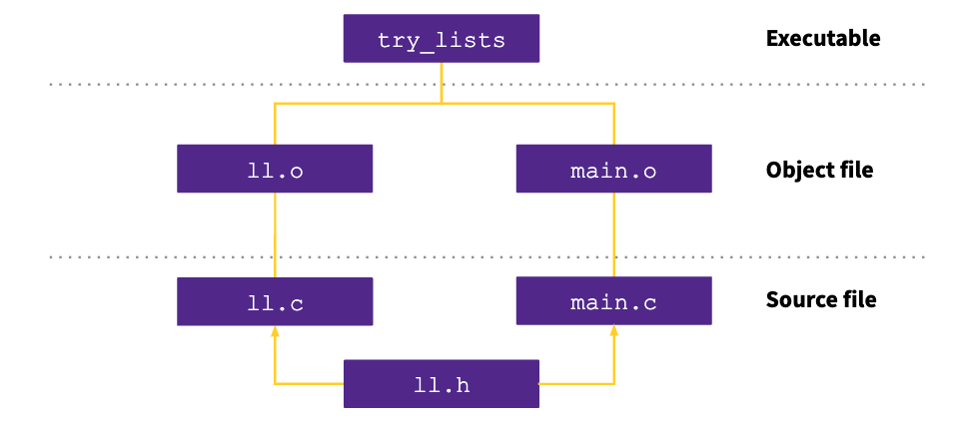
Dependency Tree: linked list project

Slide 11
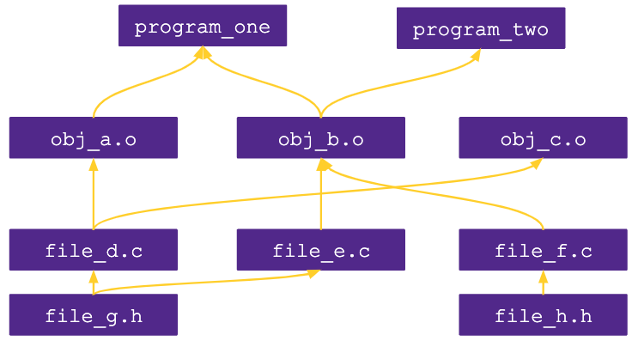
Example
Consider this dependency graph. What files (source and object) are required when building program_two?
b, e
b, e, g
a, b ,c, e, f
b, e, f, g, h
b, d, e, f, g, h

Slide 12
Make Files
Make is a program which automates building dependency trees
List of rules written in a Makefile declares the commands which build each intermediate part
Helps you avoid manually typing gcc commands, easier and less prone to typos
Automates build process
Makefiles are a list of with Make rules which include:
Target - An output file to be generated, dependent on one or more sources
Source – Input source code to be built
Recipe - command to generate target
Makefile logic
Make builds based on structural organization of how code depends on other code as defined by includes
Recursive – if a source is also a target for other sources, must also evaluate its dependencies and remake as required
Make can check when you've last edited each file, and only build what is needed!
Files have "last modification date". make can check whether the sources are more recent than the target
Make isn’t language specific: recipe can be any valid shell command
run make command from within same folder
$make [ -f makefile] [ options ] … [ targets ] ../
Starts with first rule in file then follows dependency tree
-f specifies makefile name, if non provided will default to “Makefile”
if no target is specified will default to first listed in file
target: source
recipe
tab not spaces!
ll.o: ll.c ll.h
gcc -c ll.c
https://www.gnu.org/software/make/manual/make.html#Introduction

Slide 13
More Make Tools
CC = gcc
CGLAGS = -Wall
foo.o: foo.c foo.h bar.h
$(CC) $(CFLAGS) –c foo.c –o foo.o
make CFLAGS=-g
EXE=
ifdef WINDIR #defined on Windows
EXE=.exe
endif
widget$(EXE): foo.o bar.o
$(CC) $(CFLAGS) –o widget$(EXE)\
foo.o bar.o
OBJFILES = foo.o bar.o baz.o
widget: $(OBJFILES)
gcc –o widget $(OBJFILES)
%.o: %.c
$(CC) –c $(CFLAGS) $< -o $@
clean:
rm *.o widget
make variables help reduce repetitive typing and make alterations easier
can change variables from command line
enables us to reuse Makefiles on new projects
can use conditionals to choose variable settings
ifdef checks if a given variable is defined for conditional execution
ifndef checks if a given variable is NOT defined
Special characters:
$@ for target
$^ for all sources
$< for left-most source
\ enables multiline recipies
* functions as wildcard (use carefully)
% enables implicit rule definition by using % as a make specific wildcard
Makefile
http://cslibrary.stanford.edu/107/UnixProgrammingTools.pdf

Slide 14
Phony Targets
A target that doesn’t create the listed output
A way to force run commands regardless of dependency tree
Common uses:
all – used to list all top notes across multiple dependency trees
clean – cleans up files after usage
test – specifies test functionality
printing messages or info
CC = gcc
CGLAGS = -Wall
all: my_program your_program
my_program: foo.o bar.o
$(CC) $(CFLAGS) -o my_program foo.o bar.o
your_program: bar.o baz.o
$(CC) $(CFLAGS) –o your_program foo.o baz.o
#not shown: foo.o, bar.o, baz.o targets
clean:
rm *.o my_program your_program
all: try_lists test_suite
clean:
rm objectfiles
test: test_suite
./test_suite
Makefile

Slide 15
Example Makefile
variable definitions
CC = gcc
CGLAGS = -g –Wall –std=c11
try_lists: main.o ll.o
$(CC) $(CFLAGS) -o try_lists main.o ll.o
main.o: main.c ll.h
$(CC) $(CFLAGS) –c main.c
ll.o: ll.c ll.h
$(CC) $(CFILES) –c ll.c
try_lists
must include rules for each file
main.o
ll.o
rules define dependency hierarchy
main.c
ll.h
ll.c
Makefile

Slide 16
Example
#ifndef SHOUT_H
#define SHOUT_H
/* Write message m in uppercase to stdout */
void shout(char m[]);
#endif /* ifndef SHOUT_H */
#ifndef SPEAK_H
#define SPEAK_H
/* Write message m to stdout */
void speak(char m[]);
#endif /* ifndef SPEAK_H */
shout.h
speak.h
#include <stdlib.h>
#include <string.h>
#include <ctype.h>
#include "speak.h"
#include "shout.h"
/* Write message m in uppercase to stdout */
void shout(char m[])
{
int len; /* message length */
char *mcopy; /* copy of original message */
int i;
len = strlen(m);
mcopy = (char *)malloc(len*sizeof(char)+1);
strcpy(mcopy,m);
for (i = 0; i < len; i++)
mcopy[i] = toupper(mcopy[i]);
speak(mcopy); free(mcopy);
}
#include "speak.h"
#include "shout.h"
/* Say HELLO and goodbye */
int main(int argc, char* argv[])
{
shout("hello");
speak("goodbye");
return 0;
}
#include <stdio.h>
#include "speak.h"
/* Write message m to stdout */
void speak(char m[])
{
printf("%s\n", m);
}
speak.c
main.c
all: talk
# The executable
talk: main.o speak.o shout.o
gcc -Wall -std=c11 -g -o talk main.o speak.o shout.o
# Individual source files
speak.o: speak.c speak.h
gcc -Wall -std=c11 -g -c speak.c
shout.o: shout.c shout.h speak.h
gcc -Wall -std=c11 -g -c shout.c
main.o: main.c speak.h shout.h
gcc -Wall -std=c11 -g -c main.c
# A "phony" target to remove built files and backups clean: rm -f *.o talk *~
shout.c
talk
shout.o
main.o
speak.o
Makefile
shout.c
shout.h
main.c
speak.h
speak.c

Slide 17
Appendix

Slide 18
