Slide 1
Lecture 12: Structs and Multi File C
Lecture Participation Poll #12
Log onto pollev.com/cse374
Or
Text CSE374 to 22333
CSE 374: Intermediate Programming Concepts and Tools

Slide 2
Administrivia
Assignments
HW2 Live - Soft Deadline Thursday October 29th at 9pm PST
Don’t need to zip files
More hints added!
HW3 coming this week
Reminder: Midpoint Deadline Friday November 6th at 9pm PST
Review Assignment Live – Due Wednesday
24 hrs late 20% penalty
48 hrs late 50% penalty
Not accepted more than 48hrs late

Slide 3
Data Types in C
void - a place holder
numbers – int, short, long, double, float (signed, unsigned)
char – a very short int (1 byte) interpreted as a printable character
pointers (T*) – stores address of where a value is stored in memory
arrays (T[]) – implicit promotion to pointer when passed as an argument to a function or returned from a function
booleans – not defined in C so instead we use values, 0 or NULL is interpreted as false, anything else true
Advanced: Union T, Enum E, Function Pointers, Structs

Slide 4
Typedef
A function that creates an alias for an existing type
typedef <type> <name>;
Example: In C, strings are ”char*” but we can rename them to “string”
typedef char* string;
int main(int argc, string *argv)
{
string s = “hello, world”;
printf(“%s\n”, s);
}

Slide 5
Type-casting
casting – converting one type to another
(T)E
* same as Java
main ()
{
int sum = 17, count = 15;
double mean;
mean = (double) sum / count;
printf(Value of mean: %f\n”, mean);
}
If E is a numeric type and T is a numeric type:
To wider type, get same value
To narrower type, may not get same value (employs mod operator)
From floating point to int, will round (may overflow)
From int to floating point, may round (int to double is exact on most machines)

Slide 6
Pointer-casting
If be has type T1*, then (T2*)E is a (pointer)cast
Does not alter the address stored, but used to manage types
void evil (int **p, int x)
{
int *q = (int*)p;
*q = x;
}
void f(int **p)
{
evil(p, 345);
**p = 17; // writes 17 to address 345 – best case crash
}

Slide 7
Structs
structs are a method of constructing new datatypes
store a collection of values together in memory, fields
similar to a Java class, but no methods
individual values are referred to using the “.” operator
can use typedef to rename and turn struct tag into a “type”
typedef struct Cat Cat;
or
typedef struct Cat {
…
} Cat;
Then you don’t need keyword “struct”
Cat mercy; instead of struct Cat mercy;
struct Cat
{
char *name;
int age;
char *breed;
}
int main()
{
struct Cat mercy;
mercy.name = “Iron Fist No Mercy”;
mercy.age = 6;
mercy.breed = “Pixie Bob”;
}

Slide 8
Parameters / Arguments
Function parameters are initialized with a copy of corresponding argument
If the argument is a pointer, the parameter value will point to the same thing (pointer is copied)
arrays are passed as pointers
Structs are passed as a copy by default, so it is more common to intentionally pass as pointers
avoids copying large objects
allows manipulation of original struct <- allows creation of methods that manipulate new type, like Java
to access members you must dereference the pointer (*) and access the field (.) – use parenthesis to ensure dereference happens first
(*ptr). has a shortcut: ptr->
Cat (*ptr) = (Cat*)malloc(sizeof(Cat));
(*ptr).age = 6;
…
(*ptr).age++;
ptr->age;

Slide 9
Example: Pointer.c
// constructor for a new Point
Point newPoint()
{
Point p; p.x = 0; p.y = 0; return p;
}
// translateX moves one point horizontally by deltax
void translateX(Point* p, int deltaX)
{
p->x += deltaX; // OR (*p).x += deltaX;
}
// translateX_wrong won't move the original point
void translateX_wrong(Point p, int deltaX)
{
p.x += deltaX;
}
// print out the point.
void print(Point* p)
{
printf("p = (%d, %d)\n", p->x, p->y);
}
// note: here we could pass by value
void print_point(Point p)
{
printf("p = (%d, %d)\n", p.x, p.y);
}
// main tests the Point struct
int main(int argc, char **argv)
{
Point p = newPoint();
printf ("Show point.\n");
print(&p); // pass by reference
translateX(&p, 12);
print(&p);
printf ("Show incorrectly translated point.\n");
translateX_wrong(p, 12);
print(&p);
printf ("But pass by value works for print.\n");
print_point (p);
}
// constructor for a new Point Point newPoint()
{
Point p;
p.x = 0;
p.y = 0;
return p;
}

Slide 10
Linked Lists
#include <stdlib.h>
#include <stdio.h>
typedef struct Node {
int value;
struct Node *next;
} Node;
Node *make_node(int value, Node *next) {
Node *node = (Node*)malloc(sizeof(Node));
node->value = value;
node->next = next;
return node;
}
int main() {
Node *n1 = make_node(4, NULL);
Node *n2 = make_node(7, n1);
Node *n3 = make_node(3, n2);
printf(
"%d%d%d\n",
n3->value,
n3->next->value,
n3->next->next->value
);
free(n3);
free(n2);
free(n1);
}

Slide 11
Multi-File C Programming
You can split C into multiple files!
What if we wanted to use Linked List code in a different project?
If the linked list code is long, it can make files unwieldy
What if we want to separate our “main” from the struct definitions
Pass all “.c” files into gcc:
gcc -o try_lists ll.c main.c
Must include code header files to enable one file to see the other, otherwise you have linking errors

Slide 12
Sharing code across files
#include <stdlib.h>
#include <stdio.h>
typedef struct Node {
int value;
struct Node *next;
} Node;
Node *make_node(int value, Node *next);
int main() {
Node *n1 = make_node(4, NULL);
Node *n2 = make_node(7, n1);
Node *n3 = make_node(3, n2);
// rest of main…
}
Must always declare a function or struct in every file it’s used in
Thank goodness C lets us separate declarations and definitions ;)
Include function header as definition
Node *make_node (int value, Node *next);
Include struct type definition
typedef struct Node
{
int value;
struct Node *next;
} Node;
#include <stdlib.h>
typedef struct Node {
int value;
struct Node *next;
} Node;
Node *make_node(int value, Node *next);
Node *make_node(int value, Node *next) {
Node *node = (Node*)malloc(sizeof(Node));
node->value = value;
node->next = next;
return node;
}
main.c
ll.c

Slide 13
Header Files
typedef struct Node {
int value;
struct Node *next;
} Node;
Node *make_node(int value, Node *next);
ll.h
Copying your function declarations to every file you want to use them is not fun
If you forget to make a change to all of them, confusing errors occur!
A header file (.h) is a file which contains just declarations
#include inserts the contents of a header file into your .c file
Put declarations in a header, then include it in all other files
Two types of #include
#include <stdio.h>
Used to include external libraries. Does not look for other files that you created.
#include "myfile.h"
Used to include your own headers. Searches in the same folder as the rest of your code.
#include <stdlib.h>
#include <stdio.h>
#include "ll.h"
Node *make_node(int value, Node *next) {
Node *node = (Node*)malloc(sizeof(Node));
node->value = value;
node->next = next;
return node;
}
ll.c
#include "ll.h"
int main() {
Node *n1 = make_node(4, NULL);
Node *n2 = make_node(7, n1);
Node *n3 = make_node(3, n2);
// rest of main…
}
main.c

Slide 14
Header Guards
#ifndef LL_H
#define LL_H
typedef struct Node {
int value;
struct Node *next;
} Node;
Node *make_node(int value, Node *next);
#endif
Consider the following header structure:
Header A includes header B.
Header C includes header B.
A source code file includes headers A and C.
The code now includes two copies of header B!
Solution: "header guard"
ll.h
#include <stdlib.h>
#include <stdio.h>
#include "ll.h"
Node *make_node(int value, Node *next) {
Node *node = (Node*)malloc(sizeof(Node));
node->value = value;
node->next = next;
return node;
}
#include "ll.h"
int main() {
Node *n1 = make_node(4, NULL);
Node *n2 = make_node(7, n1);
Node *n3 = make_node(3, n2);
// rest of main…
}
main.c
ll.c

Slide 15
Libraries in C
Remember #include <stdio.h>?
That tells our .c file what function declarations are in stdio.h, but what about the function definitions? (i.e. the code)
We don't have access to stdio.c
Instead, we have a pre-compiled library that we can call functions within
The stdio library is included by default with gcc
In C, these "libraries" are called object files

Slide 16
Object Files
All C code is broken down into functions
When compiled, a function is turned into "machine code" which the physical CPU electronics can understand
Object files contain the machine code for the functions within
These define the complete behavior of a function and can be called from your own C code

Slide 17
Linking in C
Every time you have compiled something with gcc, you have actually been doing two things:
Compiling
Linking
Compiling: Translating C code (a single .c file) into machine code stored in object files
Linking: Combining many object files into one executable
Building multiple programs which use some of the same source code
Compile each object once and re-use it for multiple executables
Many files
Slow-to-compile files which you don't change often don't have to be re-compiled
incremental compilation: Huge projects can take hours or days to compile from scratch! We can save time by only re-compiling what has changed.

Slide 18
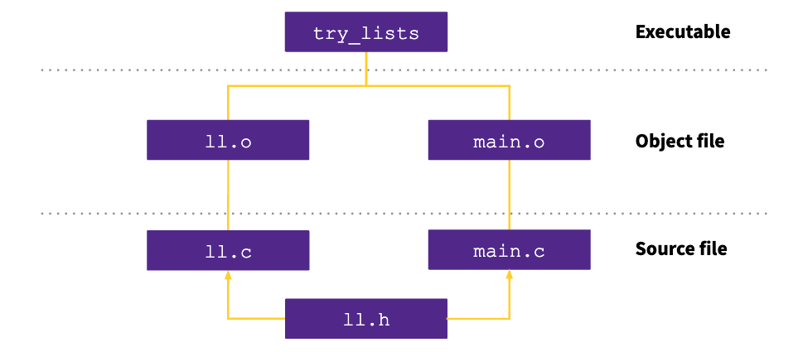
Dependency Graph: linked list project

Slide 19
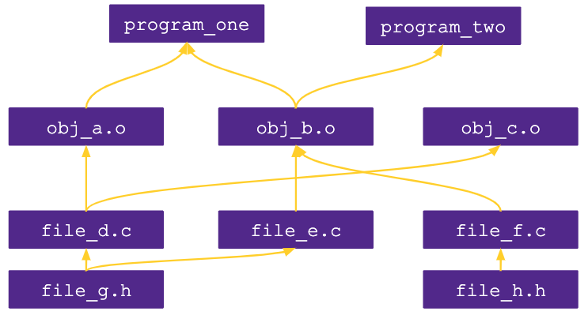
Example
Consider this dependency graph. What files (source and object) are required when building program_two?
b, e
b, e, g
a, b ,c, e, f
b, e, f, g, h
b, d, e, f, g, h

Slide 20
Automating Dependency Graphs with Make
make is a program which automates building trees of dependencies
List of rules written in a Makefile declares the commands which build each intermediate part
Helps you avoid manually typing gcc commands
single rule specifies:
An output file to be generated (also called a target)
List of input files (also called sources)
List of commands which will turn the input files into the output file
"To build this target, make sure you have these files available, and then run these commands"
Make can check when you've last edited each file, and only build what is needed!
Files have "last modification date". make can check whether the sources are more recent than the target.
Rule syntax:
ll.o: ll.c ll.h
gcc -c ll.c

Slide 21
Appendix

