Slide 1
Lecture 9: C Pointers
Lecture Participation Poll #9
Log onto pollev.com/cse374
Or
Text CSE374 to 22333
CSE 374: Intermediate Programming Concepts and Tools

Slide 2
Administrivia
Assignments

Slide 3
Where do computers store data?
CPU – Central Processing Unit – computer circuitry that followed computer instructions in assembly
RAM – Random Access Memory – a computer’s short-term memory where data is stored during program operation
When a program ends the memory in use “goes away”
Hard disc storage – a computer’s long-term memory, this is where data is stored when you need to preserve it across re-starts.
Data is stored indefinitely
Can be modified by different processes

Slide 4
How do computers store data?
Large sequences of numbers
Numbers are representations for electrical switches “transistors” that make up the brains of the CPU
All data is binary – 1s and 0s
A single digit is called a “bit”
Bits come in groups of 8 called “bytes”
All instructions can be translated into sequences of binary
Numbers represent other types of data
ASCII – each byte represents a letter of the English alphabet
Unicode – similar encoding structure to ASCII but covers a wider range of characters including non-English characters, emojis etc…
Images – represented by a 2D array of “pixels”
Each pixel is represented by 3 numbers: Red, Blue and Green values 0-255
english | h | e | l | l | o
ascii | 104 | 101 | 108 | 108 | 111
binary | 01101000 | 01100101 | 01101100 | 01101100 | 01101111
Binary Explained

Slide 5
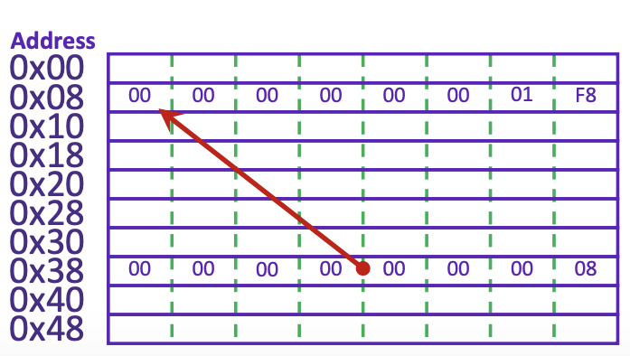
Addresses in Memory
Computer memory operates just like an array – addresses and the spaces they represent
Spaces are measured in ”bytes” of 8 bits
Each space in memory is referred to by its address
Value 504 stored at address 0x08
Address of value 504 stored at 0x38
A pointer is a data object that holds an address
Addresses can point to any type of data because they simply point to any space in memory
Like a “contact” object that stores someone’s phone number, doesn’t store the actual person
Pointers are also stored in memory
Pointers can point to other pointers! <follow down the rabbit hole>
Pointers can either point to a single variable or an array

Slide 6
Program Memory allocation
As a program executes it interacts with the computer’s working memory
Code - Sets aside space for the code compiled instructions
Globals - Then sets aside space for global variables, static constants, string literals, things that get declared at program initialization
Heap – As program executes this space of memory is used for local variables that get allocated and deallocated (new or ‘malloc’ variables)
Stack – holds and serves the current instructions in order that they are received (First In First Out)
Both the heap and stack grow dynamically throughout the run of a program
If they meet in the middle that means the program has run out of memory

Slide 7
Pointer and Address Syntax in C
int *ptr; also works! Programmer preference
int* ptr; // a variable of type “pointer to int” without assignment
int x = 123; //an int variable called “x” that stores “123”
ptr = &x; // store the address of “x” in “ptr”
* Means “pointer to type”
* placed after type indicates a pointer data type
Similar in java if you add [] after type you declare an array of that type
int* means “pointer to int”
& means “address variable”
Placing an & before a variable name will give you the address in memory of that variable
*ptr
x
&x
123
https://www.youtube.com/watch?v=5VnDaHBi8dM < Binky!

Slide 8
Dereferencing Pointers
int x = 123;
int* ptr = &x;
*ptr = 456;
printf(“new value of y:%d\n”, *ptr);
Placing a * before a pointer dereferences the pointer
Means “follow this pointer” to the actual data
*ptr = <data> will update the data stored at the address the pointer is referring to ie ‘write to memory’
*ptr will read the data stored at the address indicated by the pointer
Accessing unused addresses causes a ‘segmentation fault’
A dangling pointer is one that points to a dead local variable
Data that is no longer in use
Dereferencing a dangling pointer is “undefined behavior” (UB)
UB means ANYTHING could happen
Program could crash(best case), silently fail(worst case)
GCC can catch this kind of error with a warning, but not always

Slide 9
Strings in C
char s1[] = {’c’, ‘s’, ‘e’, ‘\0’};
char s2[] = “cse”;
char* s3 = “cse”;
All are equivalent ways to define a string in C
There are no “strings” in C, only arrays of characters
- “null terminated array of characters”
char* is another way to refer to strings in C
- Technically is a pointer to the first char in the series of chars for the string
Strings cannot be concatenated in C
printf(“hello, “ + myName + “\n”); // will not work
0x00 | 0x01 | 0x02 | 0x03 | 0x04 | 0x05 | 0x06 | 0x07 | 0x08 | 0x09
a | q | s | h | e | l | l | o | \0 | r

Slide 10
Printf – print format function
Produces string literals to stdout based on given string with format tags
Format tags are stand ins for where something should be inserted into the string literal
%s – string with null termination, %d – int, %f – float
Number of format tags should match number of arguments
Format tags will be replaced with arguments in given order
Defined in stdio.h
printf(“format string %s”, stringVariable);
Replaces %s with variable given
printf(“hello, %s\n”, myName);
https://en.wikipedia.org/wiki/Printf_format_string

Slide 11
Demo: C pointers

Slide 12
Questions

Slide 13
Binary
https://www.youtube.com/watch?v=LpuPe81bc2w < binary explained
Base 2 numbering system
Convention: starts with 0b
0b110 in decimal
0b110 = (1 * 2^2) + (1 * 2^1) + (0 * 2^0) = 4 + 2 + 6

Slide 14
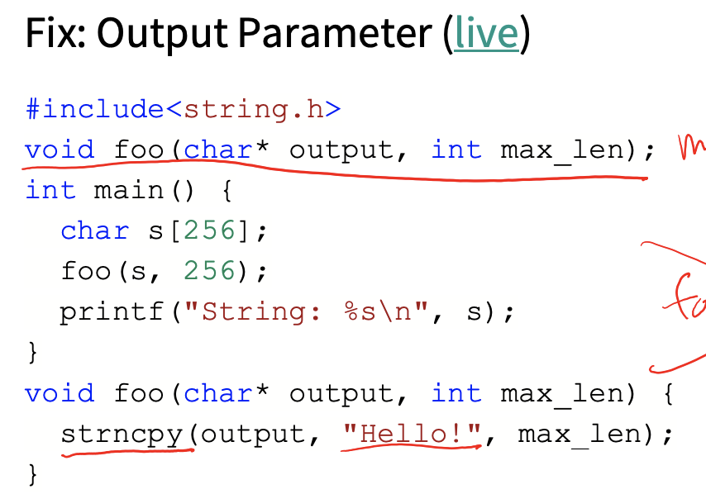
Example: Returning a String
char* foo();
int main() {
char* s = foo();
printf(“string: %s\n”, s);
}
char* foo() {
char message[256] = “Hello!”;
return message;
}
https://godbolt.org/z/sxddq7

