Slide 1
Lecture 7: Intro to C Programming
Lecture Participation Poll #7
Log onto pollev.com/cse374
Or
Text CSE374 to 22333
CSE 374: Intermediate Programming Concepts and Tools

Slide 2
Administrivia
Assignments
Hw1 turn in live
EX 4 did not release
Poll Everywhere is being mean
Review assignment coming- find groups!
Use tickets on discord
Sorry Kasey is behind on messages- will get back to you today!

Slide 3
Regex
Regular expressions (regex) are a set of rules for matching patterns in text
Used across programming languages and math
Different applications might have slightly different rules (yeah, it’s frustrating…)
Regex patterns can include characters, anchors and modifiers
Characters = the literal characters you are trying to match
Anchors – set the position in the line where a pattern may be found
^ anchor to front
$ anchor to end
Modifiers – modify the range of text pattern can match
* matches any number of characters
[set of chars]
Regex basics, let P be our pattern and S be a string to match
P can be a single character (ex: a) to match S of the same single character
P₁P₂ matches S if S=S₁S₂ where P₁ = S₁ and P₂ = S₂
P₁|P₂ matches S if P1 or P2 matches S
grep –e finds using regex
By default grep matches against .*p.*
https://regex101.com/
https://regexcrossword.com/
https://regexone.com/

Slide 4
Regex special characters
\ - escape following character
. – matches any single character at least once
c.t matches {cat, cut, cota}
| - or, enables multiple patterns to match against
a|b matches {a} or {b}
* - matches 0 or more of the previous pattern (greedy match)
a* matches {, a, aa, aaa, …}
? – matches 0 or 1 of the previous pattern
a? matches {, a}
+ - matches one or more of previous pattern
a+ matches {a, aa, aaa, …}
{n} – matches exactly n repetitions of the preceding
a{3} matches {aaa}
() – groups patterns for order of operations
(abc) matches {abc, 1abc2, 123abc}
[] – contains literals to be matched, single or range
[a-b] matches all lowercase letters
^ - anchors to beginning of line
^// matches lines that start with //
$ - anchors to end of line
;$ matches lines that end with ;
\d – matches one digit
\d+ matches {1, 2, 3, 4, …}
\s – matches whitespace character
\s matches {‘ ‘, \t, etc…}

Slide 5
Useful patterns
[a-zA-Z] - matches all English letters
[0-9]* - matches list of numbers
(abc)* - match any number of “abc”s
(foo | bar) – matches either “foo” or “bar”
^\d+$ - whole numbers (\d stands in for digit, +one or more digits) (regexpal)
^\d*\.\d+$ - numbers with decimals (regexpal)
^\b\d{3}[-.]?\d{3}[-.]?\d{4}\b$ - phone number (regexpal)
[^([a-zA-Z0-9._%-]+@[a-zA-Z0-9.-]+\.[a-zA-Z]{2,6}*$] – emails (regexpal)
https://digitalfortress.tech/tricks/top-15-commonly-used-regex/

Slide 6
Regex Practice
Regex for date in format YYYY-MM-DD
Year - [12]\d{3} – start with 1 or 2 followed by 3 digits
Month - (0[1-9]|1[0-2]) – 0 followed by a digit 1-9 OR 1 followed by a digit 0-2
Day – (0[1-9]|[12]\d|3[01]) – 0 followed by digit 1-9 OR 1 or 2 followed by any digit OR 3 followed by 0 or 1
Final - ([12]\d{3}-(0[1-9]|1[0-2])-(0[1-9]|[12]\d|3[01]))
(regexpal)

Slide 7
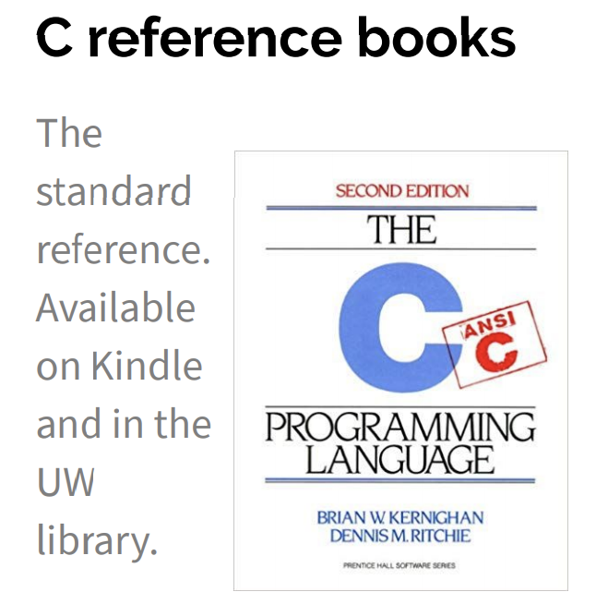
Meet C
Invented to rewrite the Unix OS, successor to B
A “low level” language gives the developer the ability to work directly with memory and processes
Low level means it sits closer to assembly, the language the CPU uses
Java is a “high level” language, compiles to bytecode, has a garbage collector that manages memory for you
Useful for software that requires low-level fOS interaction
Robotics, mobile, high performance software, drivers
Compact language, human readable but few features compared to Java
Ancestor of most modern languages
Java, C++, C#
Much syntax is shared
http://cslibrary.stanford.edu/101/EssentialC.pdf
http://www.cplusplus.com/

Slide 8
GCC
GCC is the C compiler we will use
Translates C into assembly code
Java compiler takes java code and turns it into Java bytecode (when you install JDK you teach your computer to understand javanite code)
Assembly is the language of your CPU
gcc [options] -o outputName file1.c file2.c
gcc --version
Can provide warnings for program crashes or failures, but don’t trust it much
Before compiling your code, gcc runs the C preprocessor on it
Removes comments
Handles preprocessor directives starting with #
Options
-g enables debugging
-Wall checks for all warnings
-std=c11 uses the 2011 C standard, what we will use for this class

Slide 9
C Hello World
# indicates preprocessor directive
Header file to enable printf
#include <stdio.h>
int main(int argc, char** argv)
{
printf(“Hello world\n”);
return 0;
}
return type
arguments
“hello, world!\n” is a string of length 15 where \n is one character but contains the null terminator \0
successful return
Save in file “hello.c”
Compile with command gcc hello.c
creates executable a.out
Compile with command gcc –o hello.exe hello.c
creates executable hello.exe
Run ./hello.exe

Slide 10
Hello World in C

Slide 11
#include
Provides access to code in another file, similar to Java import statements
#include<somefile.h> will insert code in somefile.h into your C file
.h files are called “header files”
#include <foo.h> // standard libraries
searches for foo.h in “system include” directories
#include “foo.h” // developer files
searches current directory, lets coder break project into smaller files (java does this automatically)
Executed by preprocessor
Pulls in code before it is compiled
Includes work recursively, pulls in includes from headers that were directly included
stdio.h provides foundational set of input and output functions
printf, stdout
http://www.cplusplus.com/reference/cstdio/

Slide 12
Functions
C programs are broken into functions
Named portion of code that can be referenced by code elsewhere
Similar to methods and classes in java
returnType functionName (type param1, …, type paramN) {
// statements
}
Declaration – specifies the function name, return type and parameters
//declaration
int square (int n);
The function header ending in ;
Similar to interfaces in Java
exist so you can call a function before you fully define it
Definition – declaration plus the code to run
//definition
int square (int n) {
return n * n;
}
You will get a Linker-error if an item is used but not defined (java equivalent of “symbol not found”)

Slide 13
Main function
void main(int argc, char** argv) {
printf(“hello, %s\n”, argv[1]);
}
argv is the array of inputs from the command line
Tokenized representation of the command line that invoked your program
argv[0] is the name of the program being run
argc stores the number of arguments ($#)+1
Like bash!
Main is the first function your program executes once it starts
Expect a return of 0 for successful execution or -1 for failure

Slide 14
Variables
C variable types: int, char, double, arrays (details)
No Booleans, use int values of nonZero=true and 0=false instead,
WARNING: opposite of bash
<type> <name> = <value> - Left side evaluates to locations = right side evaluates to values
int x = 1; // stores value 1 at location labeled x
char c = ’a’; // stores value a at location labeled c
double d = 2.5; // stores value 2.5 at location labeled d
int* xPtr = &x; // stores value of location x at location xPtr
x = 2; // stores value 2 at location x
*xPtr = 3; //stores value 3 at location xPtr
Much more on * and & tomorrow!

Slide 15
Global vs Local Variables
Variables defined inside a function are local to that function
Can only be used by function within which they are defined
May have multiple instances (recursion)
Only ”lives” until end of function
Space on stack allocated when reached, deallocated after block
Variables defined outside functions are global and can be used anywhere in the file and by any function
Will only ever be a single instance of a global variable
Lives until end of program
Space on stack allocated before main, deallocated after main
Should be avoided if possible for encapsulation
example.c
global
int result = 0;
int sumTo(int max) {
if (max == 1) return 1;
result = max + sumTo(max – 1);
return result;
}
local

Slide 16
The Stack
An area of local memory set aside to hold local variables
Functions like the stack data structure – first in first out
When we call a function it allocates memory on the stack for all local variables
Size of memory depends on datatype
When the function returns the memory for the local variables is deallocated
Java has been doing something similar in the background for you all along- garbage collector

Slide 17
Strings in C
char s1[] = {’c’, ‘s’, ‘e’, ‘\0’};
char s2[] = “cse”;
char* s3 = “cse”;
All are equivalent ways to define a string in C
There are no “strings” in C, only arrays of characters
- “null terminated array of characters”
char* is another way to refer to strings in C
- Technically is a pointer to the first char in the series of chars for the string
Strings cannot be concatenated in C
printf(“hello, “ + myName + “\n”); // will not work
0x00 | 0x01 | 0x02 | 0x03 | 0x04 | 0x05 | 0x06 | 0x07 | 0x08 | 0x09
a | q | s | h | e | l | l | o | \0 | r

Slide 18
Printf – print format function
Produces string literals to stdout based on given string with format tags
Format tags are stand ins for where something should be inserted into the string literal
%s – string with null termination, %d – int, %f – float
Number of format tags should match number of arguments
Format tags will be replaced with arguments in given order
Defined in stdio.h
printf(“format string %s”, stringVariable);
Replaces %s with variable given
printf(“hello, %s\n”, myName);
https://en.wikipedia.org/wiki/Printf_format_string

Slide 19
Demo: echo.c

Slide 20
Example: echo.c
#include <studio.h>
#include <stdlib.h>
#define EXIT_SUCCESS = 0;
int main (int argc, char** argv) {
for (int i = 1; i < argc; i++) {
printf(“%s “, argv[i]);
}
printf(“\n”);
return EXIT_SUCCESS;
}

Slide 21
Arrays in C
datatype name[length]
Contiguous block of memory
C doesn’t pass arrays around like ints, but rather passes the references to the array
Just like Java
Each item in array has an address based off of initial start item which is at 0
Arrays must be declared with a known length (so compiler can allocate space)
This size is not stored like in Java, you have to save length as a separate variable you pass around
No default values, arrays will hold whatever was in that spot before you declared it so accessing those addresses will cause errors
char arr[] = “cse”;
char* ptr = arr;
char letter_e = ptr[2]; // synonymous to *(ptr + 2)
int myArr[10];

Slide 22
C style
C curly brace style
Each curly brace is on its own line, not at the end of an instruction
C naming conventions
Constants are ALL_CAPS with underscores for spaces
C white space conventions
One declaration per line

Slide 23
Anatomy of a C program
// includes for functions & types
#include <stuff.h>
// symbolic constants
#define TRUE 1
#define FALSE 0
//global variables (if any)
Int x = 1;
// Function declarations
Void do_this(char, int)
Function definitions
Void do_this(char s, int m)
{
//statements
}
<main method at end of file?>

