Slide 1
Lecture 4: Working with grep and redirects
Lecture Participation Poll #4
Log onto pollev.com/cse374
Or
Text CSE374 to 22333
CSE 374: Intermediate Programming Concepts and Tools

Slide 2
Administrivia
Course Logistics
Office Hours start today – check out #office-hours on discord
https://courses.cs.washington.edu/courses/cse374/20au/office-hours/
Having issues with klaatu? You can use a VM provided by CSE department
https://www.cs.washington.edu/lab/software/linuxhomevm
Assignments
Participation – polls to stay open until next lecture – lectures 1-3 won’t count
Exercises turn in policy change: for 100% turn in within a week of open, for 90% turn in by midpoint due date 11/6
EX1 & EX2 open today and will not be docked any late penalty before 11/6
https://courses.cs.washington.edu/courses/cse374/20au/exercises/
Homework 1 instructions posted later today – for ec turn in 10/16
https://courses.cs.washington.edu/courses/cse374/20au/homeworks/
Style guidelines: https://google.github.io/styleguide/shellguide.html
Stay Connected
Don’t forget to join the discord https://discord.com/invite/7achjA9
Please fill out student survey https://forms.gle/7M7qaHRUAZ4x5tPm8
Anonymous Feedback form new location https://feedback.cs.washington.edu/
#feedback on discord
Want to chat? Make an appointment with Kasey: calendly.com/kasey-champion

Slide 3
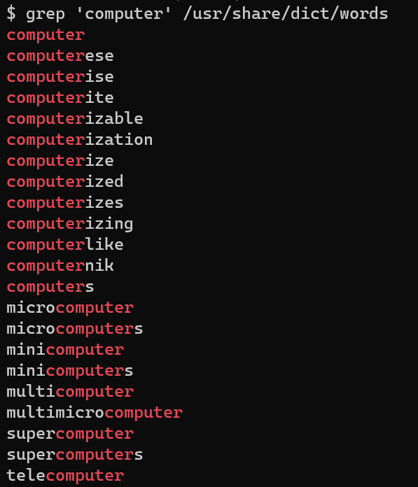
grep
Search for a given string within a given file
grep [options] pattern [files]
EX: grep “computer” /usr/share/dict/words
Helpful Options
-c : prints count of lines with given pattern
-h : display matched lines (without filenames)
-i : ignore case when matching
-l : display list of filenames with matches
https://www.geeksforgeeks.org/grep-command-in-unixlinux/

Slide 4
Demo: Grep

Slide 5
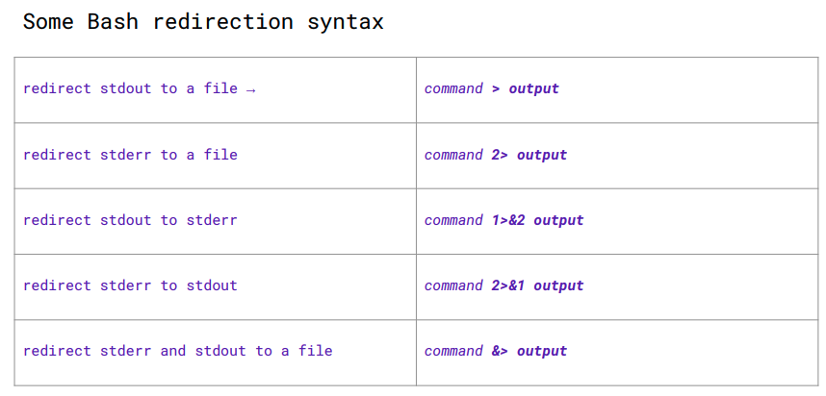
Redirecting Streams
Stdout & stderr default to terminal
Redirect stdout to a file
Adding > <file> after a command will overwrite the given file with stdout
EX: ./myprogram args < outfile
Adding >> <file> after a command will append stdout to the file’s existing content
EX: ./myprogram args >> outfile
Stderr can be redirected using 2> and 2>> because 2 represents “stderr”
If you leave an argument off some utilities they will process input from stdin
Ex: grep ‘mystring’
Will search through stdin
EX: foo<bar
Runs the program foo, with stdin from file bar
Read command binds stdin tokens to shell variables
EX:
Cal > cal.txt
Read month year < cal.txt
Echo $month of $year
Read doesn't work with | because complicated reasons

Slide 6
Some more commands
Du – disk utilization – prints the disk size of each folder/file passed as args
EX: du myDir test.txt
Common options
-h for human readable (Kilobytes, Megabytes, Gigabytes)
-d 1 limits the depth of the recursion to 1st level of directories
EX: du – h –d 1 .
Prints the size of all the files/folders in the current directory
Cal – prints current month and year with a text image of the current month

Slide 7
I/O Piping
We can feed the stdout of one process to the stdin of another using a pipe (“|”)
Data flows from process to the other through multiple transformations seamlessly
Similar to redirection, but specifically passes streams into other programs instead of their defaults
Example:
Instead of:
du –h –d 1 . > sizes.txt
grep ‘M’ sizes.txt
We can use piping
du – h –d 1 . | grep ‘M’
Piping is effective when you have one set of data that needs to be transformed multiple times
Cmd1 | cmd2 – pipe output of cmd1 into input of cmd2
Video: The Magic of Piping

Slide 8
Demo: Stream Redirection

Slide 9
File Permissions
chmod

Slide 10
Writing your own script files
Tar
wget
Notes:
Let's say we wanted to archive several files into one file to make it easier to send to our friends.
We know that there is a tool in bash called `tar` that can do something like this, but we aren't sure how to use it.
Run `man tar` to open the manual page for `tar`. Look at the three example commands listed. Which is most similar to what we want to do? Type out the example they give.
Let’s say we want to download a file with a given URL and name the downloaded file `newFileName`. We know that there is a tool in bash called `wget` that can do something like this, but we are not sure exactly how to do it.
Use `man wget` to open the manual page for `wget`. Look for the options listed; which option will achieve our goal? Type out the command which would do this, including all options and parameters.
Use `URL` to replace the true URL. Use `newFileName` to replace the name you would like to use for the downloaded file.
[____](wget -O newFileName URL)

Slide 11
Lists in Bash
Lists in bash are strings with multiple words separated by white space
Bash does not have arrays

