Slide 1
Lecture 3: Running Programs in the Shell
Lecture Participation Poll #3
Log onto pollev.com/cse374
Or
Text CSE374 to 22333
CSE 374: Intermediate Programming Concepts and Tools

Slide 2
Administrivia
Just joined?
Linux access fixes coming later today
Discord up and running!

Slide 3
Shell State
Each new instance of the bash shell maintains a “state”
Current location in the file system
PATH variable
Whenever a command is executed there is a list of pre-defined locations bash looks
PATH holds the list of pre-designed directories
echo $PATH
Bash rc file
A shell script that is automatically run whenever Bash starts up
Used to initialize your shell state
You can find example files shard online
Exists locally on your machine, not on the remote linux server
Bash history file
.bash_history is a hidden file that automatically logs your command history
https://astrobiomike.github.io/unix/modifying_your_path
https://www.gnu.org/software/bash/manual/html_node/Bash-Startup-Files.html

Slide 4
Shell Variables
Shell variables = string substitution
Declare variables in the shell to easily refer to a given string
Declare variables in the terminal with a name and a string value
<var name>=“<var string>”
EX: myvar=“myvalue”
Note: no white space allowed on either side of the “=“
Refer to your variable using the “$” symbol before the var name
$<var name>
EX: echo $myvar
myvalue
Alias
Rename a bash command, create your own shortcut
alias <string>=“substitution string”
EX: alias cheer=“echo hip hip horray!”
Only exists within the currents state of your shell
Can store alias in bashrc file to preserve alias across all shells

Slide 5
Math in Bash
Everything is interpreted as a string
No concept of integer values
To do math use double parenthesis to interpret as arithmetic expression
RES=$((1+2))
$RES will be set to “3”
MYVAR=$((RES+2))
$MYVAR will be “5”

Slide 6
Quotes in the Shell
Double quotes can be used to wrap a string with white space into a single argument
EX: myvar=“Some string”
Single quotes tell the shell to treat the string as a literal
No variable expansion or command substitution
EX: echo ‘$myvar’
$myvar
echo “$myvar”
Some string

Slide 7
Demo: Variables and Aliases

Slide 8
Processes in the Shell
Programs running in the shell are called “processes”
We refer to the code/instructions as the “program”
We can run a given program many times, creating many processes
Terminal can only run one process in the foreground at a time
Use the ”&” special character to launch a process in the background
EX: emacs &
Bash Shell has many built in programs
Commands like cd and ls
Processes have Input and Outputs
Inputs come in two main forms: arguments and stdin
Arguments are strings separated by spaces given after the command
EX: cp my/src dest/folder
Arguments: “my/src” and “dest/folder”
Arguments with spaces need to be wrapped in quotes EX: echo “hello world”
Stdin or Standard Input is a stream that the user enters into the terminal
Outputs can be stdout, stderr or a directed to an output file
All redirections & string expansions or substitutions are done by the shell before the command

Slide 9
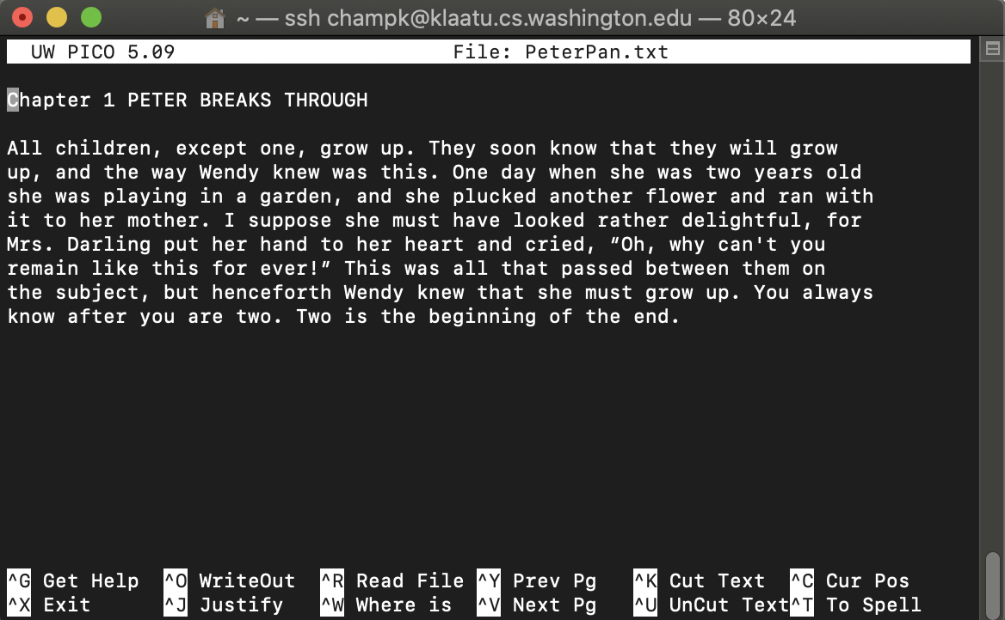
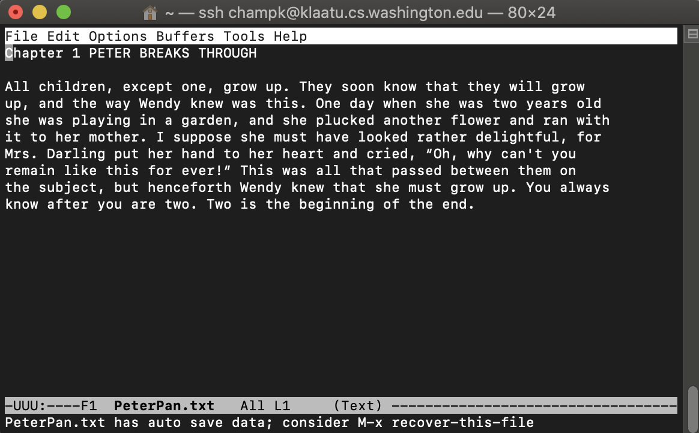
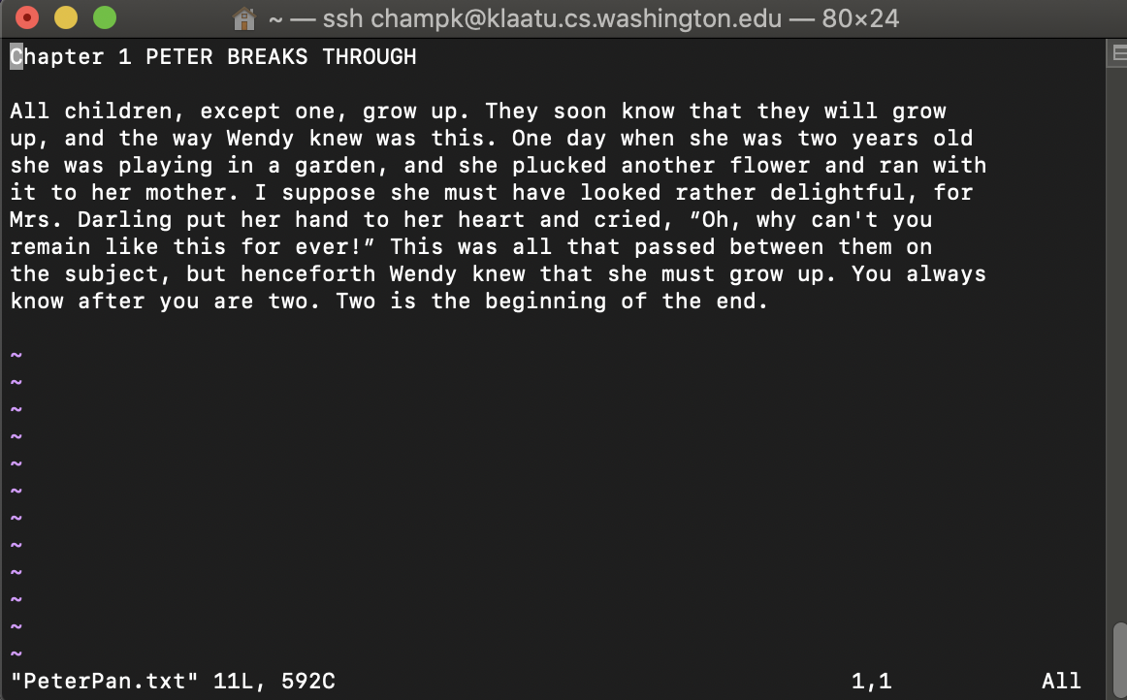
Terminal Text Editing
While working with the text interface for the OS often it is helpful to use the text interface editors
You do not have to use any of these in this course
You can use Visual Studio Code if you prefer
Editors are a matter of preference
PICO
EMACS
VIM

Slide 10
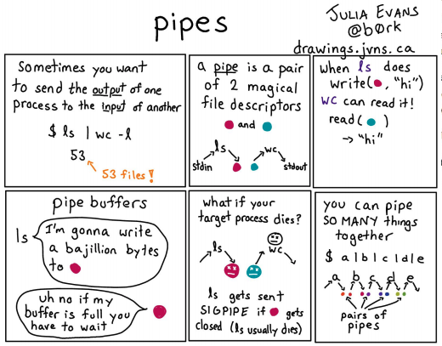
Streams
stdin – Standard in (File Descriptor = 0)
Keyboard input typed into the terminal
stdout – Standard out (File Descriptor = 1)
Results of a process after it has completed printed to the screen of the terminal
stderr – Standard error (File Descriptor = 2)
Results of a process if it exits in error printed to the screen of the terminal
I/O streams can be redirected
< yourInput
> yourOutput
Redirect stdout to a file
>> appendYourOutput
Pipes – special character “|”
Redirect the output of one process to the input of another
cmd1 | cmd2
https://www.gnu.org/software/bash/manual/html_node/Redirections.html
https://wiki-dev.bash-hackers.org/syntax/redirection

Slide 11
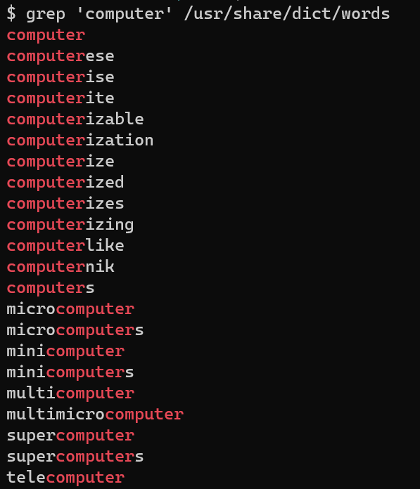
grep
Search for a given string within a given file
grep [options] pattern [files]
EX: grep “computer” /usr/share/dict/words
Helpful Options
-c : prints count of lines with given pattern
-h : display matched lines (without filenames)
-i : ignore case when matching
-l : display list of filenames with matches
https://www.geeksforgeeks.org/grep-command-in-unixlinux/

Slide 12
Demo: Grep

Slide 13
Questions
Lecture Participation Poll #3
Log onto pollev.com/cse374
Or
Text CSE374 to 22333

Slide 14
Lists in Bash
Lists in bash are strings with multiple words separated by white space
Bash does not have arrays

Slide 15
Writing Scripts
In a new file…
Make first line “#!/bin/bash” this specifies which interpreter to execute
Add your commands, save file
Make the file executable with chmod u+x

